Slide 1
Chapter 4 DSP Software
Why computers are terrible

Slide 2
Number Representation of Integers
Unsigned Integers
  Ex b0101 = 0*(2³)+ 1*(2²) + 0*(2¹) ⁺ 1*(2⁰) = 5
Offset Binary
  Same as unsigned integers, except you add arbitrary offset that can be negative or positive
Sign and Magnitude
  Same as unsigned except leftmost bit is sign
  Ex b0101 = 0*(-1)+ 1*(2²) + 0*(2¹) ⁺ 1*(2⁰) = 5
  Ex b1101 = 1*(-1)+ 1*(2²) + 0*(2¹) ⁺ 1*(2⁰) = -5
  You can then have +0 and -0 (this is icky)
Notes:
Books calls this fixed point, but most of the time now-a-days fixed point refers to a decimal point in a fixed location.

Slide 3
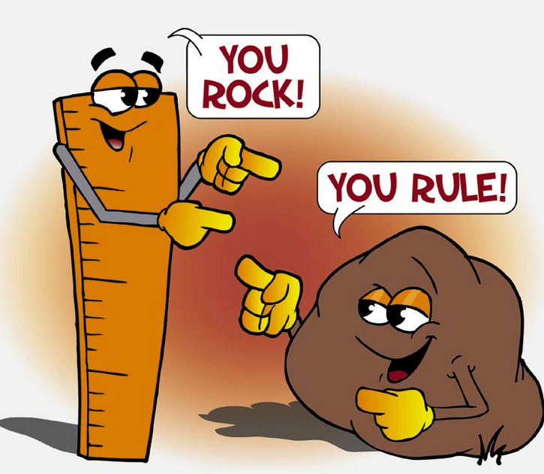
Two compliments
Two’s complement
  Same as unsigned except negative numbers are represented by flipping all bits of positive number then adding 1. Leftmost bit indicates sign.
  Positive:
    b0101 = 1*(2²) + 0*(2¹) ⁺ 1*(2⁰) = 5
  Negative (note leftmost bit is 1):
    b1101 = ???, flip all the bits
    b1101 = b0010, now add 1
    B0011 = 0*(2²) + 1*(2¹) ⁺ 1*(2⁰) = 3, then negate to get -3

Slide 4
Why Two’s complement?
One representation of 0
Easy to make hardware for (you don’t need a subtraction unit)
Subtraction and adding negative numbers is easy peasy
  5 + -3 below
    b 0101
    b 1101
    b10010 = 2, ignore carried bit

Slide 5
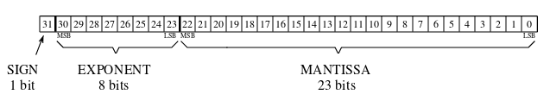
Floating Point (single precision IEEE754)
Similar to scientific notation (called floating point because decimal place can float to different spots)
value = (-1)^{SignBit} * MANTISSA * 2^{EXPONENT-127}
  If SignBit == 1, negative number
  Treat exponent like 8 bit unsigned, then subtract 127
Notes:
Fixed point has decimal in one spot

Slide 6


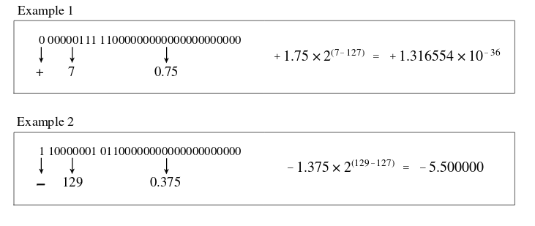
Mantissa
UH
Interpreting mantissa:
  Highest bit == .5, 2nd highest bit == .25, etc.
  Sum up bits
  Assume a leading 1 left of decimal (normalized)

Slide 7
There’s also double precision
Double:
  1 sign bit
  11 exponent bits
  52 mantissa bits

Slide 8
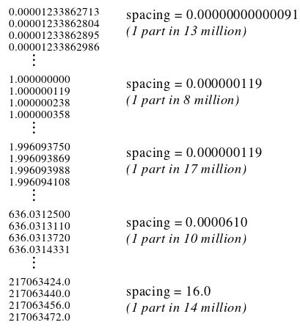
Floating point is silly
Featuring sort of weird things like:
Round off error
±∞
±0
NaN (not a number)
Different gaps between values
Subnormal values
Can represent whole numbers up until:
16,777,217 (float)
9,007,199,254,740,993 (double)
See python programs for some of this
Notes:
Read from an ADC, get quantization error
Do math on it with floats, round off error
Woo

Slide 9
Beep Boop Computers
Compilers turn programming language code into stuff computers understand
High level compiled languages
  Nice libraries
  Language features
  C, C++
  Not too painful to use
Interpreted
  Compiled line by line, slow as heckles
Assembly
  CPU instructions (ADD, MOV, LOAD, HALT)
  Have to do everything manually (protect stack, storing registers into memory, etc)
  Can have faster execution
  Will have slower writing time
  Is painful to use
Binary
  1001010101010
  Can be done with a magnetized needle and a steady hand

Slide 10
Ranges and precision
Float
  6 to 9 decimal digits of precision
  1.17549 x 10⁻³⁸ to 3.40282 x 10³⁸
Double
  15 to 17 decimal digits of precision
  2.22507 x 10⁻³⁰⁸ to 1.79769 x 10³⁰⁸
Unsigned (32 bit)
  0 to 4294967295
Unsigned (64 bit)
  0 to 18446744073709551616
Signed (32 bit)
  -2147483648 to 2147483647
Signed (64 bit)
  -9223372036854775808 to 9223372036854775807
Min size in C++ of int is 16 bits, typically 32 bits now-a-days

Slide 11
Hardware
CPU
  Math coprocessor / ALU to do math
  FPU to do floating point stuff
  Busses to get data from memory or hardware
  Fast caches (eg: L2, L3 cache) to store tiny amount of data
CISC (Complex Instruction Set Computer)
  Where single instructions can do many low-level operations (Eg, read, add, then write in one instruction)
  X86 features crazy stuff like FYL2XP1, to compute y * log_2(x + 1)
RISC (Reduced Instruction Set Computer)
Specialized processors (eg, a DSP)

Slide 12

Speed Tips
Use integers when possible
  Floating point computations take much more time
Don’t use crazy functions like sin(x) or cos(x)
  Use look up tables if you can precompute them
  Book talks about math wankery that GLIBC probably uses internally now-a-days anyway
    https://sourceware.org/git/?p=glibc.git;a=blob;f=sysdeps/ieee754/dbl-64/s_sin.c;hb=HEAD#l281
      Look for __sin for example
Profile on your specific platform

