Slide 1
CHAPTER 3
The Scientist and Engineer's Guide to
Digital Signal Processing
ADC and DAC

Slide 2


Chapter 1
Chapter 2

Slide 3
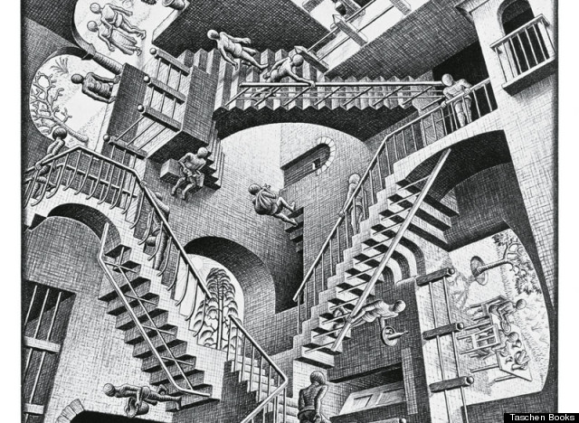
Chapter 3

Slide 4
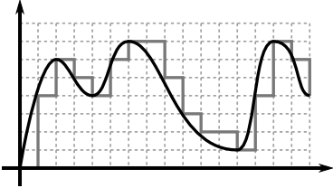
I have no idea what I’m doing
Analog Signal – a continuous signal with time varying values
Digital Signal – discrete value at each sampling point
ADC – Analog to Digital Converter, converts an analog signal to a digital signal
DAC – Digital to Analog

Slide 5
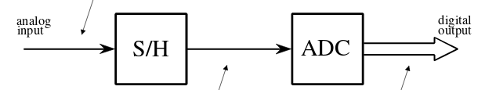
Converting Analog to Digital
Can think of it as two stages
  Sample-and-hold stage (S/H)
    Get current input voltage (sample) and output it for certain period of time (hold it)
  Analog to Digital Converter (ADC)
    Take value from S/H and convert it to a discrete value (quantize)

Slide 6
Converting Analog to Digital
Sampling – converts the independent variable (time in many cases) from continuous to discrete
  1.325028305982390583209 seconds could be converted to 1.33 seconds
Quantization – converts the dependent variable (voltage, power level, pressure) from a continuous to a discrete value.
  5.35819210912 volts could be converted to 5.36 volts
Converting continuous to discrete is like mapping an infinite set of values to a smaller set of data

Slide 7
But why come?
Book does it to differentiate between the effects of sampling and quantization
In practice you probably don’t want an input to an ADC to be fluctuating while you convert the data. Converting the data is not instantaneous.
  Sort of related example (not signal related) 8 byte RTC output could be updated while you read it in 4 byte chunks, causing a crazy time to appear
Notes:
Eg, if a converter goes digit by digit, you can start with an input of 1.000 V, put the 1 in the right spot, then if the input changes to .999V, you will put the .9 after the already placed 1 digit and have something like 1.999 Volts (probably not a realistic example)

Slide 8
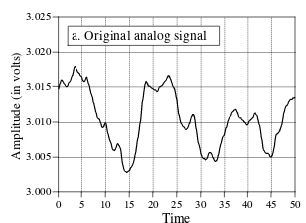
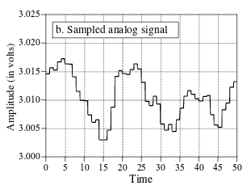
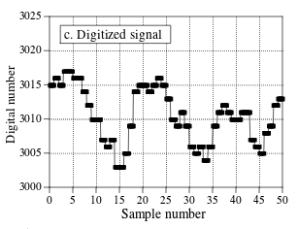
The book’s example
Sampling can be related to when you took a gandering at the data
(if time is the independent variable)
Quantization is what you map the input data to

Slide 9
Sampling and quantization errors
Data read in from ADC as series of bits
Each sample can have a maximum error of ±½ LSB (least significant bit)
  That is if you have a 12 bit ADC (2^12 == 4096) reading in values from 0V to 4.095V, 1 LSB is .001V. ½ of that is .0005V.
  0b0000 0000 0010 could represent all values from .0015V to .0025V(a range of .001V) as .002V. So samples with this value could in actuality be .0015V or .0025V, at most ½ of the LSB.
Notes:
Eg a 12 bit ADC would have 12 bits to store individual values, which is 2^12 or 4096 discrete values. If I wanted to store values from 0 to 4,000,000V each step would be a large distance from the previous step.

Slide 10
Quantization errors
Quantization error can be described as random noise added to the digitized signal.
  Uniform between ±½ LSB
  Zero mean
  Standard deviation of 1/√12 LSB (.29) (don’t ask me about the math, I don’t know)
More bits for the ADC leads to more precision
This view of is only valid when quantization error can be treated as random.
Notes:
How many bits do I need?
1. How much noise is already present in the analog signal?
2. How much noise can be tolerated in the digital signal?

Slide 11
Dithering
Quantization error appears differently when the signal stays at the same value for a long time.
Add a small amount of random noise to signal to get more information about it.

Slide 12
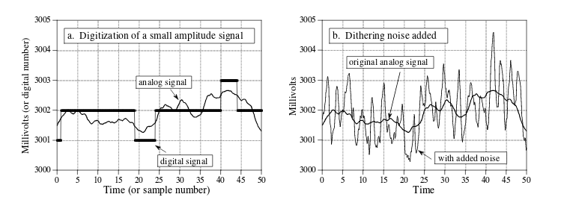
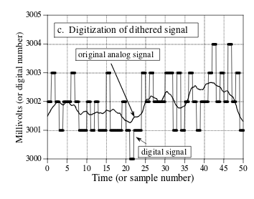
I’m probably making stuff up

Slide 13
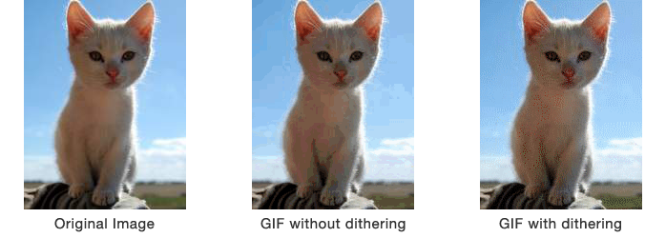
Image example of dithering
Notes:
Image from http://www.coffeecup.com/help/articles/dither-modes-in-animation-studio/

Slide 14
Sampling errors
Proper sampling – When you can exactly reconstruct an analog signal from digital data
Aliasing – the misidentification of a signal frequency, introducing distortion or error
Nyquist sampling theorem / Shannon sampling theorem / sampling theorem – a continuous signal can be properly sampled if it does not have frequency components above ½ the sampling rate.
Nyquist frequency / rate – ½ the sampling rate (in the book)

Slide 15
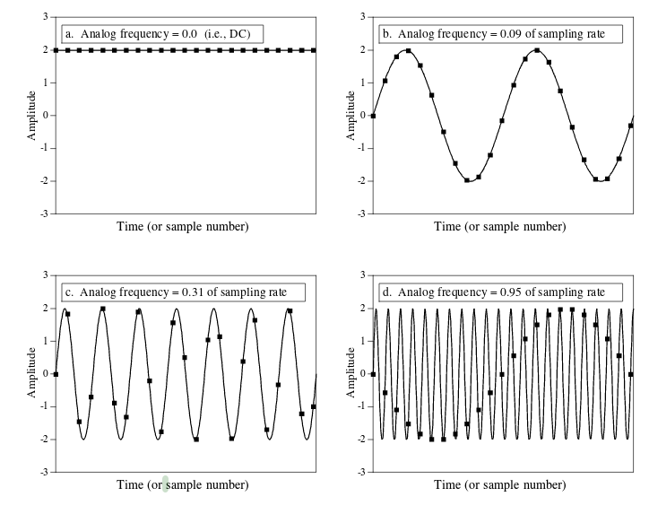
Book example
Notes:
the zero phase shift occurs for analog frequencies of 0 to 0.5, 1.0 to 1.5, 2.0 to 2.5, etc. An inverted phase occurs for analog frequencies of 0.5 to 1.0, 1.5 to 2.0, 2.5 to 3.0, and so on

Slide 16

Impulse train
Theoretical concept to compare digital and analog signals
Analog spike where digital signal was sampled
Original analog signal can be reconstructed by passing impulse train through low pass filter. (didn’t he just say it was theoretical only?), such as with a DAC

Slide 17
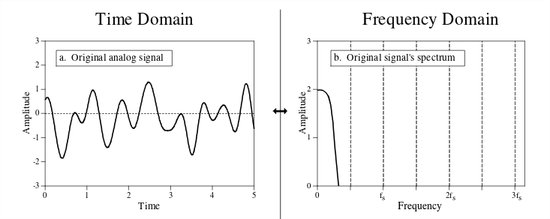
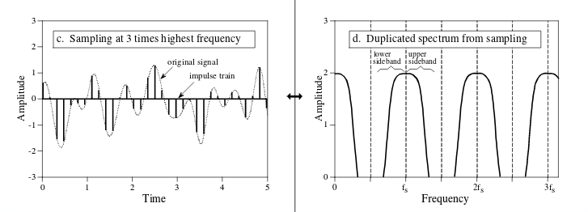
Lower sideband – flipped copy of frequency information
Upper sideband – left for right flipped copy of frequency information

Slide 18
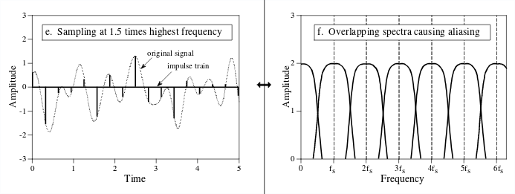
Notes:
At higher frequencies, the impulse train contains a duplication of the frequency information of the original signal.

Slide 19
Zeroth-order hold
Zeroth-order hold – Impulse train not really possible to use in practice, so input signal is held for a period of time (like the sample and hold for ADC)
Spectrum of produced value is impulse train multiplied by sinc function
Sinc function: H(f) = abs(sin(πf/f_{s}) / (πf/f_{s}))

Slide 20
Reconstruct the signal
First need to filter out all frequencies above nyquist (low pass filter)
Second boost frequencies by reciprocal of zeroth order hold, 1/sinc(). The sinc filter causes frequency response to dip.

Slide 21
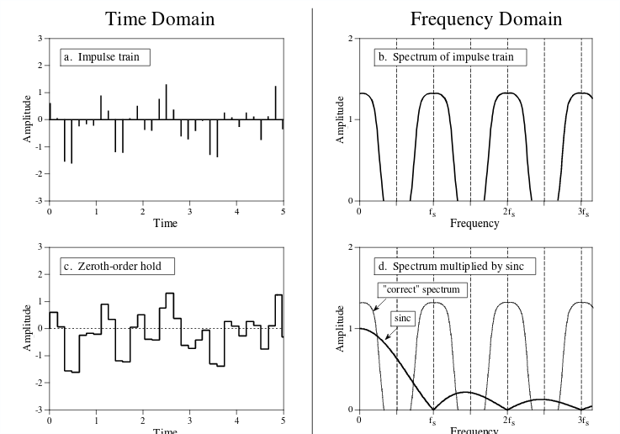
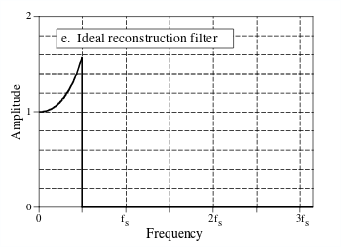
How do I learn you

Slide 22
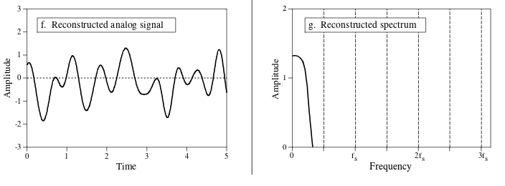
Signal magic

Slide 23
Filters
Filters filter out unwanted information in a signal, eg, only allow frequencies below 3 Hz, or only allow frequencies from 2 to 8Hz.
  Cutoff frequency – Where a filter will start to attentuate a signal
Low Pass Filter – Allow frequencies below set cutoff frequency through
High Pass Filter – Allow frequencies above set cutoff frequency through
Band Pass Filter – Allow frequencies between two cutoff frequencies through
The stop band – The frequencies a filter will remove
The pass band – The frequencies a filter will allow
Antialias filter – filter intended to remove all frequencies above Nyquist frequency during sampling, ideally it would just be low pass filter set to Nyquist frequency
Reconstruction filter – after the DAC stage, ideally it would be a low pass filter set to Nyquist frequency
Unfortunately, filters can cause problems just as they solve them.

Slide 24
Basic filters
Complexity of each filter adjusted by number of poles and zeros (which apparently the book details in later chapters)
Three basic filter types with differing performance characteristics:
  Chebyshev
  Butterworth
  Bessel filter
Performance characteristics:
  Rolloff – how quickly frequencies in stopband are attentuated
  Passband ripple – wavy variations in frequencies in the pass band
  Step response – how filter responds to rapid input changes

Slide 25
Rolloff
  Chebyshev rolls-off/drops in amplitude quickest
  Butterworth is 2nd
  Bessel is terrible
Passband Ripple
  Chebyshev has passband ripple
  Butterworth and Bessel do not have
Step Response
  Bessel has no overshoot or ringing
  Butterworth and Chebyshev show overshoot (go past value) and ringing (oscillations that decrease in amplitude)

Slide 26
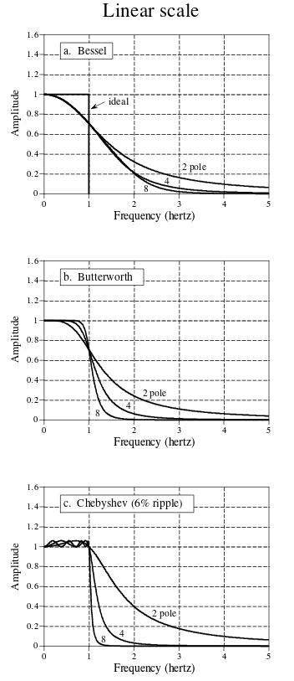
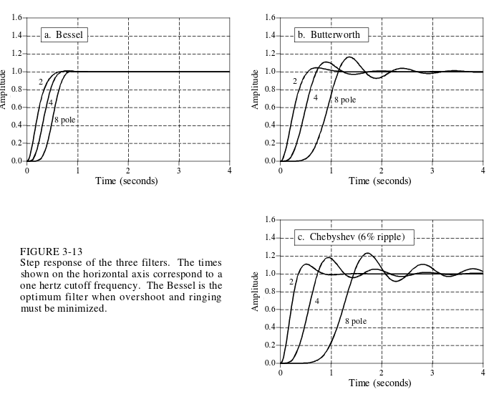
Frequency response to the left, step
response below

Slide 27
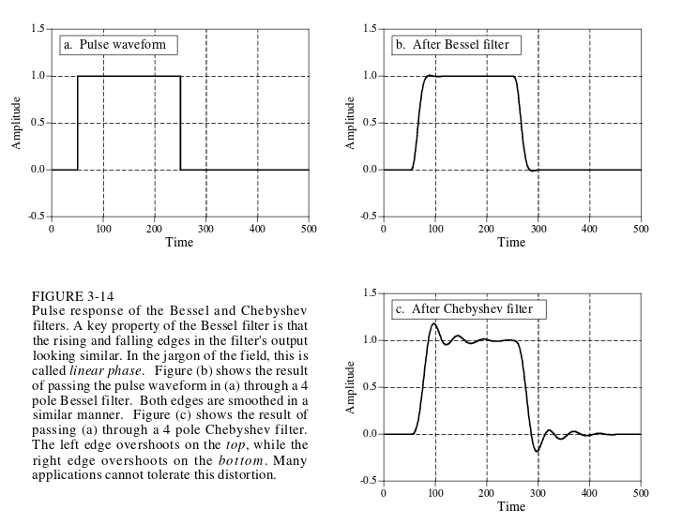
Pulse response

Slide 28
Quote smart people to appear smart
“In most systems, the frequency band between .4 and .5 is an unusable wasteland of filter roll-off and aliased signals.”
  Due to limitations of analog filters

Slide 29
What anti alias filter do I choose?
Depends on how information is represented in the signals you need to process
  Eg, sound domain is frequency encoded so you can use a chebyshev or butterworth. It’s unaffected by step response of these filters.
  Eg, time domain, such as an ECG, uses the shape of the waveform. The best filter for this is bessel, due to its nice step response.

Slide 30
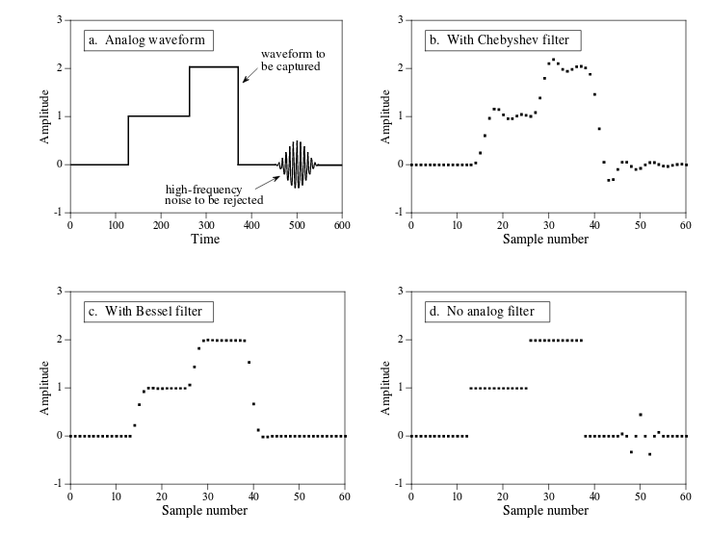
Another example from the book

Slide 31
Multirate techniques
Using multiple rates in a system
  Eg read in data at 64kHz, filter on that, then decimate to get desired 8kHz data.
  Good for two reasons:
    It replaces analog components with software
    Achieve higher performance (precision)
Decimation – throwing data away, eg ignore 7 of 8 samples
Interpolation – Generating original analog signal via digital signal
Josh help

Slide 32
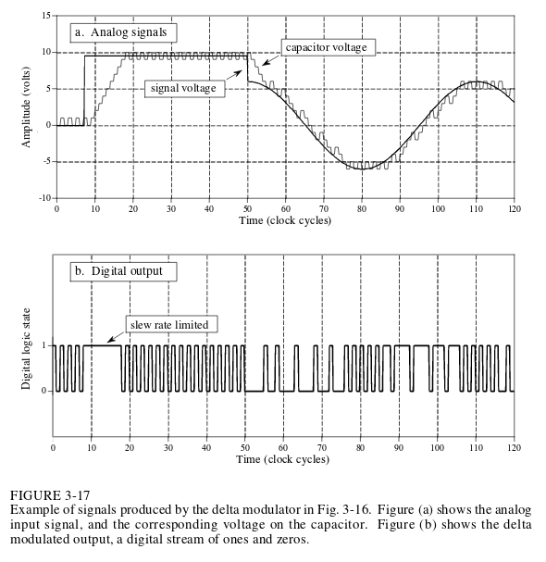
Single Bit Data
More samples, less bits
Delta modulation – increase/decrease voltage of output based on increase/decrease in input signal
Notes:
A critical limitation of this circuit is the unavoidable tradeoff between (1)
maximum slew rate, (2) quantization size, and (3) data rate.

Slide 33
Probably not lying
Continuously Variable Slope Delta (CVSD) – like delta modulater, but increases slew rate even faster by looking at last x bits.
  Eg if last 4 bits are 1 increase slew rate a boatload. If last 2 bits are 1 increase slew rate a tad.
  Great for transmitting voice
  Terrible for general purpose ADC
    DC offset not usually captured

Slide 34
The Delta Sigma Converter
Delta-sigma converter – like CSVD, except number of 1s and 0s related to level of signal not slope.
  Could form a 12 bit ADC by adding number of ones over 4096 clock cycles
  Difficult to multiplex inputs
  Don’t know exactly when samples were taken
Notes:
For example, suppose that the ones and zeros
are represented by 5 volts and 0 volts, respectively. If 80% of the bits in the data stream are ones, and 20% are zeros, the output of the low-pass filter will
be 4 volts.

