Slide 1
Chapter 6
Convolution

Slide 2
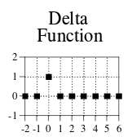
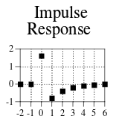
Some words and stuff
Impulse – signal with only 1 nonzero value
Delta function ( δ[n] ) - normalized impulse. Sample zero has value of 1, rest are zero.
Unit impulse – The delta function
Impulse response – The response of a system to a unit impulse, symbolized by h[n] normally
  Also know as filter kernel, convolution kernel, or kernel in filtering applications
  Also know as the point spread function in image processing

Slide 3
Impulses
Any impulse can be represented as a scaled and shifted delta function
  Eg: 3δ[n-1] has amplitude 3, and is shifted right by one sample
  Assuming linearity, the output to a system for 3δ[n-1] is just 3h[n-1]
If we know the impulse response h[n] of a system, we can know the response for all inputs of that system
  Input signals can be broken into impulses (some form of δ[n])
  Output signal can be broken into impulses (some form of h[n])
  In a linear system you can just put the input impulse decomposition in and add these up to get final output

Slide 4

Convolution
Not that convoluted
  Convolve means to roll or coil together
“there is nothing more important in this book”

Slide 5
Convolution
Mathematical operation combining two signals into a third signal
  Here, the input signal, impulse response, and output signal
  y[n] = x[n]∗h[n]
    The star is not multiplication
      Like it is in every programming language
        Convolution is giving me convulsions
          That up there is the special unicode symbol for it
            It doesn’t even look that different it’s just lower * ∗
              There is a special thing in LaTeX apparently
                :(
  length(y[n]) = length(x[n]) + length(h[n]) – 1
  Commutative: x[n]∗h[n] == h[n]∗x[n]
  Can be thought of as a sum of weighted inputs

Slide 6
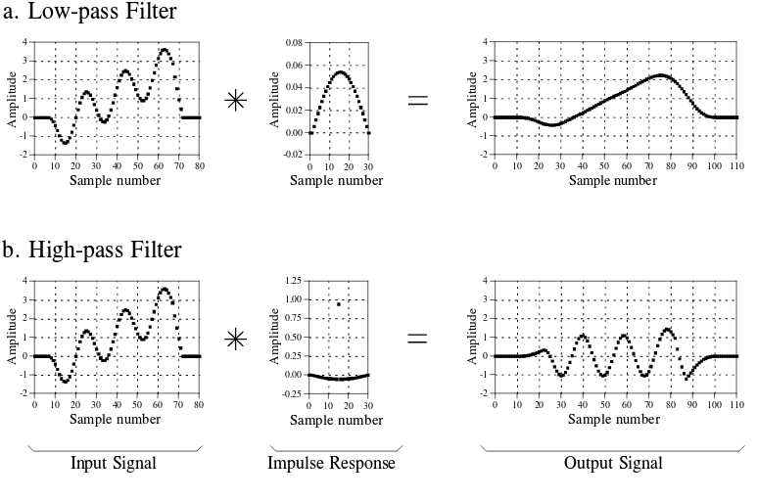

Slide 7
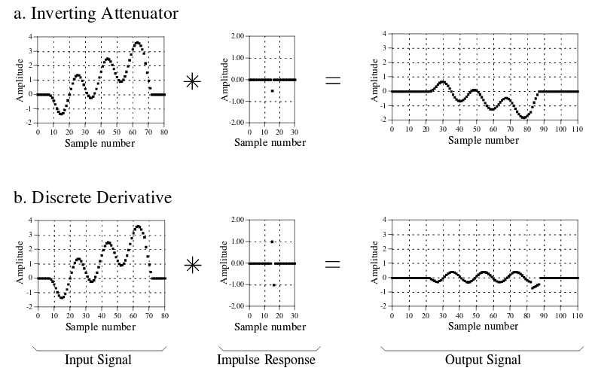

Slide 8
Input side algorithm
Describes how each sample in input affects output:
  Decompose N sample input signal into N impulses
  Pass through system to get N output signals
    Linear, know what h[n] is, so output is just scaled and shifted delta function
  Add up all the N output signals
  Convolution done.
Coding this is pretty easy

Slide 9
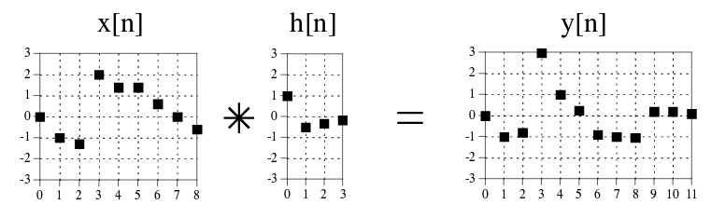

Slide 10
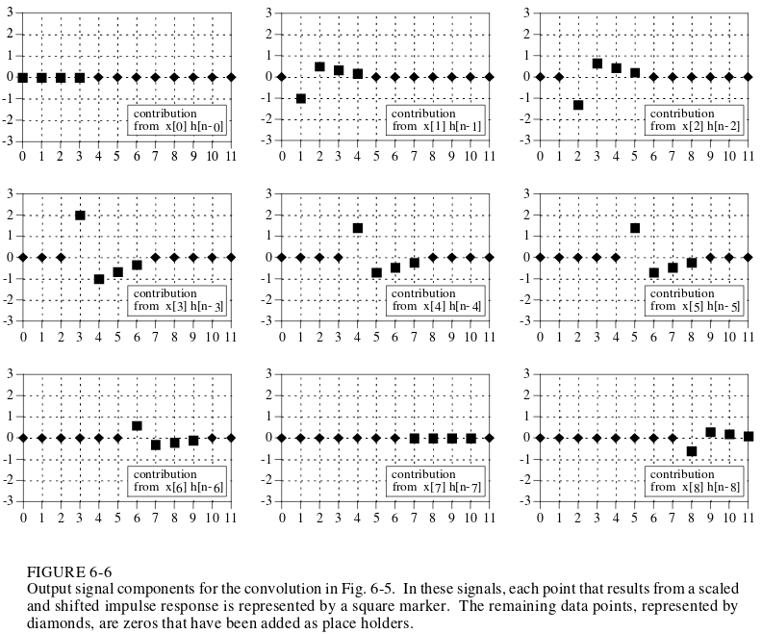

Slide 11
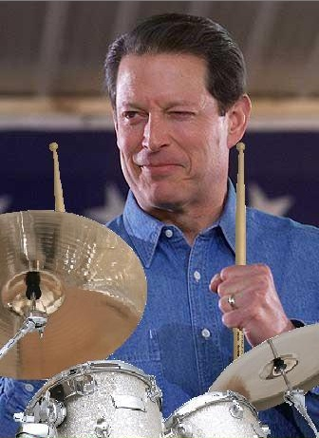
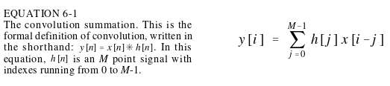
The Output Side Algorithm
Looks at each output sample and what points from the input contribute to them
  Each output sample is defined by some combination of input sample and impulse response
    Eg: y[5] = x[2]h[3]+x[3]h[2]+x[4]h[1]+x[5]h[0]

Slide 12
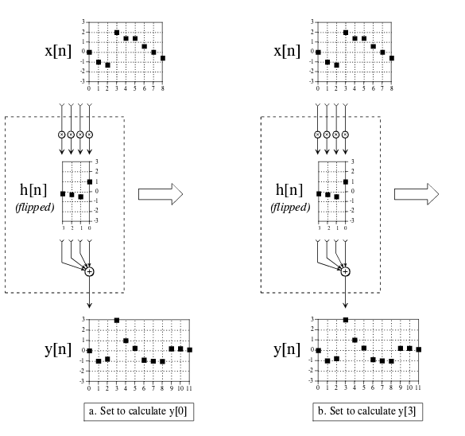
Pad the signal here
with zeroes or ignore
these samples
Input side doesn’t
have this nuisance
You could also calculate only the fully immersed part of the output

Slide 13
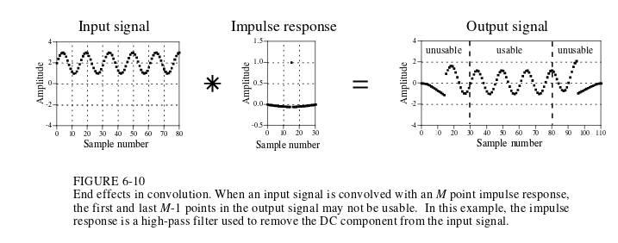
Impulse isn’t Immersed
The first M-1 and last M-1 samples in the output are based on less data that the rest of the samples.
  “The impulse response is not fully immersed in the input signal”
Beginning and end samples are useless, applies in general to DSP

