Slide 1
Chapter 10
Properties of the DFT

Slide 2
Fouri-yay
All the fourier transform variants are linear
  Homogeneity
    Change in time domain amplitude results in change in frequency domain amplitude and vice versa
    kx[ ] corrresponds to kX[ ]
      Rectangular: Real and imaginary multiplied by k
      Polar: Magnitude multiplied by k, phase stays the same
  Additivity
    If x[n] + y[n] = z[n] then
      Re X[f] + Re Y[f] = Re Z[f]
      Im X[f] + Im Y[f] = Im Z[f]
    Cannot be done in polar directly, must be converted to rectangular
  Not Shift Invariant
    Shift in time domain does not lead to a shift in the frequency domain
      x[n+s] → Mag X[f], Phase X[f]+2πsf, whree f is frequency from 0 to .5

Slide 3

Fouri-eh
Shifting time domain to right decreases slope of phase
Shifting time domain to left increases slope of phase

Slide 4
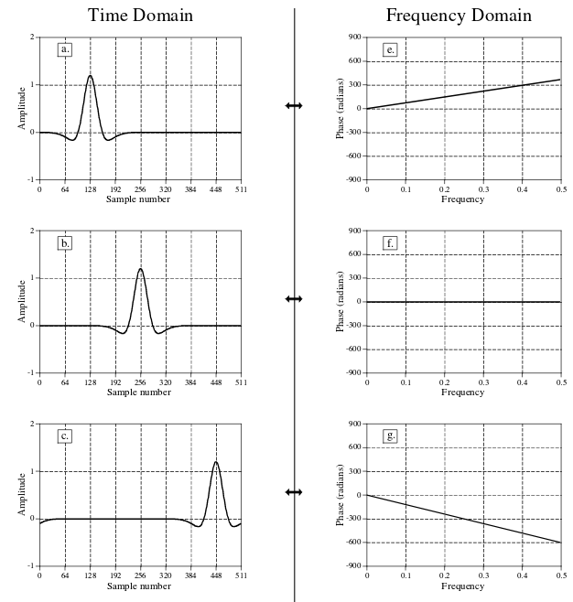
Unwrapped phase

Slide 5
Expanding / Contracting
Compressing time domain signal expands frequency spectrum
Expanding time domain signal compresses frequency spectrum
Relationship: FT(x(kt)) = 1/k * X(f/k)
  continuous
Can cause aliasing if mucking around with a signal you have (as opposed to understanding how the relationship works)

Slide 6
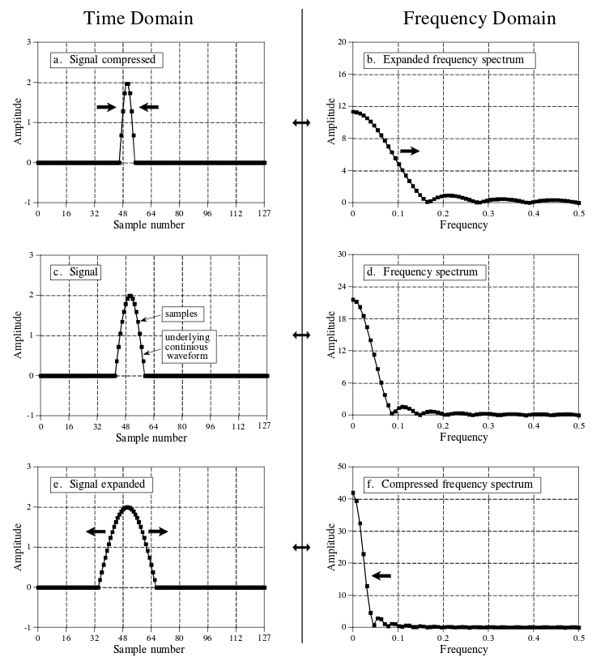
If you keep compressing time domain to a pulse the frequency domain would be a constant value (and vice versa)

Slide 7
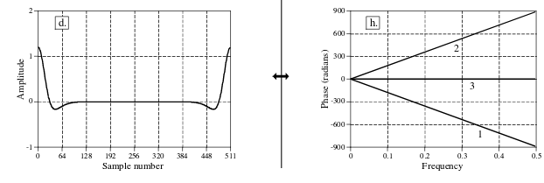
Phase Ambiguity
If we shift signal left phase slope goes up
But we can form signal by shifting right where phase would go down
But signal is also symmetric around sample N/2 so phase should be 0

Slide 8
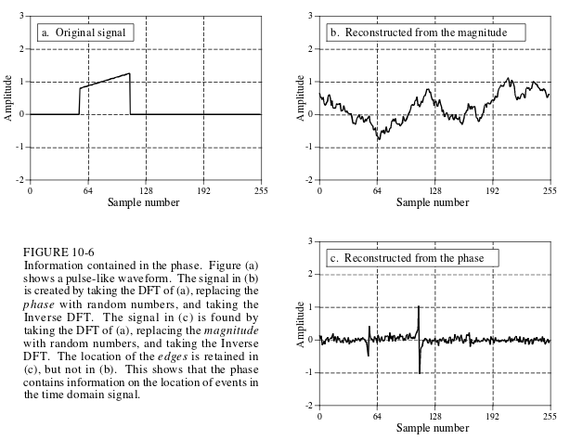
Phase and Magnitude
Phase contains “shape” information
Phase congruence → multiple sinusoids rise at same time (phases are in sync) to form the edges

Slide 9
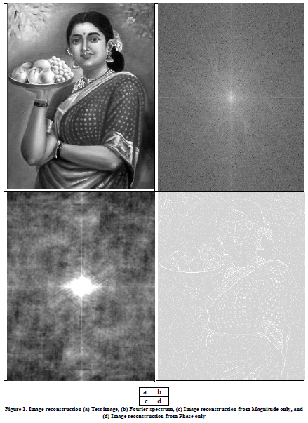
From
https://dsp.stackexchange.com/questions/16995/image-reconstructionphase-vs-magnitude

Slide 10
It’s just a phase
Symmetrical signals will have zero phase
Complex Conjugation - Negating the phase of a signal
  Complex Conjugate of X[f] is denoted by X*[f]
  will flip the signal (not the amplitude) in the time domain
    Flip around sample zero for continuous signals
    Flip around sample zero and N/2 for discrete signals
    DFT(x[-n]) → X*[f]

Slide 11
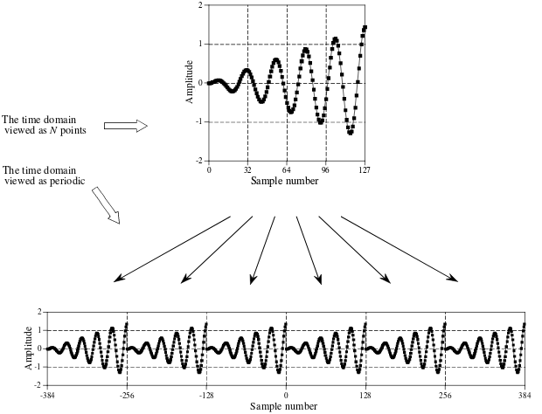
Time Domain Periodicity

Slide 12
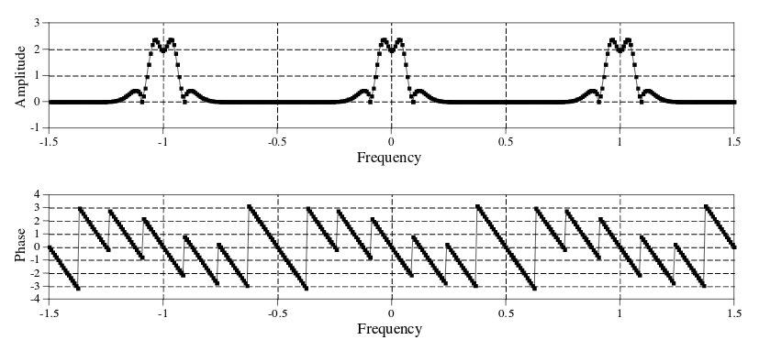
Frequency Domain Periodicity
Negative frequencies
Amplitude is mirrored around every N/2 samples (even)
Phase is rotated around every N/2 samples (odd)

Slide 13
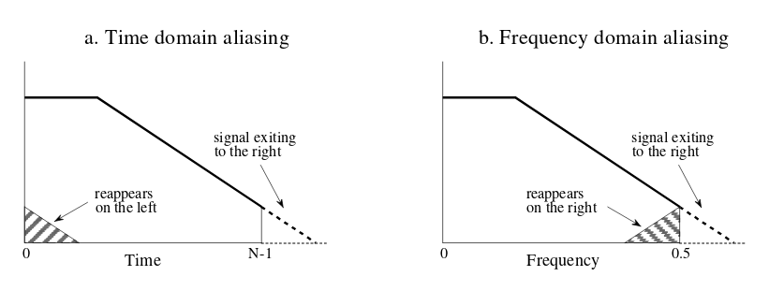
How aliasing looks
Take a gander at homework-comp.py for examples

Slide 14
Amplitude Modulation
Modulation – combine two signals to get desirable characteristics of both
Amplitude Modulation – make data signal >0 with DC offset, multiply by higher rate carrier signal
  Demodulate on other end of transmission (because we know the carrier wave)
  Doing this shifts the frequency spectrum of the data signal to be centered around the carrier’s frequency

Slide 15
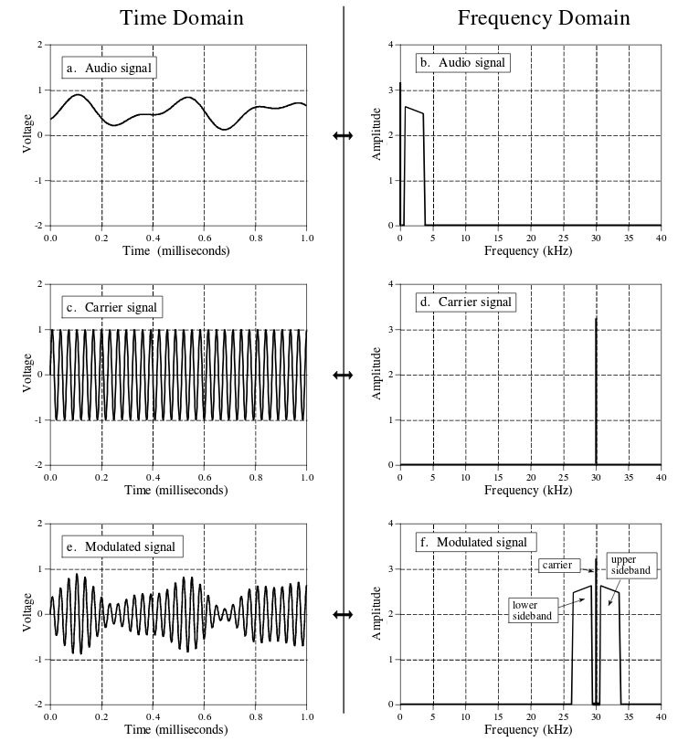
Sidebands correspond to postive and negative frequencies
Frequency Domain Multiplexing – Put multiple data signals in a carrier signal

Slide 16
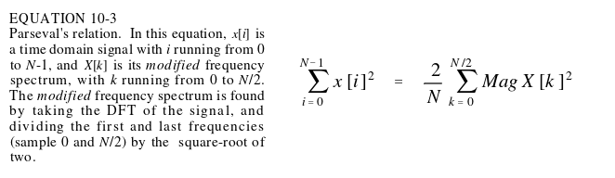
Parseval’s Relation
The book literally says this isn’t useful for DSP just interesting to note.

