Slide 1
CH15
Moving Average Filters

Slide 2
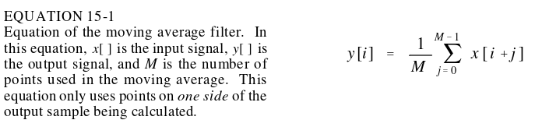
Moving Average Filter
What’s it do?
  Noise reduction
  Is a smoothing filter
Average N samples from input signal
In equation form (all samples right of x[i]):
Alternatively, can have averaged samples centered around x[i]
Filter kernel should be have area of 1 under curve
  Eg, 0, 0, 0, ¼, ¼, ¼, ¼, 0, 0, 0

Slide 3
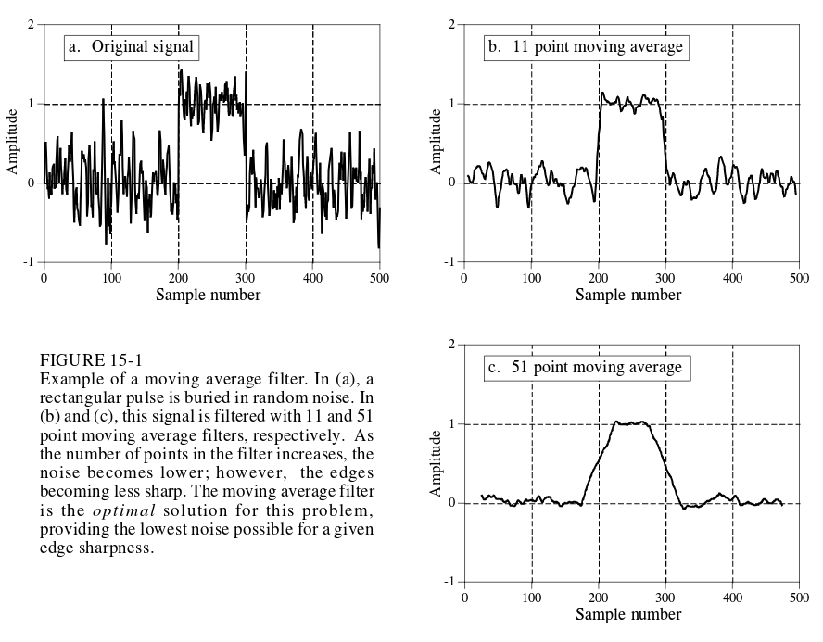
Moving Average Filter
Optimal at reducing random white noise while maintaining sharp edge response

Slide 4
MAF
More points means less noise, but worse step response
  Noise reduction is proportional to square root of number of samples in the filter kernel
    Eg 100 samples reduces noise by a factor of 10

Slide 5
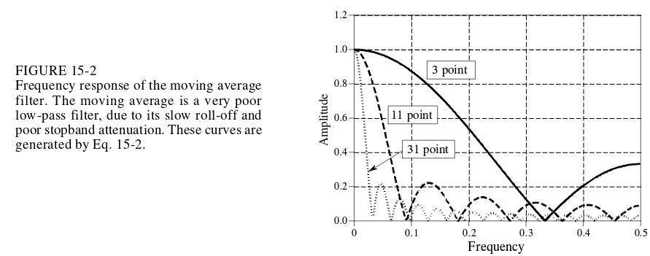
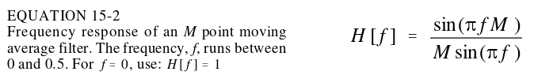
Is it good in frequency domain?
Moving average filter is bad at being a low pass filter
Poor rolloff and stopband attenuation
Great for time domain, bad for frequency

Slide 6
Multiple Pass Moving Average Filters
Applying multiple iterations of a moving average window to a signal
If enough iterations occur multiple pass gets closer and closer to a gaussian window
  Convolve a square pulse with itself yields triangle
  Convoling again gets curvier and curvier, until it is pretty much gaussian
MAF is great for time domain, but sometimes you still need better frequency domain parameters, so use multiple pass, gaussian, or blackman window
  Better stopband attentuation
  Filter kernel tapers to smaller amplitudes near the ends, so far away samples contribute less
  Step response is a smooth curve (wait why is this better?)

Slide 7
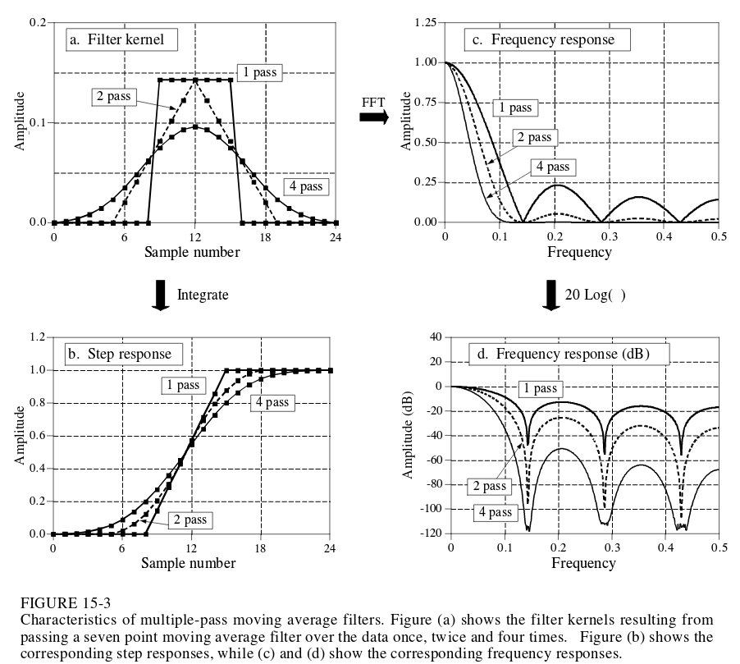

Slide 8
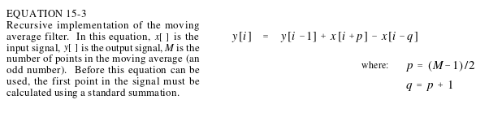
Performance
Gaussian and blackman are slow relative to moving average filter
  Gaussian and blackman need convolution
  Moving average filter can use recursive techniques
    Use previous outputs to calculate new outputs
    Only need addition and subtraction

