Slide 1
Chapter 9
Applications of the DFT
And a bunch of other things

Slide 2
Uses of DFT
Directly look at frequency spectrum
  Do I have a 5 Hz sine here?
Analyze signals in frequency domain, as opposed to time domain
Used in more elaborate signal processing techniques
  FFT convolution

Slide 3
Reducing noise in frequency domain
Take many segments of input waveform of same length
DFT each segment
Make each segment polar
Average the magnitudes of all to get a new spectrum
  Averaging smooths out noise
Alternatively, LPF the spectrum to remove noise

Slide 4
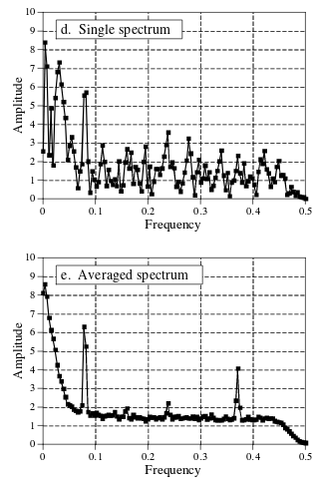
SNR improvements
More data leads to better frequency domain resolution and better noise removal
  Easier to separate close frequencies with more inputs to a single DFT
  Padding data with zeroes can also increase frequency domain resolution

Slide 5
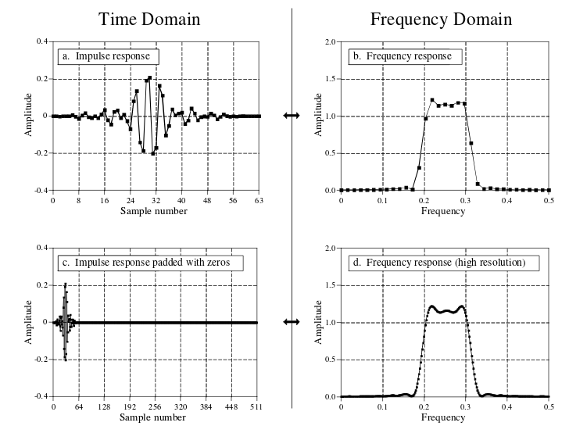
Zero padding magic

Slide 6
͔N̵̶̩ơ̭̮͎̠̯̩̳͈͡í̸̠̺ś̲̻̼̬̟̦̲̹͝ḙ̷͈̦̀͘ ͍̜̬̕͞
White noise – equal amount of all frequencies
  Randomness from environment
1/f noise AKA pink noise – Noise rapidly increases below 10Hz
  Why?
    I don’t know, see theories at: https://en.wikipedia.org/wiki/Pink_noise#Origin
60 Hz noise (atleast in the US)
  Noise from power source
  Typically have harmonics too (eg 120Hz, 180Hz, etc)
  https://en.wikipedia.org/wiki/Mains_hum
25-40kHz noise from switching power supplies
MHz noise from radion stations
  My speakers picked up a classical radio station when I lived in college dorms
Motion artifacts (microphonics)
  10 to 100 Hz

Slide 7
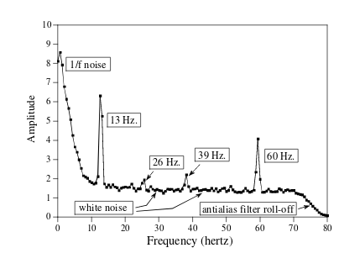

Slide 8
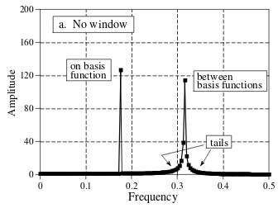
Spectral Leakage
When a specific DFT frequency band cannot represent a frequency exactly
  Finite amount of bands in DFT so not everything is perfectly representable
  Can appear as tails

Slide 9
Windowing functions
Reduce spectral leakage by using a windowing function
  Multiply input signal by windowing signal then compute DFT
Side effect: Can broaden the peaks of frequencies in DFT
Gradually reduce samples at edges of input to DFT to 0 to make signal look periodic (as DFT assumes)
Many types of windowing functions with tradeoffs between spectral leakage (tails), frequency resolution (main lobes), and amplitude of frequency components

Slide 10
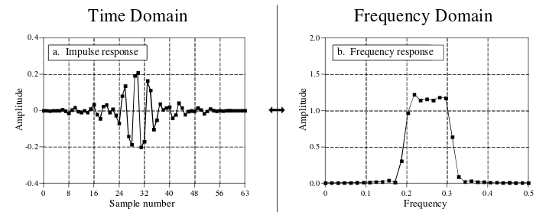
Frequency Response of Systems
Frequency response – DFT of impulse response
Not readily apparent what impulse response does in time domain, but frequency response makes it easy to see it is a band pass filter
Impulse response is discrete, but frequency response can be infinitely long if padded with infinite zeroes

Slide 11
Convolution via Frequency Domain
Convolution in time domain is equivalent to multiplication in the frequency domain
  And vice versa
What use is this?
  Deconvolution – Not very doable in time domain. It is just division in the frequency domain though.
  Performance of convolution
    Take FFT of both signals, multiply, then take IFFT.
    Don’t bother doing this with a normal DFT algorithm. The FFT is stupid fast / efficient so it reduces work to do a convolution by a lot

Slide 12
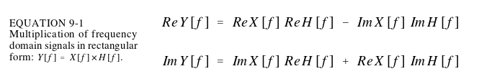
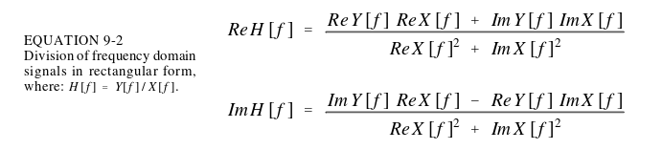
How to math (in rectangular)
x

Slide 13
How to math (in polar)
Multiplication
  Mag Y[f] = Mag X[f] × Mag H[f]
  Phase Y[f] = Phase X[f] + Phase H[f]
Division
  Mag H[f] = Mag Y[f] / Mag X[f]
  Phase H[f] = Phase Y[f] - Phase X[f]

Slide 14
Circular Convolution
Result of convolution is signal of length N+M-1
If you do time domain convolution in frequency domain, you must make sure the length of the IDFT is going to be atleast N+M-1
  Or else you get circular convolution, where adjacent periods spill over into your period

Slide 15
