Slide 1

EnviroWatch: A Comprehensive Environmental Monitoring Web Frame and Cleanup Coordination System
Group No. 11
  Project Guide
  Prof. Neha Deshmukh
Madhu Gage | 20104037
Rohan Ahire | 20104133
Chirag Kadam | 20104105
Darpan Mhatre | 20104019

Slide 2
Contents
Introduction
Objectives
Problem Definition
Technological Stack
Literature Survey
Review Suggestions (Given in Last meeting)
Proposed System Architecture
Prototype Design
Implementation Status
Conclusion
References

Slide 3
Introduction
To stop pollution, climate change, and biodiversity loss, individuals, governmental institutions, and non-governmental organizations (NGOs) must act efficiently and together.
We introduce "EnviroWatch," an innovative web framework created to monitor environmental well-being and cleanup coordination.
A comprehensive web framework with real-time monitoring system and data analytics.
An Mobile Application for end user interaction with the organizations

Slide 4
Objectives
The objectives of the project are
To model and design a web framework for monitoring environmental well-being.
To provide a dynamic dashboard for the visualization of Data.
To build a user-friendly application for Users, Government organizations, and NGOs.
To provide a chatbot for assistance and user experience enhancement.

Slide 5
Problem Definition
Garbage issue is continuously growing leading to crises such as health problems, pollution, water blockage, etc., creating a impact on our daily lives and environment.
There should be a platform that links ordinary people with various cleanup organizations, the government, and entities.
EnviroWatch provides a web platform that enhances environmental monitoring and cleaning coordination.
EnviroWatch also provides a mobile application for end user interaction with Government and NGOs.

Slide 6
Technological Stack
Frontend:
  Application: Flutter
  Web framework: HTML, CSS
Backend: Firebase
Additional tools: Power BI
IDE:
  Application: Android studio
  Web Framework: Visual Studio Code
Operating System: Windows

Slide 7
Literature Survey
Sr. No. | Title | Author | Key Findings | Year
1. | Garbage Management System | Geethamani R, Rakshana P, Raveena P, Ragavi R | The Waste is generated in large amount from decades and piled up in different parts of the country. The Management system has proposed a technology-based solution with 5 kinds of users(admin, user, people, buyer, distributor). System proposed a cost-effective, web-based garbage waste management system. | 2021

Slide 8
Sr. No. | Title | Author | Key Findings | Year
2. | An overview on different methods of Domestic Waste Management and Energy generation in India | Piyali Mondal, Anojkumar Yadav | Emphasis on biogas production from organic kitchen waste, agricultural residues, and sewage sludge. Promotion of source segregation at the household level to separate biodegradable waste from non-biodegradable waste. Awareness campaigns and incentives to encourage waste reduction, reuse, and recycling. | 2021
3. | Web-based, Multi-platform, Centralized, Offline Compatible Supply Chain Management System for Emergency Responses | Dawei Wang, Yuehwern Yih, John Service, Lionel Lajous, Sarah Robbins-Penniman | A user-friendly web interface that allows authorized users to access and manage supply chain data from any location with internet connectivity. A centralized database to store critical supply chain information. Real-time tracking and management of inventory levels, including stockouts, overstock situations, and expiration date tracking. | 2020

Slide 9
Review Suggestions
Changes in ppt
Addition of key-points instead of paragraphs.
Addition of Author to Literature survey.
Addition of block diagram in Proposed system.
Addition of conclusion slide.
Addition of reference slide with links.

Slide 10
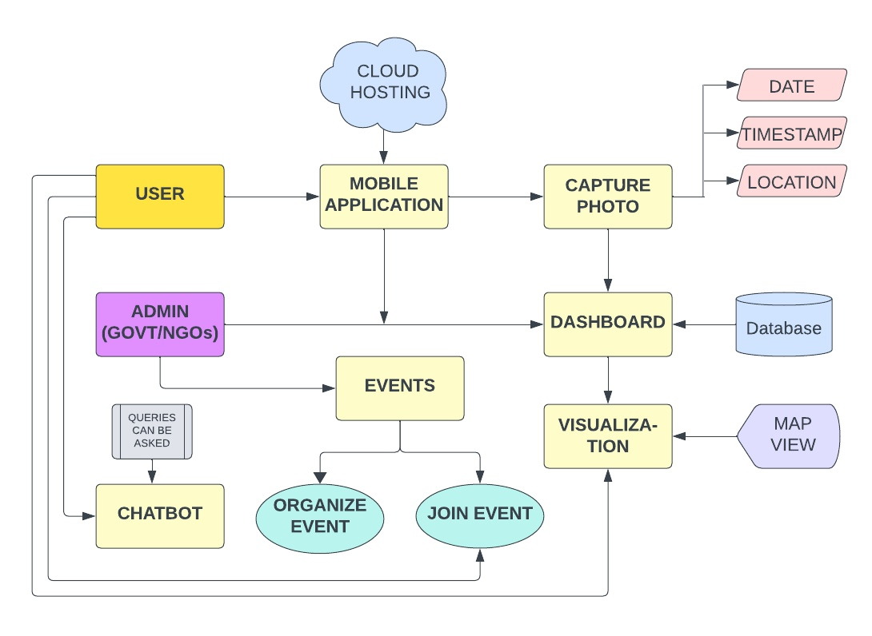
Proposed System Architecture

Slide 11
Prototype Design
https://www.figma.com/proto/qmSEej5IsJsZeETu8k88Gd/Nike-webpage-design-(Beginner)-(Community)?page-id=0%3A1&type=design&node-id=7-153&viewport=535%2C603%2C0.21&t=OOXkPp8ifXYgUklj-1&scaling=scale-down&mode=design

Slide 12
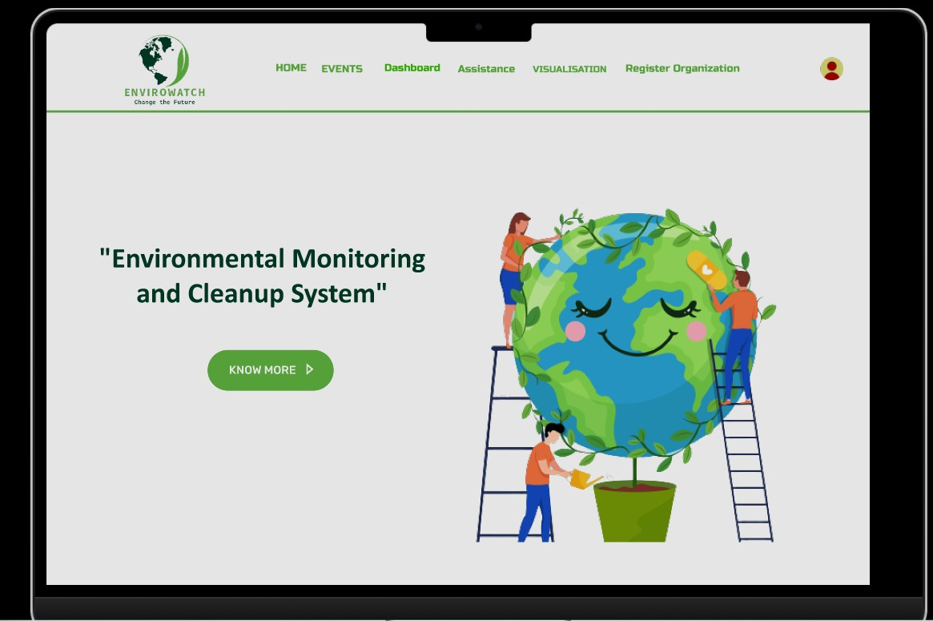
Implementation Status
Home Page

Slide 13
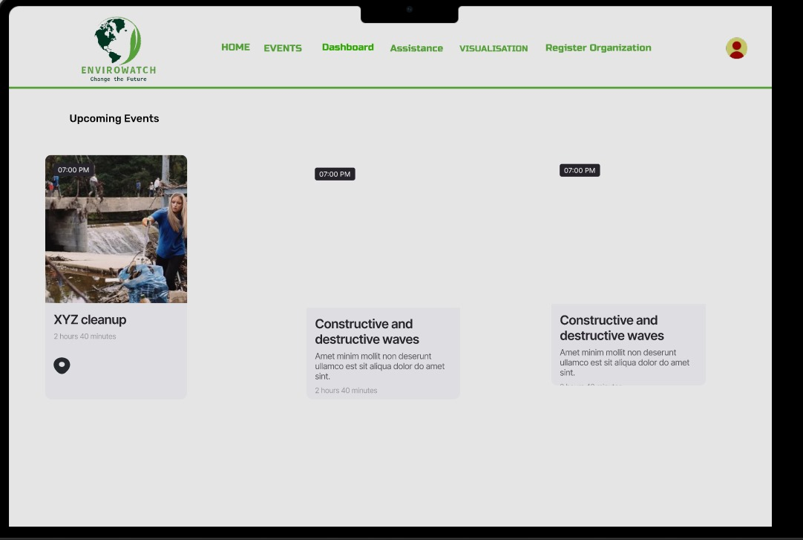
Events Tab

Slide 14
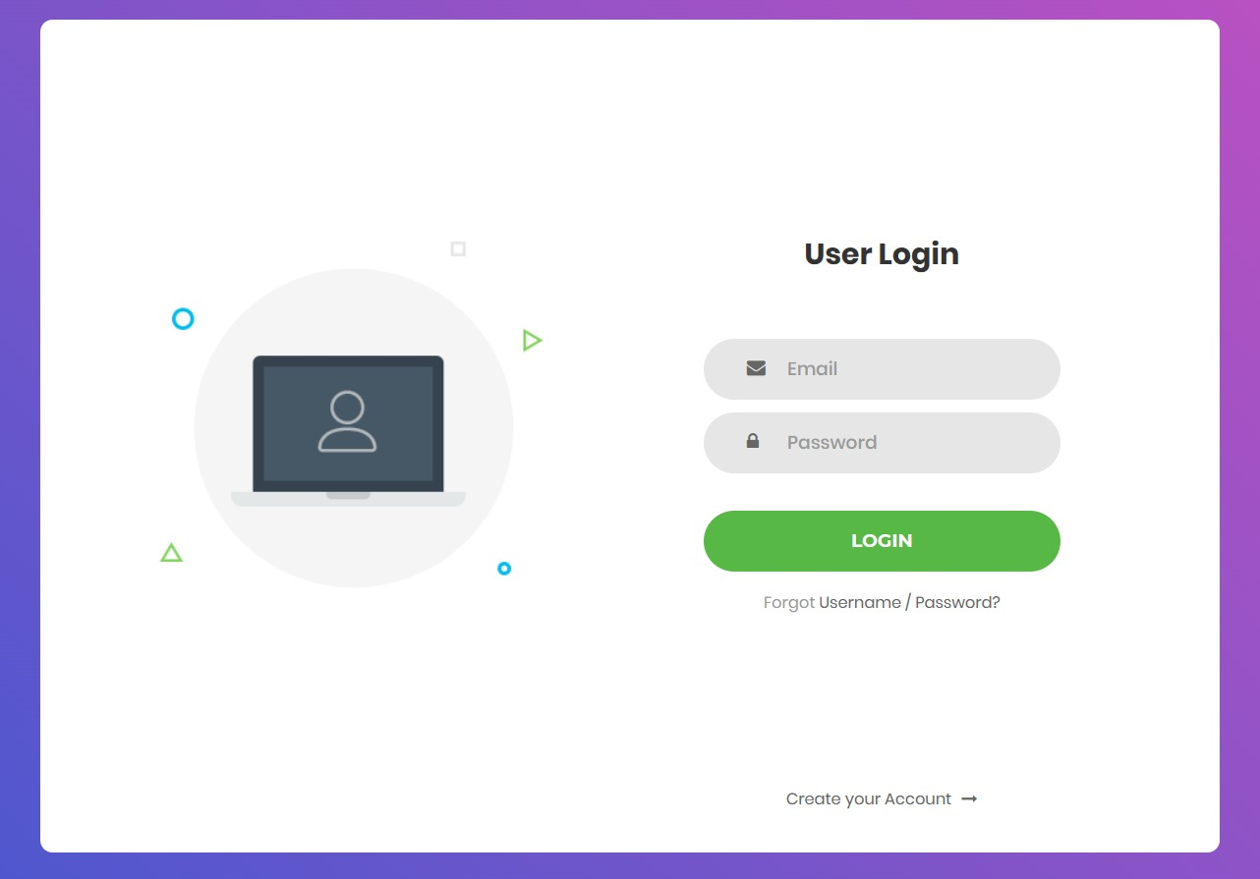
Login Page

Slide 15
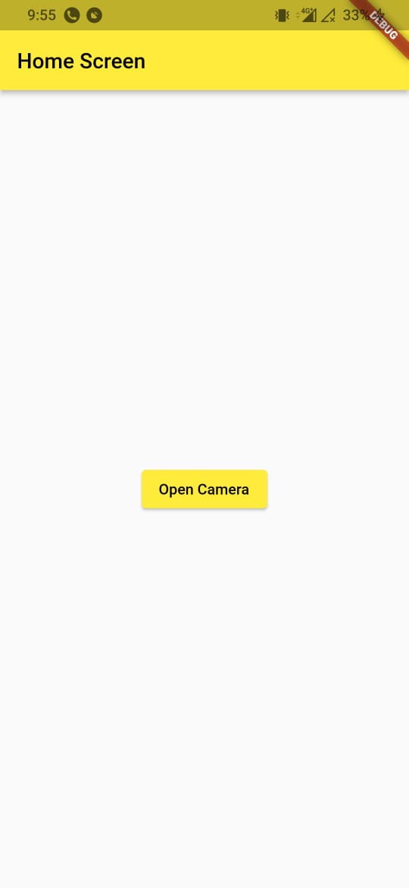
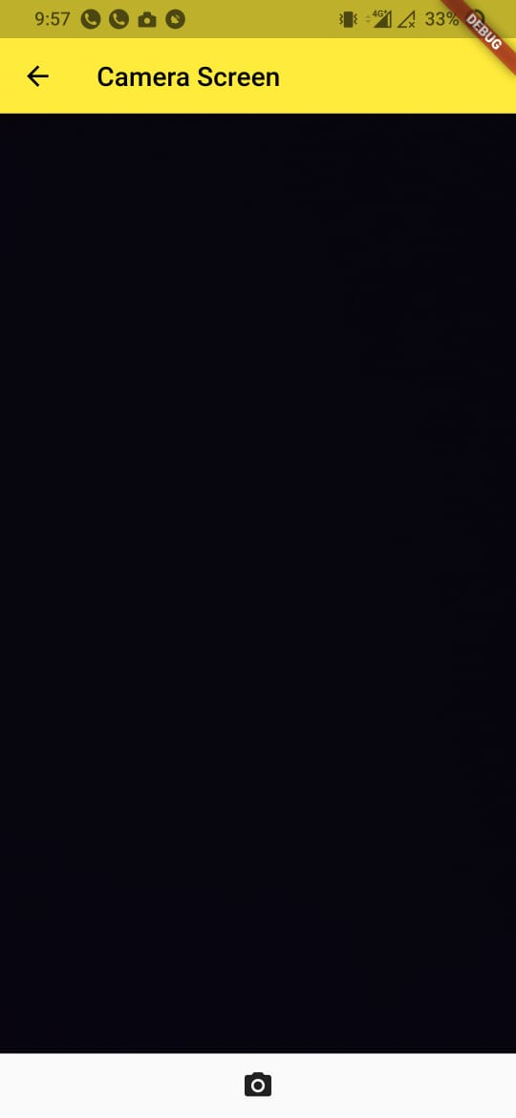
Mobile Application

Slide 16
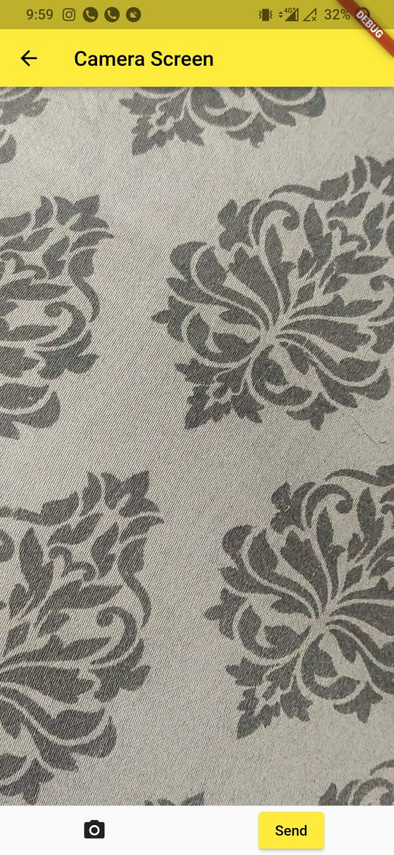
Mobile Application

Slide 17
Conclusion
Garbage is an endless issue that harms both the environment and human life.
A solution was required to help in cleaning and developing connections between the general public, NGOs, and organizations.
‘EnviroWatch’ offers organizations a comprehensive web framework alongside data analytics and real-time monitoring systems.
An end-user mobile application that allows people to interact with organizations as well as send pictures of waste.

Slide 18
References
Garbage Management System, 2021.
  [Geethamani R, Rakshana P, Raveena P, Ragavi R]
An overview on different methods of Domestic Waste Management and Energy generation in India, 2021.
  [Piyali Mondal, Anojkumar Yadav]
Web-based, Multi-platform, Centralized, Offline Compatible Supply Chain Management System for Emergency Responses,2020.
  [Dawei Wang, Yuehwern Yih, John Service, Lionel Lajous, Sarah, Robbins Penniman]

Slide 19
Thank You...!!

