Slide 1
DOCUMENT SCREENING USING NLP
PROJECT – P150
GROUP NO – 6
MENTOR: MR.Adhvait
TEAM MEMBERS:-
Rohit Shivaji Ahirrao
Sushmita Singh
Kiran.B.Koti
Savita Pralhad LodiwalE
Akanksha Mishra

Slide 2
BUSINESS OBJECTIVE
To create a Resume Parser based on Natural Language Processing to extract required information from resumes.
To make ease of selecting resumes for recruiter without actually going through each of them.
To help candidates to find and apply the most suitable jobs from the job boards .

Slide 3
PROJECT ARCHITECTURE
EDA
Model Building
Model Evaluation &
Feedback
Deployment

Slide 4
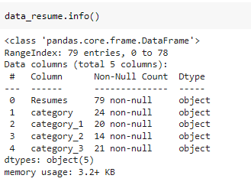
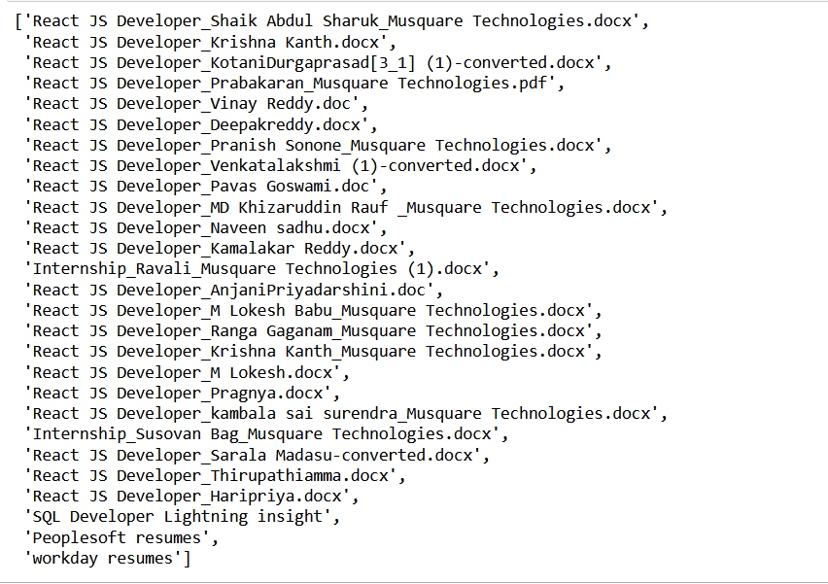
DATASET

Slide 5
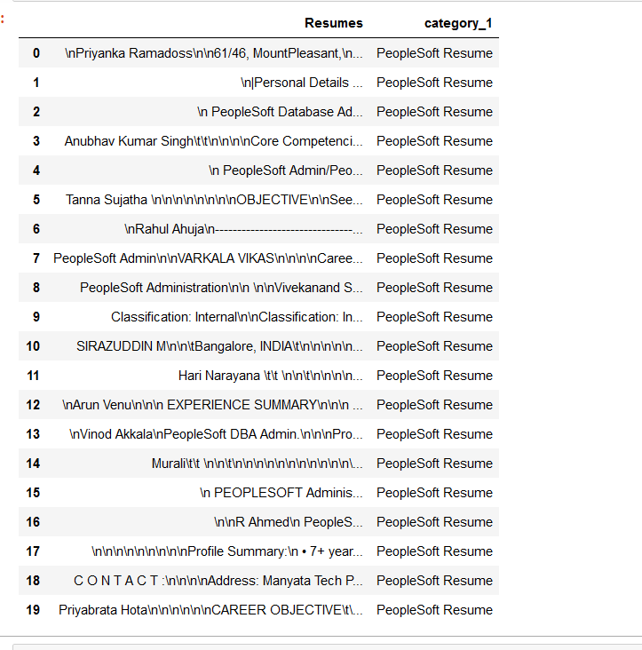
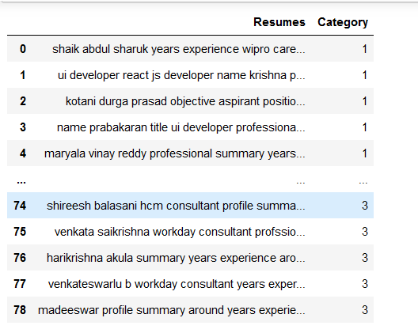
EXPLORATORY DATA ANALYSIS
Convert char to lower case, Remove the URL,#tag ,extra space,stopwords
Tokenizing
Normalising
High low frequency words
Stopwords
Lemmatization

Slide 6
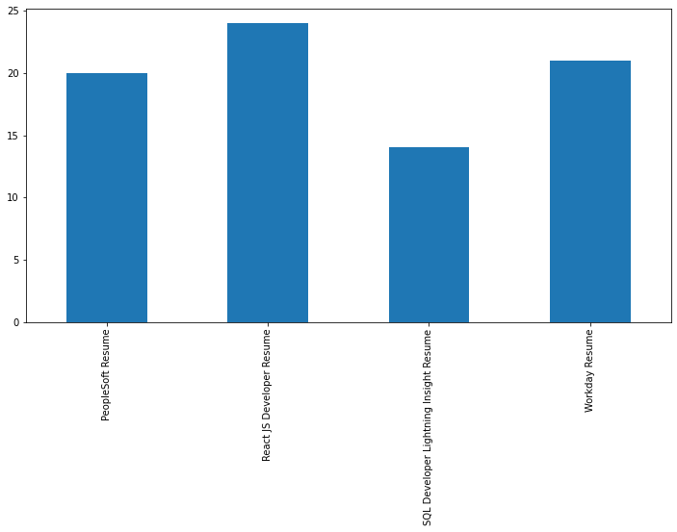
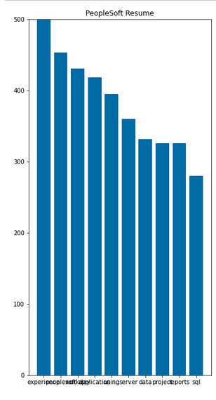
BARPLOTS
Category
Word Frequency distribution

Slide 7
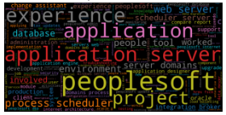
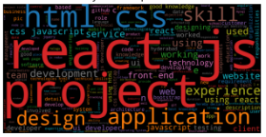
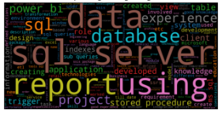
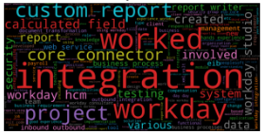
WORLD CLOUD
PeopleSoft Resume
React JS Developer Resume -
SQL Developer Lightning Insight
Resume
Workday Resume

Slide 8
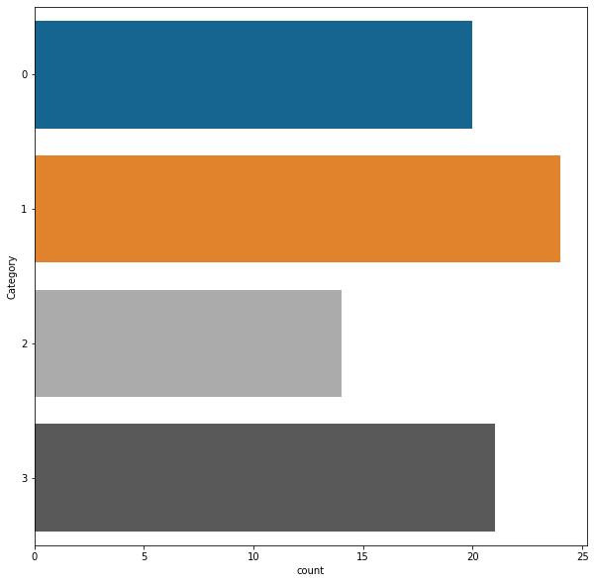
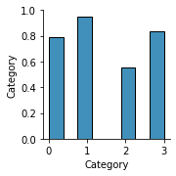
PAIRPLOTS

Slide 9
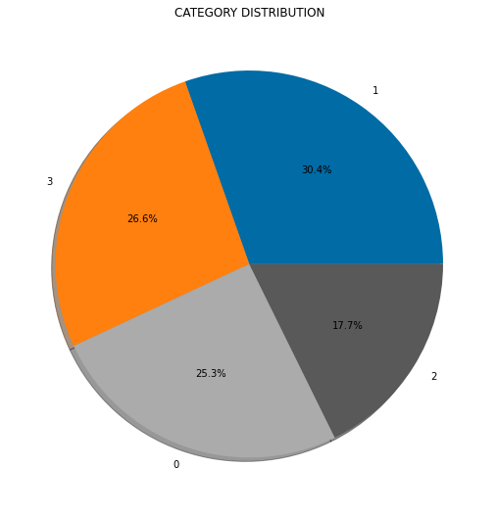
Pie Chart

Slide 10
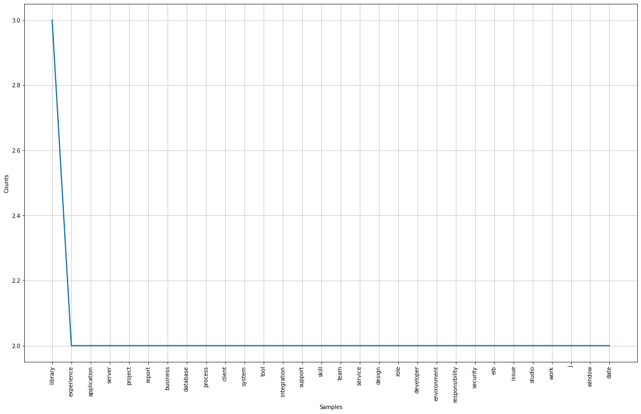
FREQUENCY DISTANCE

Slide 11
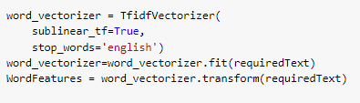
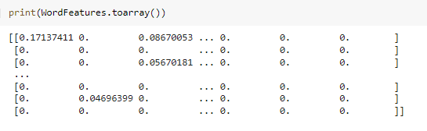
TFidf vectorizer
Model Building

Slide 12
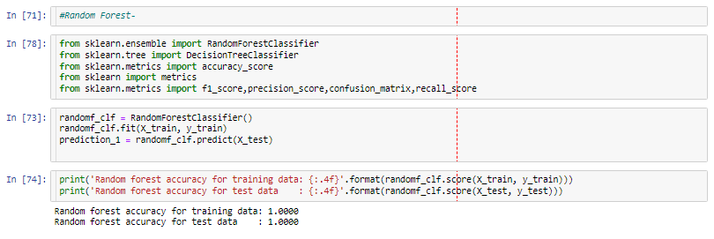
Random Forest

Slide 13
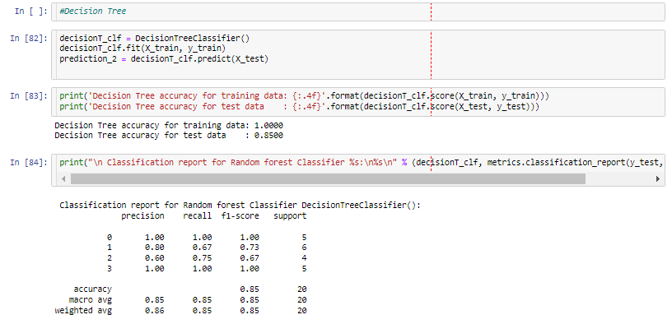
Decision Tree

Slide 14
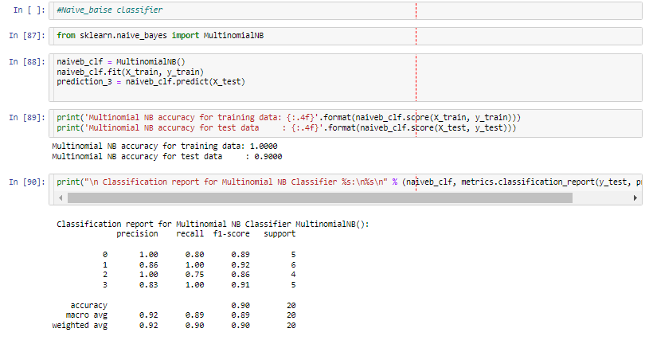
Naïve Bayes

Slide 15
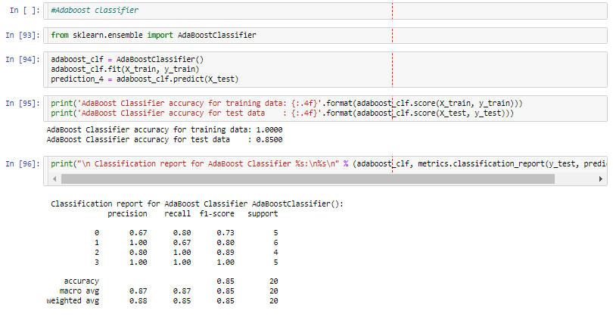
Adaboost Classifier

Slide 16
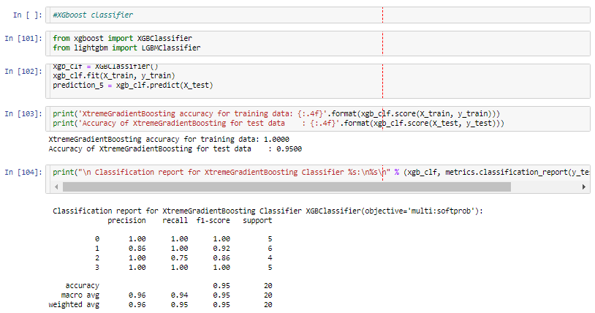
Xgboost Classifier

Slide 17
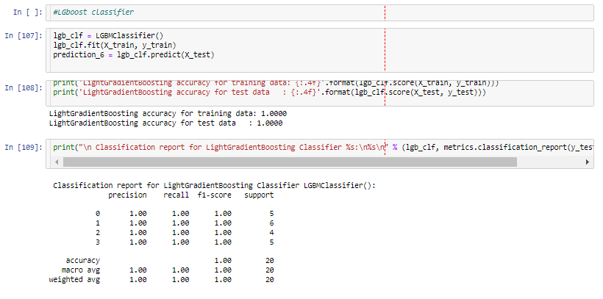
Lgboost Classifier

Slide 18
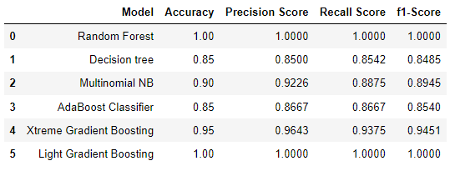
Models Scores

Slide 19
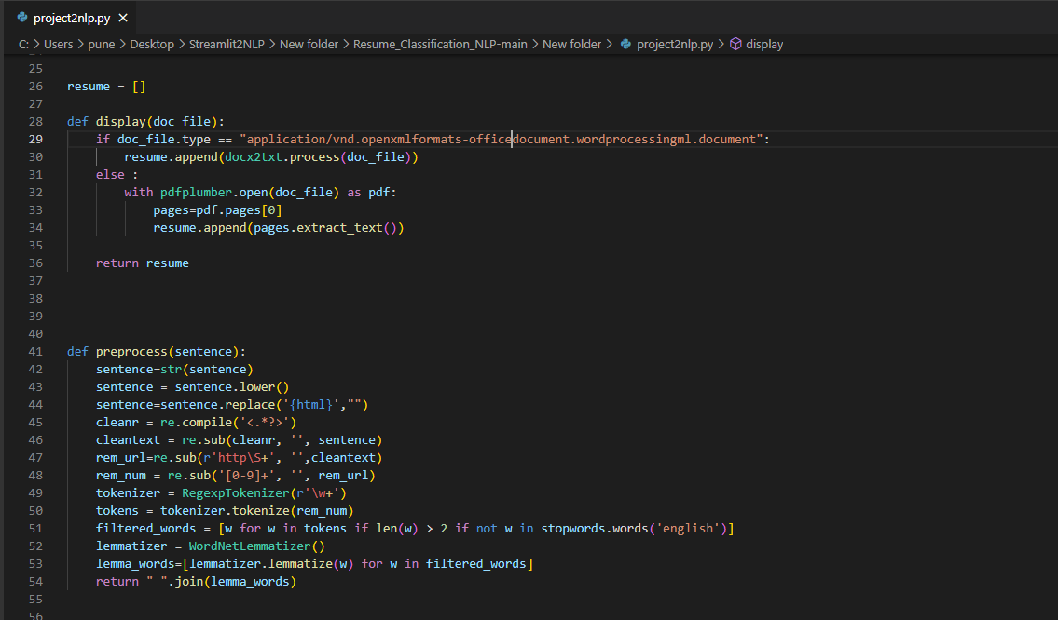
Deployment
Deployment is done by streamlit(streamlet py code file )

Slide 20
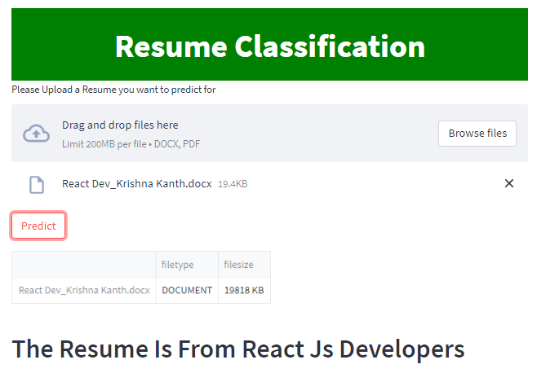
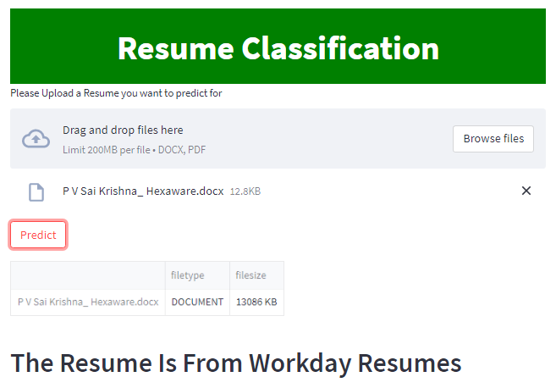
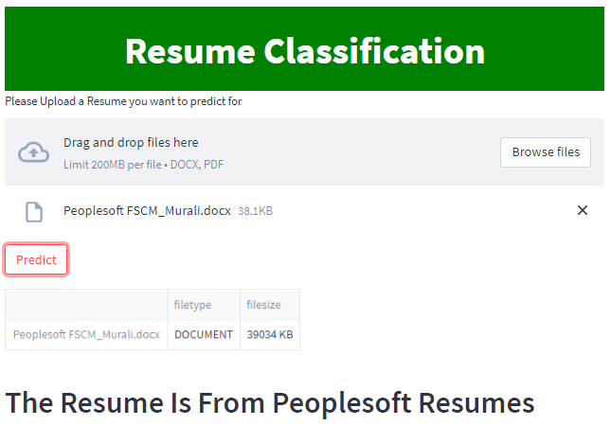
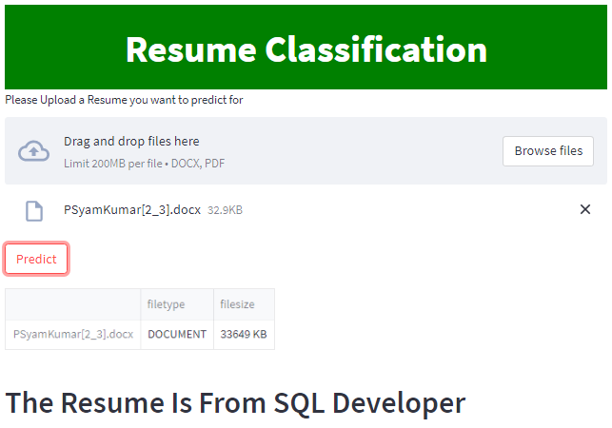
Output
Model is predicting the resume category as below.

