Slide 1
Sl No | Circle | Regularized from 15-03-2005 to 31-03-2007 | Infrastructure Developed During |  | Balance No of regularized UA IP sets to be provided with infrastructure
 |  |  | Present month | Cumulative | LIST-A +B +C+D | LIST-A | LIST-B | LIST-C | LIST-D
1 | North | 325 | 0 | 325 | 0 | 0 | 0 | 0 | 0
2 | West
3 | East | 824 | 0 | 824 | 0 | 0 | 0 | 0 | 0
4 | South
5 | Rural | 5007 | 0 | 3251 | 1756 | 0 | 17 | 978 | 761
6 | Ramanagara | 6243 | 0 | 3552 | 2691 | 0 | 2 | 2689 | 0
7 | Kolar | 18285 | 0 | 12794 | 5491 | 0 | 0 | 5491 | 0
8 | Davanagere | 37301 | 130 | 11490 | 25811 | 72 | 56 | 13666 | 12017
9 | Tumkur | 50249 | 0 | 36831 | 13418 | 0 | 260 | 0 | 13158
 | TOTAL | 118234 | 130 | 69067 | 49167 | 72 | 335 | 22824 | 25936

Slide 2
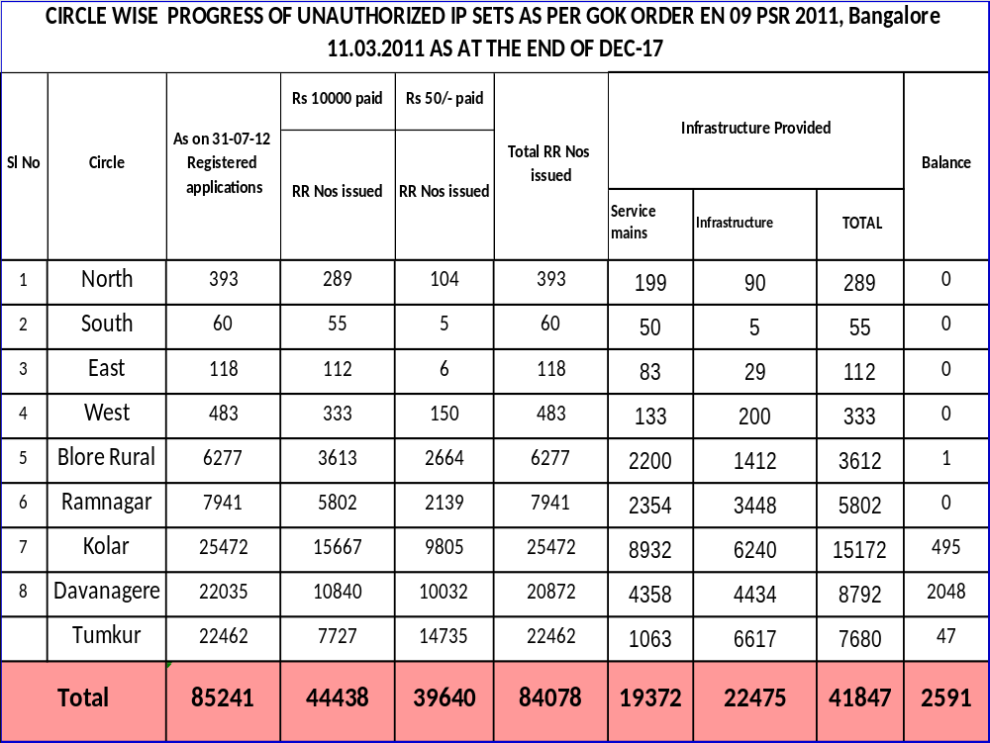

Slide 3
