Slide 1
Operating Systems
Midterm assignment
Job scheduling simulator

Slide 2
Objectives
To introduce CPU scheduling, which is the basis for multiprogram-based operating systems
To describe various CPU-scheduling algorithms
To discuss evaluation criteria for selecting a CPU-scheduling algorithm for a particular system

Slide 3
Mission
Implement of scheduling function
Files provided
main.c
schedule.h
proc_list.txt
You have to make schedule.c file and implement functions declared in schedule.h
You should submit “schedule.c” only

Slide 4
Mission
given
yours
include
structures
main
schedule.h
Function prototypes
user
tick = 0
loop:
call scheduler
display running proc
tick++
call display performance
Process list file name
Scheduling method
schedule.c
Implementation
by yourself
Proc_list.txt
process information

Slide 5
Process list
Structure of process list follows below:
First line: the number of process (1~10)
From second line
Process ID / (1~10 integer)
Process beginning time (0~100 integer)
CPU burst time (1~20 integer)

Slide 6
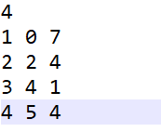
Process list (Example)
proc_list.txt
the number of process
pid | arrival time | burst time
1 | 0 | 7
2 | 2 | 4
3 | 4 | 1
4 | 5 | 4

Slide 7
Code summary
main.c
#include <stdio.h>
#include <stdlib.h>
#include "schedule.h"
// global variables
int tick = 0;
int main(int argc, char* argv[])
{
char file_name[1024] = "";
int schedule_method = -1;
printf("Enter process file name:");
scanf("%s", file_name);
printf("Enter process scheduling mehtod \n");
printf("1: FCFS: First Come First Served (Non-preemptive) \n");
printf("2: SJF: Shortest Job First (Non-preemptive) \n");
printf("3: SRTF: Shortest Remaining Time First (Preemptive) \n");
printf("4: RR: Round Robin (Non-preemptive) \n");
scanf("%d", &schedule_method);
Yellow-marked lines are from schedule.h

Slide 8
Code summary
main.c
set_schedule(schedule_method);
// set processes
read_proc_list(file_name);
while(1){
int res = do_schedule(tick);
if (res == 0 || tick > 1000) break;
tick++;
}
print_performance();
return 0;
}
Yellow-marked lines are from schedule.h

Slide 9
Code summary
schedule.h
#ifndef __schedule_h__
#define __schedule_h__
void read_proc_list(const char* file_name);
void set_schedule(int method);
int do_schedule(int tick);
void print_performance();
#endif

Slide 10
Code summary
schedule.h
The function read the file and initialize processes
// fn: read_proc_list
// desc: read process file list
// param
// file_name: process list name
void read_proc_list(const char* file_name);

Slide 11
Code summary
schedule.h
// fn: set_schedule
// desc: set scheduling method
//
// param: method
// scheduling method
// 1. FCFS (Non-preemptive)
// 2. Shortest Job First (Non-preemptive)
// 3. Shortest Remaining Time First (Preemptive)
// 4. Round Robin : Time Quantum = 2 (Preemptive)
// return none
void set_schedule(int method);

Slide 12
Code summary
schedule.h
// fn: do_schedule
// desc: scheduling function called every tick from main
// param
// tick: time tick beginning from 0
// return
// 0: when all process are terminated
// 1: otherwise
//
int do_schedule(int tick);

Slide 13
Code summary
schedule.h
// fn: print_performance();
// desc: print system performance
void print_performance();

Slide 14
Output format
Messages
Scheduling method before scheduling beginning
When new process is arrival
When dispatch to new process (context switching)
When All Processes are terminated
Scheduling method: xxx (Preemptive or Non-preemptive)
[tick: 00] New Process (ID: 00) newly joins to ready queue
[tick: 00] Dispatch to Process (ID: 00)
[tick: 00] All processes are terminated.

Slide 15
Output format
Messages
When all processes are terminated.
Evaluation table is shown.
PID | arrival | Finish | burst | Turn around time | Waiting time | Response time
1 | 0 | 0 | 0 | 0 | 0 | 0
2 | 0 | 0 | 0 | 0 | 0 | 0
… | 0 | 0 | 0 | 0 | 0 | 0
average |  |  |  | 00.00 | 00.00 | 00.00
0 means a digit

Slide 16

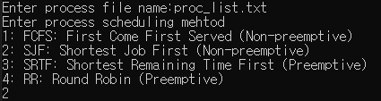
Example
Process list file: proc_list.txt
Scheduling method: SJF
This is the same as the example on P. 27 of the lecture slide.
proc_list.txt

Slide 17
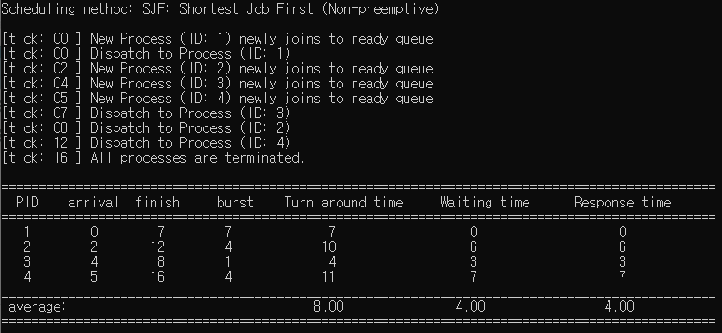
Example
Process list file: proc_list.txt
Scheduling method: SJF
This is the same as the example on P. 27 of the lecture slide.
proc_list.txt

Slide 18
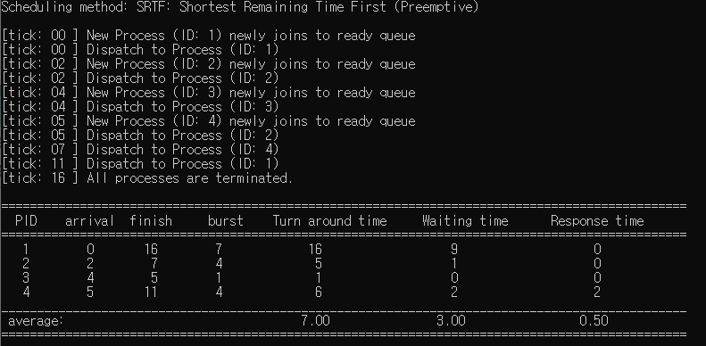
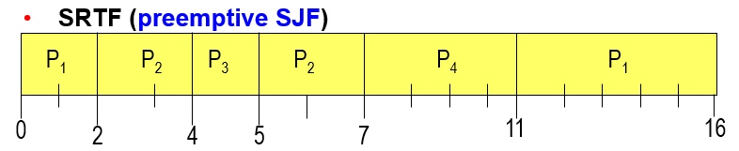
Example
Process list file: proc_list.txt
Scheduling method: SRTF
This is the same as the example on P. 27 of the lecture slide.
proc_list.txt

Slide 19

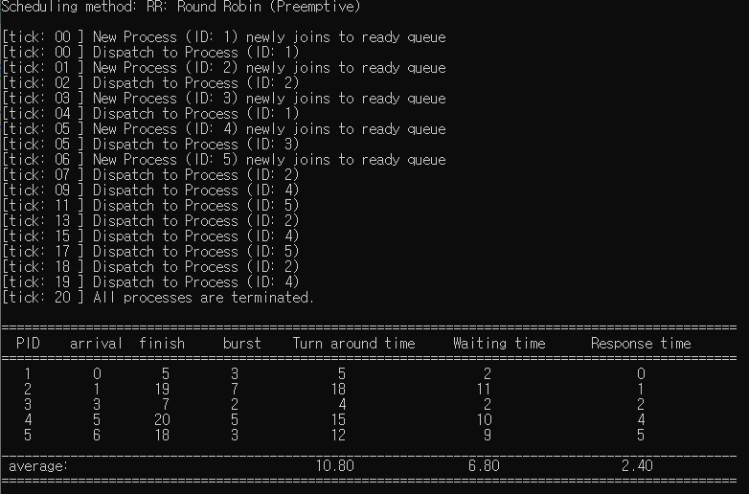
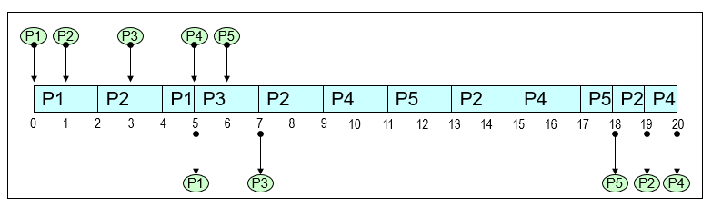
Example
Process list file: proc_list2.txt
Scheduling method: RR
This is the same as the example on P. 50 of the lecture slide.
proc_list2.txt

Slide 20
Submission rules*
Do not modify main.c or schedule.h
We will evaluate using the provided version of the two files.
Modification by you will not affect at all.
You only submit “schedule.c” file
When two processes have the same priority
The process in running state use CPU continuously (due to cost of context switching)
If both processes are in ready state, it doesn't matter which one you choose. (the result will be same).

Slide 21
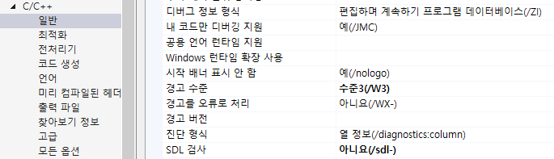
Submission rules*
You can write the file regardless of the operating systems such as Windows, Linux or Mac OS.
But, do not use OS-dependent functions like MFC.
Use standard C. Header files listed below are only allowed:
stdio.h
stdlib.h
If errors are occured about scanf in Visual C++, disable SDL check in your project property.

Slide 22
TIP #1
Evaluation metrics
Turn around time
finish tick – arrival tick
Waiting time
finish tick – arrival tick – burst tick
Response time
first tick the CPU was first allocated – arrival tick

Slide 23
Scoring criteria
Total: 300
Submission: 20
Compile success: 20
Evaluation using random process list with three scheduling method
For each Scheduling method (test our own process list.)
Correct output message (new arrival, dispatch) (30)
Correct result for average turn around time (10)
Correct result for average waiting time (10)
Correct result for average response time (10)
Subtotal: 4 x 60 =240
Code review: 20

Slide 24
Due date
May 17, 23:59 (3 weeks)
Submit to the e-campus
“schedule.c” file only.
Insert your name and id on the top of the file
No delay is allowed
Do not cheat or you'll lose everything sincerely.

Slide 25
End of the class
Thank you

