Slide 1


THE FINANCIAL OPERATING SYSTEM
FOR MOROCCAN BUSINESSES
One workflow for documents, invoicing, payments, accounting, tax and payroll — built around how Morocco actually works.
PRE-SEED · 2026
mohasibai.com
Notes:
Open with the category claim. Mohasib is infrastructure for the business–accountant relationship, not a single-feature app.
[Sources]
https://feature-widgets.midday.ai/pitch

Slide 2
THE PROBLEM
02
A BROKEN CLOSE
Every month, the financial truth is rebuilt by hand.
The information exists. The workflow connecting it does not.
01
03
02
04
Inbox
Spreadsheets
WhatsApp
Accountant
supplier invoices buried in email
cash, payroll and tax reconciled manually
receipts and reminders without structure
receives an incomplete package too late
Result: slow closes, poor visibility, avoidable errors — and no shared source of truth.
Notes:
Frame the problem as a coordination failure across existing tools and actors.
[Sources]
https://feature-widgets.midday.ai/pitch

Slide 3
WHY NOW
03
A MARKET MOVING ONLINE
Morocco’s business base is growing into a digital compliance stack.
Company formation, administration and financial workflows are moving online — while the software layer remains fragmented.
~380k
95,235
+17.7%
corporate entities filed a tax declaration in 2024
companies created in 2024
company creation growth in H1 2025
The window
AI can now read the paperwork. Government rails are digitizing. A new generation of businesses expects consumer-grade software.
National electronic company creation is already live across Morocco.
Notes:
The point is convergence: demand growth + digitized rails + capable automation.
[Sources]
https://omtpme.ma/wp-content/uploads/2026/01/OMTPME_RA-Edition-2025.pdf
https://www.ompic.ma/fr/actualites/creation-de-95235-entreprises-en-2024-0
https://www.ompic.ma/fr/actualites/office-marocain-de-la-propriete-industrielle-et-commerciale-les-creations-dentreprises
https://www.ompic.ma/fr/actualites/ompic-generalisation-de-la-plateforme-de-creation-dentreprises-par-voie-electronique-sur

Slide 4
THE SOLUTION
04
ONE SHARED WORKFLOW
Mohasib turns business activity into accountant-ready books.
Capture once. Automate the repetitive work. Keep the business and accountant on the same financial record.
01
02
03
04
CAPTURE
→
UNDERSTAND
→
OPERATE
→
COMPLY
Email · upload · archive
OCR · classify · match
Invoice · collect · pay · payroll
TVA · entries · CGNC exports
ONE FINANCIAL RECORD · TWO SIDES OF THE SAME WORKFLOW
Notes:
Explain the data flow from raw documents to compliant output.
[Sources]

Slide 5
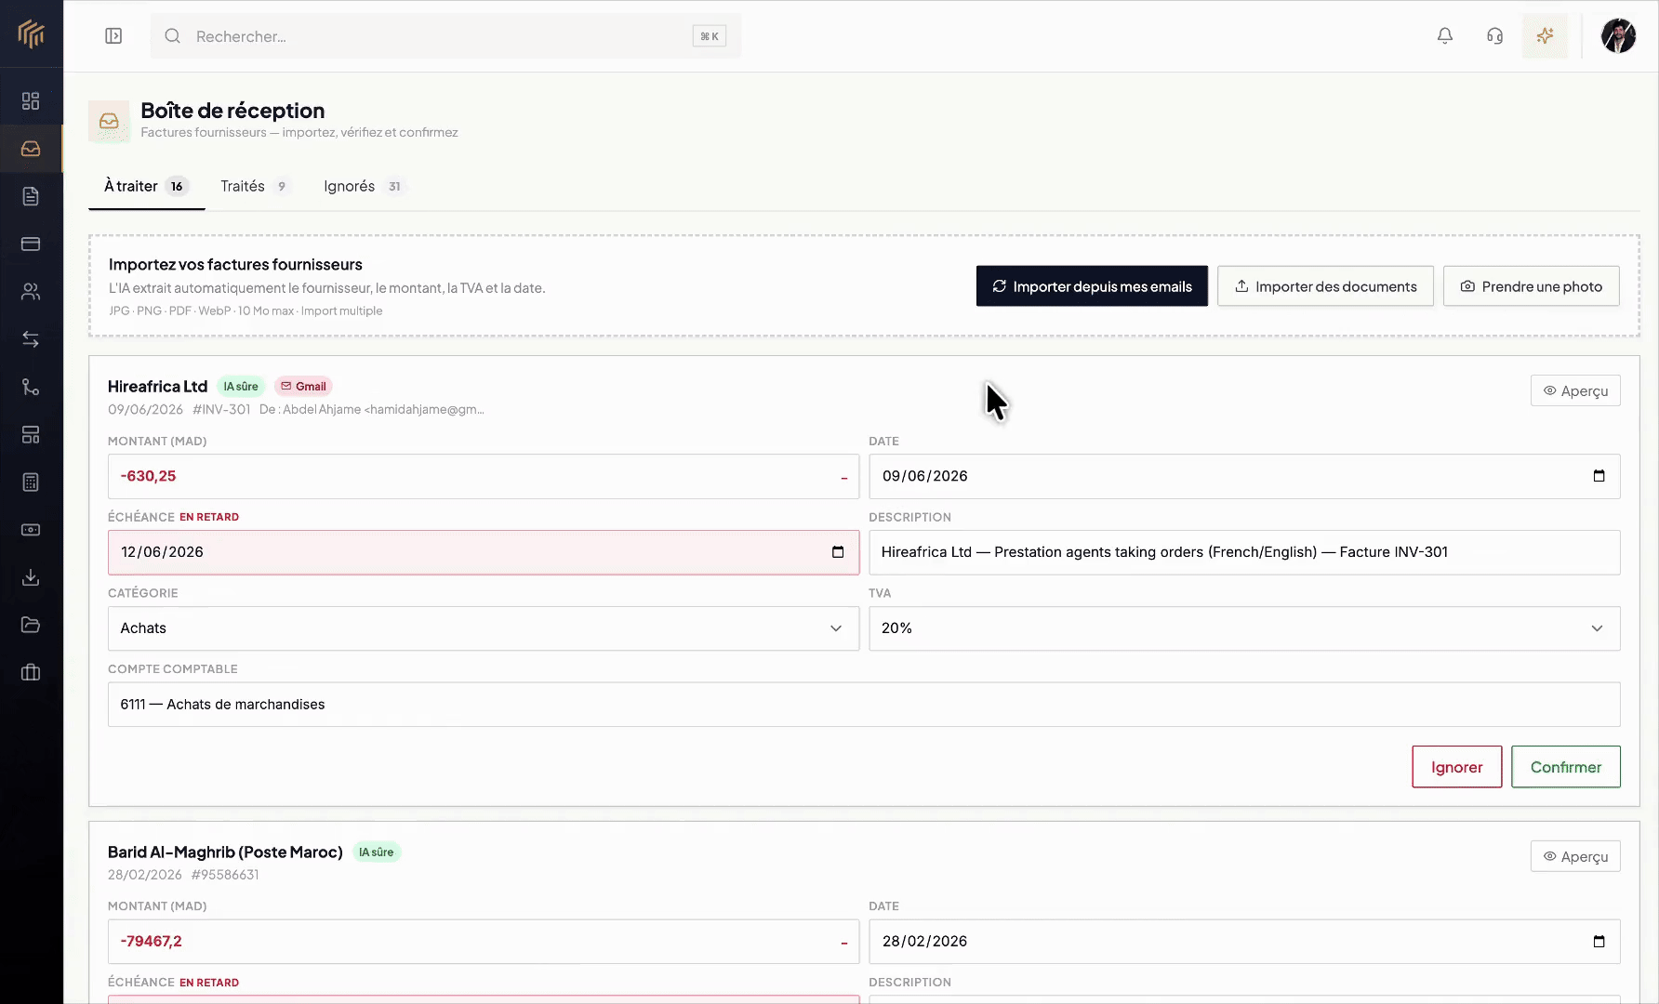
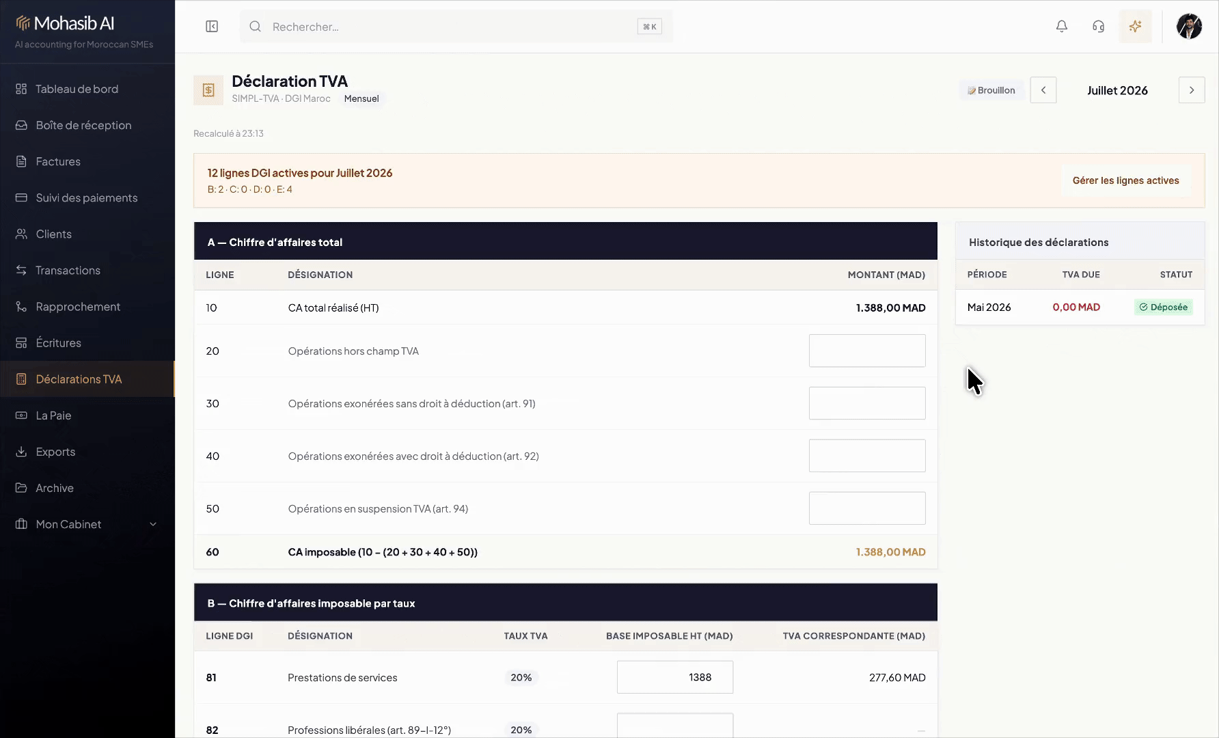
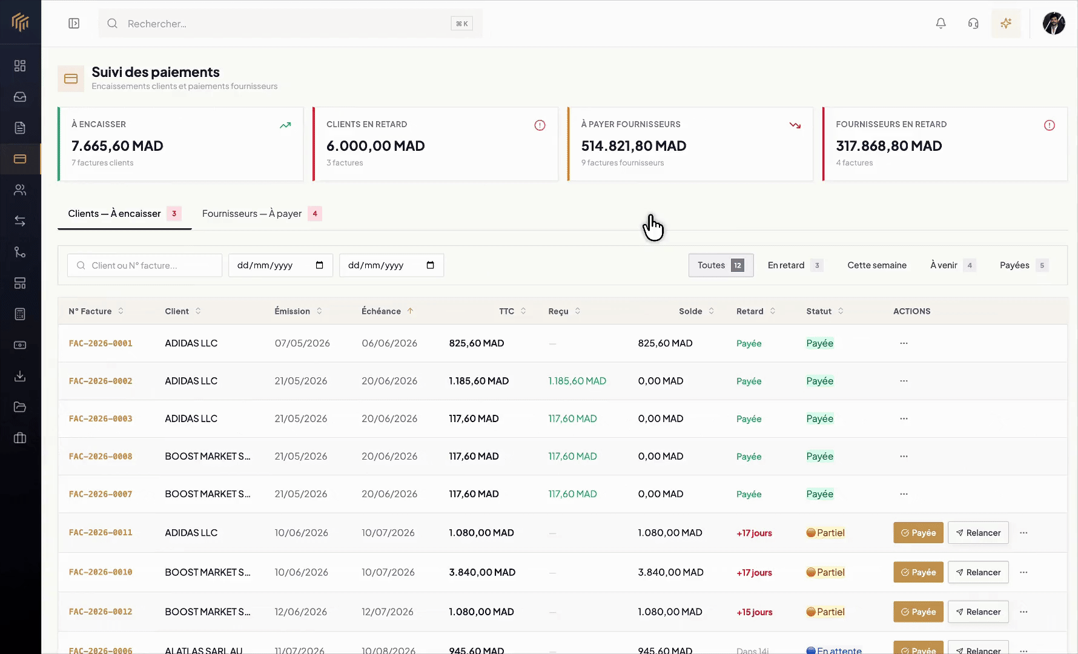
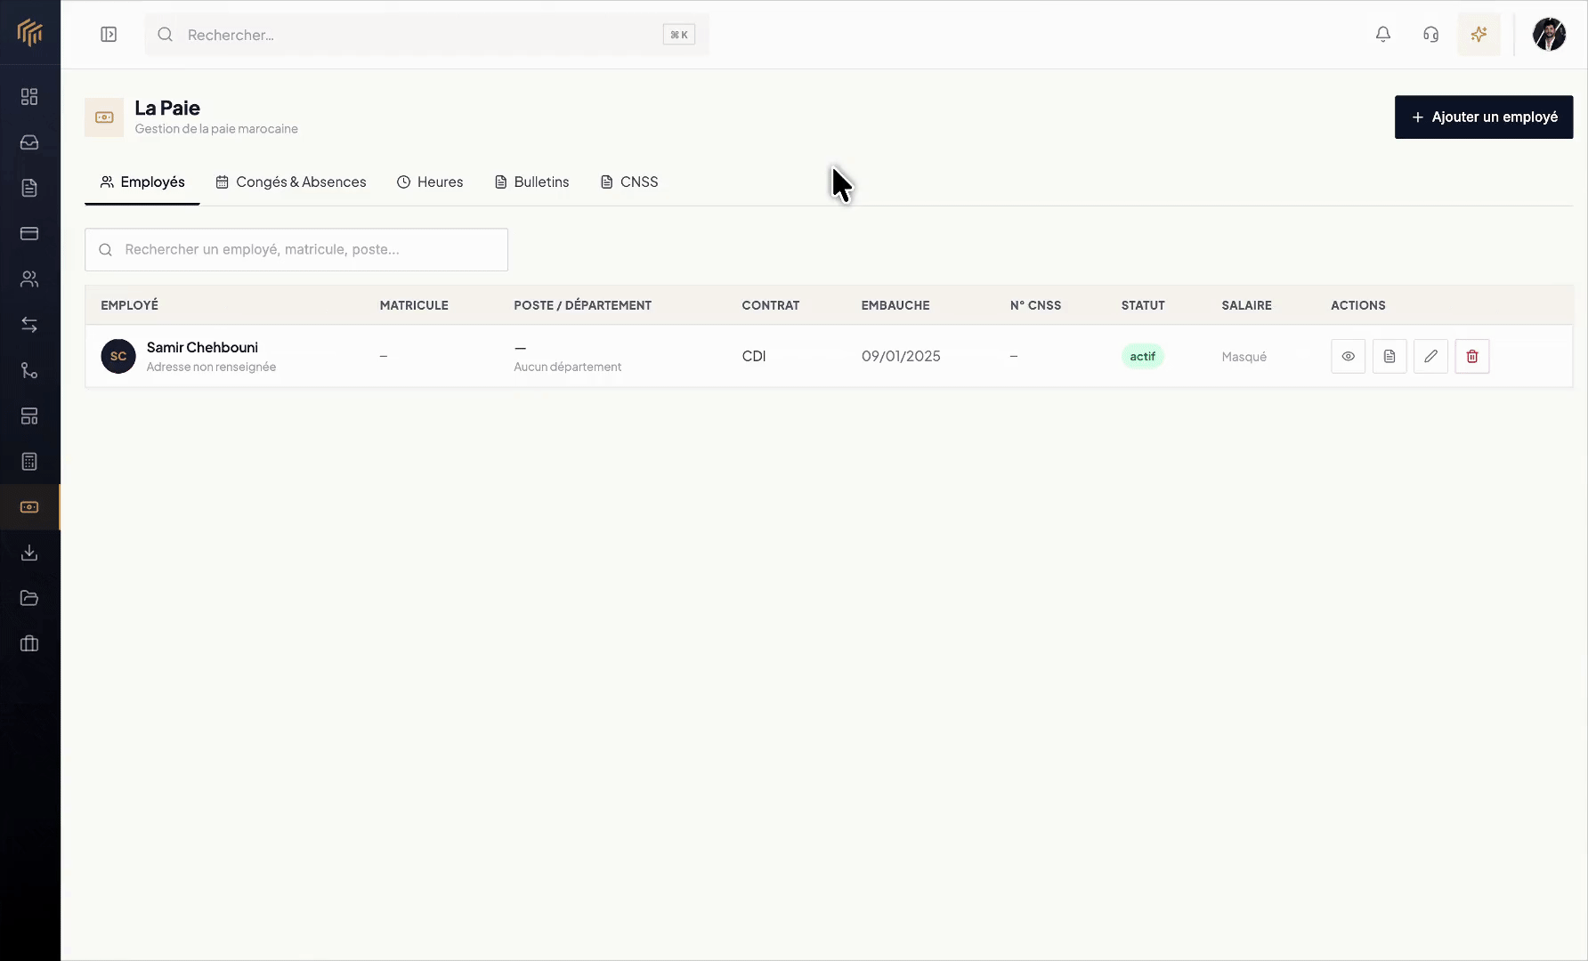
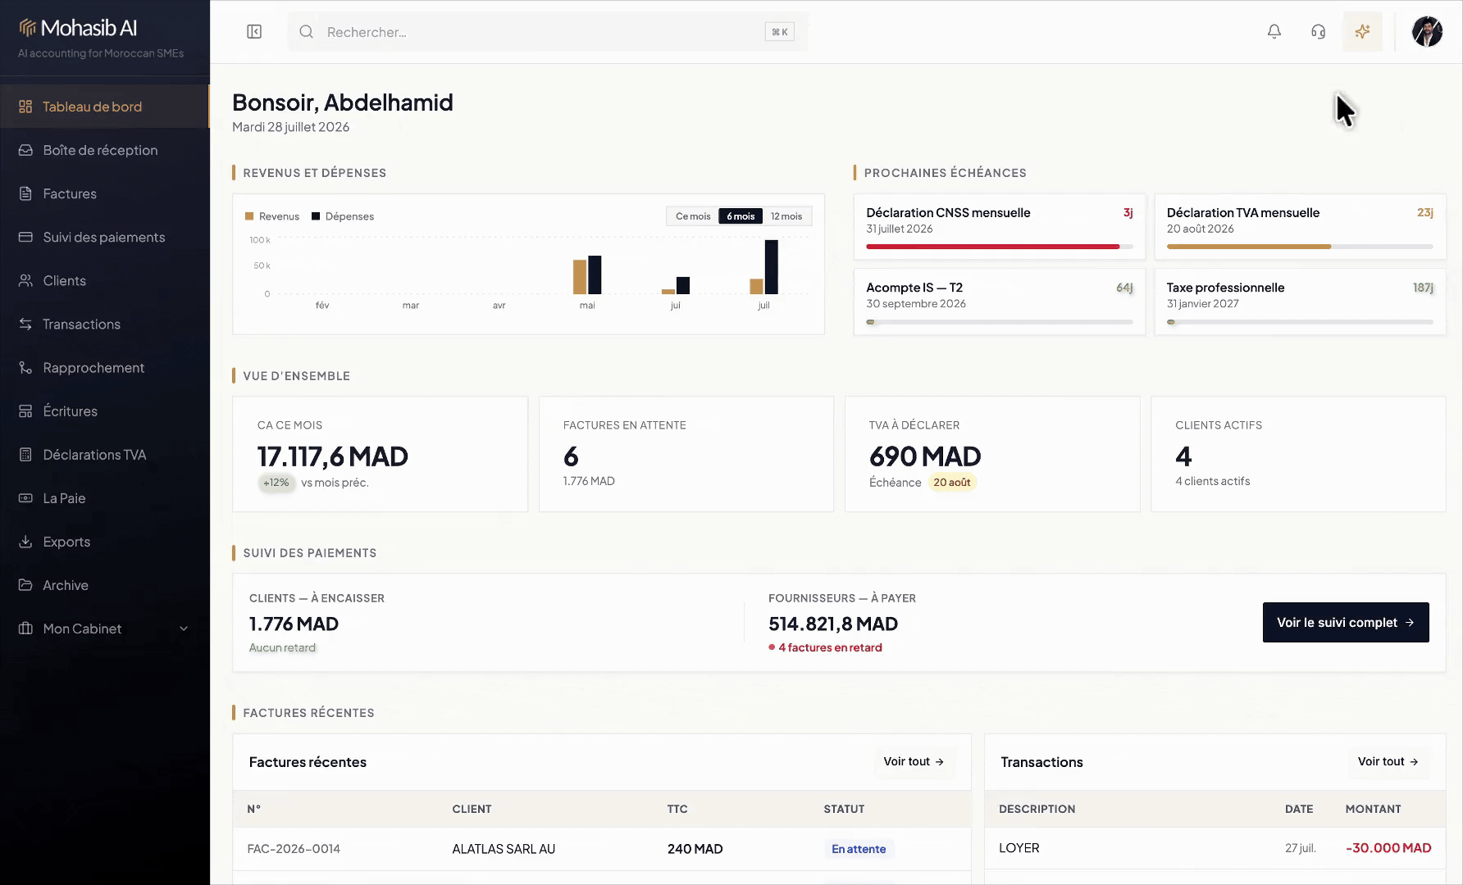
PRODUCT
05
The product already spans the monthly financial cycle.
Native to Moroccan workflows: TVA, payroll, bank reconciliation, document archive and accountant exports.
TVA
PAYMENTS
PAYROLL
AGENT
INBOX + OCR
Notes:
Use the screenshots as proof of breadth, then return to the core job: shorten the distance between activity and reliable books.
[Sources]

Slide 6
VALUE CREATION
06
ONE RECORD, THREE WINNERS
Mohasib removes work from every side of the relationship.
01
02
03
BUSINESS OWNER
ACCOUNTANT
ACCOUNTING FIRM
Know what is due, paid and owed — without rebuilding a spreadsheet.
Receive clean documents, categorized activity and export-ready books.
Operate more client files with a shared inbox and standardized workflow.
Send invoices
Review exceptions
Multi-dossier view
Track cash
Prepare TVA
Mass operations
Run payroll
Close faster
Client portal
Notes:
This slide makes the B2B2B logic concrete: the same data product has distinct value propositions.
[Sources]

Slide 7
DISTRIBUTION WEDGE
07
START FREE. BECOME THE SYSTEM OF RECORD.
Free invoicing creates the business relationship; workflow depth and accountant collaboration monetize it.
01
FREE INVOICING
Acquire entrepreneurs at the moment they create revenue
02
OPERATING WORKFLOWS
Convert when documents, cash, TVA or payroll become painful
03
ACCOUNTANT NETWORK
One accounting firm can activate and standardize many client spaces
Every connected client increases product value, expansion revenue and embedded distribution.
Notes:
The wedge is permanent free invoicing, not a time-limited teaser. Monetization follows operational complexity and collaboration.
[Sources]

Slide 8
MARKET
08
A FOCUSED MARKET CAN STILL BE LARGE
The core Morocco opportunity is already a billion-dirham software category.
Illustrative bottom-up sizing using Mohasib’s current entry paid plan.
380,000
+ accounting-firm expansion
tax-filing corporate entities
+ 95k newly created companies / year
× 299 MAD / month × 12
+ future Maghreb and francophone markets
≈ 1.36B MAD core annual TAM
We win a narrow beachhead first: Moroccan TPE/SMEs and the accountants who serve them.
Notes:
TAM arithmetic: 380,000 × 299 × 12 = 1,363,440,000 MAD. It excludes cabinet expansion and geography.
[Sources]
https://omtpme.ma/wp-content/uploads/2026/01/OMTPME_RA-Edition-2025.pdf
https://www.ompic.ma/fr/actualites/creation-de-95235-entreprises-en-2024-0

Slide 9
BUSINESS MODEL
09
REVENUE EXPANDS WITH OPERATIONAL COMPLEXITY
Simple entry pricing; usage and collaboration increase account value.
FREE
0 MAD
Unlimited invoicing, quotes, credit notes and client management
ENTREPRISE FLEX
299 MAD / mo
100 OCR documents · 1 user · payroll for 5 employees
CABINET FLEX
499 MAD / mo
2 collaborators · multi-file cockpit · client-space access
EXPANSION LEVERS
documents · employees · users · managed files · connected client spaces
Notes:
Prices shown are the live current flexible pricing model in the product workspace.
[Sources]

Slide 10
GO-TO-MARKET
10
A COMPOUNDING ACQUISITION ENGINE
Land businesses directly, then turn accountants into trusted multipliers.
01
02
03
FREE PRODUCT
→
ASSISTED ACTIVATION
→
ACCOUNTANT PARTNERS
SEO + templates + calculators + word of mouth
Import documents, connect inbox, reach first useful close
Co-manage the books; introduce Mohasib to the rest of the portfolio
North-star loop
Free invoice → connected workflow → accountant collaboration → portfolio distribution
Notes:
Describe the first repeatable motion: acquire via useful free tools, activate on a high-value workflow, then expand through the accountant relationship.
[Sources]

Slide 11
DEFENSIBILITY
11
LOCALIZATION IS THE ENTRY. WORKFLOW DEPTH IS THE MOAT.
Mohasib compounds advantage where global point solutions are shallow and legacy suites are difficult to use.
LOCAL OPERATING LAYER
TVA · CGNC · payroll · identifiers · document conventions
WORKFLOW GRAPH
Documents linked to transactions, invoices, payments and entries
TWO-SIDED ADOPTION
Business workspace + accountant workspace on the same record
The result: higher switching cost, better automation context, and a distribution advantage that strengthens with every connected file.
Notes:
Avoid calling localization alone a moat. The defensibility comes from connected workflows, accumulated context and two-sided adoption.
[Sources]

Slide 12
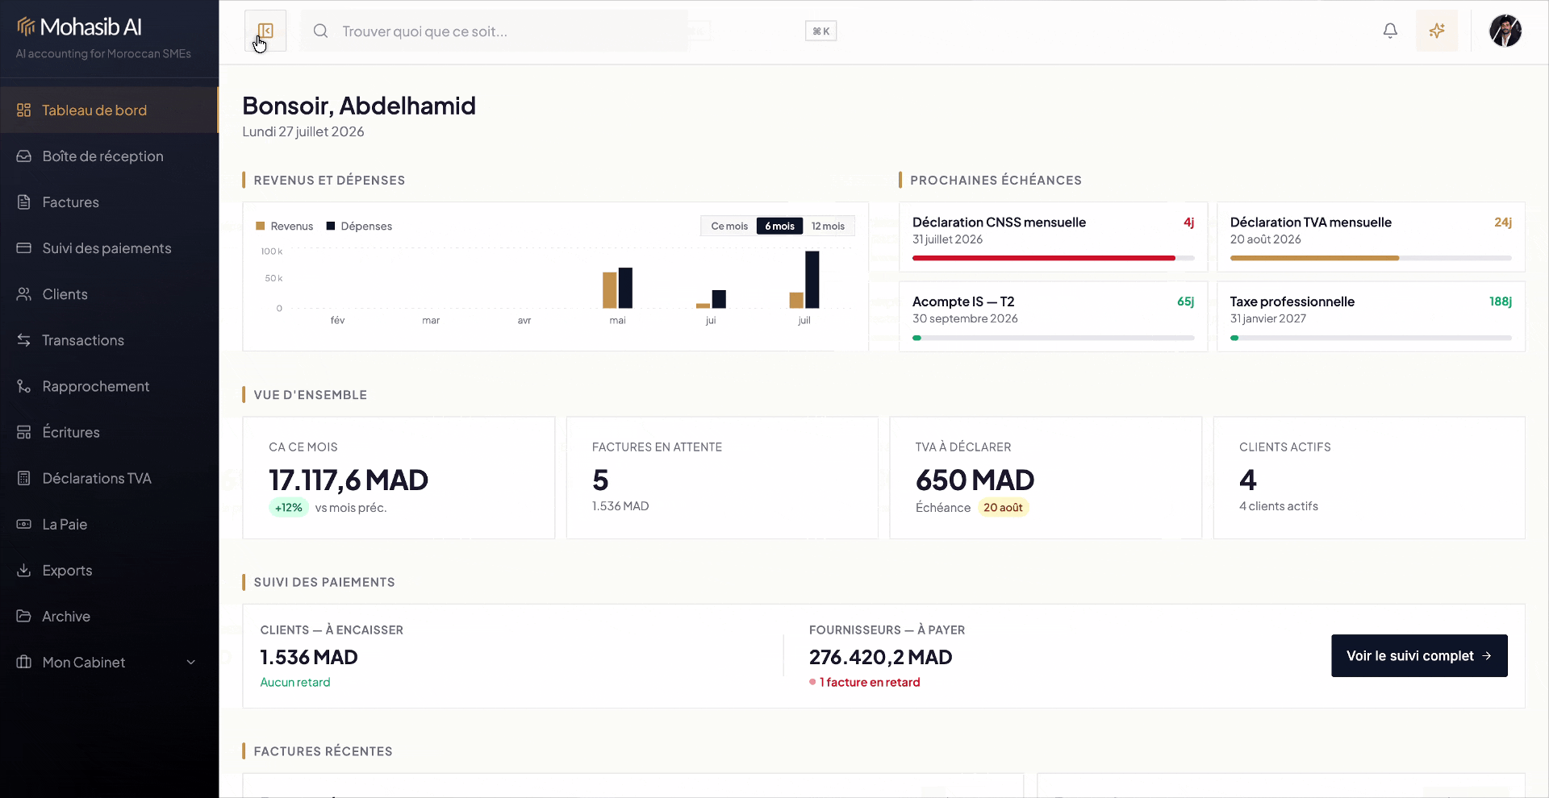
EXECUTION PROOF
12
The product is built. The next milestone is distribution.
A working, production-shaped platform already covers the core financial operating cycle.
INBOX + OCR
INVOICING
PAYMENTS
BANK MATCHING
TVA
PAYROLL
ACCOUNTING
CGNC EXPORTS
ARCHIVE
AI AGENT
MULTI-DOSSIER
TEAM ACCESS
Built founder-first, with a single product language across businesses and accounting firms.
Notes:
This is execution proof, not a traction slide. Replace or precede it with verified customer/revenue data when available.
[Sources]

Slide 13
18-MONTH PLAN
13
PROVE THE CHANNEL, THEN SCALE THE CATEGORY
Capital accelerates distribution, onboarding and compliance depth — not a greenfield build.
0—6 MONTHS
6—12 MONTHS
12—18 MONTHS
PROVE
REPEAT
SCALE
Convert the free wedge into repeatable paid activation
Standardize onboarding and partner-led portfolio rollout
Expand distribution and prepare the next geography
Instrument activation
Migration playbooks
Sales + customer success
Founder-led onboarding
Partner enablement
Automation depth
10 accountant design partners
Retention + expansion loops
Regional readiness
Notes:
The 10 design-partner target is a forward milestone, not existing traction.
[Sources]

Slide 14

TEAM + ASK
14
Founder-led velocity, focused on a local problem worth owning.
WE ARE RAISING A PRE-SEED ROUND
Partner with us to make reliable financial operations the default for every Moroccan business.
ABDELHAMID AHJAME
Founder · product builder
CAPITAL TO SCALE DISTRIBUTION
Built Mohasib end-to-end across product, accounting workflows and go-to-market surfaces.
ACCOUNTING + SME ECOSYSTEM ACCESS
SUPPORT FOR REGIONAL EXPANSION
contact@mohasibai.com · mohasibai.com
Notes:
Close with the partnership ask. Insert the exact round amount and use-of-funds allocation once confirmed.
[Sources]

Slide 15
APPENDIX · COMPETITIVE FRAME
15
DESIGNED FOR THE GAP IN THE MARKET
Mohasib combines local compliance depth with a modern operator experience.
HIGH LOCAL WORKFLOW DEPTH ↑
Generic AI
assistants
MOHASIB
local + usable + connected
Global invoicing
& point tools
Legacy local
accounting suites
LOW
HIGH
OPERATOR EXPERIENCE →
Notes:
This is a category map, not an audited competitor feature matrix. Use named competitors only after current product verification.
[Sources]

