Slide 1
Visualizing World Maternal and Child Health Stats and USAid by Alex Johnson
Goal: Visualize the correlation between USAid and maternal and child health, pointing to trends and commonalities with the data that was available.
Data source #1: WorldBank .csv dataset called Genderstats, provides information on gender statistics throughout the world. Important variables - size (19.8 mb), which stats were relevant to keep for the project, missing data points, how to structure the data appropriately to line up with the second data source.
Data source #2: foreignassistance.gov API provides resources on USAid amounts worldwide for multiple issues. Important variables - returned via JSON and REST protocol, filtered by sector(maternal and child health), year(2011 - see project report for why) and what type of transaction would be returned(spent). What JSON dictionary keys, values pairs to parse through, and what to do for countries that didn’t have aid amount available and structure it appropriately with the first data source.

Slide 2
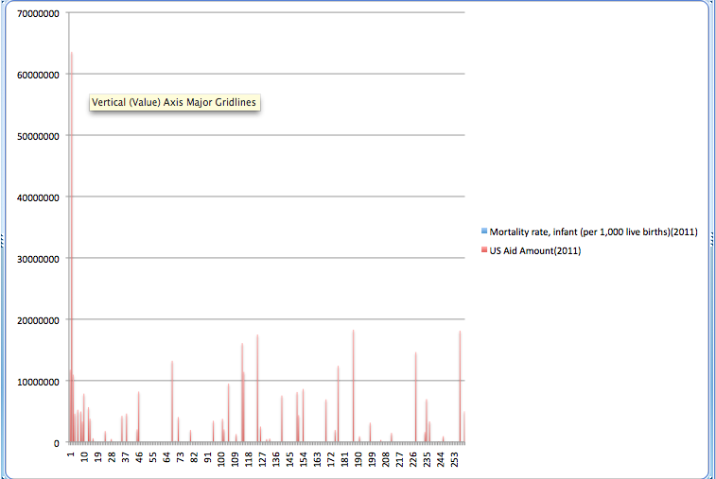
Example Genderstats result: Infant Mortality Rate(2011) vs US Aid (2011)
Comparison of infant mortality
rates per 1000 live births
(from Genderstats) with
amount of US Aid from the API
the year 2011. As will be
discussed in the final report,
the data available was scarce
and incomplete. Chart made
with csv analysis in excel.

