Slide 1

SQL JOINS

Slide 2

SQL JOIN
A JOIN clause is used to combine rows from one or more tables, based on a related
column between them.
SELECT Orders.OrderID, Customers.CustomerName, Orders.OrderDate
FROM Orders
JOIN Customers ON Orders.CustomerID=Customers.CustomerID;

Slide 3
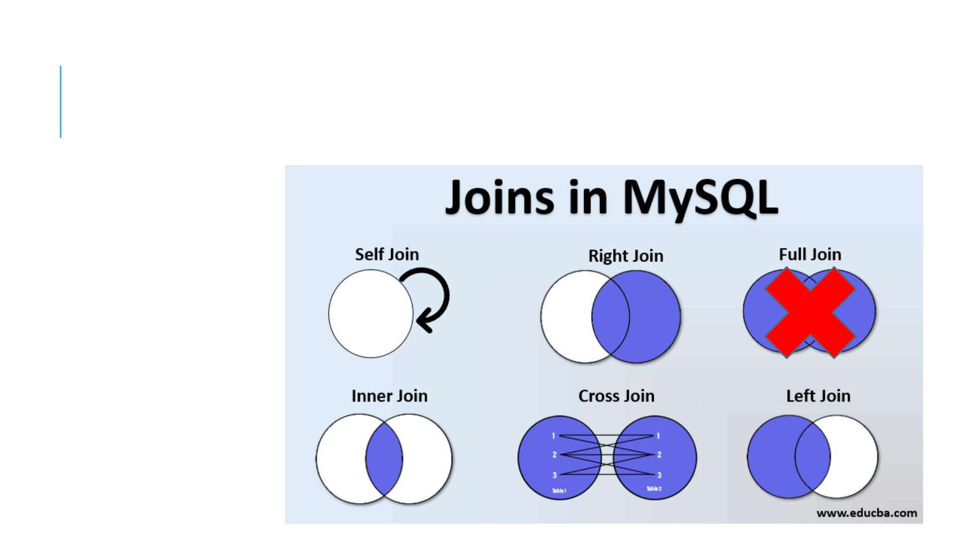
DIFFERENT TYPES OF SQL JOINS
Inner join
Left join
Right join
Cross join
Self Join

Slide 4
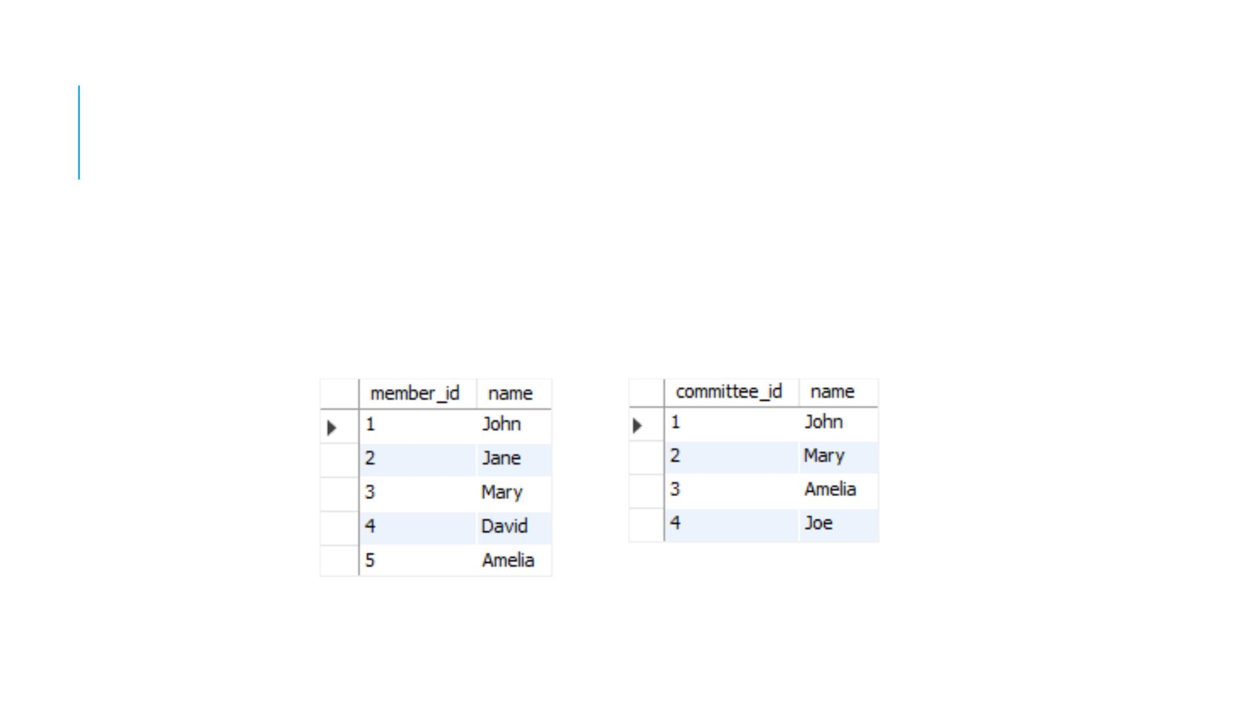
INTRODUCING THE DATA
members
committees

Slide 5
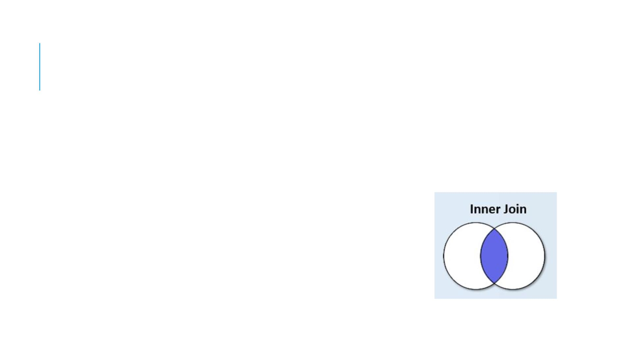
INNER JOIN
The inner join clause joins two tables based on a condition
whic h is known as a join predicate.
SELECT column_list
FROM table_1
INNER JOIN table_2 ON join_condition;

Slide 6
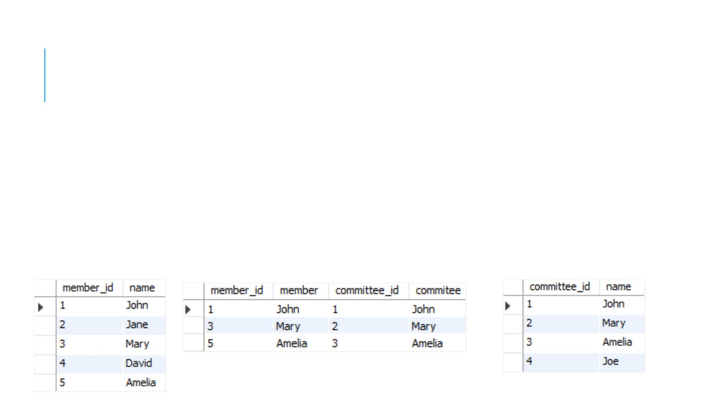
INNER JOIN
The inner join clause compares eac h row from the first table with
every row from the second table. If values in both rows cause the
join condition evaluates to tr ue, the inner join clause creates a new
row whose column contains all columns of the two rows from both
tables and include this new row in the final result set. In other
words, the inner join clause includes only rows whose values match.

Slide 7
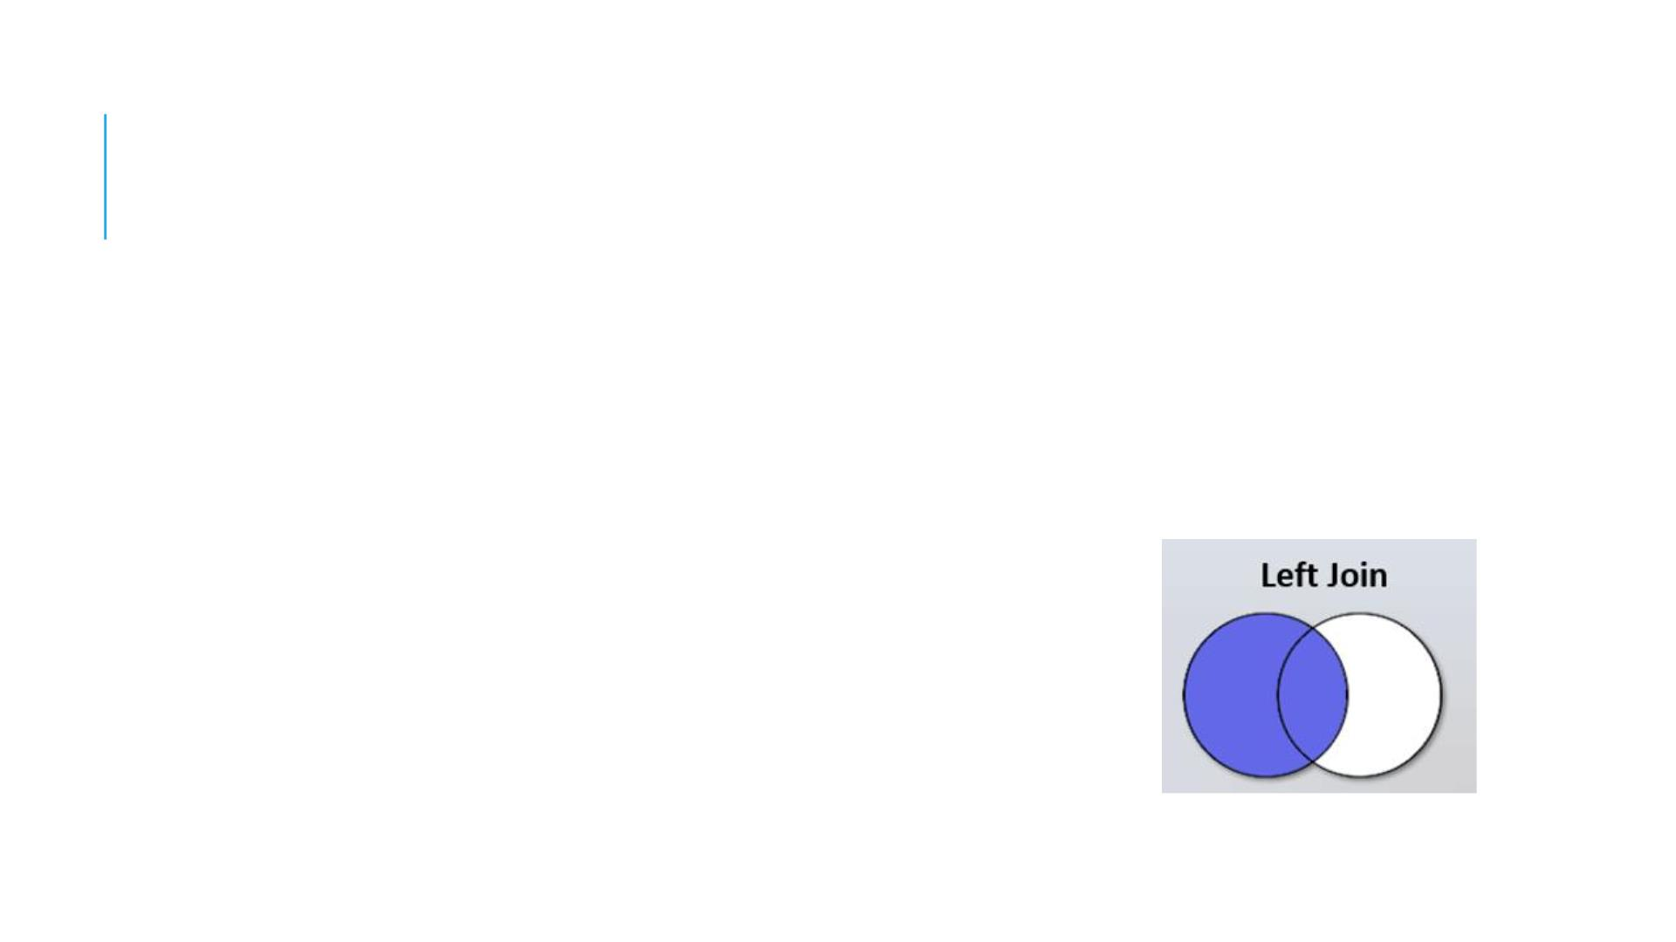
LEFT JOIN
The left join selects data starting from the left table. For
eac h row in the left table, the left join compares with every
row in the right table.
SELECT column_list
FROM table_1
LEFT JOIN table_2 ON join_condition;

Slide 8
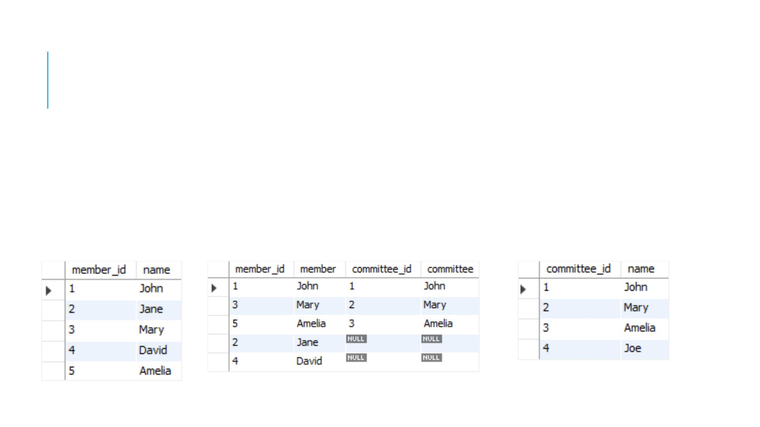
LEFT JOIN
If the values in the two rows are not matched, the left join
clause still creates a new row whose columns contain
columns of the row in the left table and NULL for columns
of the row in the right table.

Slide 9
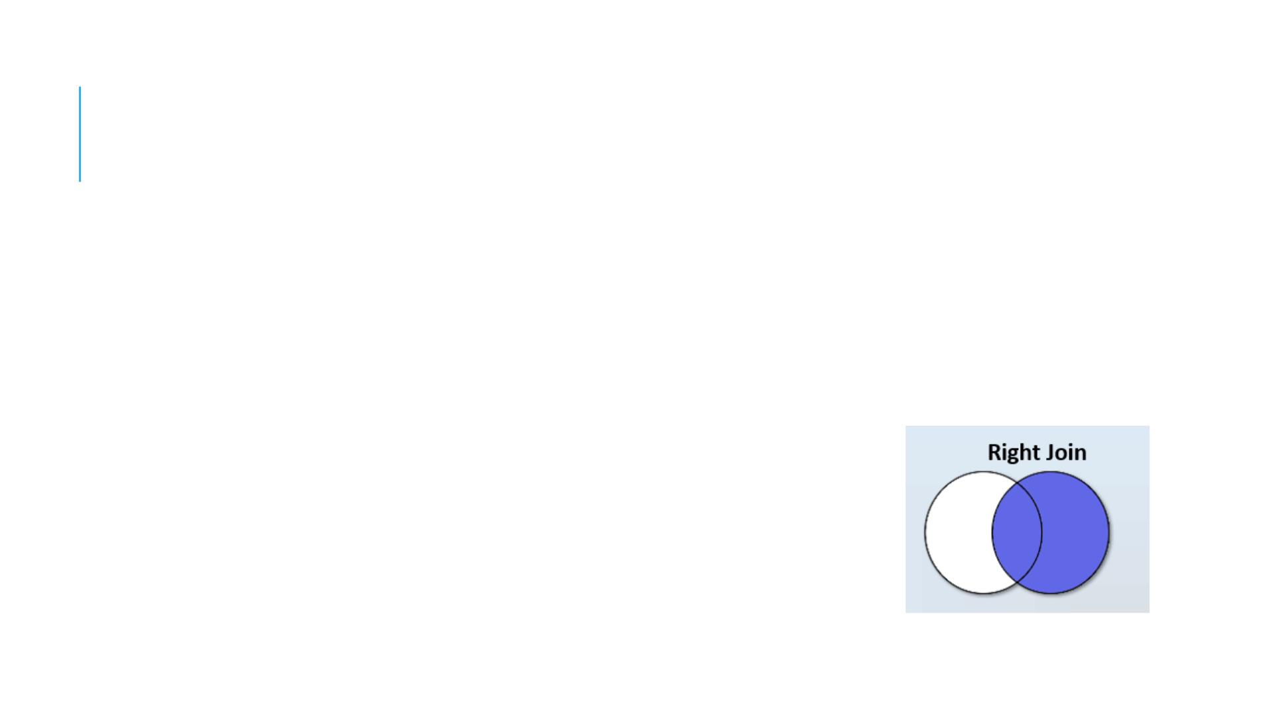
RIGHT JOIN
The right join clause is similar to the left join clause except
that the treatment of tables is reversed. The right join
starts selecting data from the right table instead of the left
table.
SELECT column_list
FROM table_1
RIGHT JOIN table_2 ON join_condition;

Slide 10
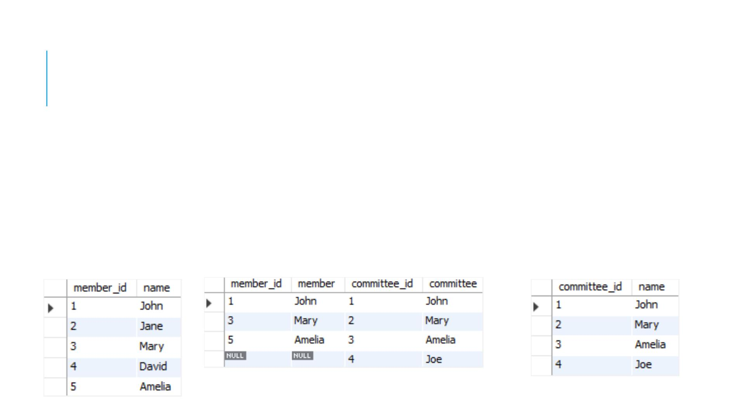
RIGHT JOIN
The right join clause selects all rows from the right table
and matches rows in the left table. If a row from the right
table does not have matching rows from the left table, the
column of the left table will have NULL in the final result
set.

Slide 11
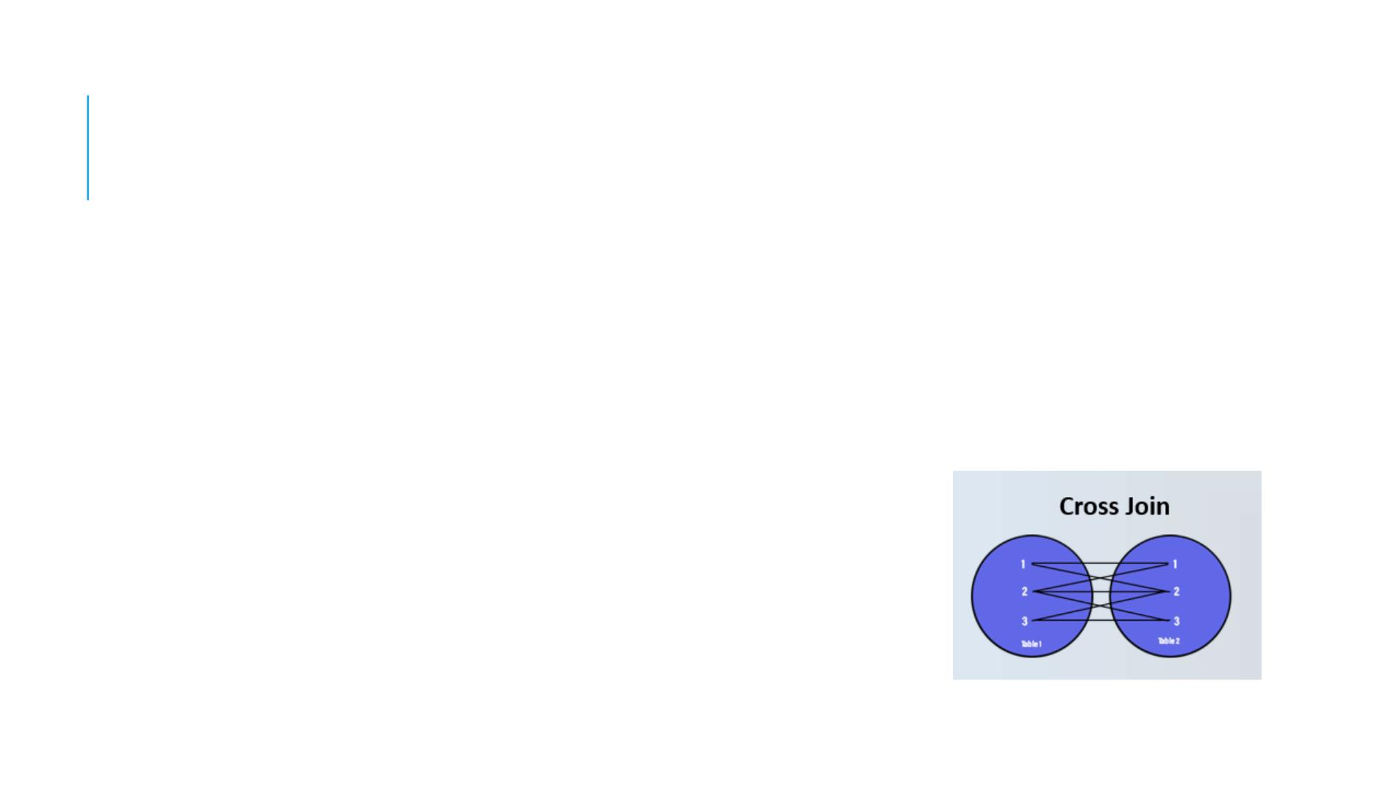
CROSS JOIN
Unlike the inner join, left join, and right join, the cross join
clause does not have a join condition. The cross join
combines eac h row from the first table with every row from
the right table to make the result set.
SELECT column_list
FROM table_1
CROSS JOIN table_2;

Slide 12
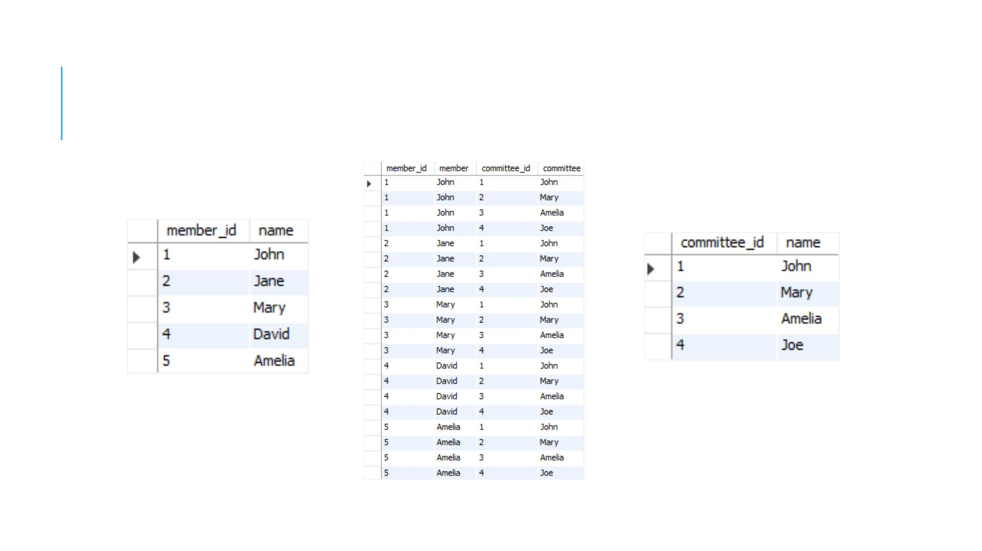
CROSS JOIN

Slide 13
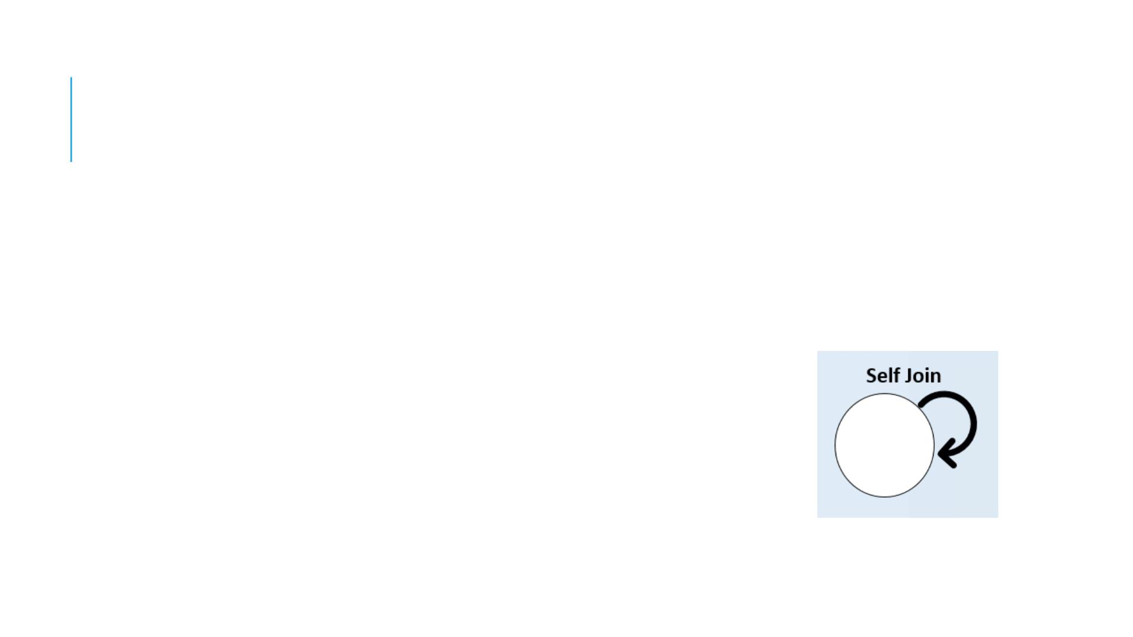
SELF JOIN
The self join is often used to query hierarchical data or to
compare a row with other rows within the same table.
SELECT column_list
FROM table
JOIN table ON join_condition;

Slide 14
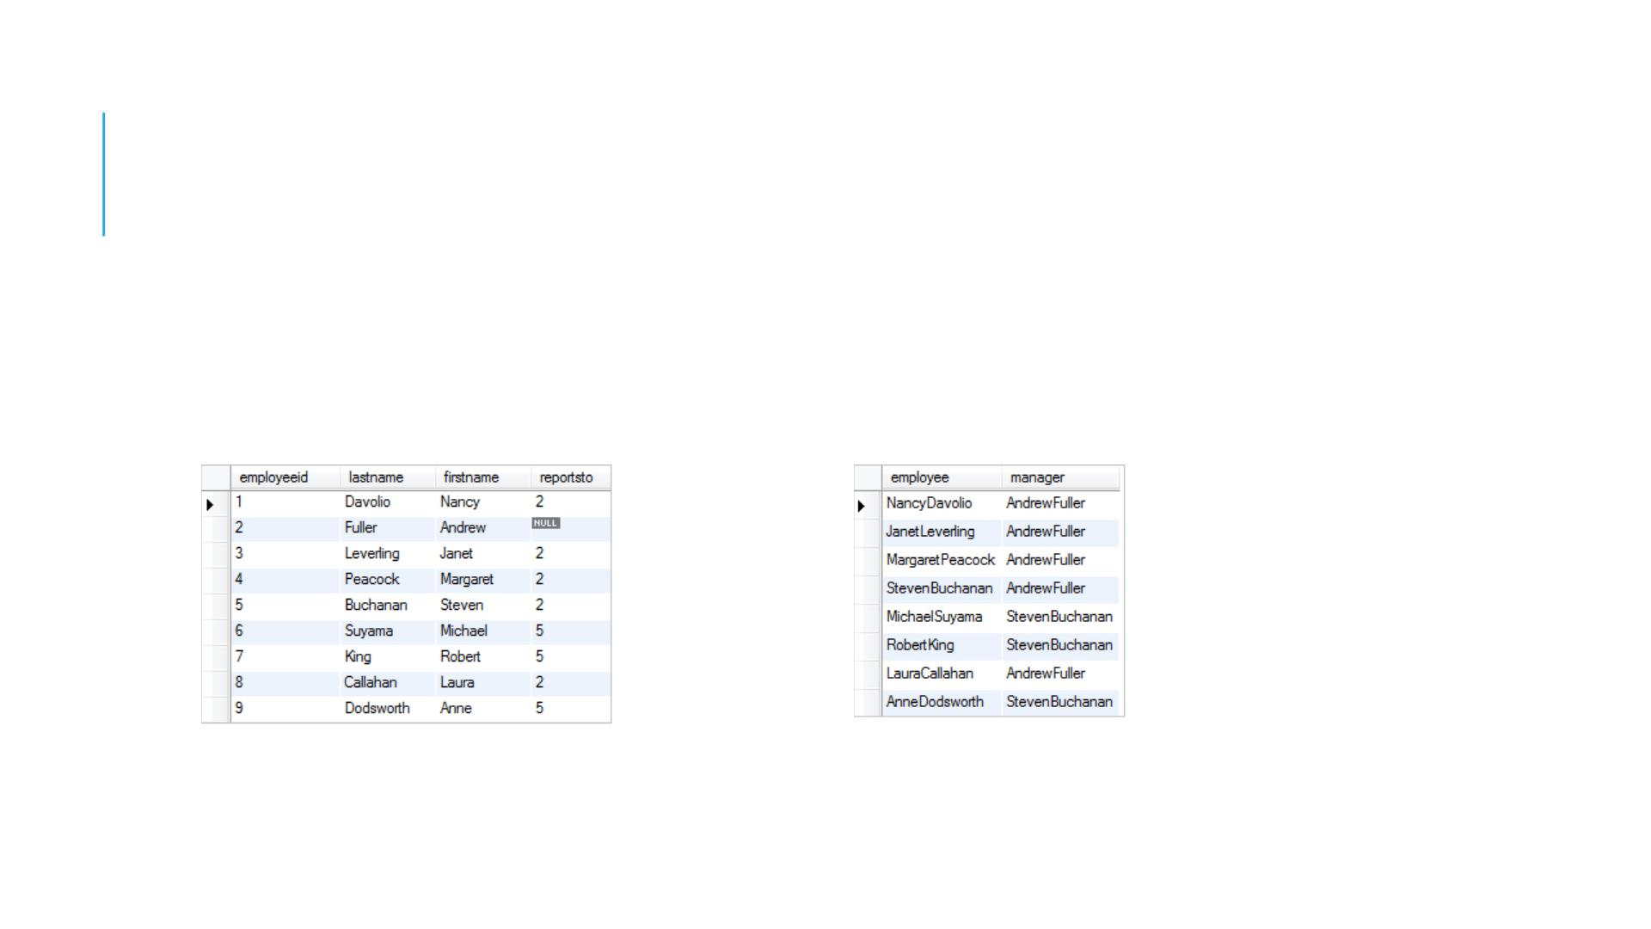
SELF JOIN
SQL self join with inner join example

Slide 15
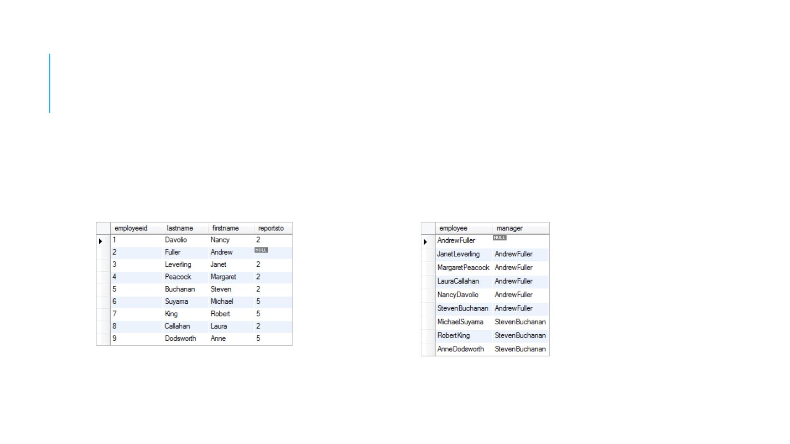
SELF JOIN
SQL self join with left join example

Slide 16
"ON" AND "USING" CLAUSES
In above JOIN query examples, we have used ON clause to match the records
between table.
USING clause can also be used for the same purpose. The difference with USING is
it needs to have identical names for matched columns in both tables.
SELECT column_list
FROM table_1
JOIN table_2 USING (column_name);

Slide 17
RENAMING TABLES USING ALIASES
You can rename the table you are using in select statement, using AS key word or just
providing a alias
SELECT column_list
FROM table_1 as t1
JOIN table_2 t2
ON t1.column = t2.column;

Slide 18
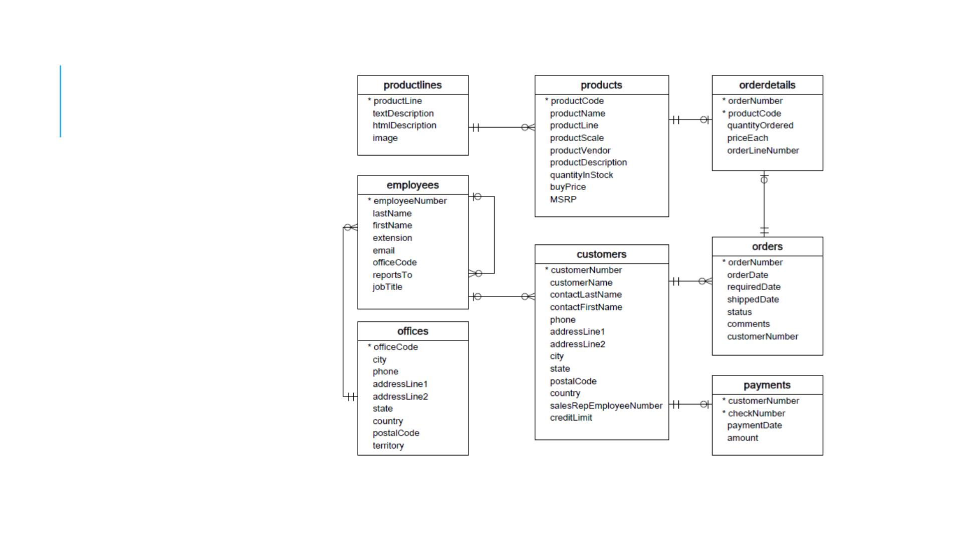
PRACTICE

