Slide 1

Orchestrating Quantum Assured InfoSec Platform

Slide 2


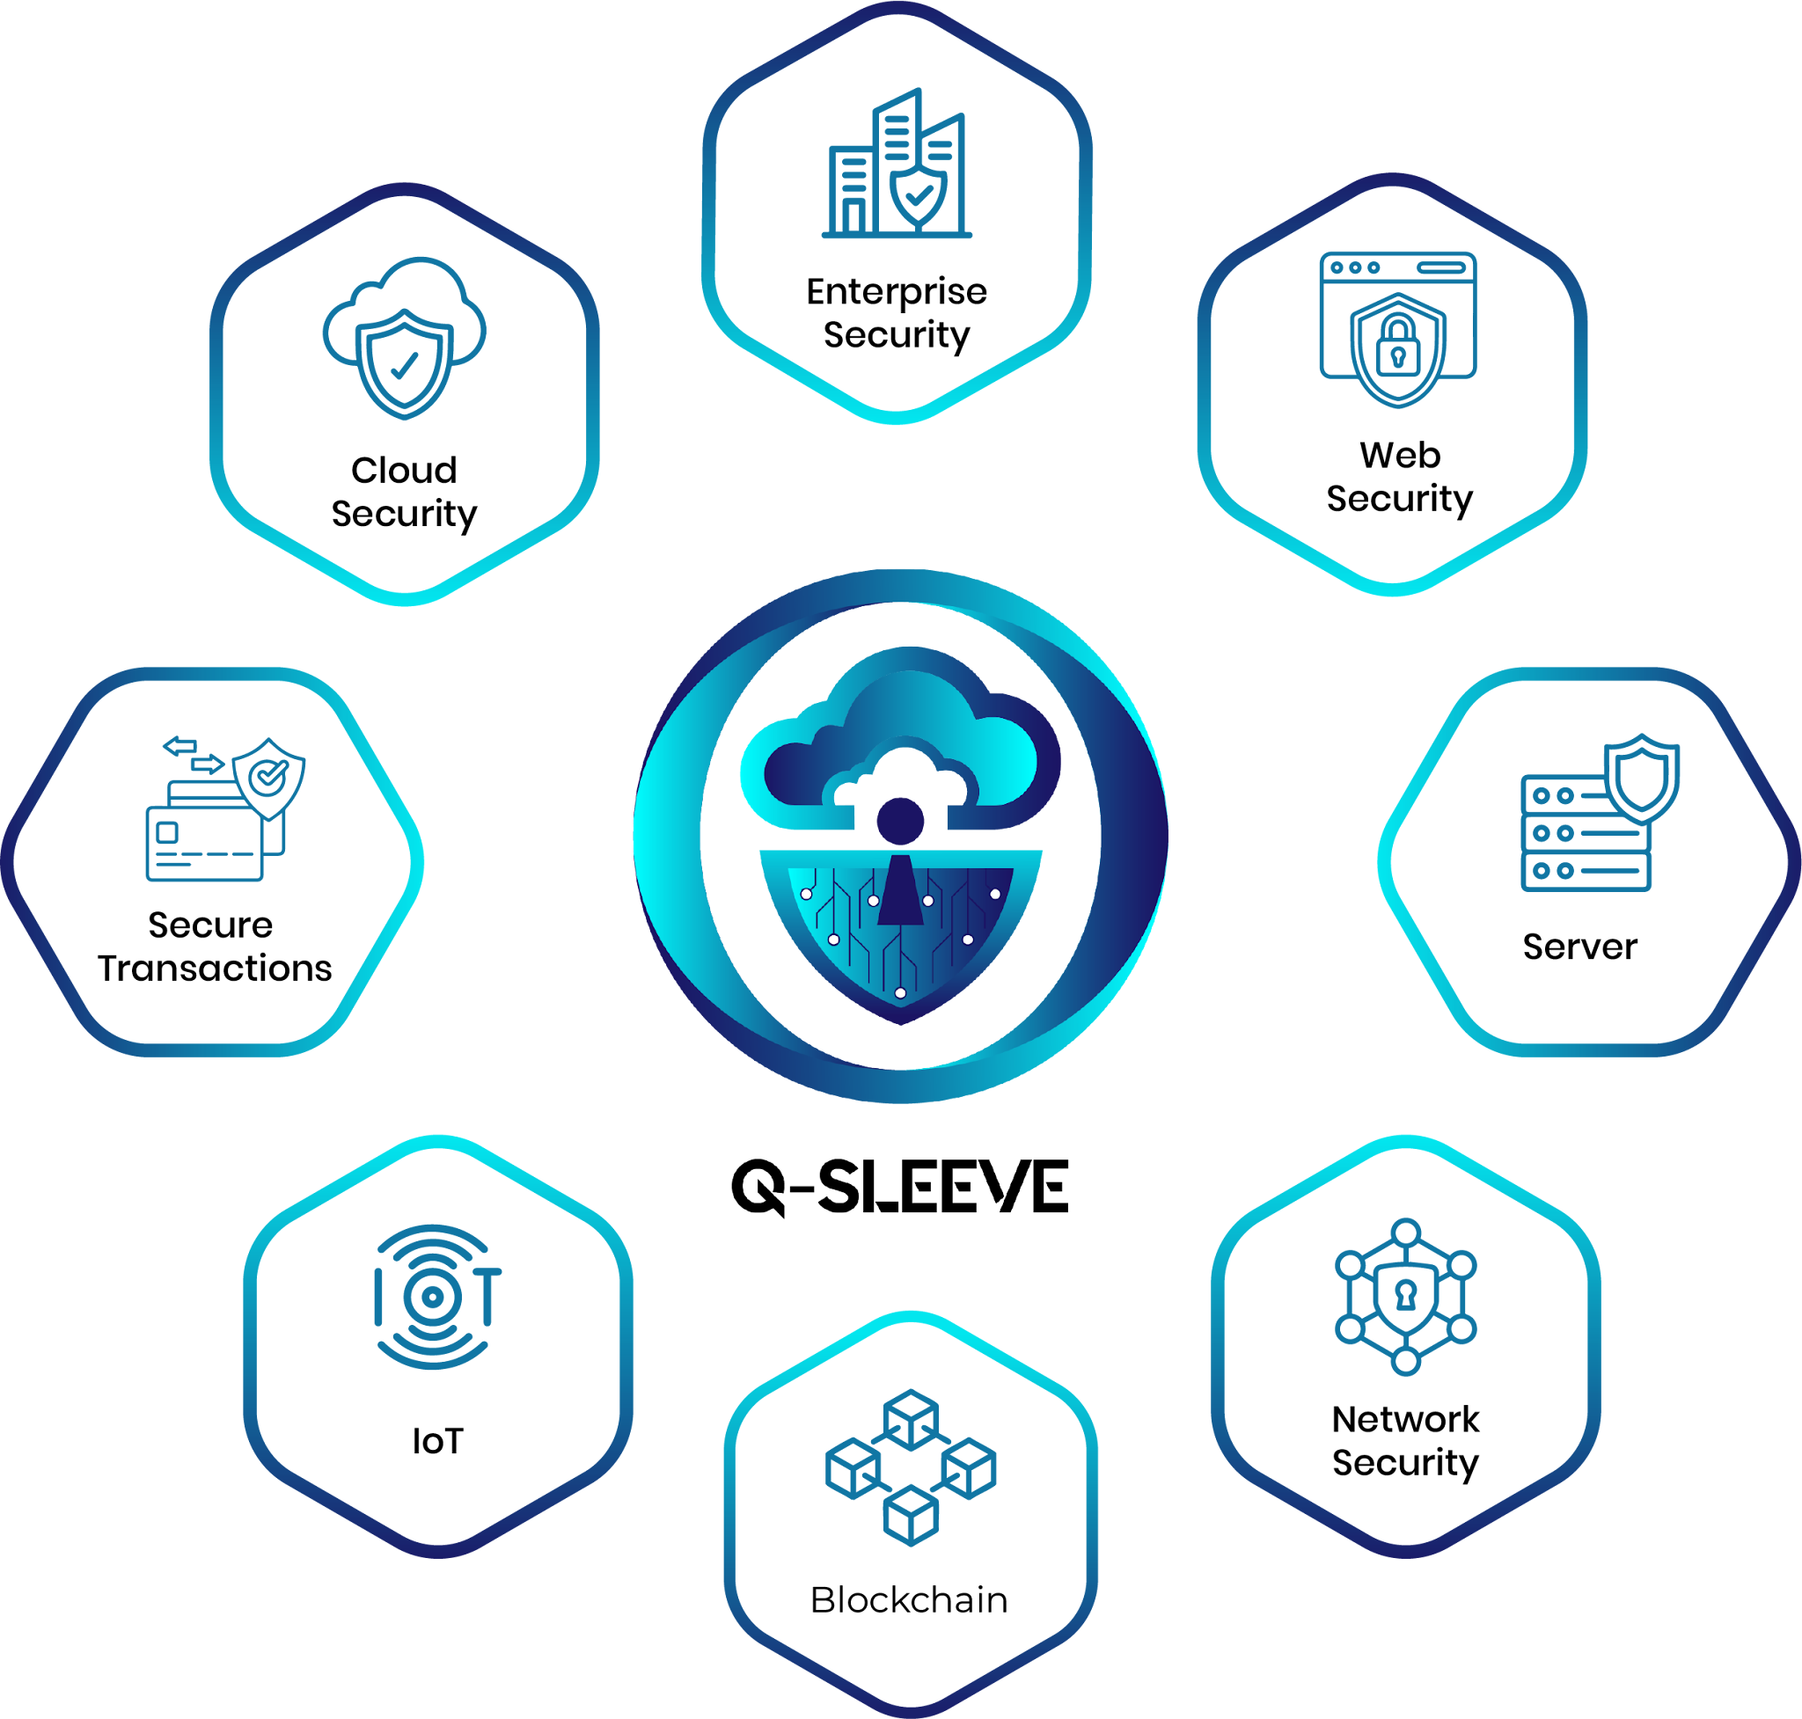





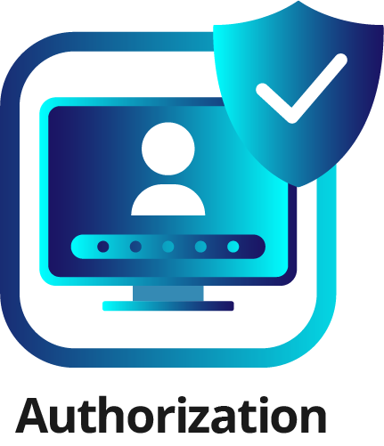

Q-Forte: Roadmap under Implementation
PHASE – 1
PHASE – 2
PHASE – 3

Slide 3
Q-Forte : Phase-I
KEY FEATURES
1
With ChecQ-AI, organizations can identify and address cryptographic weaknesses in their websites, software, and networks, preparing them for the age of quantum computing.
2
Q-Sleeve is a comprehensive security platform providing quantum-safe protection for all IT infrastructure, including enterprise, servers, networks, cloud, web, IoT, and transactions.
3
Software-based Quantum Random Number Generator (QuRNG) service providing verifiable, certified true randomness from quantum computers.
Quantum Security Assurance Product Suite designed to elevate the Information Security posture of enterprises to cutting-edge Post Quantum Cryptography confidence level.
4
With focus on robust quantum level security assurance with crypto-agility, this product suite consists of a Quantum Vulnerability Assessment Tool (ChecQ-AI), a Quantum Safe VPN solution (Q-Sleeve) and cloud-based scalable Quantum Random Number Generators (QuRNG) ensuring full spectrum enhancement of the organisation’s security infrastructure to PQC standards.
This suite’s complete SOC capabilities effectively protect IT infrastructure from current and future quantum threats.

Slide 4
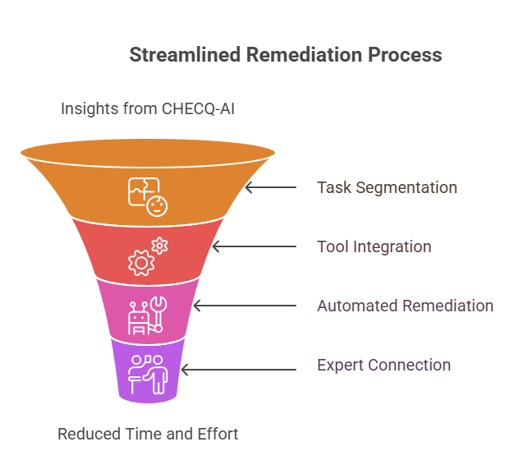




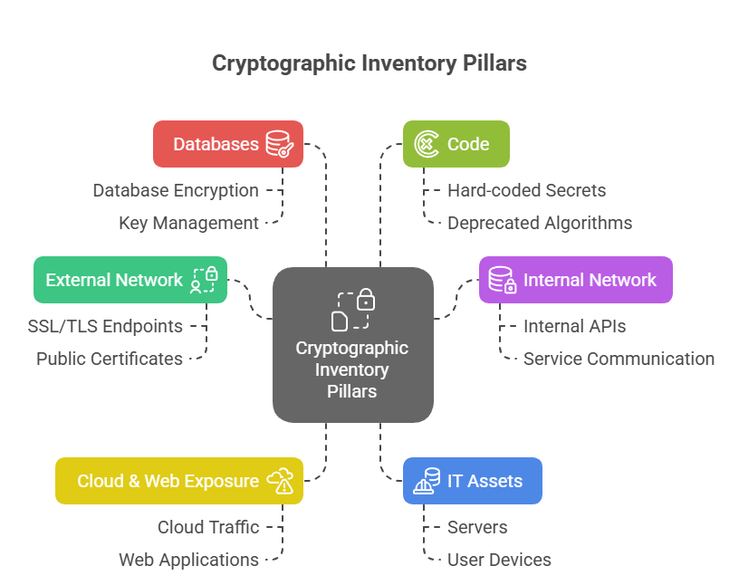
AI FEATURES
Quantum Vulnerability
Identification
Post Quantum
Remediation
Analysis and Cryptography Auditing
Risk Assessment and
Network Monitoring
Cutting-edge Crypto Vulnerability Scanning Tool enabling building of CBOM & PQC Migration Roadmap, followed by Post-Migration PQC compliance monitoring of global IT infrastructure of organisations striving for Quantum Resilience.
Offers specialized capabilities in detecting and addressing cryptographic quantum vulnerabilities in websites, network, code base and software packages to assess associated risk. By utilizing ChecQ-AI, institutions can proactively safeguard their cryptographic systems and protect critical infrastructure from potential quantum computer cyberattacks.​

Slide 5
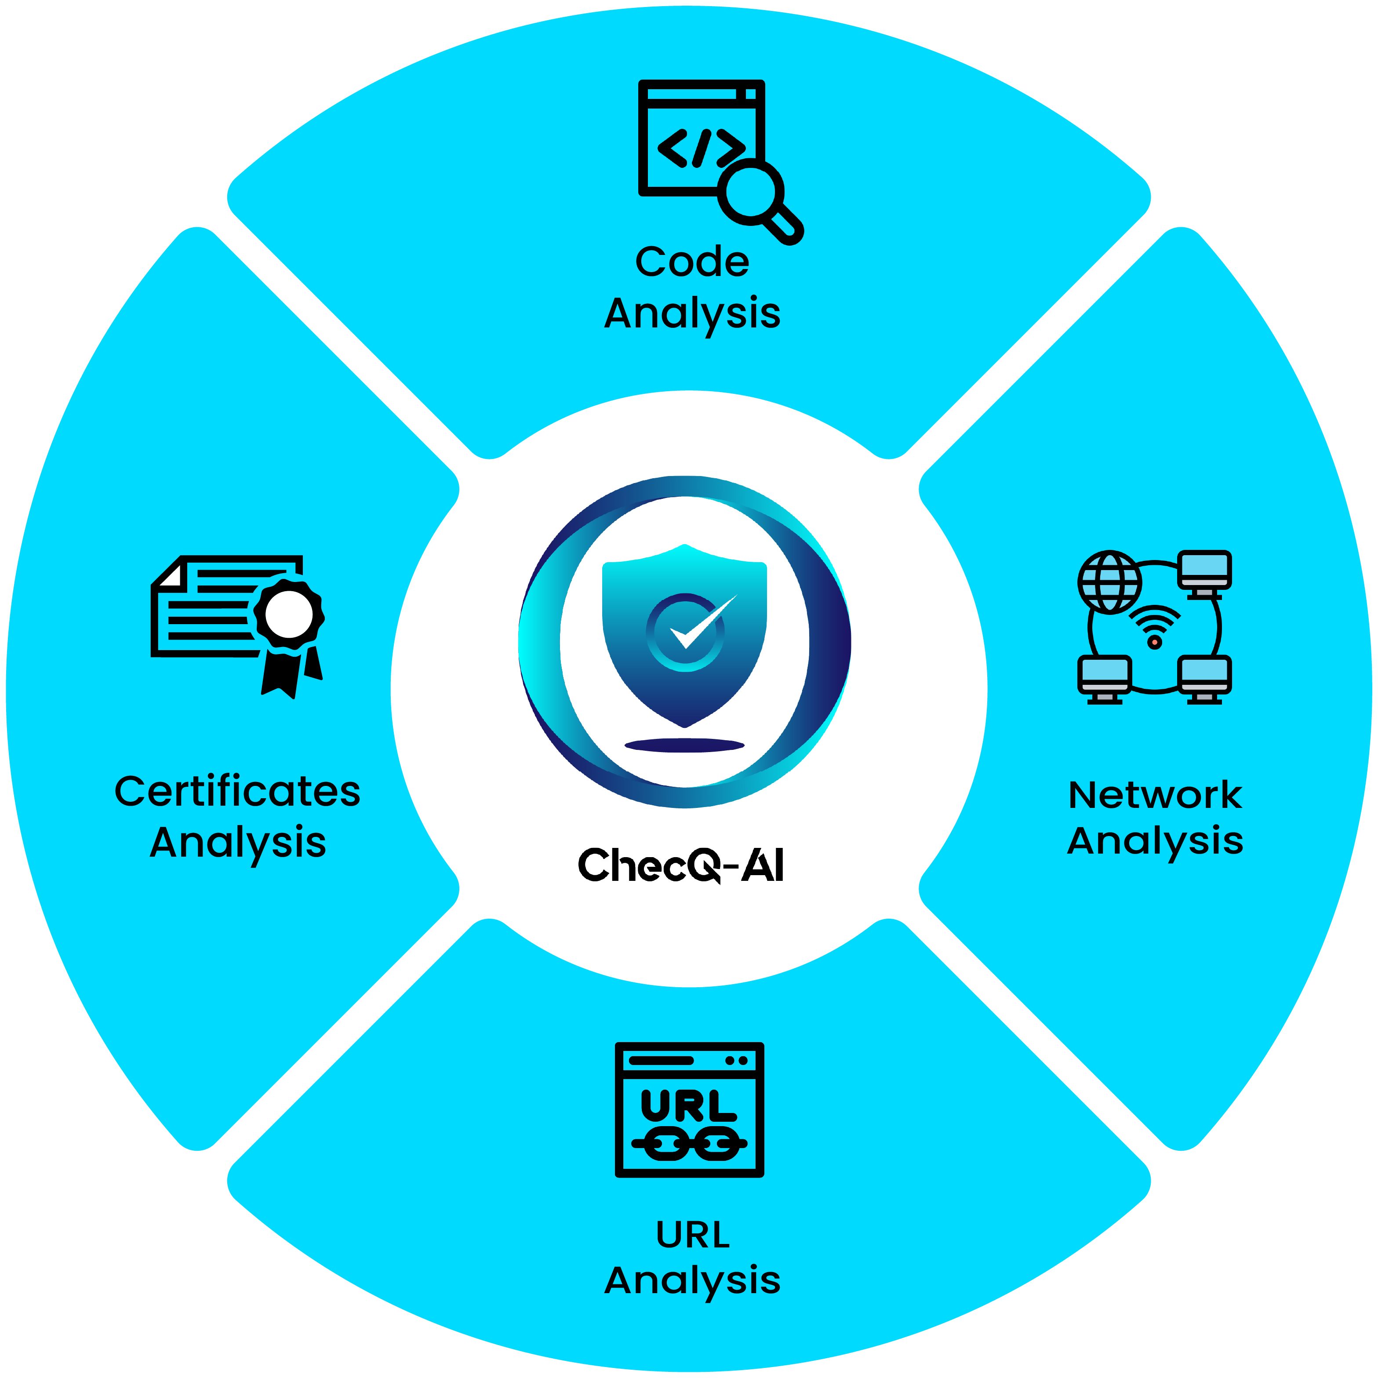
ChecQ-AI: Vulnerability assessment components
Code Analysis: Identify insecure or quantum-vulnerable algorithms in source code and assess their security posture in both classical (pre-quantum) and post-quantum contexts.
Network Analysis: Assess communication protocols for PQC readiness, detect weak handshakes and vulnerable algorithms across classical and post-quantum contexts, and continuously monitor real-time environments for evolving cryptographic risks and alerts.
Certificate Analysis: Review certificates from individual uploads, bulk folders, or system stores to detect weak cryptography and assess vulnerabilities and PQC readiness across classical and post-quantum contexts.
URL Analysis: Identify vulnerabilities in cryptographic implementations, detect outdated protocols and insecure cipher suites and evaluate endpoint readiness for Post-Quantum Cryptography (PQ) key exchanges.

Slide 6
KPI: Quantum Assurance
S.No | KPI / Metric | Definition
1 | Weak Algorithm Detection Factor | % of algorithms in inventory flagged as deprecated or insecure (e.g., MD5, SHA-1, RSA-1024).
2 | Key Lifecycle Compliance Rate | % of keys with properly defined lifecycle states (per NIST SP 800-57).
3 | Protocol Security Compliance | % of protocols in use that meet current best-practice configurations (e.g., TLS 1.3 preferred).
4 | Quantum-Vulnerable Asset Ratio | % of cryptographic assets using quantum-vulnerable algorithms (e.g., RSA, ECC).
5 | Hybrid Algorithm Adoption Rate | % of assets using hybrid classical + PQC key exchanges.
6 | Regulatory Compliance Coverage | % of assets compliant with target regulations (e.g., FIPS 140-3, PCI-DSS, GDPR).
7 | CNSA 2.0 Alignment Score | Weighted score for compliance with CNSA 2.0 timelines.
8 | Overall Crypto Health Score | Weighted composite score of asset security, lifecycle hygiene, compliance, and agility.
9 | Quantum Readiness Index (QRI) | Weighted score of PQC readiness, quantum-vulnerable asset ratio, and migration plan status.
10 | CBOM Completeness Score | % of CBOM-required metadata fields populated across all assets.

Slide 7

Demonstration

Slide 8
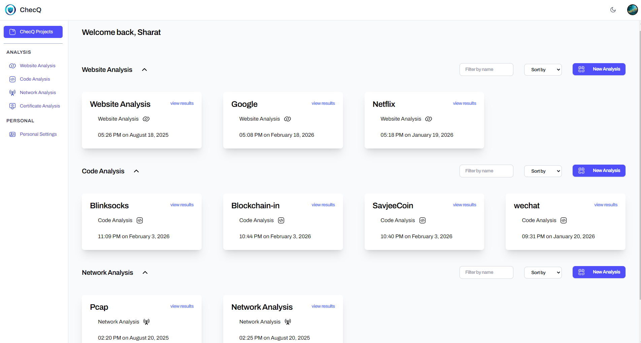
Dashboard
Centralized dashboard for clear visibility and control over cryptographic data.
Access to historical scans to track trends and monitor changes over time.
Comprehensive audit trail for enhanced transparency and compliance.

Slide 9
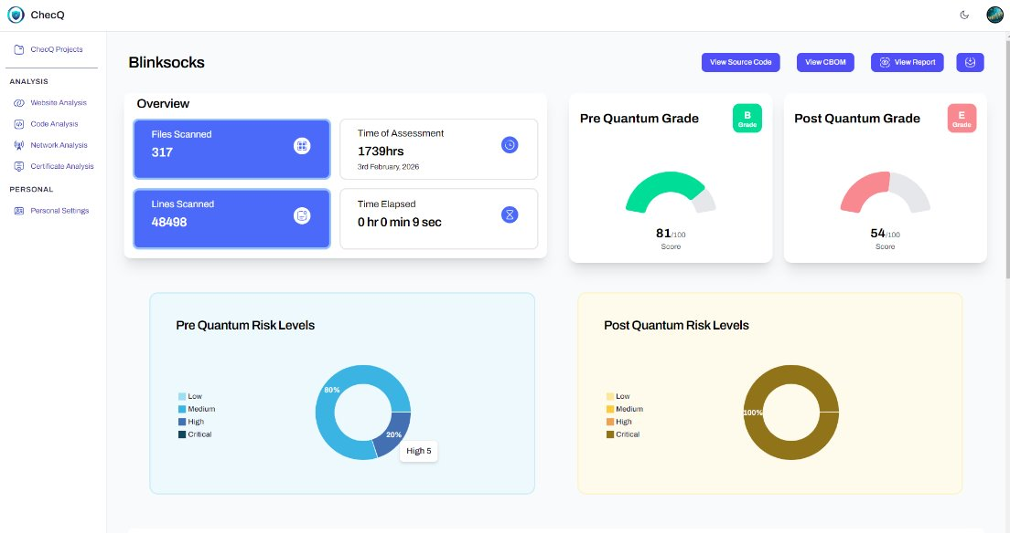
Code Analysis
Deep source scanning to identify cryptographic algorithms and libraries in use.
Detect insecure or quantum-vulnerable implementations within codebases.
Flags insecure or quantum-vulnerable components within the CBOM.

Slide 10
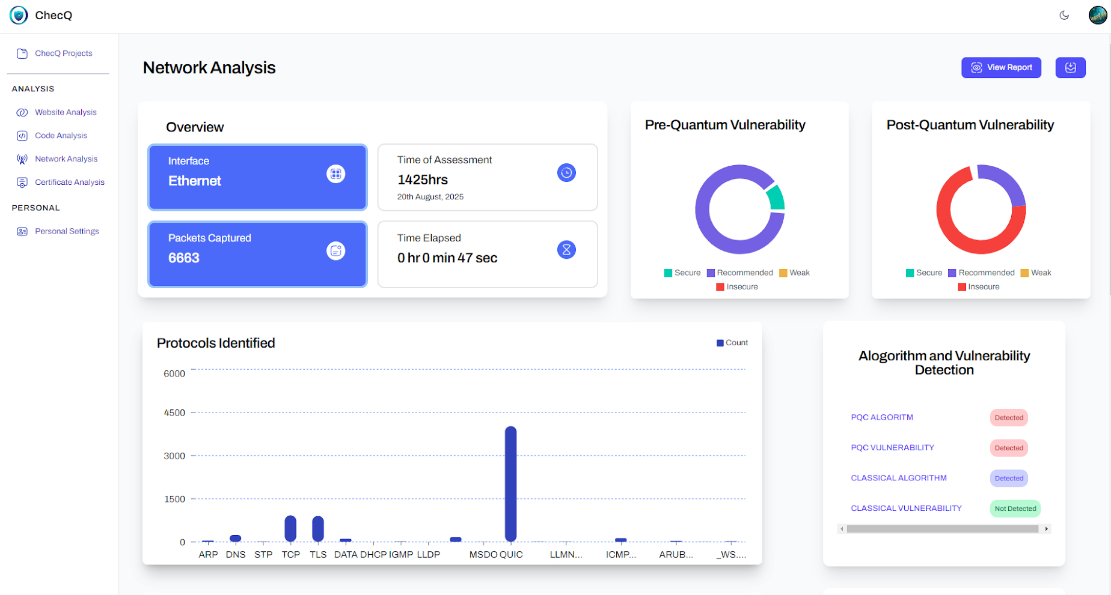
Network Analysis
Discovers active protocols and cipher suites across network communications.
Detects weak configurations and vulnerable cryptographic practices in transit.
Enables continuous monitoring for evolving risks and quantum-readiness.

Slide 11
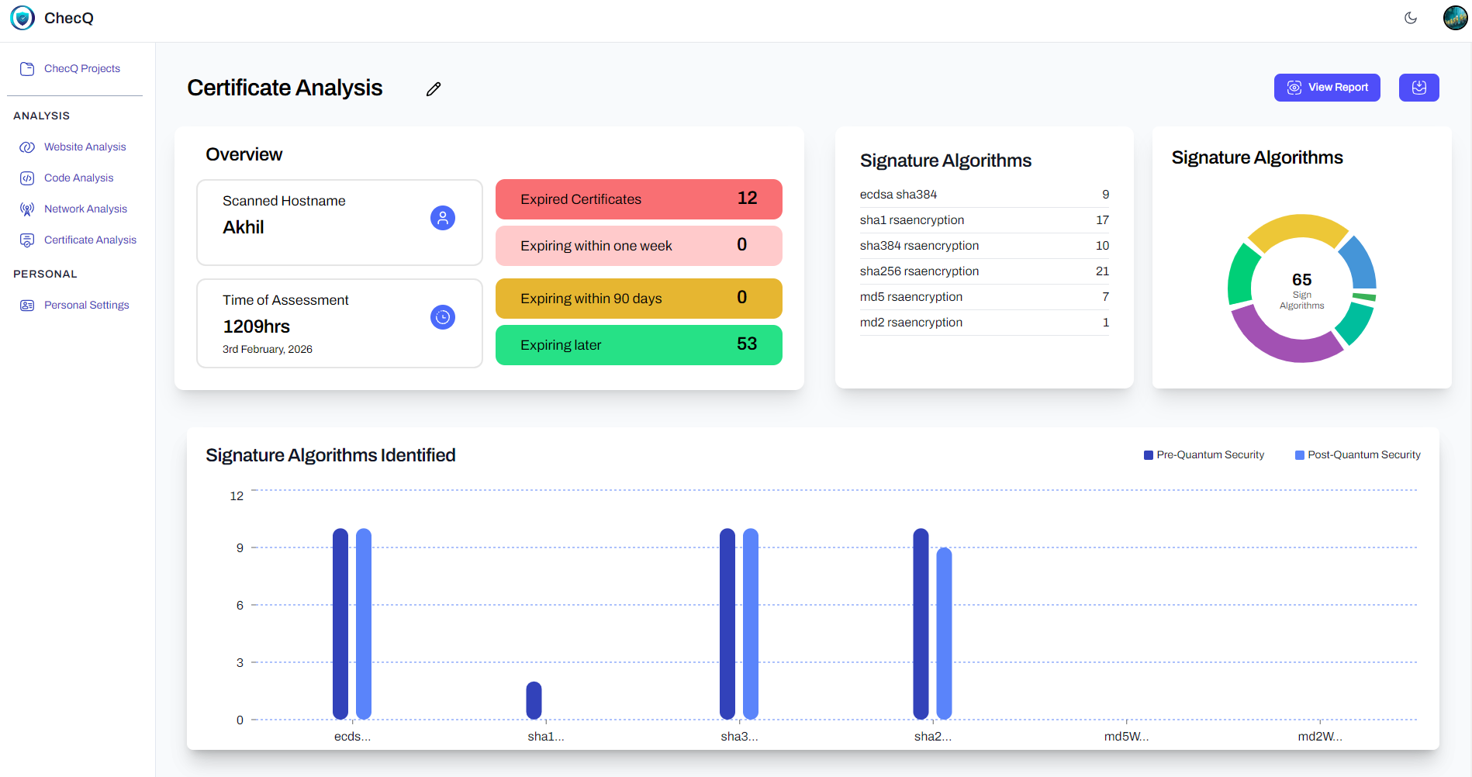
Certificate Analysis
Comprehensive discovery of all X.509 certificates across systems and environments.
Identification of risks including expired, misconfigured, and quantum-vulnerable certificates.
Enhanced visibility and control to support secure management and PQC readiness.

Slide 12
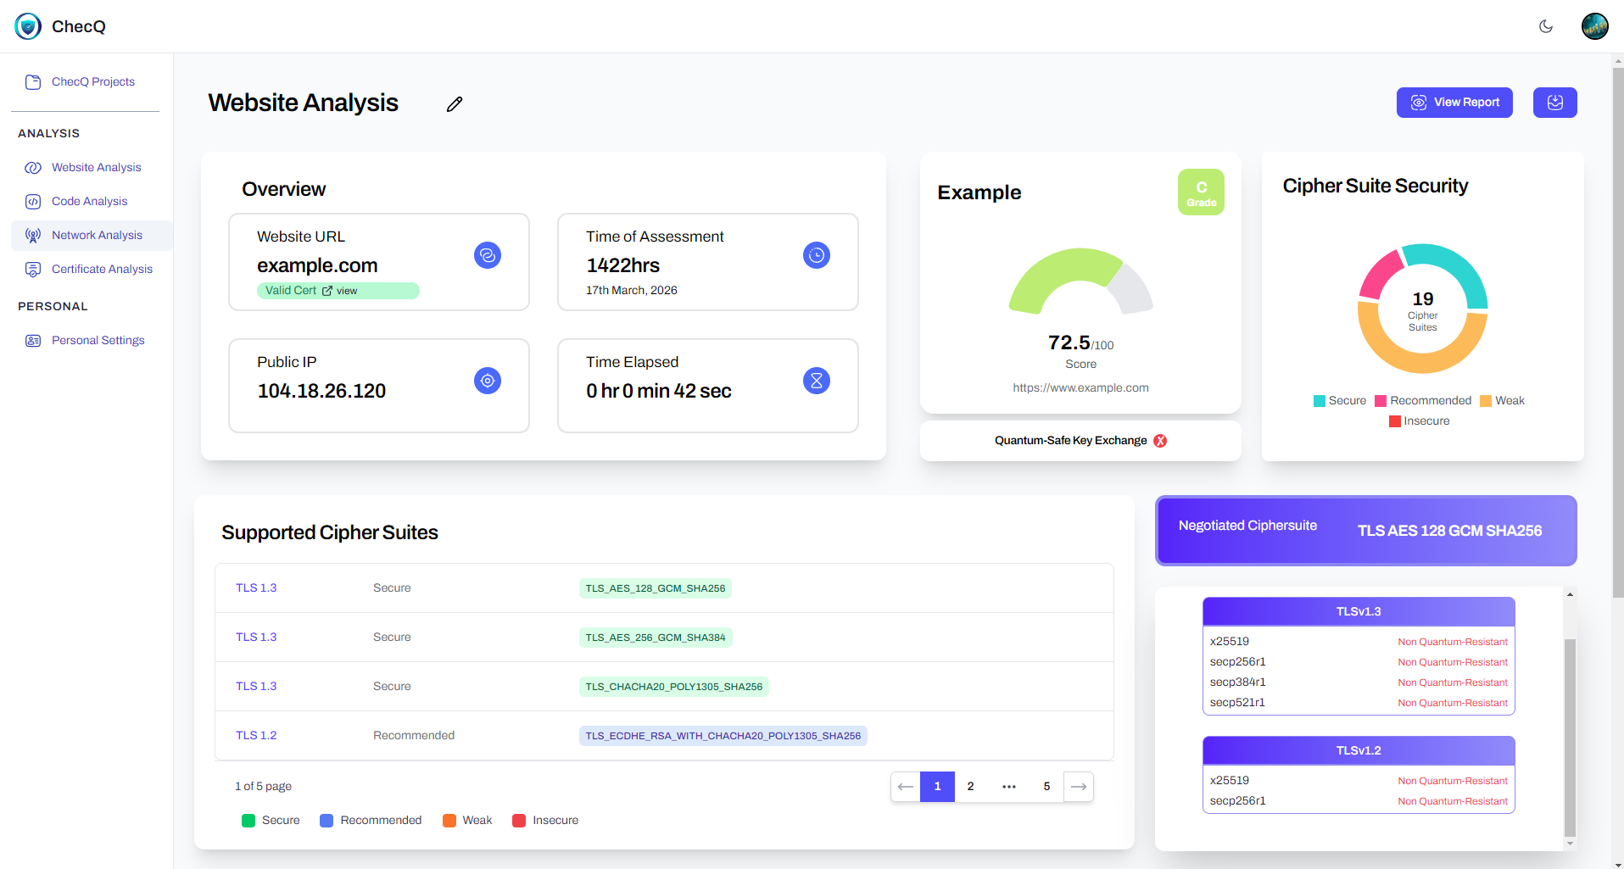
URL Analysis
Ensures quantum-readiness of public-facing web assets and dependencies.
Scans websites and external services for cryptographic security posture.
Maintains trust in digital connections through proactive risk identification.

Slide 13
Future-Proof Encryption
NIST Compliant
Guarding data against emerging quantum computing capabilities.
Q-Sleeve supports the most recent NIST-standardized post-quantum cryptography (PQC) algorithms.
Versatile Integration
Adaptive Security
Seamlessly integrating
into existing systems
and protocols.
Q-Sleeve Technology Stack is scalable across all IT infrastructure scenarios, including enterprise, server, network, cloud, web, IoT security, and secure transactions.
Cryptography Rigor
Built upon solid cryptography and mathematical foundations for long-term security.​
Powered by QRNG
Q-Sleeve, based on Quantum-safe VPN technology, is designed to deliver seamless PQC migration for global organisation’s cloud assets, on-premises IT infrastructure, and networks to NIST PQC standards with Crypto Agility ensuring future proof Quantum Safe digital environment.

Slide 14
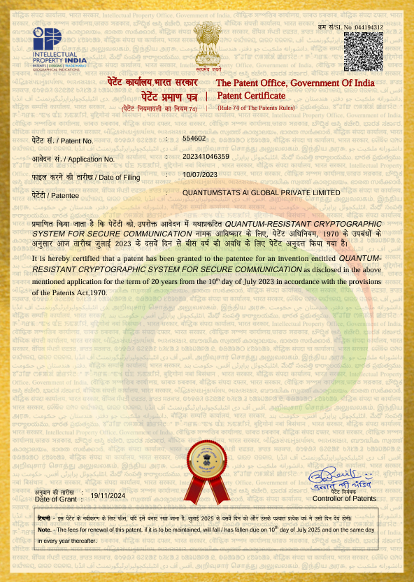
Intellectual Property and R&D Commitment
IP and Research Powering Q-Forte’s Tech Stack
Quantum-Resistant Cryptographic System for Secure Communication (Patent Granted)
Quantum Random Number Generation QRNG with Digital Quantum Simulation (Filed)
VPN Client, VPN Server, Private CA, PQC based Digital Certificates
Application Layer
Quantum-Safe Key Exchange
Application Layer
VPN protocol
Transport Layer
VPN Tunnel
(Tun interface)
Network Layer
VPN Tunnel
(Tap interface)
Data Link Layer
Existing infrastructure of the
Orgnisation
Existing Infrastructure

Slide 15
Network
Routing Protocols
Online Gaming
and Lotteries
KEY FEATURES
Risk Management
and Option Pricing
Secure Data Storage
and Digital Assets
1
Transparent Design
2
Symmetric Key Generation Derived from Quantum Randomness
Modeling of
Financial Systems
Identity and Access
Management
3
Flexible and Integratable
4
Test Suites Qualified
Heuristic Algorithm based
Simulations/ Monte
Carlo Simulations
Secure Token and
OTP Generation for
Digital Payments
5
Quantum Hardware Agnostic
A Hardware Agnostic True Random Number Generator
6
Accessible with any Smart Device
QuRNG is a state-of-the-art, highly scalable cloud-based Quantum Random Number Generation (QRNG) Service with integrated verification for the user. The application emulates the quantum phenomena on flagship Quantum Computers to generate true maximal randomness or entropy, that can be verified and certified as genuinely quantum. For the first time, the solution offers practically scalable and truly random symmetric key generation, a milestone unattainable with classical computers.
7
Adaptable to Applications
8
Truly Scalable Architecture

Slide 16
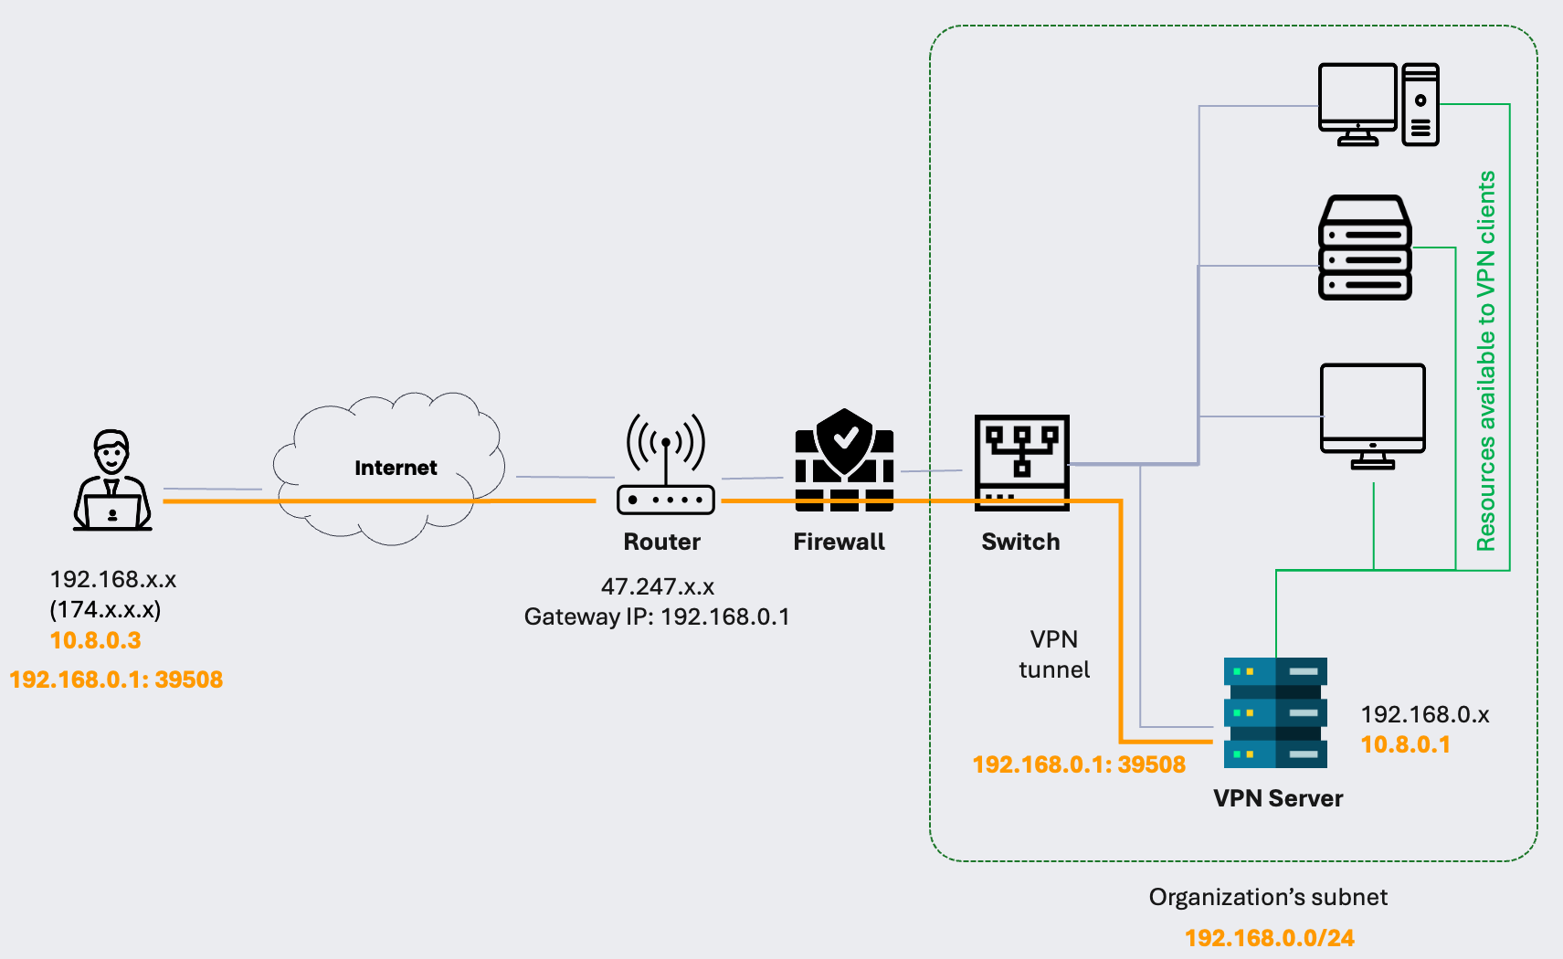
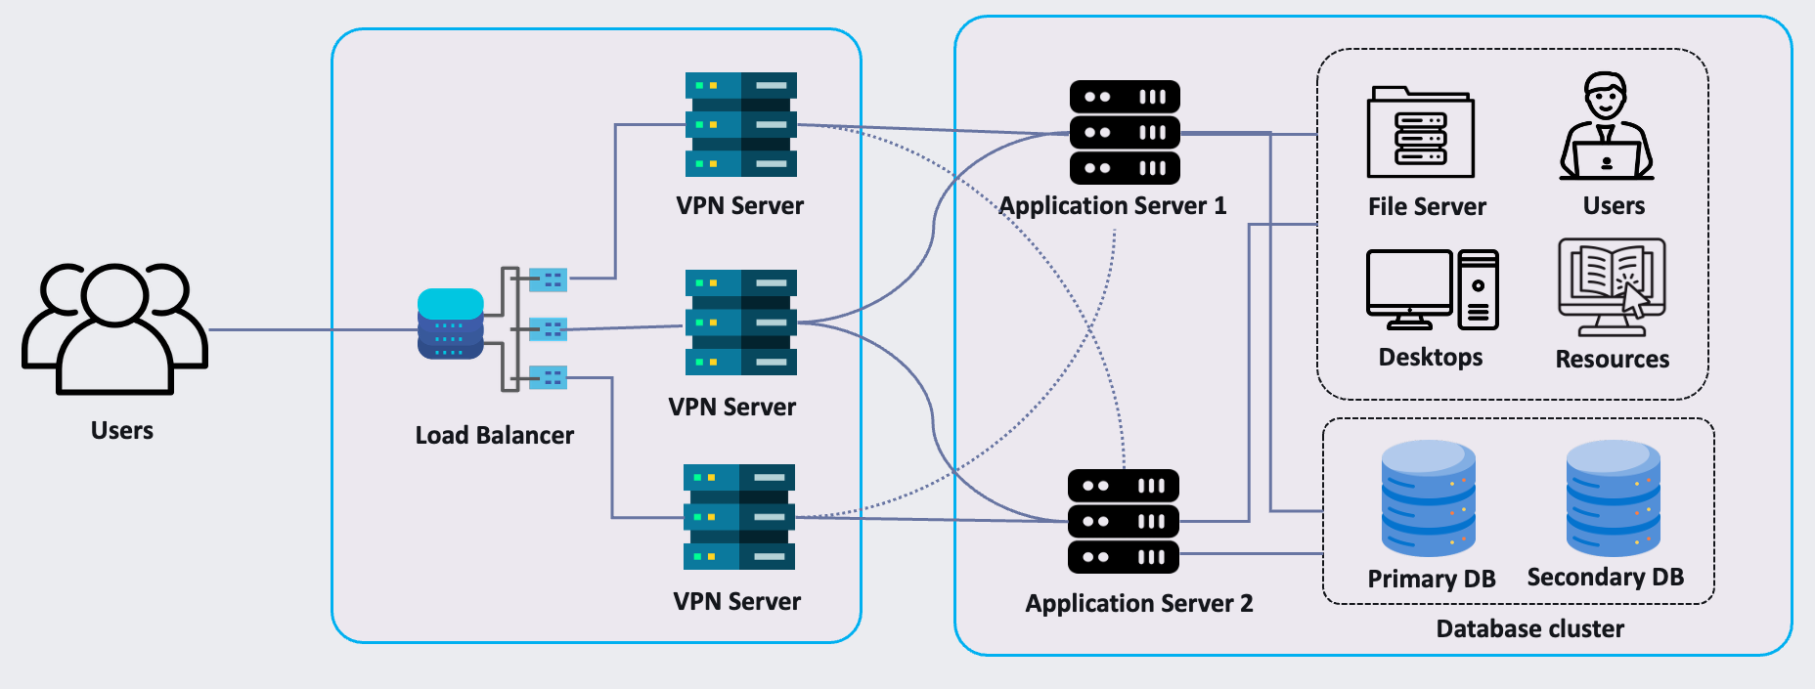
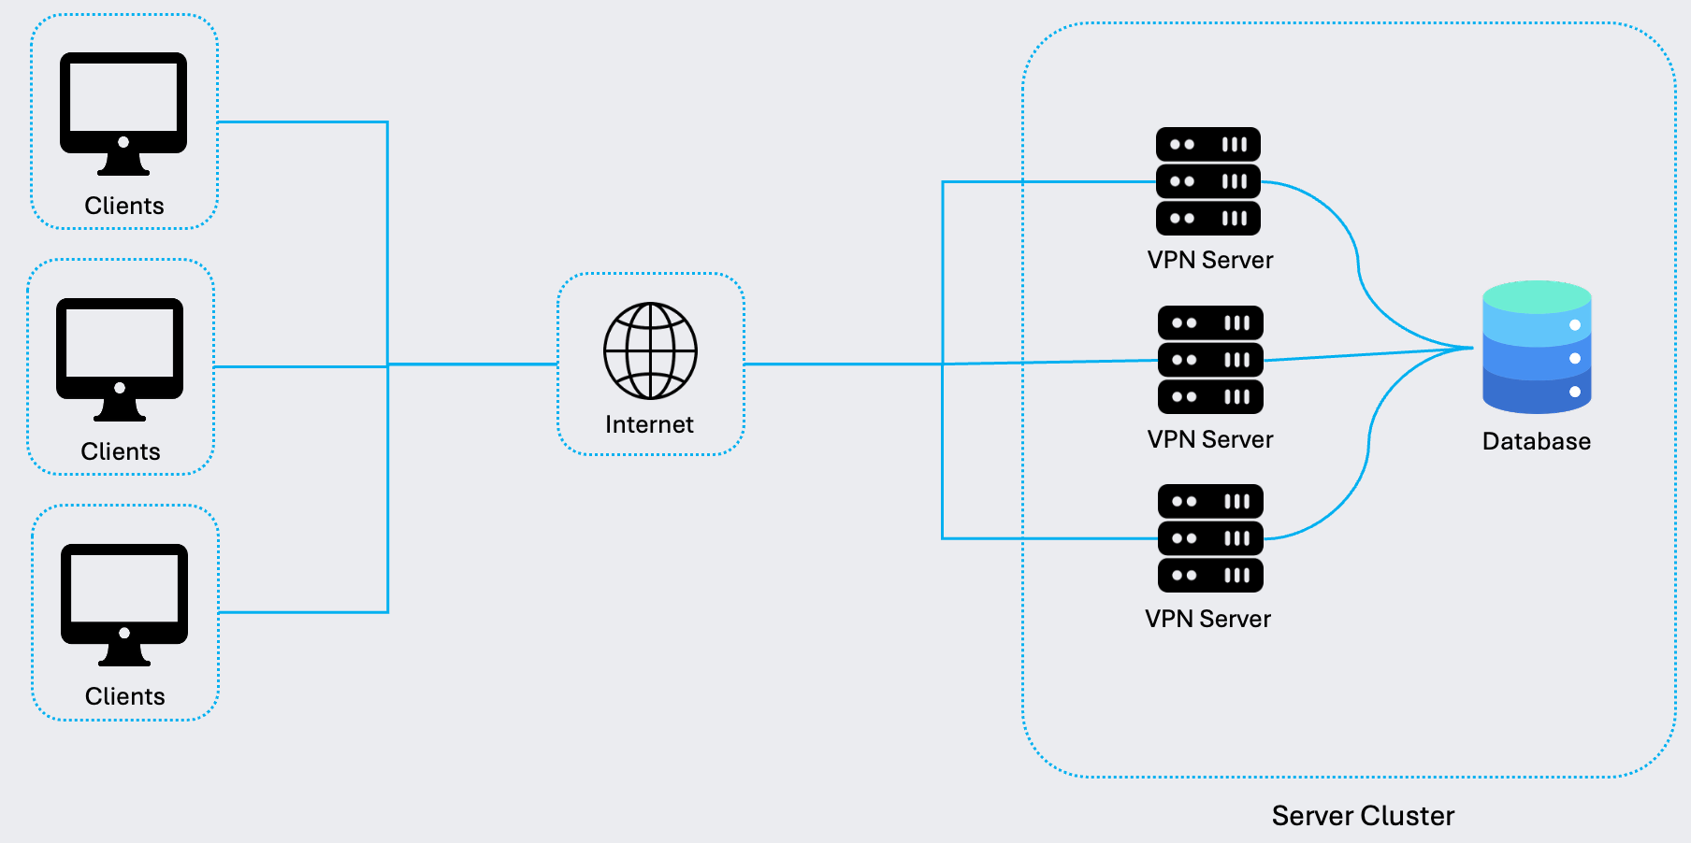
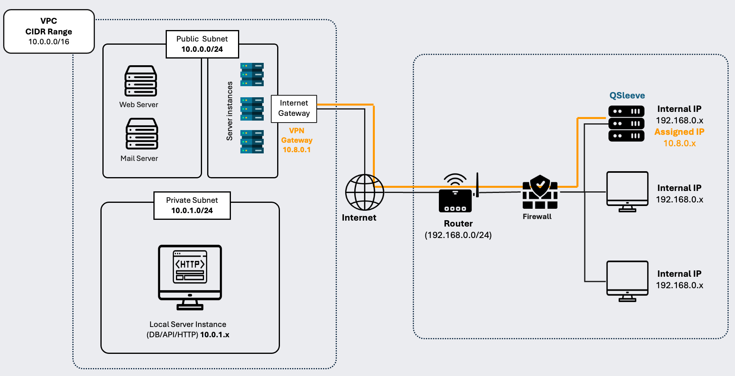
Q-Forte: Deployment at Scale
Remote Networking
High Availability
Load Balancing
Hybrid Architecture – Cloud + On-premise

Slide 17
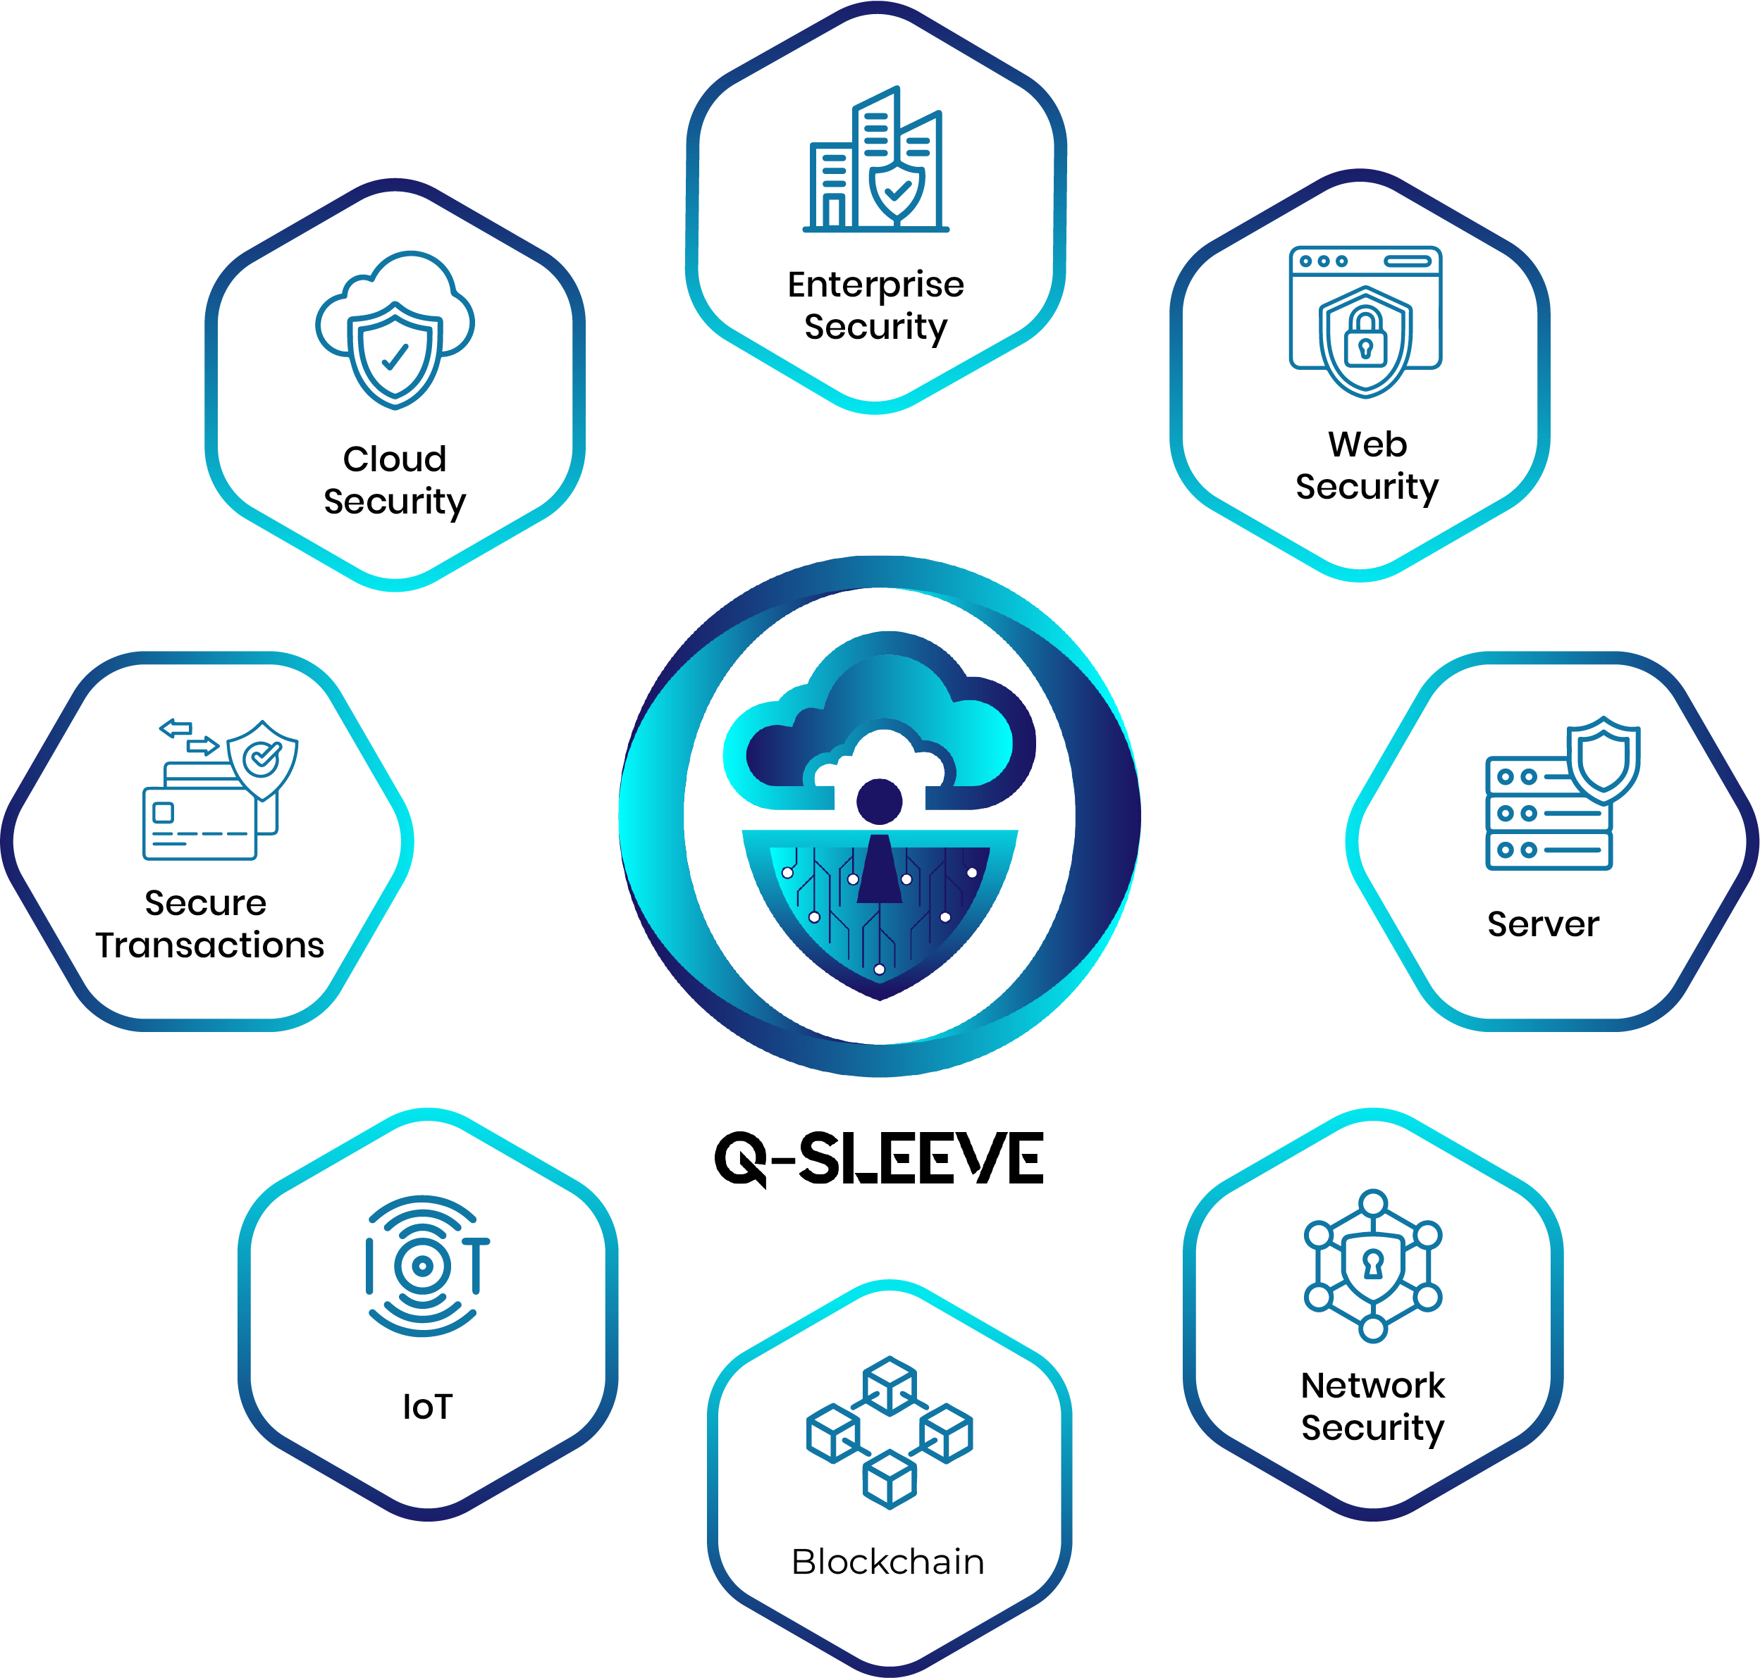
Q-Forte: Phase II
Scalable Q-Sleeve Technology Stack
Enterprise security
Server protection
Network security
Cloud security
Web security
IoT security
Secure transactions

Slide 18
Q-Forte: Phase III
‸
1
2
3
KEY FEATURES
Quantum Secure Messaging & Collaboration
Quantum-safe Digital Trust & Identity Management
Quantum Secure Data Storage

Slide 19











Q-Forte: Quantum Assured InfoSec Platform
Identity and Access Management

Slide 20
