Slide 1
Coloring Problem (Algorithmic Problems)

Slide 2
Coloring Problem
the problem is that we have to color the vertices of a G(V, E) graph such that no two adjacent vertices share the same color
we use integer representation for the given colors
the smallest number of colors needed to color a graph G(V, E) is called its chromatic number
there may be more than one solution - for example we can color a graph with 4 vertices in 12 ways with 3 colors
there are several applications of this problem

Slide 3
Coloring Problem
A
B
C
E
D
F

Slide 4
Coloring Problem
the problem is that we have to color the vertices of a G(V, E) graph such that no two adjacent vertices share the same color
it is again an NP-complete problem
there is an exponential number of possible states
if we have k colors and want to assign colors to vertices in a G(V, E) graph then the running time is O(k^{V})
so with brute-force approach we can achieve exponential running time complexity

Slide 5
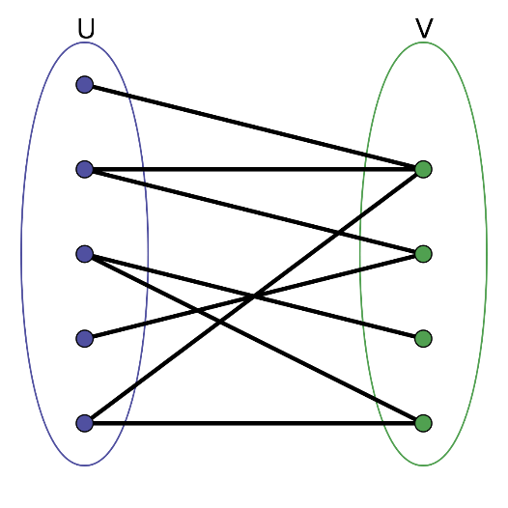
Applications - Coloring Problem
1.) BIPARTITE GRAPHS
determining if a graph can be colored with 2 colors is equivalent to determining whether or not the graph is bipartite
this problem is computable in O(N) linear time using breadth-first search
bipartite graph: a graph whose vertices can be divided into two disjoint sets U and V ( U and V are independent sets ) such that every edge connects a vertex in U to one in V

Slide 6
Applications - Coloring Problem
2.) SCHEDULING
the aim is to make an exam schedule for a university
we have different subjects and different students enrolled on every subject - many subjects would have common students
how do we schedule the exam so that no two exams with a common student are scheduled at the same time?
how many minimum time slots are needed to schedule all exams?

Slide 7
Applications - Coloring Problem
2.) SCHEDULING
this problem can be represented as a G(V, E) graph where every vertex is a subject and an edge between two vertices means there is a common student
so this is a G(V, E) graph coloring problem where minimum number of time slots is equal to the k chromatic number of the graph

Slide 8
Applications - Coloring Problem
3.) RADIO FREQUENCY ASSIGNMENT
when frequencies are assigned to towers - frequencies assigned to all towers at the same location must be different because of the interference
how to assign frequencies with this constraint? what is the minimum number of frequencies needed?
this problem is also an instance of graph coloring problem where every tower represents a vertex
an edge between two towers represents that they are in range of each other

Slide 9
Applications - Coloring Problem
4.) REGISTER ALLOCATION (COMPUTERS)
compiler optimization relies heavily on the coloring problem
register allocation is the process of assigning a large number of target program variables onto a small number of CPU registers

Slide 10
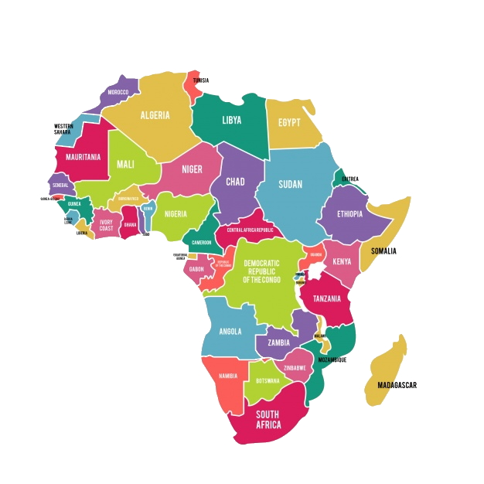
Applications - Coloring Problem
5.) MAP COLORING
we want to construct a map of countries
or states where adjacent countries or states
can not be assigned the same color
this is one of the widely known algorithmic problems
four colors are enough to color any map – this is the
so-called four color theorem

Slide 11
Algorithms - Coloring Problem
There are several approaches to solve this problem:
1.) greedy approach – it finds a solution but not necessarily the best one possible (it may use more colors)
2.) backtracking – it can discard and reject multiple bad states
within a single iteration (or recursive function call)
3.) Powell-Welsh algorithm - relies on sorting the nodes based
on the degree (number of edges)

Slide 12
Coloring Problem
we assign colors one by one to different vertices starting from the first vertex (for example with index 0)
before assigning a color: we check for safety by considering already assigned colors to the adjacent vertices
if we find a color assignment which is feasible: we mark the color assignment as part of solution
if we do not a find color due to clashes: we BACKTRACK

Slide 13
Coloring Problem
A
B
C
E
D
F

Slide 14
Coloring Problem
A
B
C
E
D
F

Slide 15
Coloring Problem
A
B
C
E
D
F

Slide 16
Coloring Problem
A
B
C
E
D
F

Slide 17
Coloring Problem
A
B
C
E
D
F

Slide 18
Coloring Problem
A
B
C
E
D
F

Slide 19
Coloring Problem
A
B
C
E
D
F

Slide 20
Coloring Problem
A
B
C
E
D
F

Slide 21
Coloring Problem
A
B
C
E
D
F

Slide 22
Coloring Problem
A
B
C
E
D
F

Slide 23
Coloring Problem
A
B
C
E
D
F

Slide 24
Coloring Problem
A
B
C
E
D
F

Slide 25
Coloring Problem
A
B
C
E
D
F

Slide 26
Coloring Problem
A
B
C
E
D
F

Slide 27
Coloring Problem
ROOT
this is the empty state
(starting state)

Slide 28
Coloring Problem
ROOT
this is the empty state
(starting state)
vertex 0

Slide 29
Coloring Problem
ROOT
this is the empty state
(starting state)
vertex 0
vertex 1

Slide 30
Coloring Problem
ROOT
this is the empty state
(starting state)
vertex 0
vertex 1

Slide 31
Coloring Problem
ROOT
this is the empty state
(starting state)
vertex 0
vertex 1
we can prune these branches
and beause of that we can discard
mutiple bad states (subtrees) in the same iteration
PRUNING BOOSTS THE RUNNING TIME OF BACKTRACKING

