Slide 1
JAVA Prepared By Mohammad M. Rahman(Mafi) B.E. in Computer Engineering Stony Brook University

Slide 2
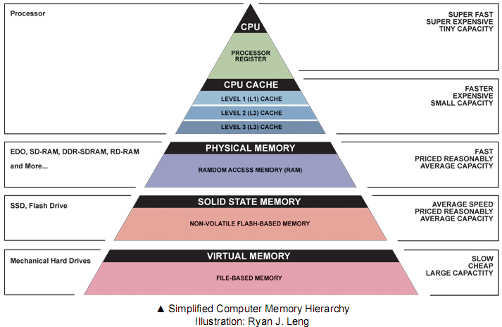

Slide 3
RAM
Code Segment
Stack
Heap
Memory Management system

Slide 4
Advantages of Java
1.Java is a high-level Object Oriented Programming Language.
2.It is Platform-independent(easily run from one computer to another).
3.It is Distributed(network).
4.It is interpreted.
5.It is Secure.

Slide 5
Java Compile Cycle
Editor
Source code
Java Compiler
Eclipse
Javac
Operating System
JVM
Bytecodes
Classname.class
Notes:
Java life cycle:
When you write a source code using either notepad or eclipse IDE, it needs to be converted into byte code using javac compiler. Byte code is in the form of .class . The class file then loads into the JVM using java loader . the JVM then send all the information to the operating system which shows you the output
The compiler:
When you compile a java file it is written with the extension .java. for example A.java
The job of the compiler is to convert the ‘A.java’ into byte code (machine language) which will appear as ‘A.class’
The next step is to load the A.class into JVM (Java virtual machine)
JVM component:
JVM has the following components:
Class loader (java): the class loader is also called java which loads the class file into the JVM
Bytecode verifier:
The byte code verifier verifies the byte codes that is loaded.
Execution engine (JIT code generator): In the next step the JIT(just in time ) code generator converts the byte code into binary machine language which is understood by the operating system.

Slide 6
Compile java File to Class File
A.java
B.java
C.java
A.Class
B.Class
C.class
Compiler

Slide 7
JVM Components
A.Class
B.Class
C.class
Class Loader
Bytecode Verifier
Execution Engine
JIT Code
Generator

Slide 8

i=0
i=1
i=2
i=3
i=4
i=5
i=6
i=7

Slide 9
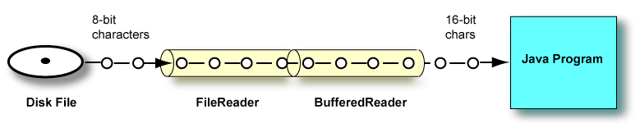
FileReader and BufferedReader
BufferedReader in = new BufferedReader(new FileReader( fileName ) );

Slide 10
Pyramid

