Slide 1
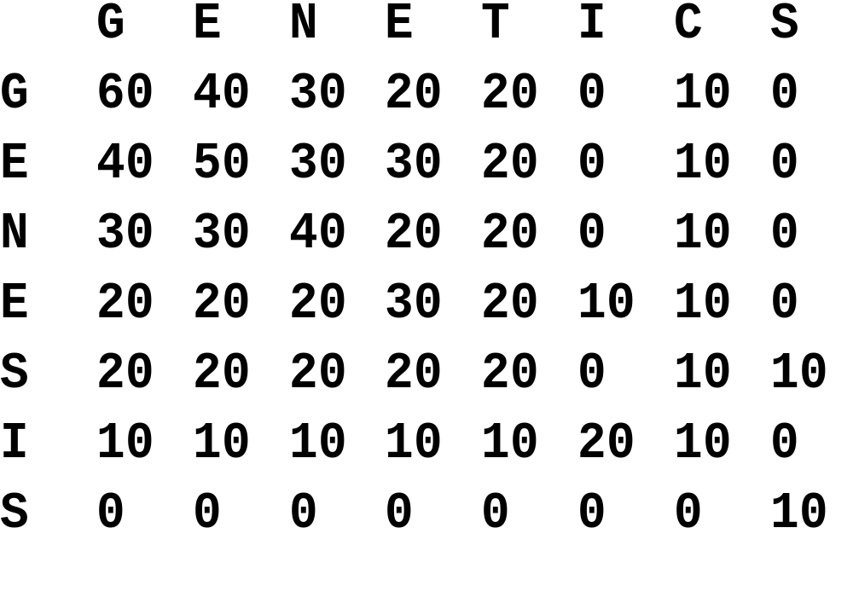
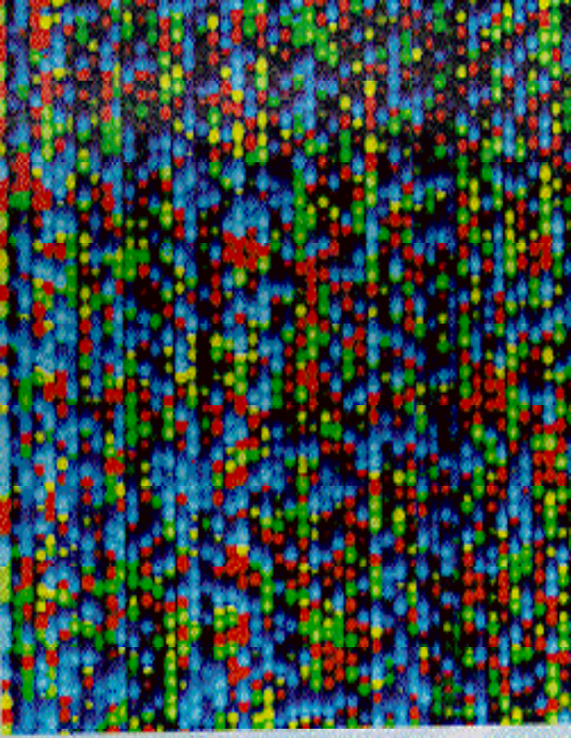
Sequencing & Sequence Alignment

Slide 2
Objectives
Understand how DNA sequence data is collected and prepared
Be aware of the importance of sequence searching and sequence alignment in biology and medicine
Be familiar with the different algorithms and scoring schemes used in sequence searching and sequence alignment

Slide 3
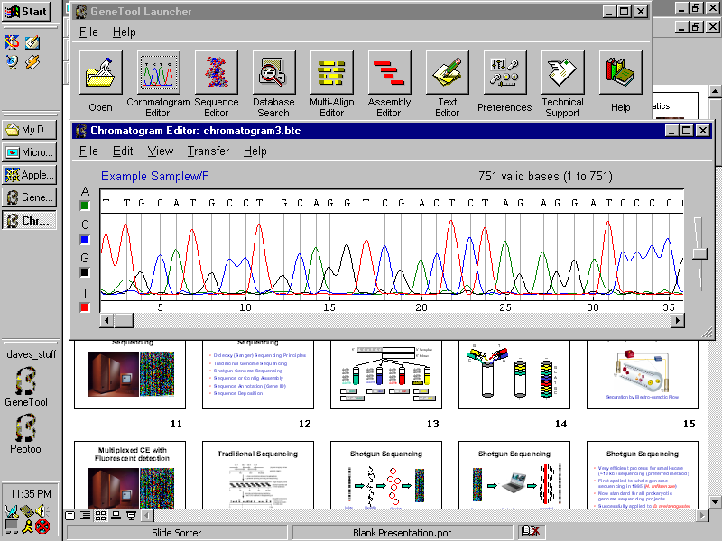
High Throughput DNA Sequencing

Slide 4
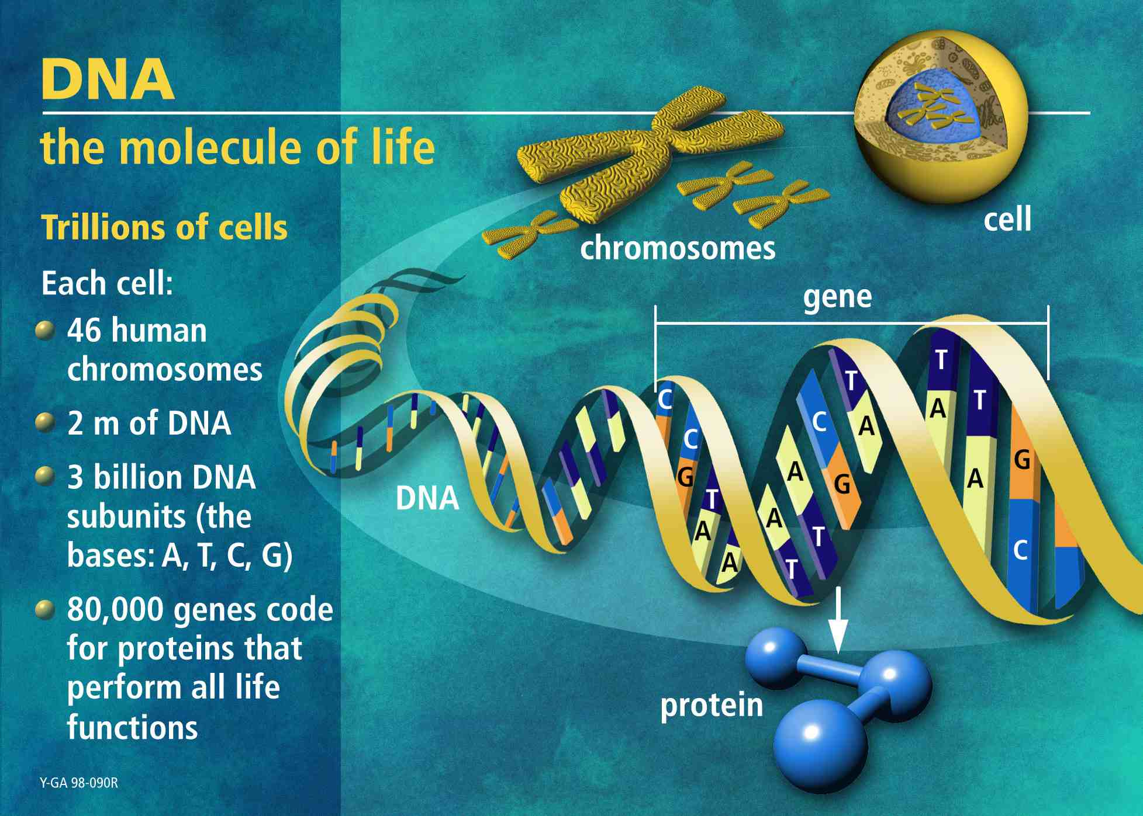
30,000

Slide 5
Shotgun Sequencing
Isolate
Chromosome
ShearDNA
into Fragments
Clone into
Seq. Vectors
Sequence

Slide 6
Principles of DNA Sequencing
Primer
DNA fragment
Amp
PBR322
Tet
Ori
Denature with
heat to produce
ssDNA
Klenow + ddNTP
+ dNTP + primers

Slide 7
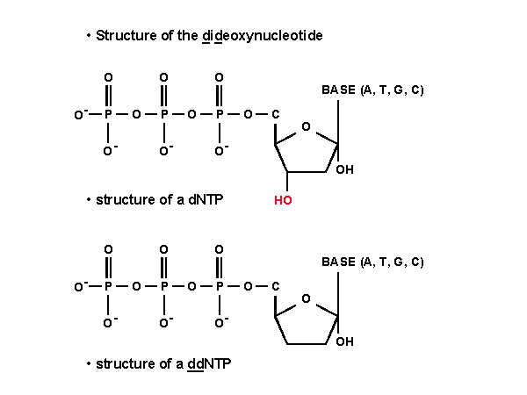
The Secret to Sanger Sequencing

Slide 8
Principles of DNA Sequencing
5’
G C A T G C
3’ Template
5’ Primer
dATP
dCTP
dGTP
dTTP
ddCTP
dATP
dCTP
dGTP
dTTP
ddATP
dATP
dCTP
dGTP
dTTP
ddTTP
dATP
dCTP
dGTP
dTTP
ddCTP
GddC
GCddA
GCAddT
ddG
GCATGddC
GCATddG

Slide 9
Principles of DNA Sequencing
G
T
_
_
C
A
G
C
A
T
G
C
+
+

Slide 10
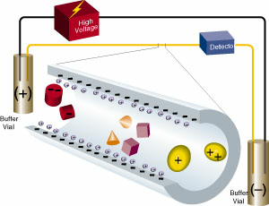
Capillary Electrophoresis
Separation by Electro-osmotic Flow

Slide 11
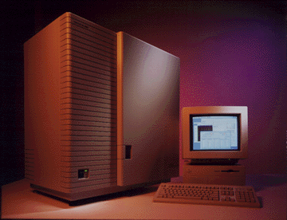
Multiplexed CE with Fluorescent detection
ABI 3700
96x700 bases

Slide 12

Shotgun Sequencing
Sequence
Chromatogram
Send to Computer
Assembled
Sequence

Slide 13
Shotgun Sequencing
Very efficient process for small-scale (~10 kb) sequencing (preferred method)
First applied to whole genome sequencing in 1995 (H. influenzae)
Now standard for all prokaryotic genome sequencing projects
Successfully applied to D. melanogaster
Moderately successful for H. sapiens

Slide 14
The Finished Product
GATTACAGATTACAGATTACAGATTACAGATTACAG
ATTACAGATTACAGATTACAGATTACAGATTACAGA
TTACAGATTACAGATTACAGATTACAGATTACAGAT
TACAGATTAGAGATTACAGATTACAGATTACAGATT
ACAGATTACAGATTACAGATTACAGATTACAGATTA
CAGATTACAGATTACAGATTACAGATTACAGATTAC
AGATTACAGATTACAGATTACAGATTACAGATTACA
GATTACAGATTACAGATTACAGATTACAGATTACAG
ATTACAGATTACAGATTACAGATTACAGATTACAGA
TTACAGATTACAGATTACAGATTACAGATTACAGAT

Slide 15
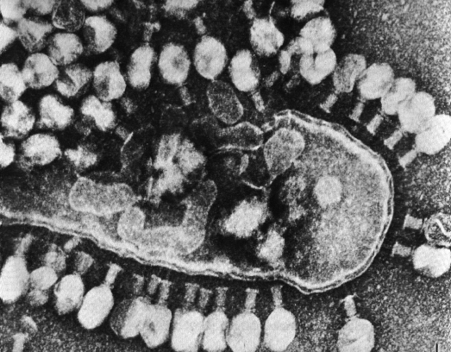

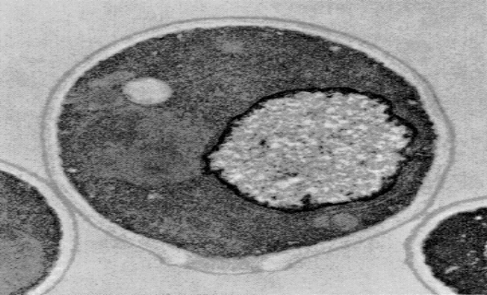
Sequencing Successes
T7 bacteriophage
completed in 1983
39,937 bp, 59 coded proteins
Escherichia coli
completed in 1998
4,639,221 bp, 4293 ORFs
Sacchoromyces cerevisae
completed in 1996
12,069,252 bp, 5800 genes

Slide 16

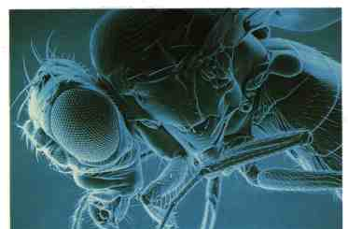

Sequencing Successes
Caenorhabditis elegans
completed in 1998
95,078,296 bp, 19,099 genes
Drosophila melanogaster
completed in 2000
116,117,226 bp, 13,601 genes
Homo sapiens
1st draft completed in 2001
3,160,079,000 bp, 31,780 genes

Slide 17
So what do we do with all this sequence data?

Slide 18
Sequence Alignment

Slide 19
Alignments tell us about...
Function or activity of a new gene/protein
Structure or shape of a new protein
Location or preferred location of a protein
Stability of a gene or protein
Origin of a gene or protein
Origin or phylogeny of an organelle
Origin or phylogeny of an organism

Slide 20
Factoid:
Sequence comparisons
lie at the heart of all
bioinformatics

Slide 21
Similarity versus Homology
Similarity refers to the likeness or % identity between 2 sequences
Similarity means sharing a statistically significant number of bases or amino acids
Similarity does not imply homology
Homology refers to shared ancestry
Two sequences are homologous is they are derived from a common ancestral sequence
Homology usually implies similarity

Slide 22
Similarity versus Homology
Similarity can be quantified
It is correct to say that two sequences are X% identical
It is correct to say that two sequences have a similarity score of Z
It is generally incorrect to say that two sequences are X% similar

Slide 23
Similarity versus Homology
Homology cannot be quantified
If two sequences have a high % identity it is OK to say they are homologous
It is incorrect to say two sequences have a homology score of Z
It is incorrect to say two sequences are X% homologous

Slide 24
Sequence Complexity
MCDEFGHIKLAN…. High Complexity
ACTGTCACTGAT…. Mid Complexity
NNNNTTTTTNNN…. Low Complexity
Translate those DNA sequences!!!

Slide 25
Assessing Sequence Similarity
THESTORYOFGENESIS
THISBOOKONGENETICS
THESTORYOFGENESI-S
THISBOOKONGENETICS
THE STORY OF GENESIS
THIS BOOK ON GENETICS
Two Character
Strings
Character
Comparison
* * * * * * * * * * *
Context
Comparison

Slide 26
Assessing Sequence Similarity
Rbn KETAAAKFERQHMD
Lsz KVFGRCELAAAMKRHGLDNYRGYSLGNWVCAAKFESNFNT
Rbn SST SAASSSNYCNQMMKSRNLTKDRCKPMNTFVHESLA
Lsz QATNRNTDGSTDYGILQINSRWWCNDGRTP GSRN
Rbn DVQAVCSQKNVACKNGQTNCYQSYSTMSITDCRETGSSKY
Lsz LCNIPCSALLSSDITASVNC AKKIVSDGDGMNAWVAWR
Rbn PNACYKTTQANKHIIVACEGNPYVPHFDASV
Lsz NRCKGTDVQA WIRGCRL
is this alignment significant?

Slide 27
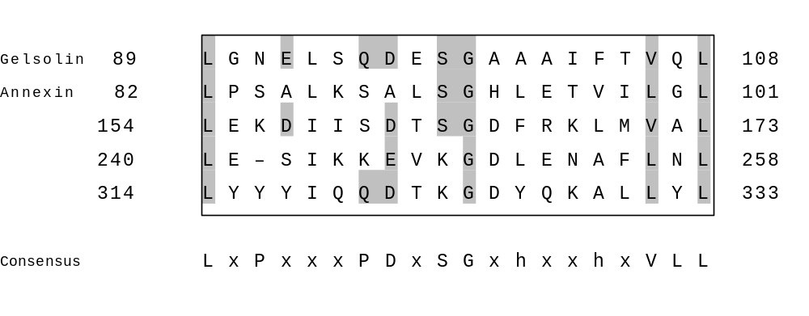
Is This Alignment Significant?

Slide 28
Some Simple Rules
If two sequence are > 100 residues and > 25% identical, they are likely related
If two sequences are 15-25% identical they may be related, but more tests are needed
If two sequences are < 15% identical they are probably not related
If you need more than 1 gap for every 20 residues the alignment is suspicious

Slide 29
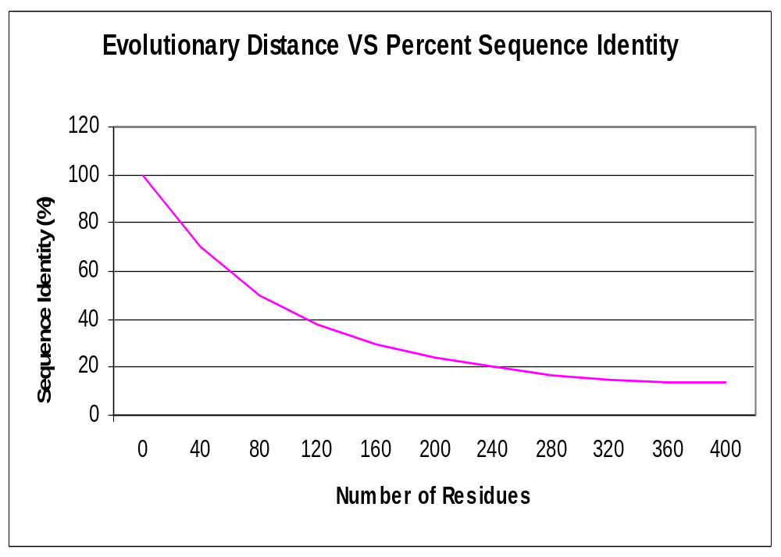
Doolittle’s Rules of Thumb
Twilight Zone

Slide 30
Sequence Alignment - Methods
Dot Plots
Dynamic Programming
Heuristic (Fast) Local Alignment
Multiple Sequence Alignment
Contig Assembly

Slide 31
PAM Matrices
Developed by M.O. Dayhoff (1978)
PAM = Point Accepted Mutation
Matrix assembled by looking at patterns of substitutions in closely related proteins
1 PAM corresponds to 1 amino acid change per 100 residues
1 PAM = 1% divergence or 1 million years in evolutionary history

Slide 32
Fast Local Alignment Methods
Developed by Lipman & Pearson (1985/88)
Refined by Altschul et al. (1990/97)
Ideal for large database comparisons
Uses heuristics & statistical simplification
Fast N-type algorithm (similar to Dot Plot)
Cuts sequences into short words (k-tuples)
Uses “Hash Tables” to speed comparison

Slide 33
FASTA
Developed in 1985 and 1988 (W. Pearson)
Looks for clusters of nearby or locally dense “identical” k-tuples
init1 score = score for first set of k-tuples
initn score = score for gapped k-tuples
opt score = optimized alignment score
Z-score = number of S.D. above random
expect = expected # of random matches

Slide 34
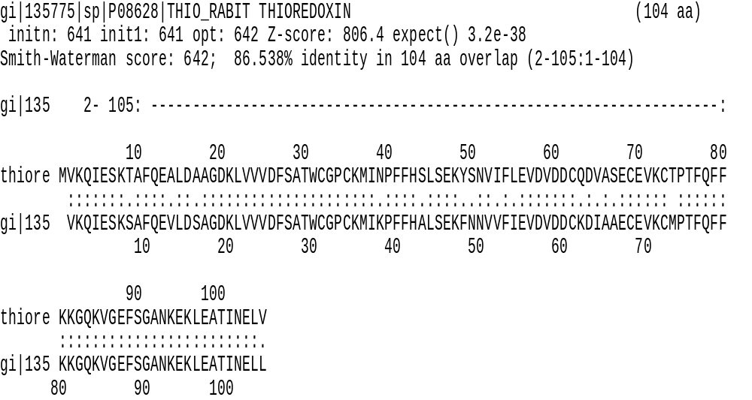
FASTA

Slide 35
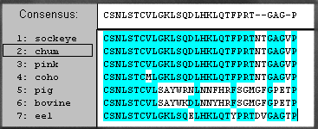
Multiple Sequence Alignment
Multiple alignment of Calcitonins

Slide 36
Multiple Alignment Algorithm
Take all “n” sequences and perform all possible pairwise (n/2(n-1)) alignments
Identify highest scoring pair, perform an alignment & create a consensus sequence
Select next most similar sequence and align it to the initial consensus, regenerate a second consensus
Repeat step 3 until finished

Slide 37
Multiple Sequence Alignment
Developed and refined by many (Doolittle, Barton, Corpet) through the 1980’s
Used extensively for extracting hidden phylogenetic relationships and identifying sequence families
Powerful tool for extracting new sequence motifs and signature sequences

Slide 38
Multiple Alignment
Most commercial vendors offer good multiple alignment programs including:
    GCG (Accelerys)
    PepTool/GeneTool (BioTools Inc.)
    LaserGene (DNAStar)
Popular web servers include T-COFFEE, MULTALIN and CLUSTALW
Popular freeware includes PHYLIP & PAUP

Slide 39
Mutli-Align Websites
Match-Box http://www.fundp.ac.be/sciences/biologie/bms/matchbox_submit.shtml
MUSCA http://cbcsrv.watson.ibm.com/Tmsa.html
T-Coffee http://www.ch.embnet.org/software/TCoffee.html
MULTALIN http://www.toulouse.inra.fr/multalin.html
CLUSTALW http://www.ebi.ac.uk/clustalw/

Slide 40
Multi-alignment & Contig Assembly
ATCGATGCGTAGCAGACTACCGTTACGATGCCTT…
TAGCTACGCATCGTCTGATGGCAATGCTACGGAA..
TAGCTACGCATCGT
TAGCAGACTACCGTT
ATCGATGCGTAGC
GTTACGATGCCTT

Slide 41
Contig Assembly
Read, edit & trim DNA chromatograms
Remove overlaps & ambiguous calls
Read in all sequence files (10-10,000)
Reverse complement all sequences (doubles # of sequences to align)
Remove vector sequences (vector trim)
Remove regions of low complexity
Perform multiple sequence alignment

Slide 42
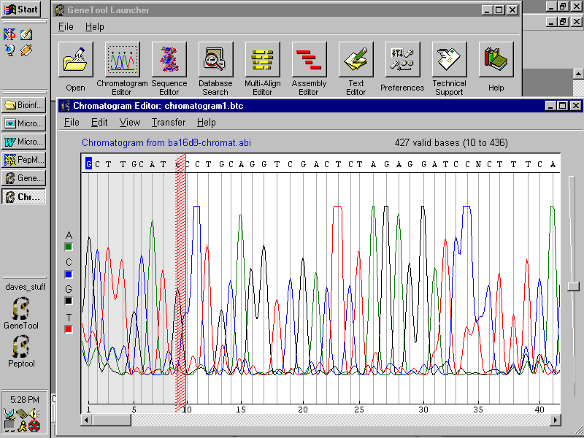
Chromatogram Editing

Slide 43
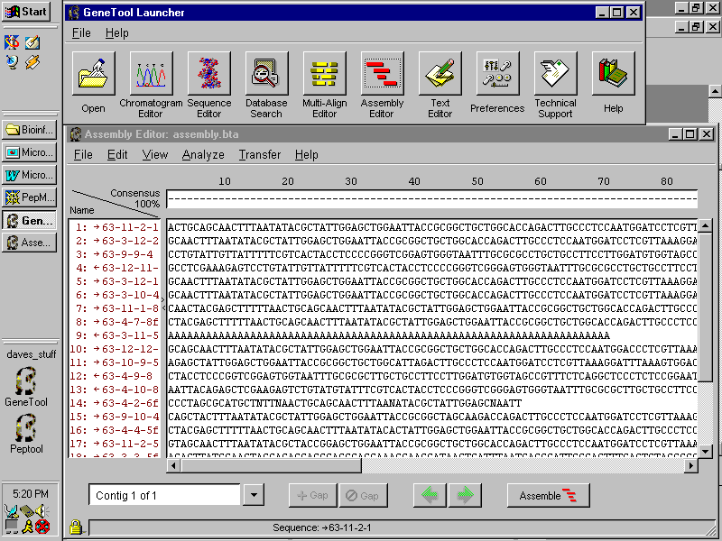
Sequence Loading

Slide 44
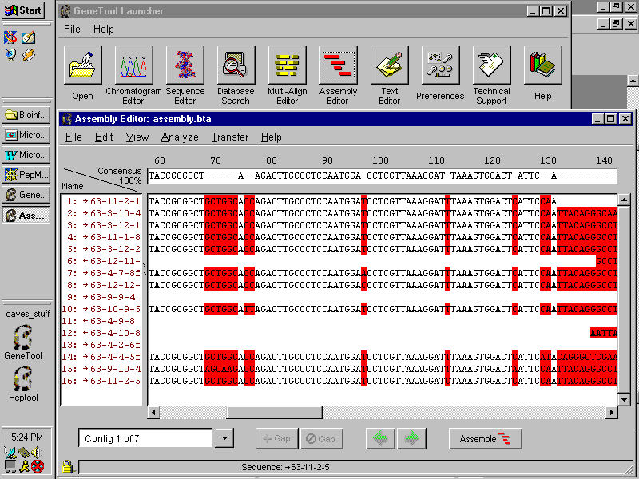
Sequence Alignment

Slide 45
Contig Alignment - Process
ATCGATGCGTAGC
TAGCAGACTACCGTT
GTTACGATGCCTT
TGCTACGCATCG
CGATGCGTAGCA
CGATGCGTAGCA
ATCGATGCGTAGC
TAGCAGACTACCGTT
GTTACGATGCCTT
ATCGATGCGTAGCAGACTACCGTTACGATGCCTT…

Slide 46
Sequence Assembly Programs
Phred - base calling program that does detailed statistical analysis (UNIX) http://www.phrap.org/
Phrap - sequence assembly program (UNIX) http://www.phrap.org/
TIGR Assembler - microbial genomes (UNIX) http://www.tigr.org/softlab/assembler/
The Staden Package (UNIX)
http://www.mrc-lmb.cam.ac.uk/pubseq/
GeneTool/ChromaTool/Sequencher (PC/Mac)

Slide 47
Conclusions
Sequence alignments and database searching are key to all of bioinformatics
There are four different methods for doing sequence comparisons 1) Dot Plots; 2) Dynamic Programming; 3) Fast Alignment; and 4) Multiple Alignment
Understanding the significance of alignments requires an understanding of statistics and distributions

