Slide 1
Chapter 3. Calculation

Slide 2
Expression
This chapter explains the meaning of the elements of expressions in Python. In the chapter, we learn how to operate expression and sequence
An expression is a combination of values, variables, operators, and calls to functions. Expressions need to be evaluated. If you ask Python to print an expression, the interpreter evaluates the expression and displays the result.
A statement is an instruction that the Python interpreter can execute. We have only seen the assignment statement so far. Some other kinds of statements that we’ll see shortly are while statements, for statements, if statements, and import statements. (There are other kinds too!)
Computer is an expert in operation

Slide 3
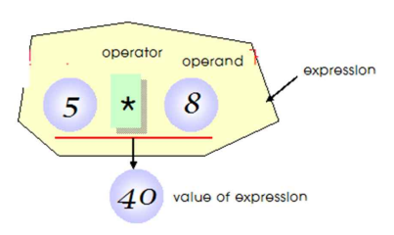
Operator and Operand
Operators are functionality that do something and can be represented by symbols such as + or by special keywords. Operators require some data to operate on and such data is called operands. In this case, 2 and 3 are the operands.
Operand is the argument of operator
Operator (연산자)
Operand (피연산자)

Slide 4
Math operator (산술연산자)
+ (plus)
Adds two objects
3 + 5 gives 8. 'a' + 'b' gives 'ab‘
- (minus)
Gives the subtraction of one number from the other; if the first operand is absent it is assumed to be zero.
-5.2 gives a negative number and 50 - 24 gives 26.
* (multiply)
Gives the multiplication of the two numbers or returns the string repeated that many times.
2 * 3 gives 6. 'la' * 3 gives 'lalala'.
** (power)
Returns x to the power of y
3 ** 4 gives 81 (i.e. 3 * 3 * 3 * 3)
/ (divide)
Divide x by y
13 / 3 gives 4.333333333333333

Slide 5
Math operator (산술연산자)
// (divide and floor)
Divide x by y and round the answer down to the nearest integer value. Note that if one of the values is a float, you'll get back a float.
13 // 3 gives 4
-13 // 3 gives -5
9//1.81 gives 4.0
% (modulo)
Returns the remainder of the division
13 % 3 gives 1

Slide 6
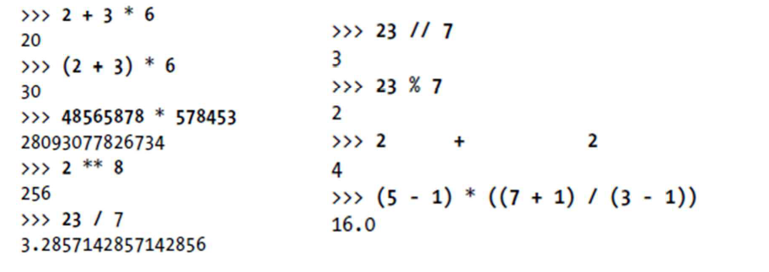
Example

Slide 7
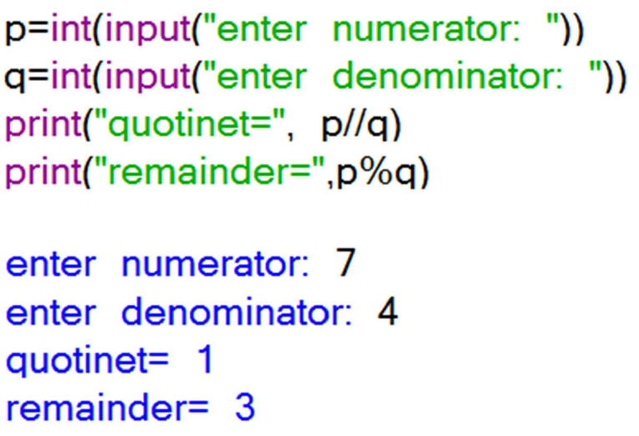
Modulo and ‘divide and floor’

Slide 8
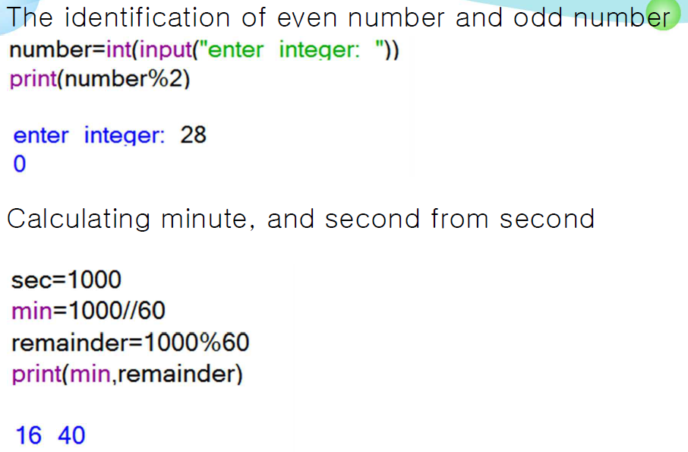
The use of remainder

Slide 9
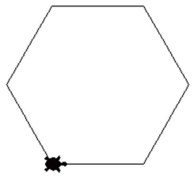
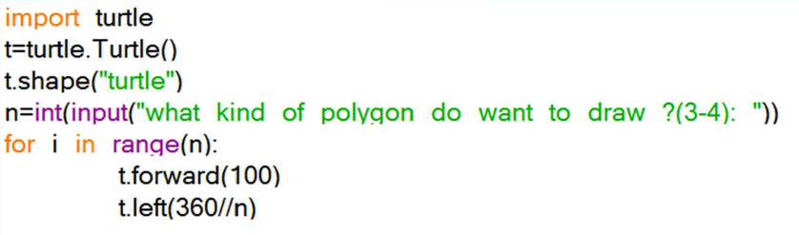
Practice: Drawing polygon
What kind of polygon do you want to draw (from triangle to hexagon)?
for I in range(n) : #repeat n times
t.forward(100) #write a repeated sentence
t.left(60) #write a repeated sentence
<<Solution>>

Slide 10
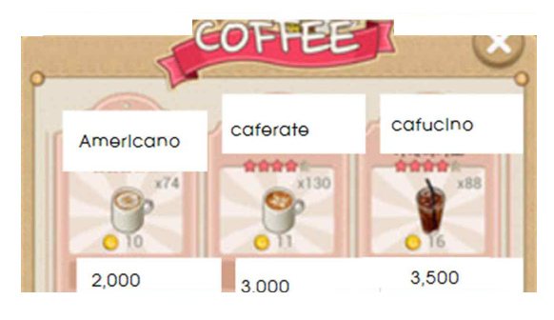
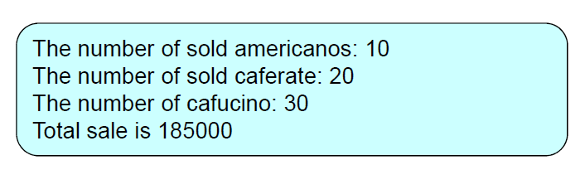
Practice: Calculating the sales of cafe
We have a plan to start a café. How much do we make sales based on the menu below ?

Slide 11
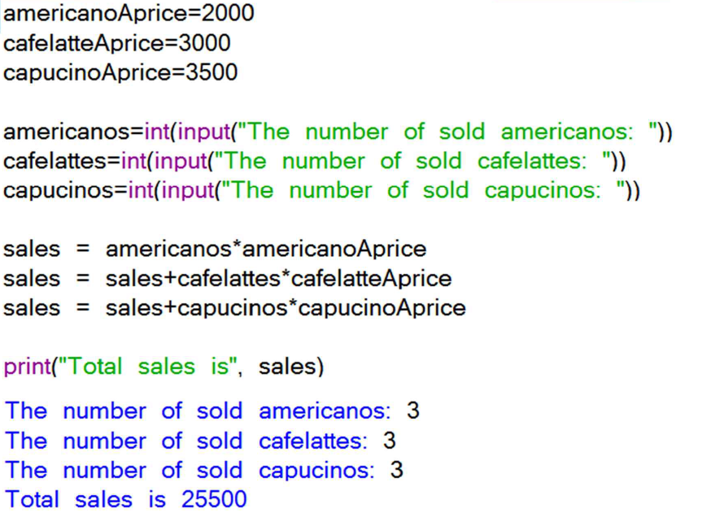
Solution

Slide 12
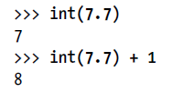

Int()
The int() function is also useful if you need to round a floating-point number down.
In your program, you used the int() and str() functions in the last three lines to get a value of the appropriate data type for the code.

Slide 13
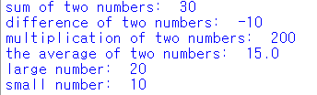
Assignment 1
Input two numbers from user, calculate the sum of two numbers, difference of two numbers, multiplication of two numbers, the average of two numbers, large number, and small number, results below (use “max(x,y)” “min(x,y)” embedded in Python)

Slide 14
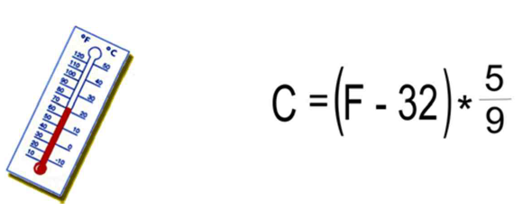
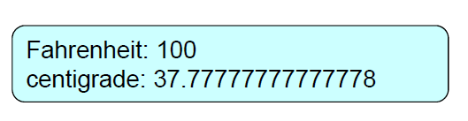
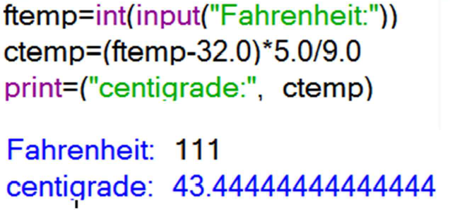
Practice: Converting fahrenheit to centigrade
In Korea, we use centigrade. Other countries use Fahrenheit. Convert Fahrenheit given to centigrade
<<Solution>>

Slide 15
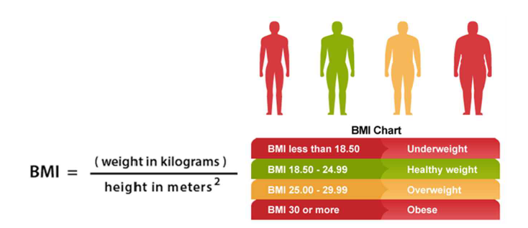
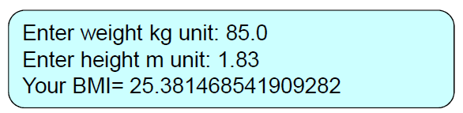
Practice: Calculating BMI
Body mass index (BMI) is a value derived from the mass (weight) and height of a person. The BMI is defined as the body mass divided by the square of the body height, and is universally expressed in units of kg/m2, resulting from mass in kilograms and height in meters.
Write a program which
inputs height, weight from
user and produces BMI

Slide 16
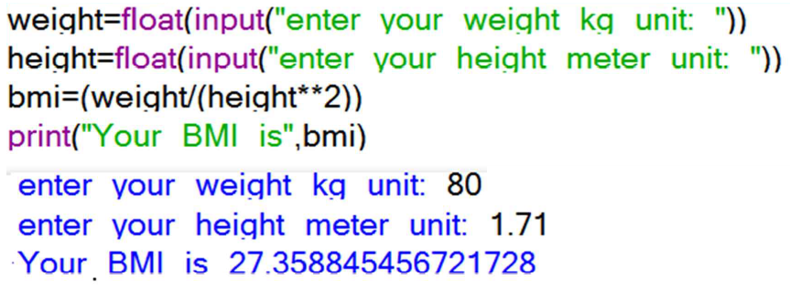
Solution

Slide 17
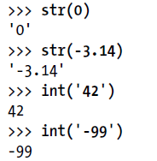
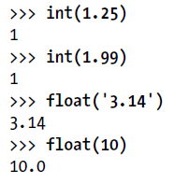
Int(), float()
The str(), and float() functions will evaluate to the integer, and floating-point forms of the value you pass, respectively.
Try converting some values in the interactive shell with these functions, and watch what happens.

Slide 18
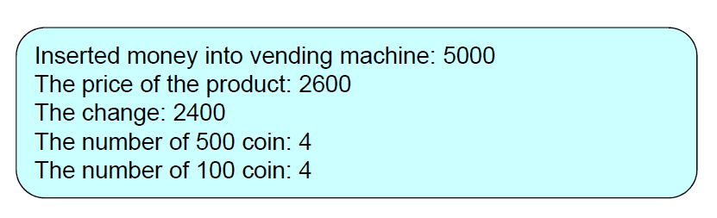
Practice: Vending Machine Program
Write a vending machine program. Vending machine receives money and displays the price of the products. The price of the products is assumed 100 won unit
Program calculates and displays changes. The machine handles only 500 won coin and 100 won coin

Slide 19
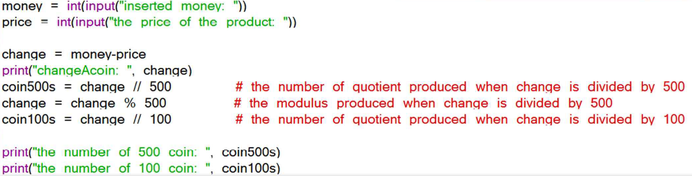
Solution

Slide 20

Power operator
For calculating power(지수), ** operator is used
Power operator is higher in priority other than operators. (ex) 10*2**7=1280
Ex) Calculating maturity program
Principal(원금): 1,000
Rate: 0.05
Period: 10
a=1000
r=0.05
n=10
Print(a*(1+r)**n)

Slide 21
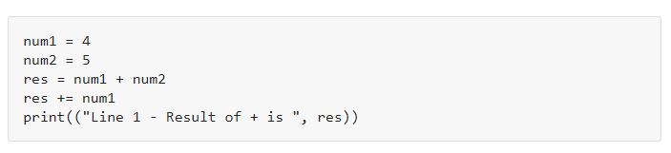
Compound Operator (복합연산자)
Assignment operators are used in Python to assign values to variables. a = 5 is a simple assignment operator that assigns the value 5 on the right to the variable a on the left. There are various compound operators in Python like a += 5 that adds to the variable and later assigns the same.
We can also use a compound assignment operator, where you can add, subtract, multiply right operand to left and assign addition (or any other arithmetic function) to the left operand.
Step 1: Assign value to num1 and num2
Step 2: Add value of num1 and num2 (4+5=9)
Step 3: To this result add num1 to the output of Step 2 ( 9+4)
Step 4: It will print the final result as 13

Slide 22
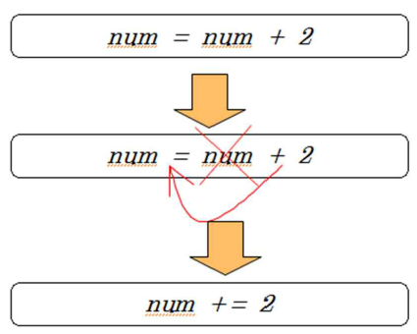
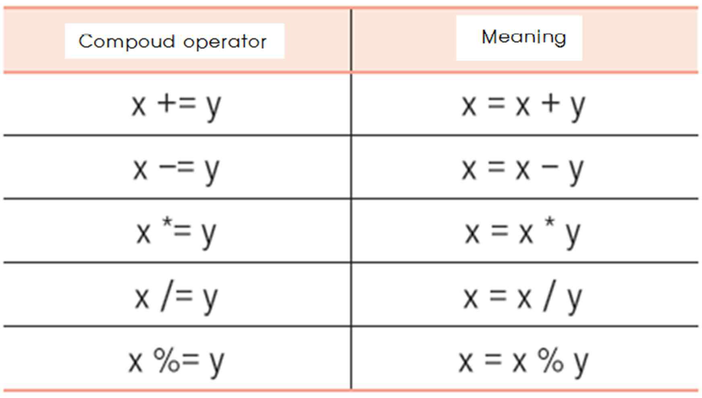
Compound Operator (복합연산자)

Slide 23
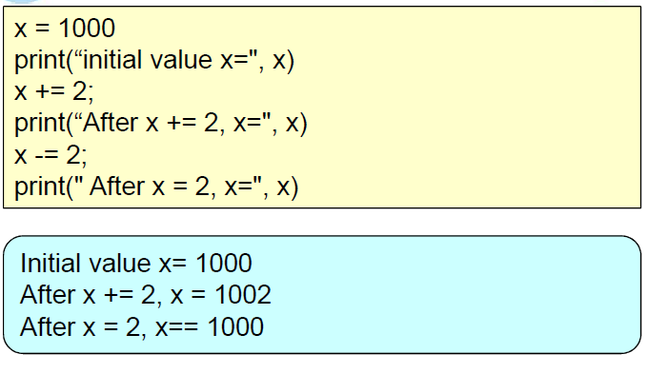
Compound Operator (복합연산자)

Slide 24
Comment (주석)
A comment in Python starts with the hash character, # , and extends to the end of the physical line.
A hash character within a string value is not seen as a comment, though. To be precise, a comment can be written in three ways - entirely on its own line, next to a statement of code, and as a multi-line comment block
for I in range(n) : #repeat n times
t.forward(100) #write a repeated sentence
t.left(60) #write a repeated sentence

Slide 25
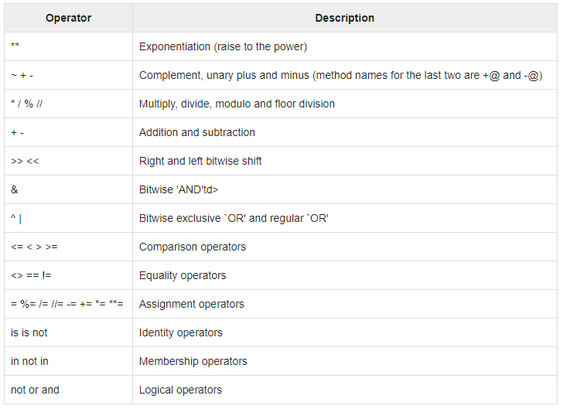
Precedence of operators
The following table lists all operators from highest precedence to lowest.

Slide 26
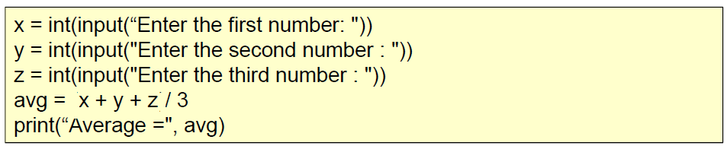
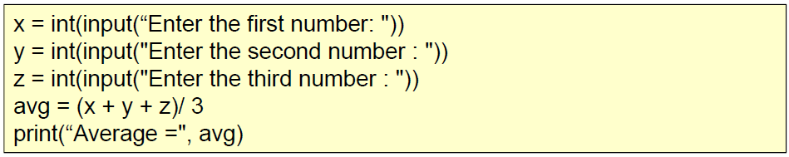
Practice: Calculating average
What is error in the code to calculating average below ?

Slide 27
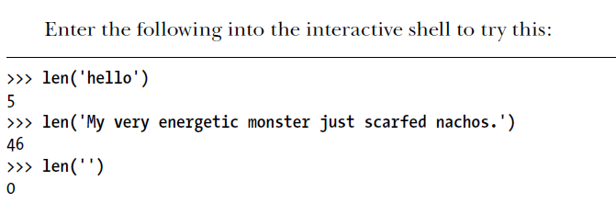
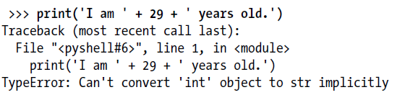
len() function
You can pass the len() function a string value (or a variable containing a string), and the function evaluates to the integer value of the number of characters in that string.

Slide 28

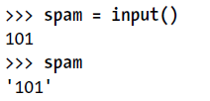
str()
If you want to concatenate an integer such as 29 with a string to pass to print(), you’ll need to get the value '29', which is the string form of 29.
The str() function can be passed an integer value and will evaluate to a string value version of it, as follows
The str() function is handy when you have an integer or float that you want to concatenate to a string. For example, the input() function always returns a string, even if the user enters a number

Slide 29


The value stored inside spam isn’t the integer 101 but the string '101'.
If you want to do math using the value in spam, use the int() function to get the integer form of spam and then store this as the new value in spam.
Now you should be able to treat the spam variable as an integer instead of a string.

Slide 30
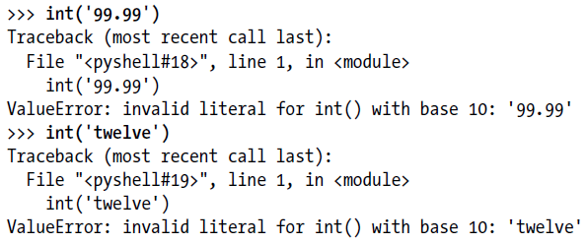
Int()
Note that if you pass a value to int() that it cannot evaluate as an integer, Python will display an error message.
.

Slide 31
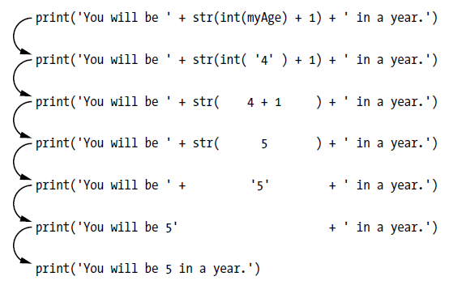

Slide 32
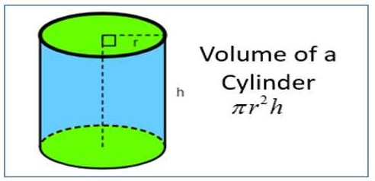

Assignment 2
Write a program calculating volume of cylider

