Slide 1
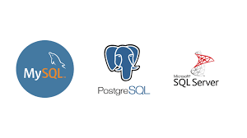
Plan
MySQL
01
PostgreSQL
02
SQL SERVER
03
RDBMS #
04

Slide 2
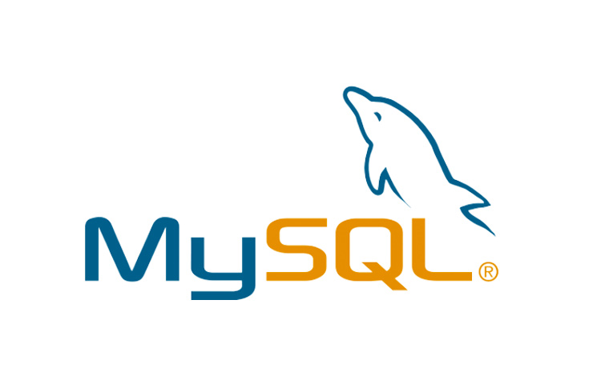
Definition
MySQL
Key Features
Product
When /not use it

Slide 3
Definition
Product
Key Features
When / NOT use it
In 1995, two Software Engineers, Michael Widenius and David Axmark, created the Open Source Relational Database Management System (RDBMS) MySQL. Since its inception, MySQL quickly became popular in the industry and community for its enterprise-grade features and free, flexible (GPL) community license, and upgraded commercial license. Among the open-source Databases,
- Open source RDBMS with two licensing models: free Community Server and proprietary Enterprise Server.
- Offers ACID transactional guarantee (with InnoDB engine). In terms of CAP, it offers immediate Consistency.
- Offers horizontal partitioning (sharding) via its Shared Nothing MySQL Cluster. As a result, it offers high availability and high throughput with low latency and near-linear Scaling.
- With its MySQL Cluster, it offers multi-master ACID transactions.
- Multi-model database and supports both structured data (SQL) and semi-structured data (JSON).
When to Use MySQL
Structured Data (SQL) with an ACID transaction guarantee.
Horizontal Scalability is a key requirement, especially with Write heavy data.
Multi-Master ACID transaction is a fundamental requirement.
MySQL
MySQL Enterprise Edition
MySQL Standard Edition
MySQL Classic Edition
MySQL Cluster CGE
MySQL Embedded (OEM/ISV)
When not to Use MySQL
“Distributed SQL” is required where millions of transactions should be handled in a globally distributed database.
Data is extremely relational (e.g., Social Media), i.e., Graph like data.
Data is Semi-structured, i.e., JSON data with advanced query features.

Slide 4
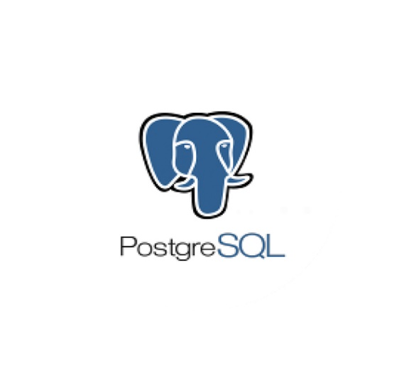
Definition
PostgreSQL
Key Features
Product
When /not use it

Slide 5
Definition
Product
Key Features
When / NOT use it
Over the past 30 years, PostgreSQL leads the way in Modern database Development, contributing many innovations, and Michael Stonebraker got a Turing Award in 2014 primarily for his work in PostgreSQL.
Today, PostgreSQL is one of the most used databases. It is also the most Advanced Open Source Relational Database.
EDB for PostgreSQL (Horizontal Scaling)
CitusData (Distributed SQL)
ScaleGrid (Horizontal Scaling)
Aiven for PostgreSQL (Multi-Cloud)
Amazon RDS for PostgreSQL
Azure PostgreSQL Database
Google Cloud SQL for PostgreSQL
- Open Source RDMBS with a very permissible PostgreSQL license. There are many extensions of PostgreSQL with various advanced features.
- Offers ACID transactional guarantee. In terms of CAP, it offers immediate Consistency as a single Server.
- Citus Data, a PostgreSQL extension, offers much-coveted Distributed SQL features, i.e., a database with the transactional guarantee of an SQL database and horizontal scaling of NoSQL database.
- It offers more Advanced indexes liked partial Index, Bloom Filters. Also, creating an Index in PostgreSQL is non-blocking.
- It is a feature-rich multi-model database supporting Structured Data (SQL), Semi-Structured Data (JSON, XML), Key-Value, Spatial Data.
When to Use PostgreSQL
- Data is structured (SQL), and ACID transaction guarantee is a key criterion with strict Data integrity.
- When “Distributed SQL” is required, where millions of transactions should be handled in a globally distributed database.
- A sophisticated query planner is wanted.
When not to Use PostgreSQL
- Multi-Master ACID transaction is a must-have feature.
- Data is Semi-structured, i.e., JSON data with advanced query planers.

Slide 6
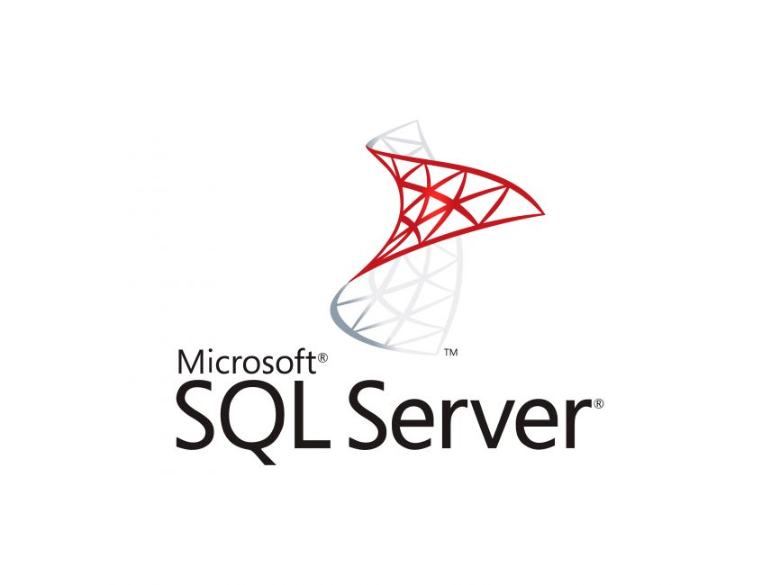
Definition
SQL SERVER
Key Features
Product
When /not use it

Slide 7
Definition
Product
Key Features
When / NOT use it
In 1988, Microsoft joined with Ashton-Tate and Sybase to create an RDBMS as a Sybase SQL Server variant. In 1989, they released the first version of Microsoft SQL Server. Although not as innovative or advanced as others, Microsoft SQL Server has gone through major updates and overhauls over the years. Initially released for IBM OS/2, it was soon released for Windows Systems. In the last three decades, it was the dominating commercial Mid-range database in Windows Systems
Azure SQL (horizontal scaling)
Amazon RDS for SQL Server
SQL Server on Google Cloud
- Proprietary RDBMS with diverse licenses: Developer and Express (free), Standard, and Enterprise (commercial).
- Offers ACID transactional guarantee. In terms of CAP, it offers immediate Consistency as a single Server.
- Supports Server-side scripting via T-SQL, .NET languages, R, Python, and Java.
- It is a multi-Model database supporting Structured Data (SQL), Semi-Structured Data(JSON), Spatial Data.
When to Use SQL SERVER
- Data is structured (SQL) with an ACID transaction guarantee.
- The development platform is strongly coupled with other Microsoft Products.
- Azure Cloud is the preferred public Cloud Technology with a preference for Managed SQL database.
When not to Use SQL SERVER
- Not ideal for companies with low Budgets for databases.
- Multi-Master ACID transaction is a must-have feature.
- Data is Semi-structured, i.e., JSON data, and needs advanced query operations.

Slide 8

A comparison between the three RDBMS

Slide 9
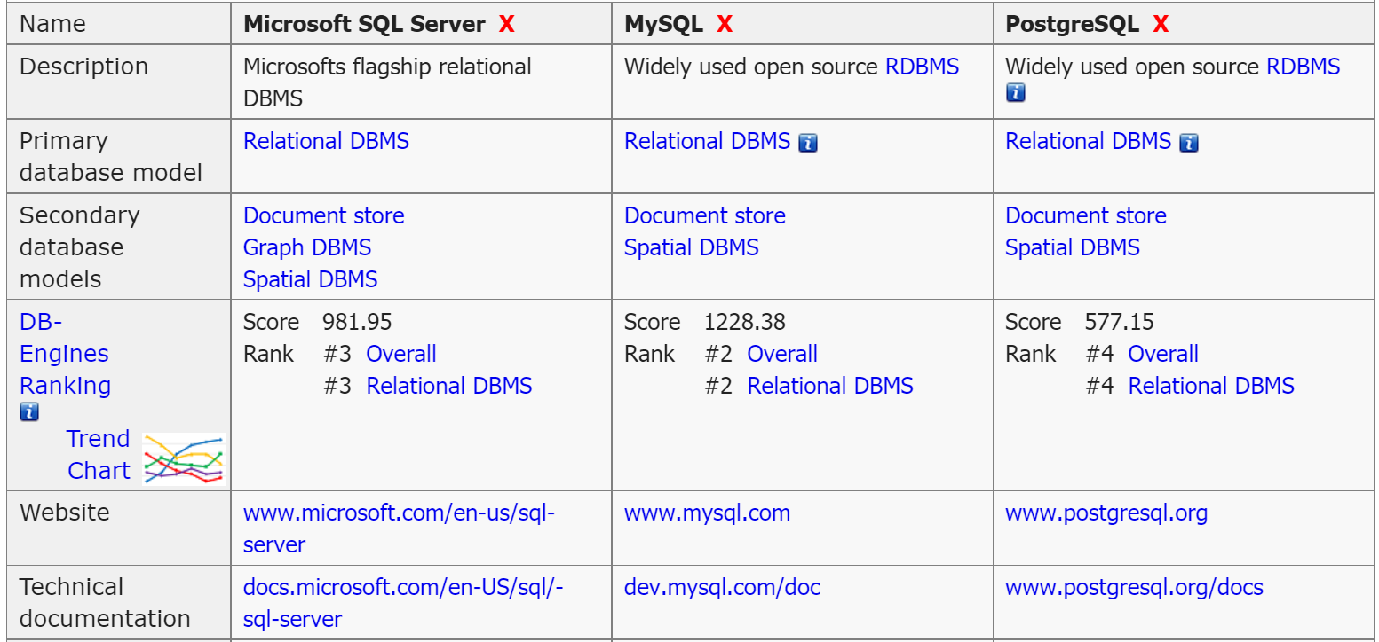

Slide 10
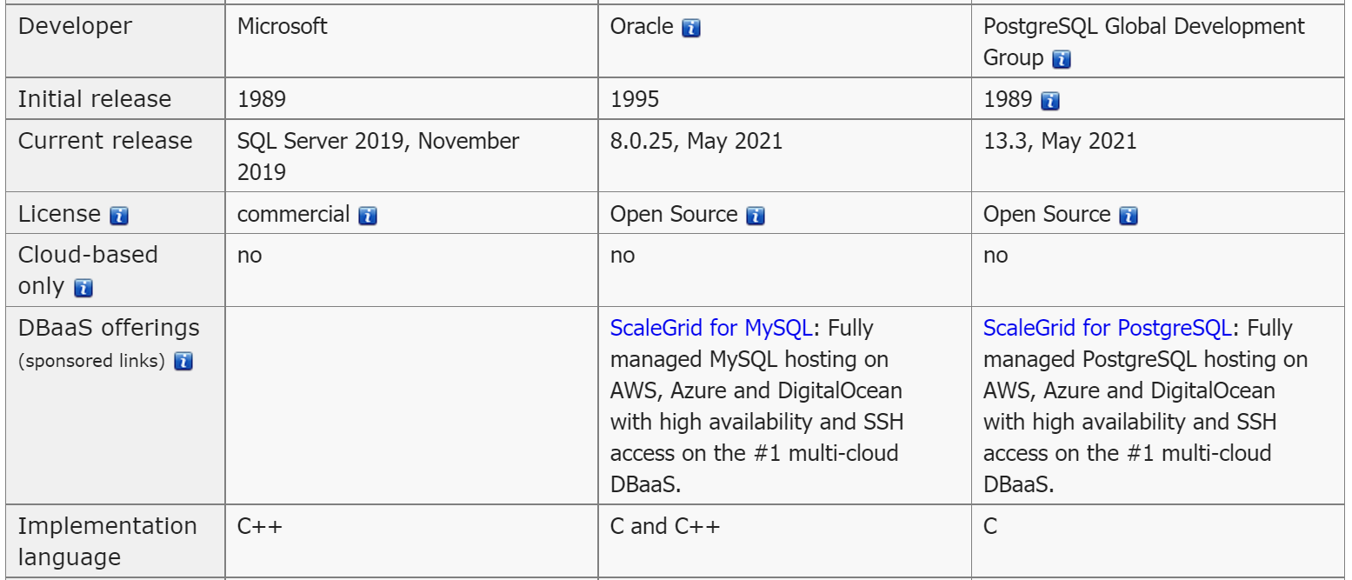

Slide 11
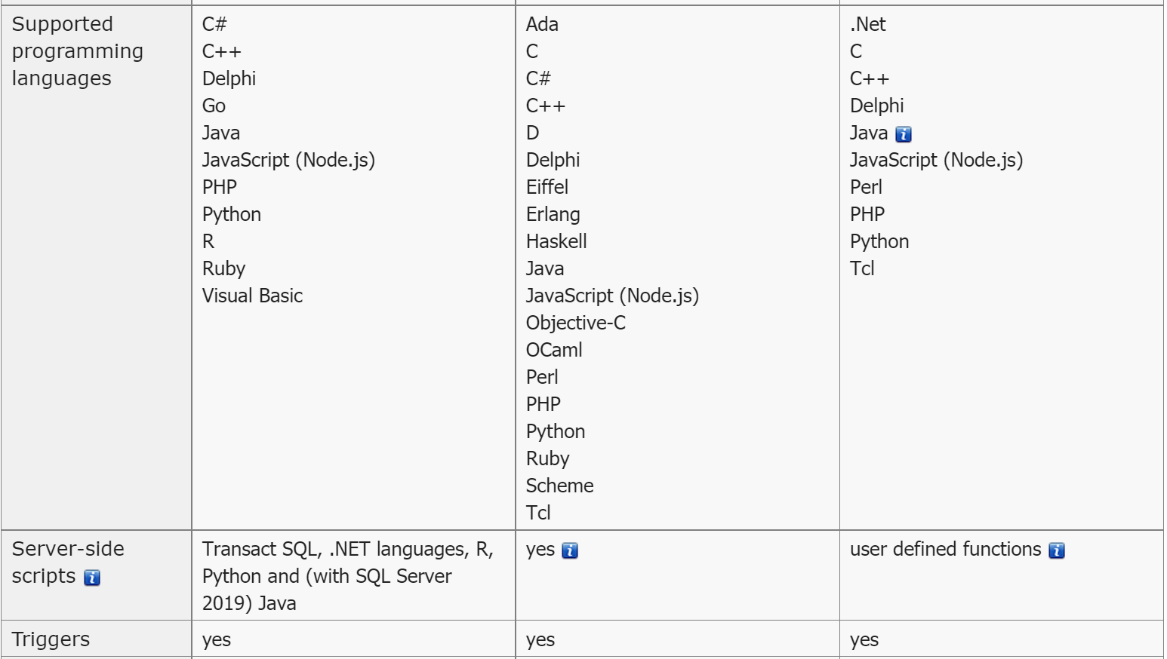

Slide 12
Some of MYSQL disadvantages are that it has been known to suffer from poor performance when scaling, open source development has lagged since Oracle has taken control of MySQL, and it does not include some advanced features that developers may be used to.
The main disadvantage of PostgreSQL is that it can be slower in performance than other databases such as MySQL. It is also slightly less popular than MySQL.
The main disadvantage of SQL Server IS Expensive pricing. Microsoft offers a free entry-level version called Express but can become very expensive as you scale your application.
Notes:
You can safely remove this slide. This slide design was provided by SlideModel.com – You can download more templates, shapes and elements for PowerPoint from http://slidemodel.com

Slide 13
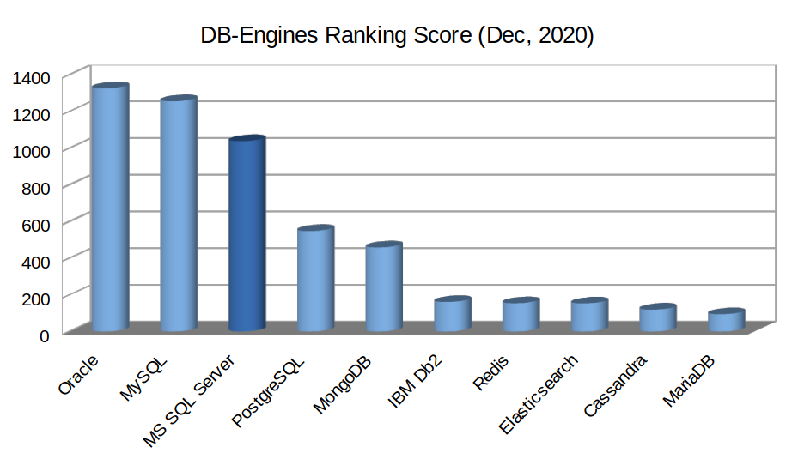
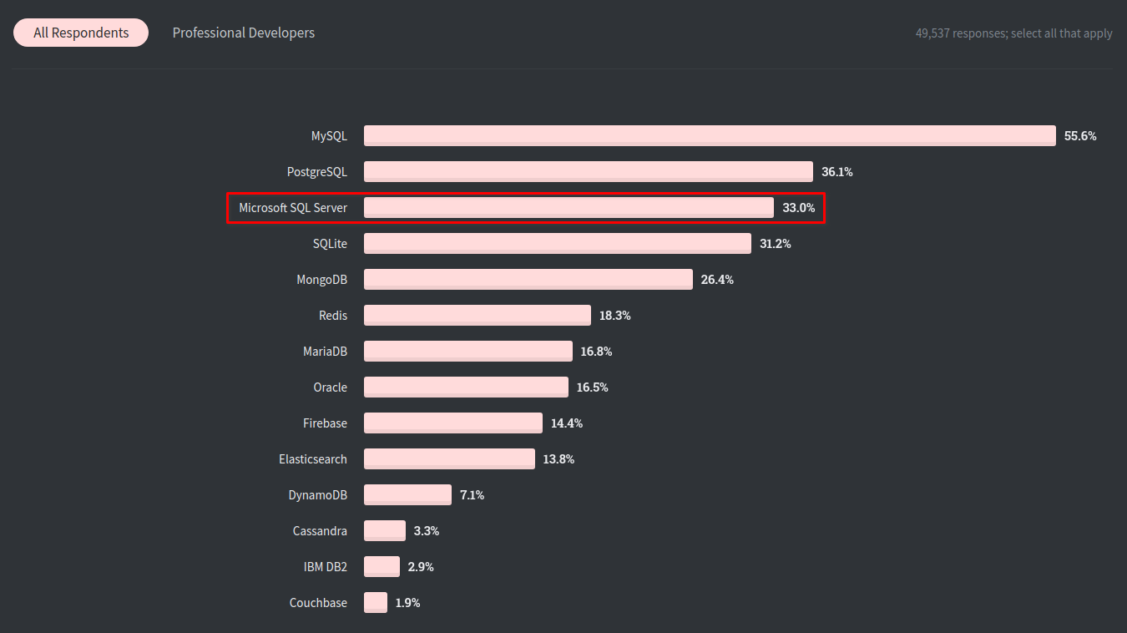
According to the
DB-Engines
According to the Stack
Overflow Developer

