Slide 1
Welcome to the world of Back-end Development !!

Slide 2
Intro To Node.js

Slide 3
Agenda
01
What is Node.js?
02
How Node Works
03
Node.js FUNdamentals: NPM

Slide 4
A glimpse at Back-End Dev
It’s code that connects the web to a database,
manages user connections, and powers the web
application itself.
Backend development works in tandem with the
front end to deliver the final product to the end
user.

Slide 5
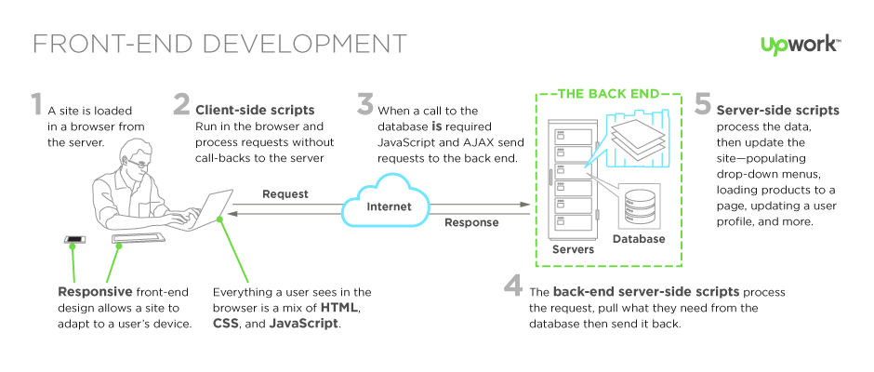
Front-end Development

Slide 6
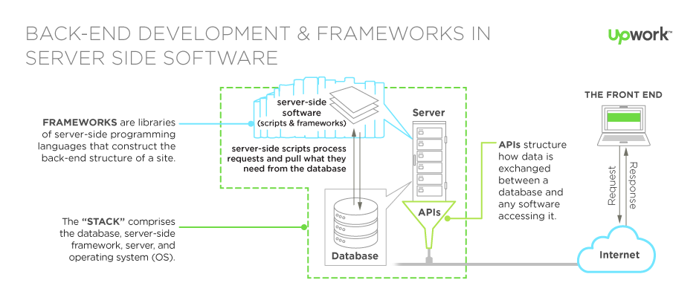
Back-End Development & Frameworks In Server Side Software

Slide 7
What is Node.js?
Open-source
and
cross-platform
A server-side
environment
A runtime
environment
built on Google Chrome's V8
Allows Node
developers to build
servers
and
network applications
with JavaScript.
a component of a
development
platform that allows developers to test a software program
while it’s running
V8 is Google’s
JavaScript engine
and is responsible
for executing
Node’s code. (the
navigator is much
stronger)
can be used to build
different types of
applications such as
command line
application, web
application, REST API
server
Notes:
https://i.ytimg.com/vi/XUSHH0E-7zk/maxresdefault.jpg made by Dahl Ryan

Slide 8
Why Node.js?
Asynchronous
License
Popularity
Node.js
eliminates the
waiting, and
simply
continues with
the next request.
=
very memory
efficient
and
non-blocking
Node.js is
released under
the MIT license
=
strong
investment
Used by Neflix,
LinkedIn,Uber,
Paypal,Medium,eBay,
Nasa
Very Fast
Cross-functional
Being built on
Google Chrome's V8 JavaScript Engine, Node.js
library is very
fast in code
execution.
As Node.js is
JavaScript, it
fills the gap
between
frontend and
backend skills
for developers

Slide 9
How Node Works?

Slide 10
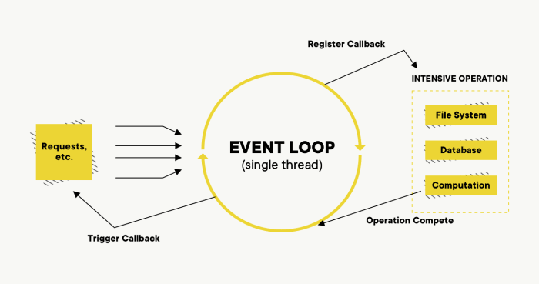

Slide 11
Node Module System
⚠ Every file in NodeJS is considered a Module. (vars & functions declared within it are scoped to that module)

Slide 12
NPM modules :
a set of publicly available, reusable
components, available through easy
installation via an online repository,
with version and dependency
management.
Node
Package
Manager
These are libraries built by the
awesome community which will
solve most of your generic
problems. npm (Node package
manager) has packages you can use in your apps to make your
development faster and efficient.

Slide 13
Thank you!

