Slide 1

Redux
What, Why & How

Slide 2


Redux
What is Redux ?
State container
Created by Dan Abramov
Can be used without React
Notes:
Redux est une bibliothèque open-source JavaScript de gestion d'état pour applications web. Elle est plus couramment utilisée avec des bibliothèques comme React ou Angular pour la construction d'interfaces utilisateur.
2015

Slide 3
Redux
Redux can be used with any framework like Angular, VueJs and any library like ReactJs.

Slide 4
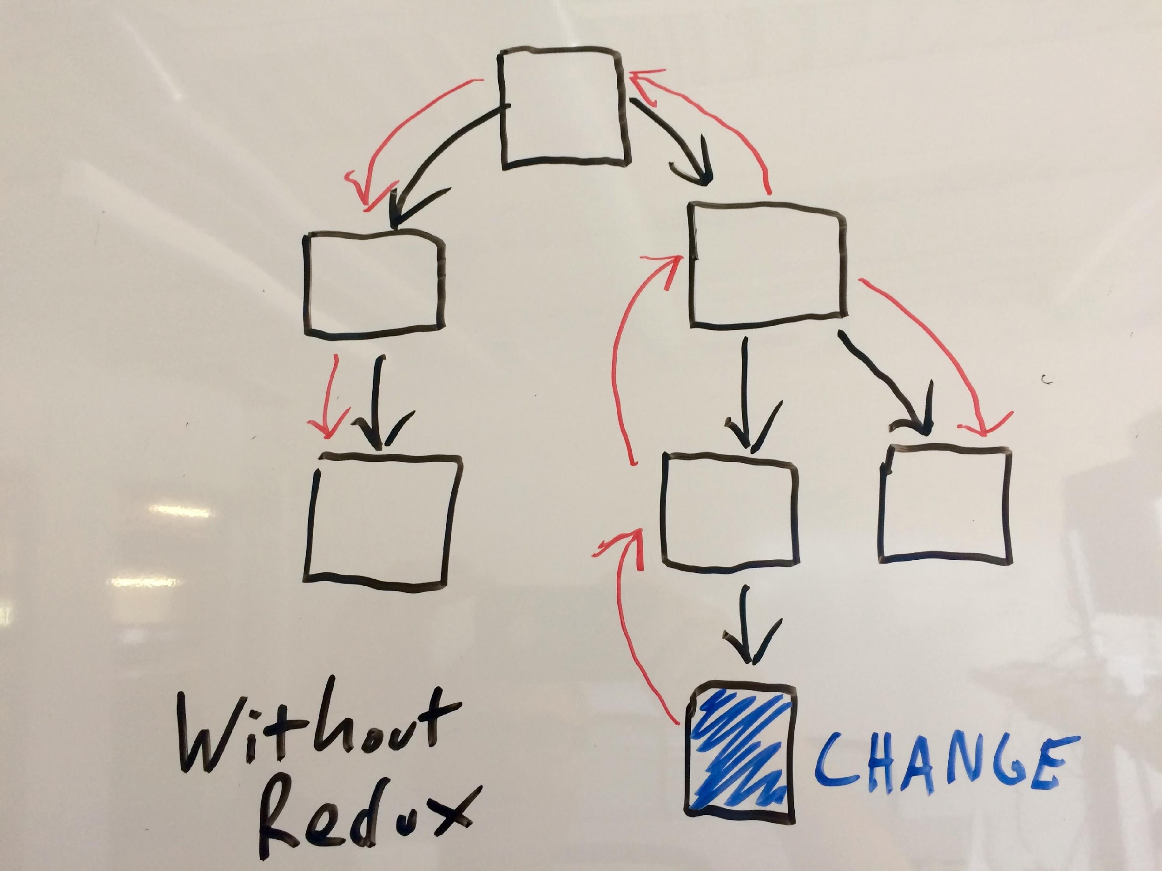
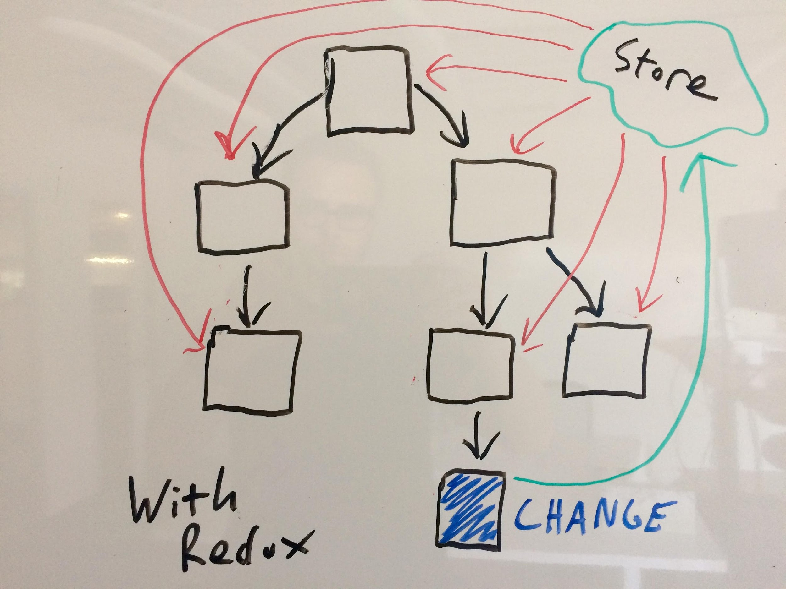
Redux
What problem does Redux solve ?
store

Slide 5
Redux
What is Redux ?
Single source of truth: The state of your whole application is stored in an object tree within a single store.
State is read-only: The only way to change the state is to emit an action,describing what happened.
Changes are made with pure functions: To specify how the state tree is transformed by actions, you write pure reducers.

Slide 6
Redux
Architecture of Redux
State: an object (nested)
Actions:
are plain JavaScript objects.
Actions must have a Type property that indicates the type of actions,Types should typically be defined as string constants,
describes intend change of state, think of an action as just a set of instructions used by Redux to update state.
function actionName(payload) {
return {type :ACTION, payload} }

Slide 7
Redux
View => Action => Reducer(s) => Store => View
Architecture of Redux
Reducers:
pure function, which takes the previous state and action as arguments, returns updated state
Const Reducer =(state , action )=> {
switch (action,type) {
case 1: return updated state;
case 2: return updated state;
default : return state
}
}
Export default Reducer

Slide 8
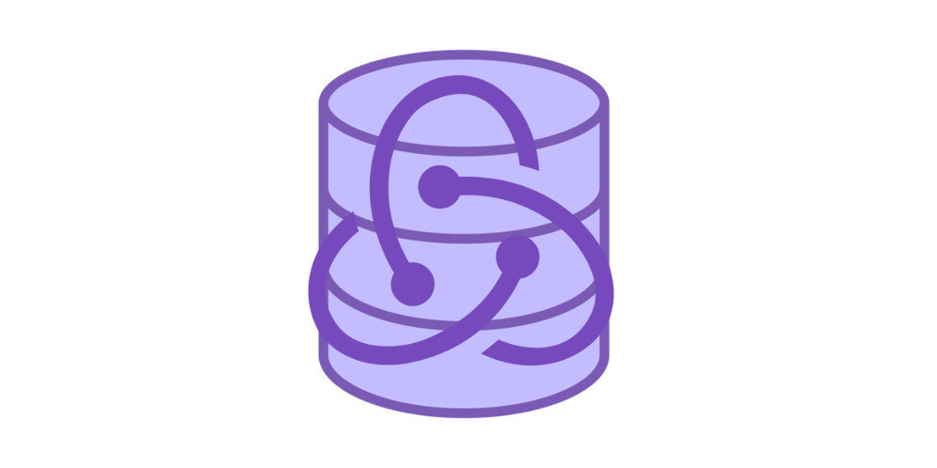
Redux
Architecture of Redux
Store :
Where state lives
Import {createStore} from ’redux ’
Const store = createStore( Reducer)
Export default store

Slide 9
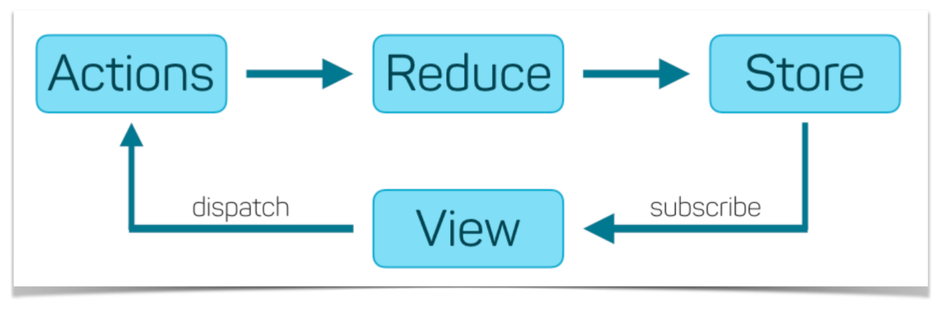
Redux
Architecture of Redux
3
4
2
1
5

Slide 10
Redux
Architecture of Redux
view

Slide 11
Redux
Example :
COUNTER
with React-Redux
Notes:
https://codesandbox.io/s/vnl1zyz677

