Slide 1
Intro To DOM
time to start making some cool stuff

Slide 2

Agenda
01
02
03
04
DOM: What?
Accessing the DOM
DOM & CSS
DOM Events

Slide 3
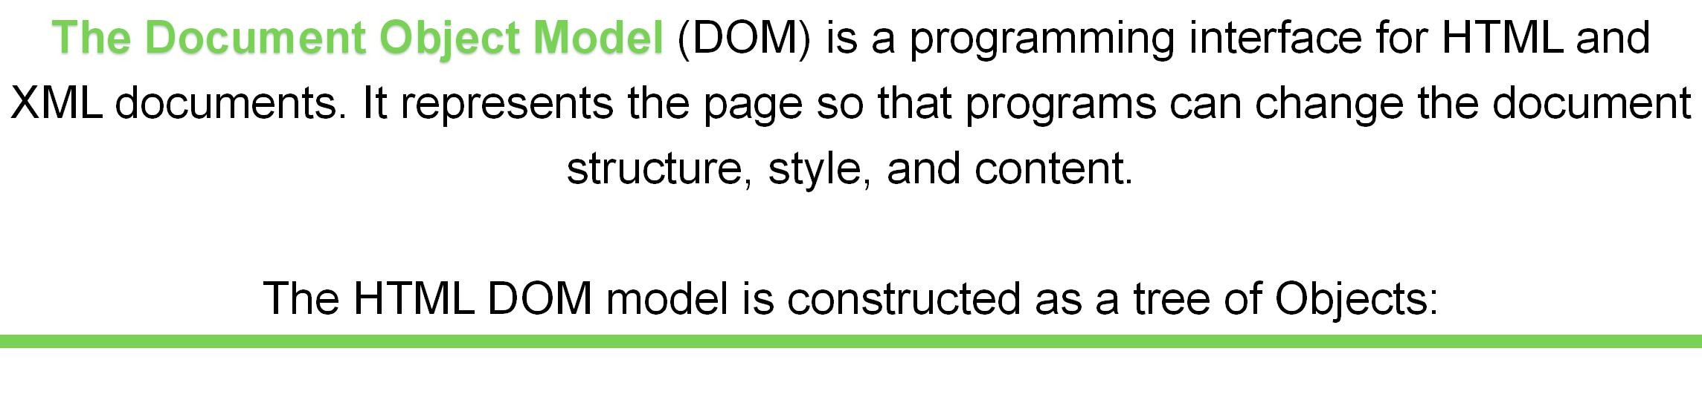

What is the DOM?

Slide 4
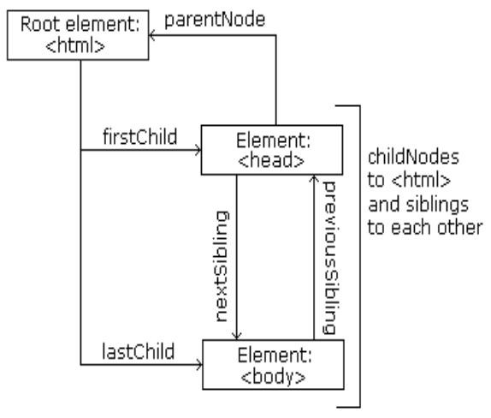

Slide 5
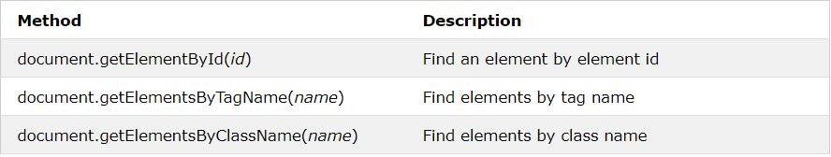
Accessing the DOM
The elements in an HTML document are available directly as document properties.
If you want to access any element in an HTML page, you always start with accessing the document object.
Finding HTML Elements

Slide 6

Target Elements With Selectors
document.querySelector — returns the first element within the document that matches the specified or
group of selector. If no matches are found null is returned..
document.querySelectorAll —
This represents the list of all the document’s elements that match the specified group of selectors.

Slide 7
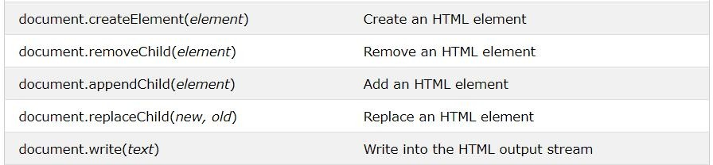
Adding HTML elements

Slide 8
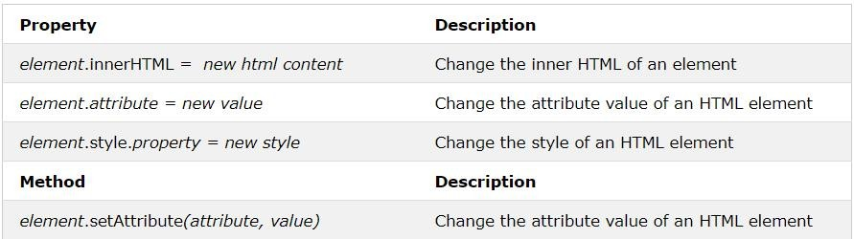
Changing HTML elements

Slide 9

document.getElementById(id).style.property = “new style”
D | O | M
C | S | S

Slide 10
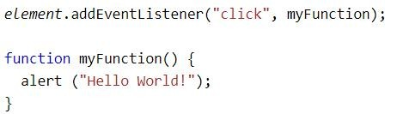
DOM EventListener
The addEventListener() method attaches an event handler to an element without overwriting existing event handlers.
You can add many event handlers of the same type to one element, i.e two "click" events. You can easily remove an event listener by using the removeEventListener() method.
Syntax : element.addEventListener(event, function);

Slide 11
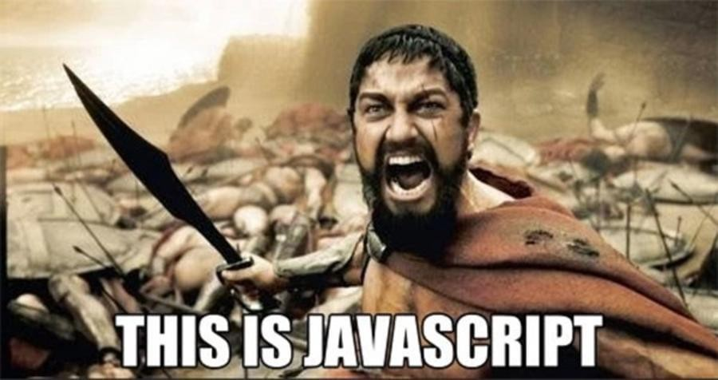

Slide 12

Thank You

