Slide 1
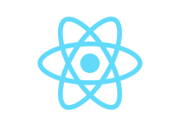
Itroduction To React
By Mouna Halima

Slide 2
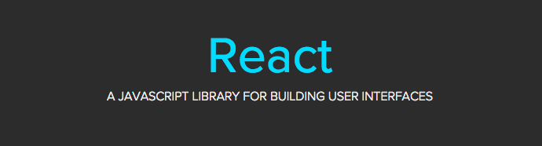
What is React?

Slide 3
What is React?
React (also known as React.js or ReactJS) is an open-source, front end, JavaScript library for building user interfaces or UI components.
React runs on the client as a Single Page Application(SPA), but can be used to built full stack apps by communicating with a server/API (eg. MERN stack)

Slide 4
Why use React?
Structure the view layer of your application
Reusable components with their own state
JSX – Dynamic markup
Easy to learn
Simple in debugging
Very popular in industry

Slide 5
Features of react
JSX
Components
One-way data binding
Virtual DOM
Simplicity
Performance

