Slide 1
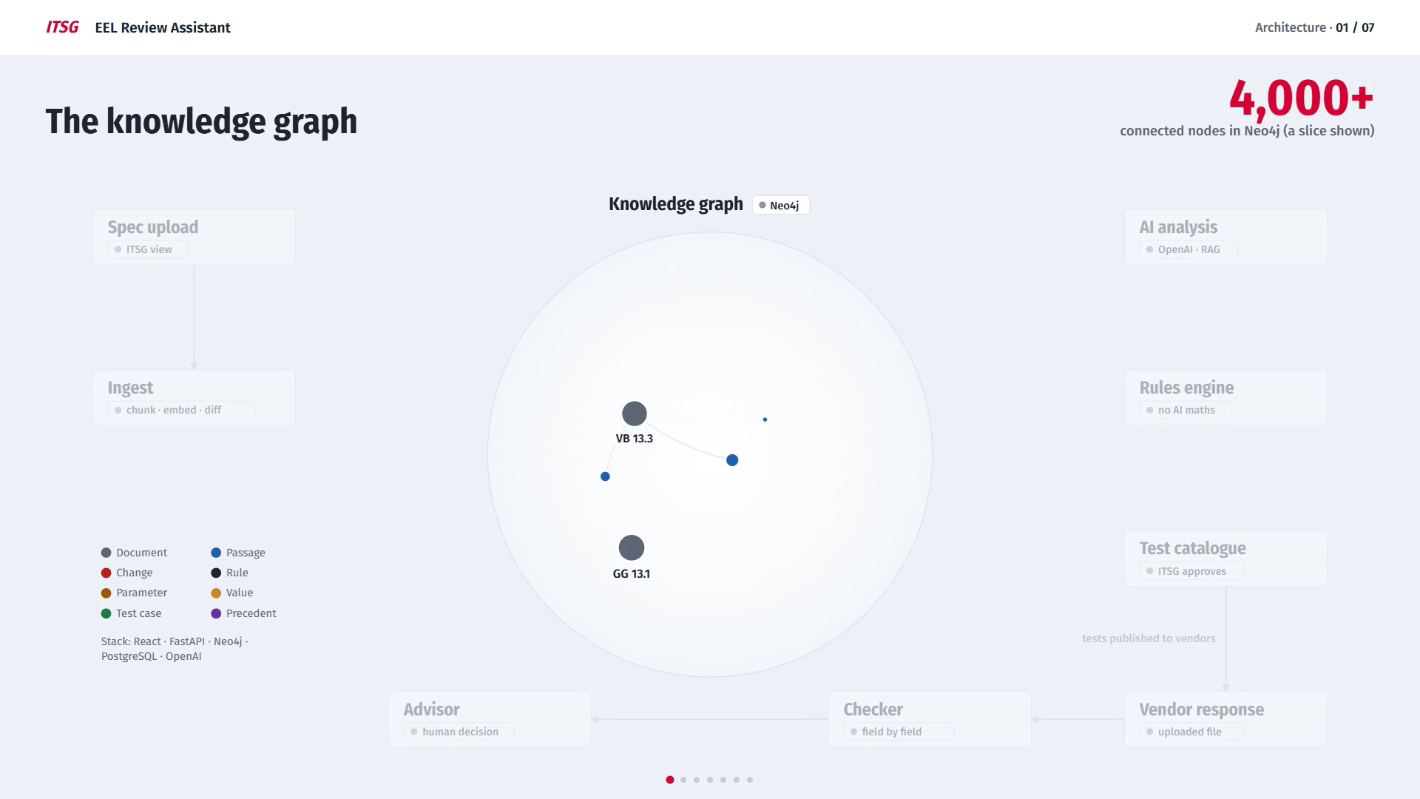
Notes:
This is our knowledge graph. It holds every rule, every document and every test case, and shows how they are connected.

Slide 2
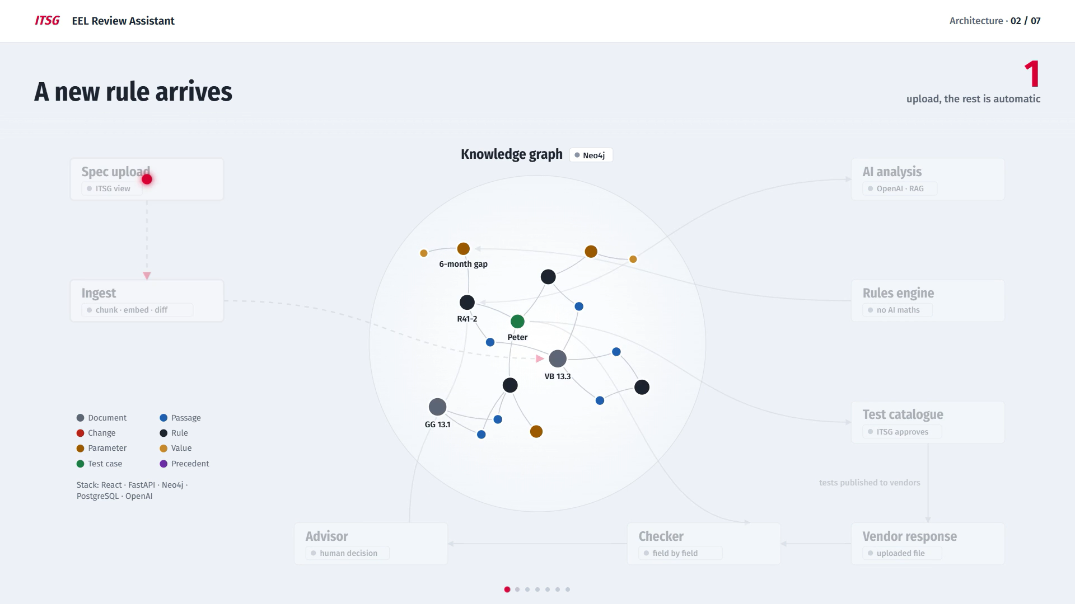
Notes:
Rules change every year. When a new version comes out, ITSG uploads it once. The platform breaks it into pieces, compares it with the old version, and marks exactly what changed in the graph.

Slide 3
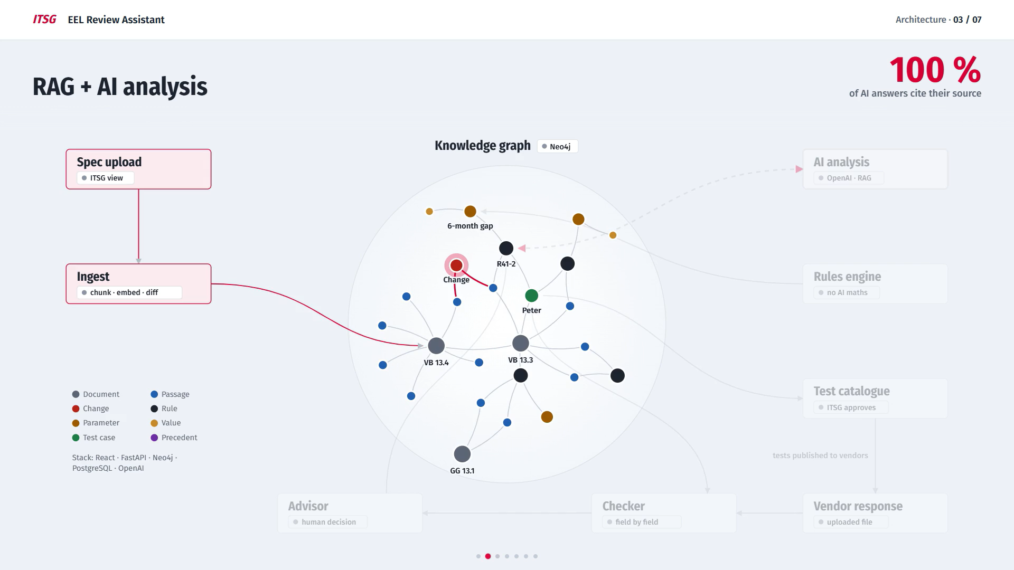
Notes:
This is where RAG comes in. The AI looks up everything connected to that change in the graph, finds the rule it affects, and explains what is different, always with the source.

Slide 4
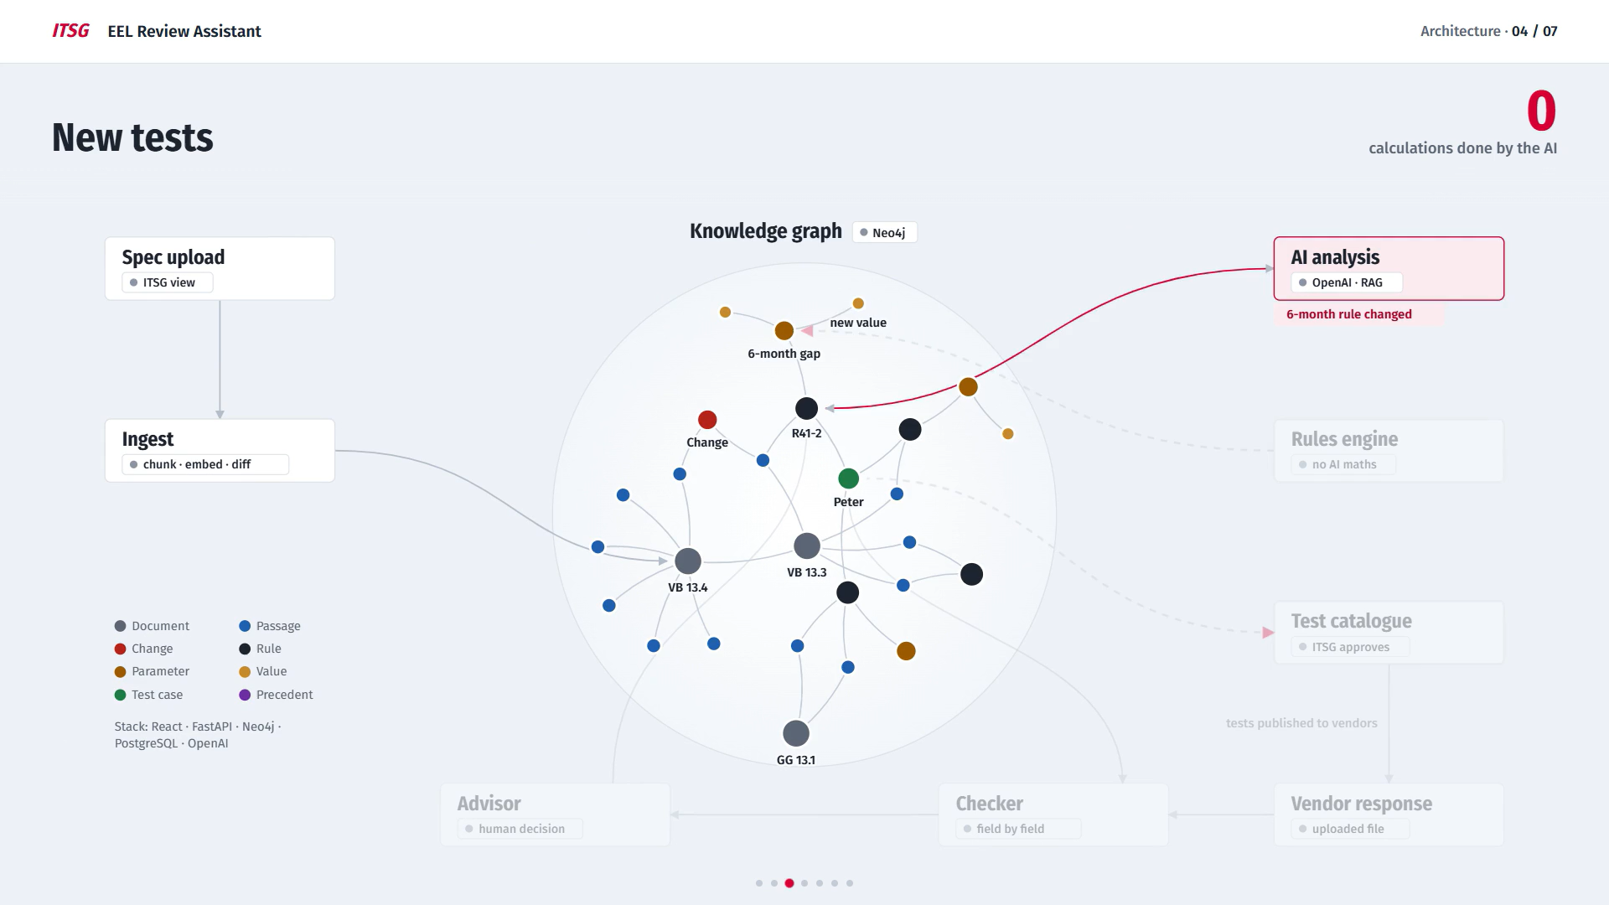
Notes:
Next, the rules engine creates new tests for the changed rule, one public and one hidden. It calculates the expected results itself, so there is no AI guessing, and ITSG approves them.

Slide 5
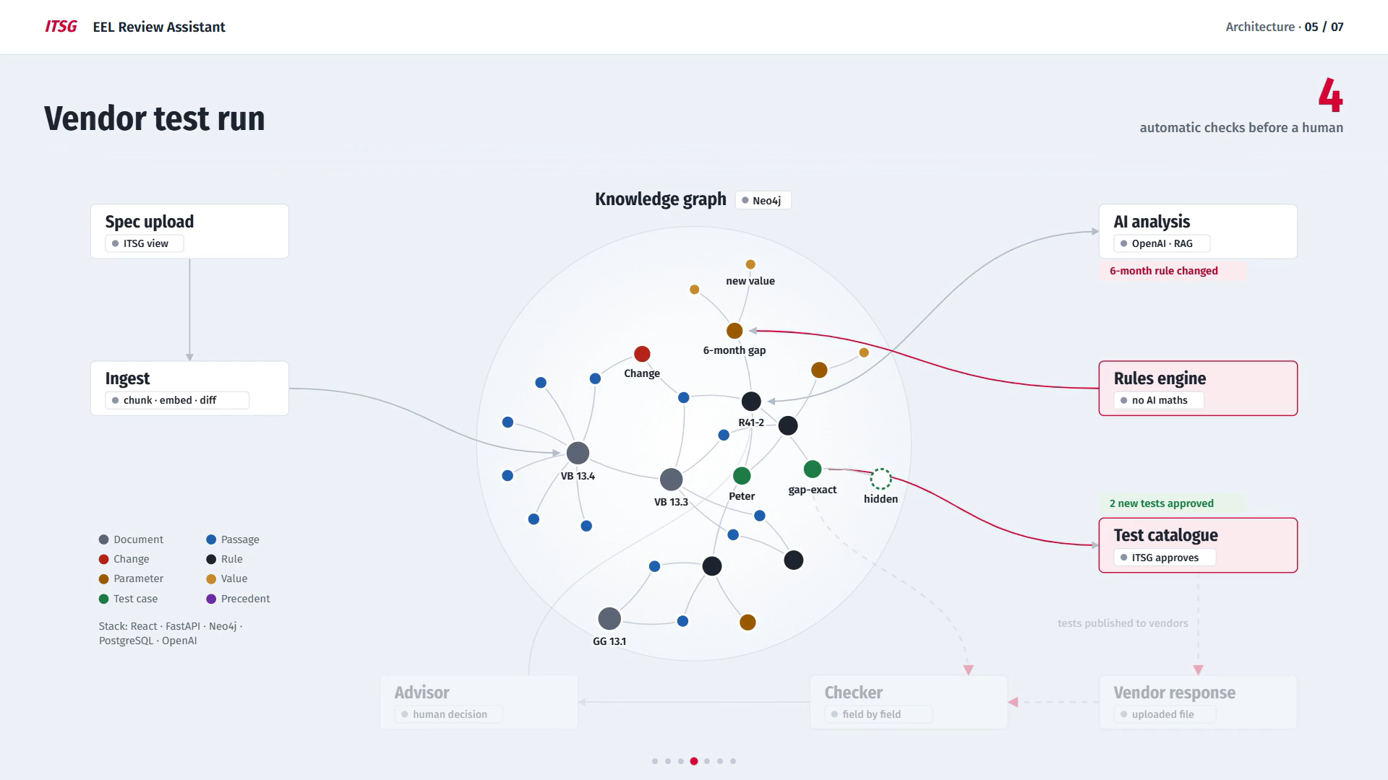
Notes:
Once approved, the tests go out to the vendors. Their software sends back a file, and our checker compares it field by field with the expected results.

Slide 6
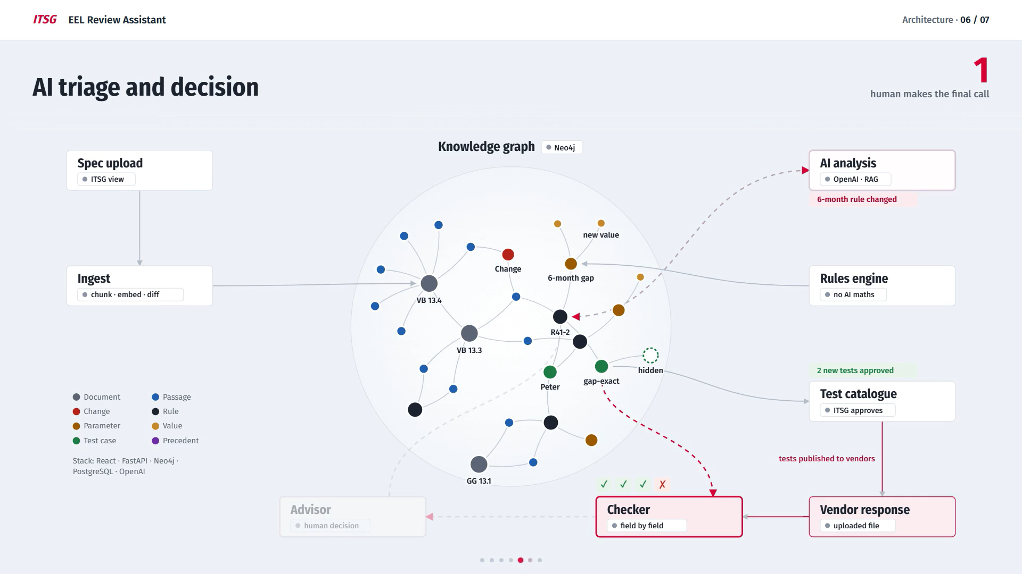
Notes:
If something doesn't match, the AI looks up the rule behind it and suggests whether it is a real error. But a human advisor always makes the final call.

Slide 7
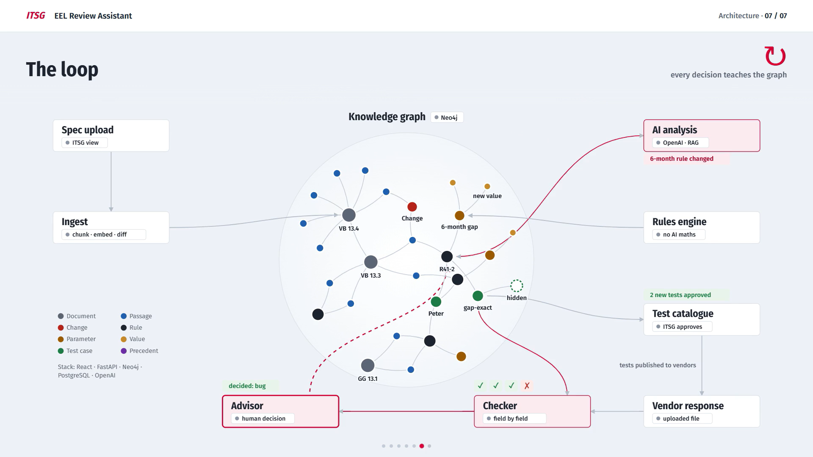
Notes:
Finally, the advisor's decision is saved in the graph. Next time the same difference appears, the platform already knows the answer. Let's see it live.

