Slide 1
BIG MART DATASET
Done by: Ahmed Afaan
1604-20-747-051(DST-5A)

Slide 2
Overview
“BIG MART” data set in collection of data from 10 stores in different cities .
“BIG MART” data had collected 2013 sales data for 1559 products.
In this we will see that how various features like Item weight , Item MRP , Item type etc plays a important role in increasing the sales.
With the help of python programming we can arrange this data in a proper manner.
Also we can case study and predict the sales growth and losses .

Slide 3
Introduction:
“BigMart” dataset is Handle by The Experience Data Scientist. Our AIM is to get
insights from the dataset. In this project ,we try to understand the data how various features play a role in increasing the sales of “BigMart’.The given url is
Url:“https://raw.githubusercontent.com/AmenaNajeeb/Data/ master/bigmart_data.csv”
The aim is to visualize data and understand the variables and products which play a key role in increasing sales

Slide 4
DESCRIPTION
There are 8523 rows and 12 columns.
Variables:
Item Identifier - unique product ID
Item Weight -weight of product
Item Fat Content -whether the product is low fat or high fat
Item Visibility -display area
Item Type -category of the product
Item MRP -price of the product
Outlet Identifier -unique store ID
Outlet Establishment Year -the year in which store was established
Outlet Size -the size of the store in terms of ground area covered
Outlet Location Type -type of city in which the store is located
Outlet Type -whether the outlet is just a small store or a supermarket
Item Outlet Sales -sales of the product in particular store which we have to predict
FILE:https://raw.githubusercontent.com/AmenaNajeeb/Data/master/bigmart_data.csv

Slide 5
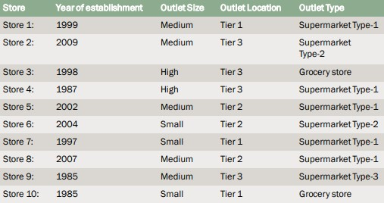
Ten stores in different cities:

Slide 6
DESCRIPTION
There are 8523 rows and 12 columns.
Variables:
Item Identifier - unique product ID
Item Weight -weight of product
Item Fat Content -whether the product is low fat or high fat
Item Visibility -display area
Item Type -category of the product
Item MRP -price of the product
Outlet Identifier -unique store ID
Outlet Establishment Year -the year in which store was established
Outlet Size -the size of the store in terms of ground area covered
Outlet Location Type -type of city in which the store is located
Outlet Type -whether the outlet is just a small store or a supermarket
Item Outlet Sales -sales of the product in particular store which we have to predict
FILE:https://raw.githubusercontent.com/AmenaNajeeb/Data/master/bigmart_data.csv

Slide 7
Project approach:
As the given following data is messy . We need to arrange and manage the following as:
■ Preprocessing the data
■ Arrange data (removing null values)
■ Analyse data (visualizing )
■ Modification data
■ Presenting data
Exploring data ➔➔➔ prepocessing data
Data preparation,cleaning and transformation comprises the majority of the work in a data mining application (90%). Pre-process Data means “Cleaning➔Integrate➔Package.
■ Analyse Data (Building model) Training and Testing.

Slide 8
Arrangement of Data (removing null values).
■ To deal with null values , first we need to find out the null values.
■ The given data have 3,873(1463+2410)null values.
■ 1,463-- Item weight null values. ■ 2,410 -- Outlet Size null values. Commands:
1. Itemnull=np.randint(6,21) df[“Item_Weight”][np.isnan(df[“Item_Weight”])]=Itemnull
2. df[“Outlet_Size]=df[“Outlet_Size”].dilona(“Medium”)The size of Data →Zeta bytes=270 .
→This huge data is of no use ,if cannot be interpret it.
→Huge data sitting in a data center is a burden, if correctly processed , it can become Digital Gold.
Data Visualisation:
The process of taking raw data, transforming into graphs, charts, image and even videos that explain the numbers and allow us to gain insight from it.

Slide 9
Results:
■ According the given Data , all the Data is convert into codes and plotted Graphs .
■ There are all 10 types of Categories in which the following graphs are plotted .
■ All the categories are plotted against the “ITEM OUTLET SALES”.

Slide 10
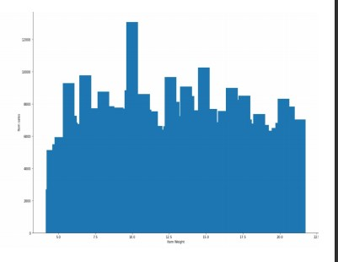
Item Weight
➔The highest weighted Item is 21.5kg.
➔The lowest weighted Item is 2.5kg. The highest weighted products sold is 10kg .

Slide 11
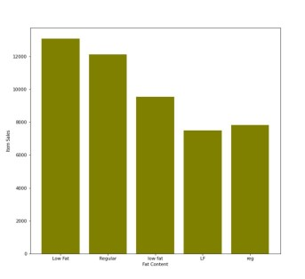
Item Fat Content:
➔There are 5 categories as shown in graph.
➔But There are only 2 types of fat content.
➔Low Fat or low fat or LF means the same .
➔ Regular or reg means the same

Slide 12
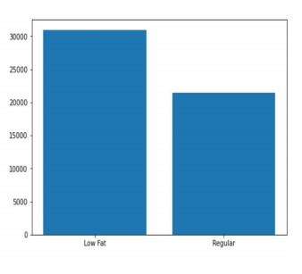
The Updates graph :
➔ The total number of product sold out for low fat is 31,000.
➔The total number of product sold out for the regular is 22,500.
➔As we can see the value of Low Fat products have a huge difference ( 9,500)

Slide 13
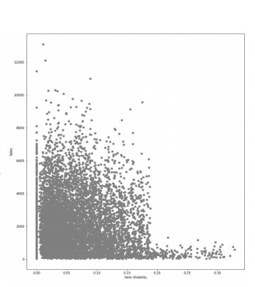
Item Visibility:
➔The most attractive part of a supermarket or store is displaying of products.
➔The Store have displayed 0-35% of product.
➔19-35% displayed products are lease sold .
➔ 2-18% displayed products are highly sold.

Slide 14
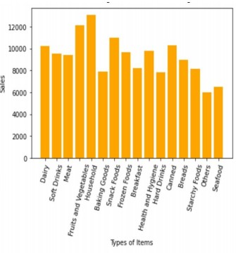
Item Type:
➔There are 16 categories .
➔Nearly , 13,000 products of Household are sold.
➔Fruits and Vegetables have 12,000 products sold.
➔ Other have least number of product s sold (6,200).

Slide 15
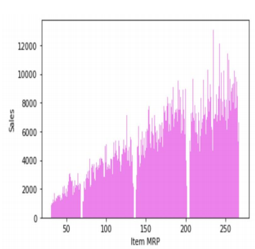
Item MRP:
➔ There are 4 Types of division between MRPs.
➔Lower MRP products are lease sold.
➔ Higher MRP products are highly sold.

Slide 16
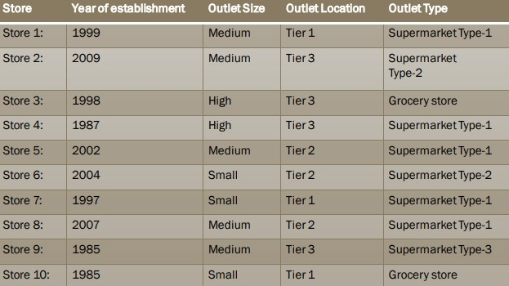
Stores and Details:

Slide 17
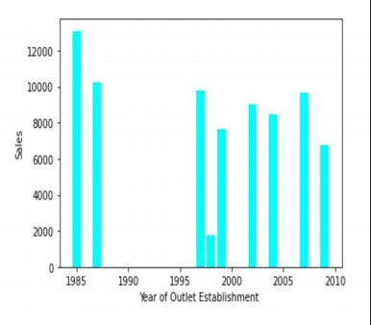
Outlet Establishment Year:
➔There were two stores opened in year 1985.
➔The Store Established in year 1987 has the highest number of individual products sold.
➔The Store Established in year 1998 have least number of product sold.

Slide 18
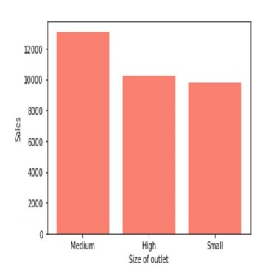
Outlet Size:
➔ There are only three categories.
➔ Medium size have more number of product sold.
➔ High and Small size products are almost same.

Slide 19
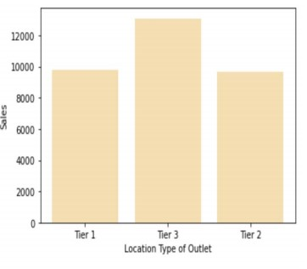
Outlet Location Type:
➔ There are only three categories.
➔ Tier 2 has highest number of products sold. ➔ Tier 1 and Tier 3 almost same number of product sold .

Slide 20
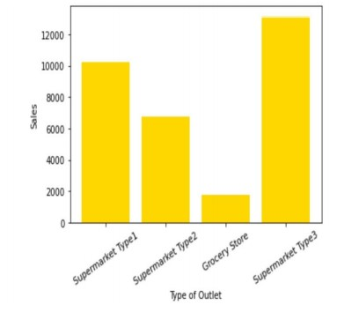
Outlet Type:
➔ There 4 Types of categories. ➔Supermarket( 1,2,3 ) and grocery store.
➔ Supermarket type 3 have highest number of products sold.
➔ Grocery store have least number of products sold.

Slide 21
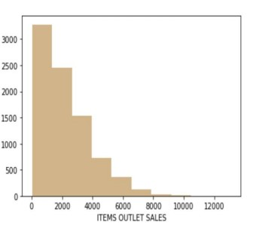
10. Item Outlet Sales:
This graph is plotted between “ Item Outlet Sales” and “Frequency”.
We can see that the frequency is rapidly decreases. Sales drops by 16% then 40% ...... The last frequency is at 10,000 .

Slide 22
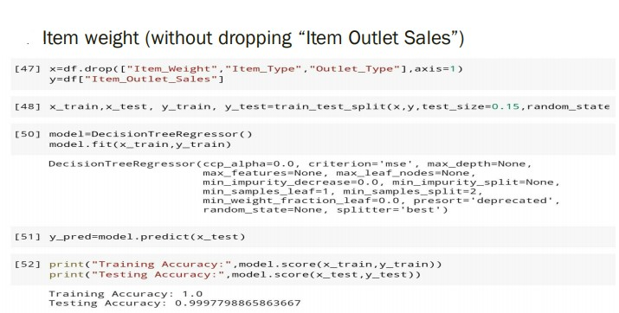
Results of Model Building:

Slide 23
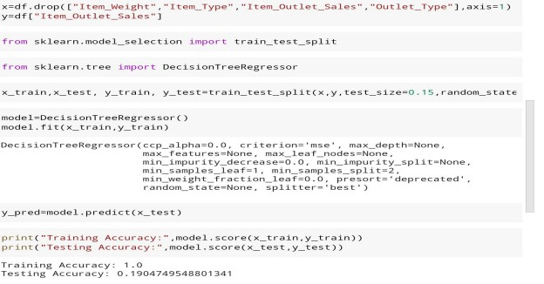
Item weight ( with dropping “Item Outlet Sales”):

Slide 24
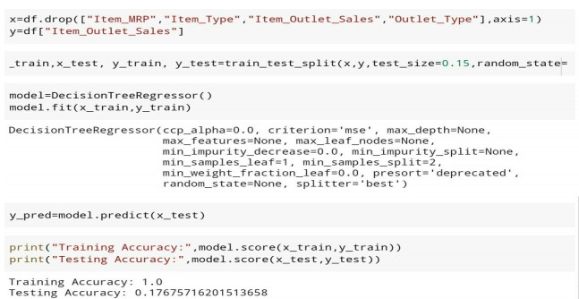
Item MRP ( with dropping “Item Outlet Sales”):

Slide 25
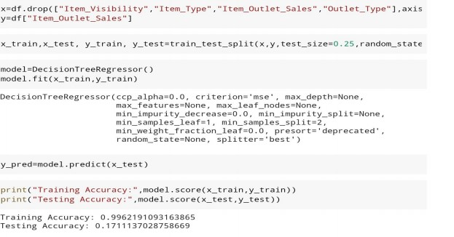
Item Visibility ( with dropping “Item Outlet Sales”):

Slide 26
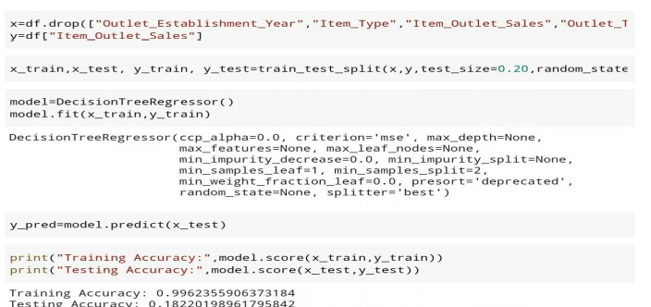
Outlet Establishment Year( with dropping “Item Outlet Sales”):

Slide 27
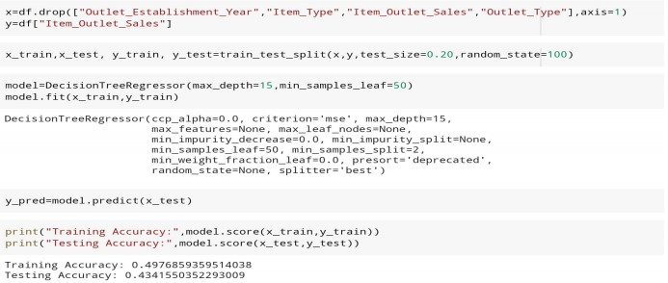
Model Building type 2:
Outlet Establishment Year( with dropping “Item Outlet Sales”):

Slide 28
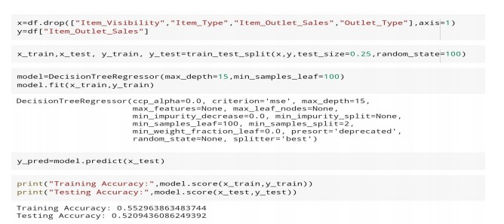
Item Visibility (with dropping “Item Outlet Sales”:

Slide 29
Conclusion:
After the brief visualization of the following data “BigMart” . The Factors that play an important role in increase of sales are :
Fat Content- Fat Content brings a huge impact in Sales. It is the most preferred choice of customers.
2. Item visibility-Item Visibility with 2-19% attracts more number of customer’s.
3. Household Item, Fruit, Vegetables and Snacks have more number of products sold . Hence it plays an important role in increasing of sales.
4. Item MRP- Higher MRP products are highly sold in Sales .
5. Outlet Establishment Year- Old is Gold , hence the old store attracts more customers in sales.
6. Medium size with Tier 3 location is like a good mine . 7. Supermarket Type-3 increase the sales by 20% when compared to others. These are the number of various features which can bring a huge impact on sales .

Slide 30
THANK YOU FOR LISTENING

