Slide 1
Final Year Project
A Simulation-Based Framework for
Mitigating a 51% Attack on Blockchain Networks
Presented by Ahmad Ali • BC220425973
Group ID: F25PROJECT5043F
Supervisor: Dr. Fouzia Jumani • Virtual University of Pakistan

Slide 2
Agenda
• Background: what is a 51% attack
• Problem statement and project goal
• Proposed defense: Safe Mode Detection
• System architecture and design
• Implementation walkthrough
• GUI walkthrough (intro, configuration, live simulation, results, event logs)
• Live demonstration
• Results and analysis
• Limitations and future work
• Conclusion

Slide 3
Background
• Proof-of-Work blockchains agree on history using the longest chain rule
• Honest miners normally control the majority of the network's hashrate
• If one miner gains more than 50% of the hashrate, the rule starts to break down
• That miner can secretly build a private chain and publish it later to replace the public one
• This is what is called a 51% attack
• Several smaller PoW coins (Ethereum Classic, Bitcoin Gold, Verge) have already been hit

Slide 4
How the Attack Works
1. Attacker quietly forks the chain
2. Mines blocks on the private chain in secret
3. Inserts a double-spend transaction on the private fork
4. Waits until the private chain is longer than the public one
5. Publishes the private chain — the network adopts it because it is longer
6. Original transactions are erased, attacker spends the same coins twice
Once the attacker controls enough hashrate, this is not a matter of luck. Given enough time the longer chain will eventually be theirs.

Slide 5
Problem Statement
• Smaller PoW networks have low total hashrate
• An attacker with modest mining hardware can rent enough cloud compute power to cross 50%
• Once they cross it, double-spending becomes possible
• Standard longest-chain rule cannot tell an honest reorganization from a fraudulent one
• We need a defense that does not rely on hashrate alone

Slide 6
Project Goal
• Build a Python simulation of a small PoW blockchain
• Make a malicious miner capable of carrying out the 51% attack
• Implement Safe Mode Detection and measure how it changes the result
• Provide a GUI that lets anyone run experiments interactively
• Compute hashrate from the number of mining nodes a miner owns (realistic, not a fixed number)

Slide 7
Proposed Defense: Safe Mode Detection
Safe Mode Detection has two parts that work together:
1. Long Private Chain (LPC)
Reject any block that would create six or more consecutive blocks by the same miner. This prevents any single party from dominating block production.
2. UTXO Comparison
When a competing chain is published, compare the UTXO snapshots of both chains. Any difference is evidence of a double-spend, the chain is rejected.
Together: even a > 50% attacker cannot replace the honest chain without either tripping the LPC streak limit or producing UTXO differences that the comparison step catches.

Slide 8
Dynamic Hashrate from Node Count
Hashrate is not a fixed number — it is derived from the nodes a miner controls:
MaliciousMiner('Attacker', num_nodes=17) # attacker owns 17 mining nodes
HonestMiner('Honest_1', num_nodes=5) # each honest miner owns 5 nodes
Network computes at runtime:
hashrate = miner.num_nodes / total_network_nodes
Example: 5 honest miners × 5 nodes = 25 honest nodes
Attacker: 17 nodes → 17 / 42 = 40.5% hashrate
This makes the simulation realistic: adding more mining hardware increases your share of the network proportionally, just like a real Proof-of-Work network.

Slide 9
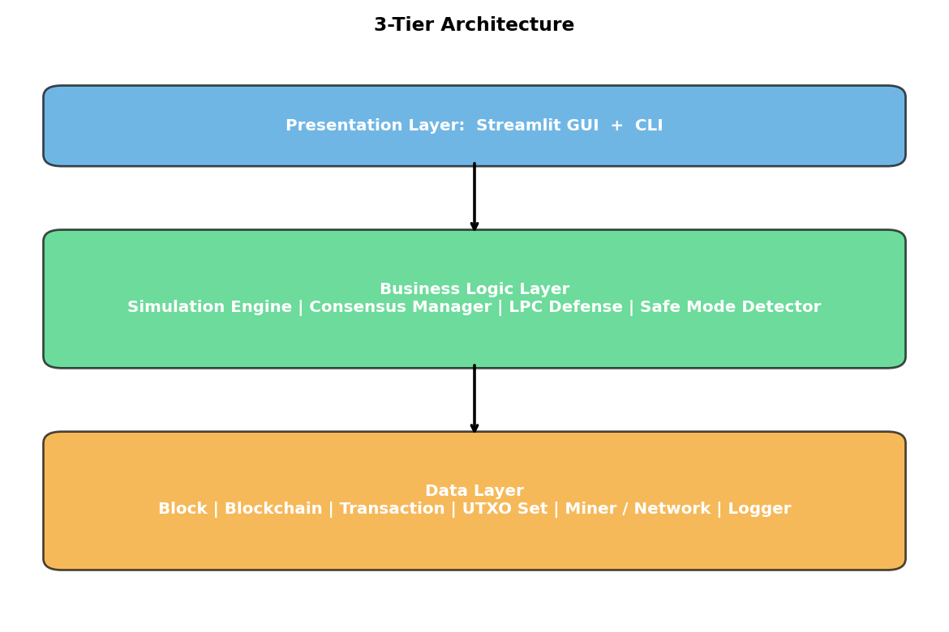
System Architecture (Three-Tier)

Slide 10
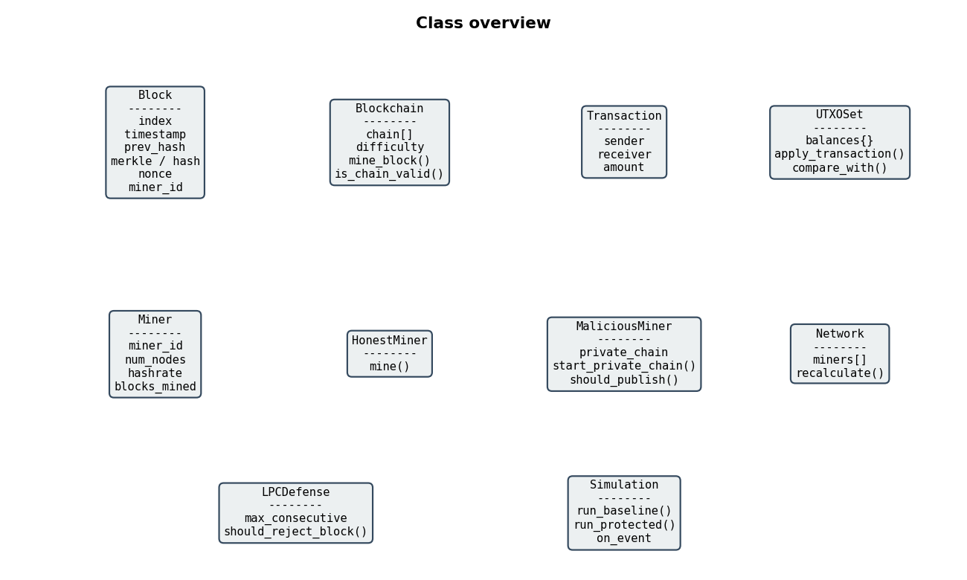
Main Classes

Slide 11
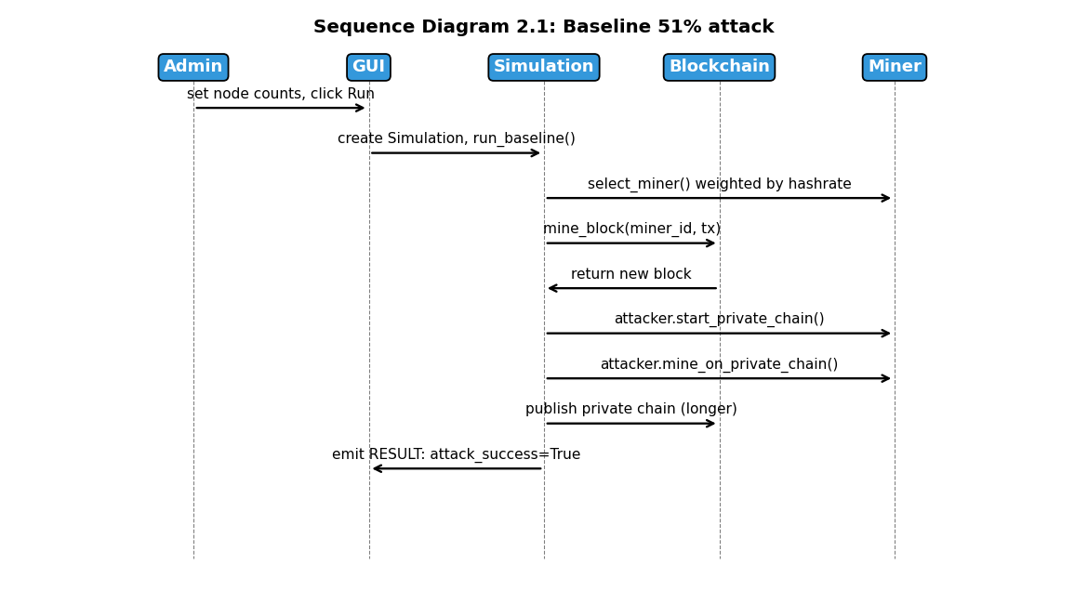
Sequence: Baseline Attack

Slide 12
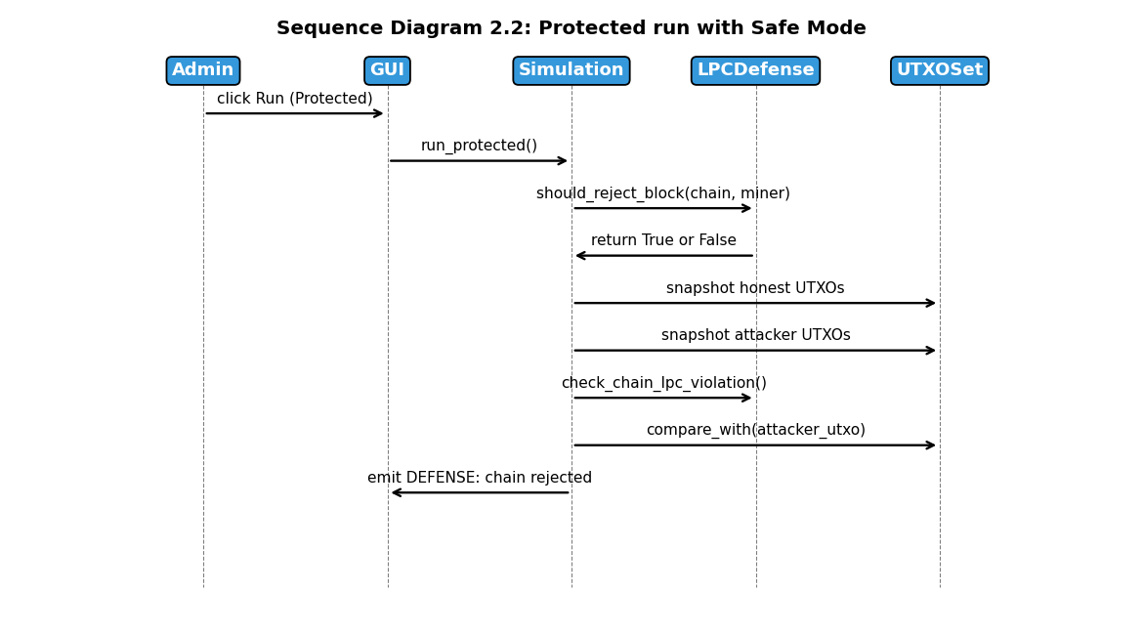
Sequence: Protected Run

Slide 13
Tools and Libraries
• Python 3.10 — programming language
• Streamlit — interactive web GUI built in pure Python
• Matplotlib + Plotly — charts (static for report, interactive for GUI)
• Pandas — tabulating results and CSV export
• hashlib (stdlib) — SHA-256 for block hashing
• Visual Studio Code — development environment

Slide 14
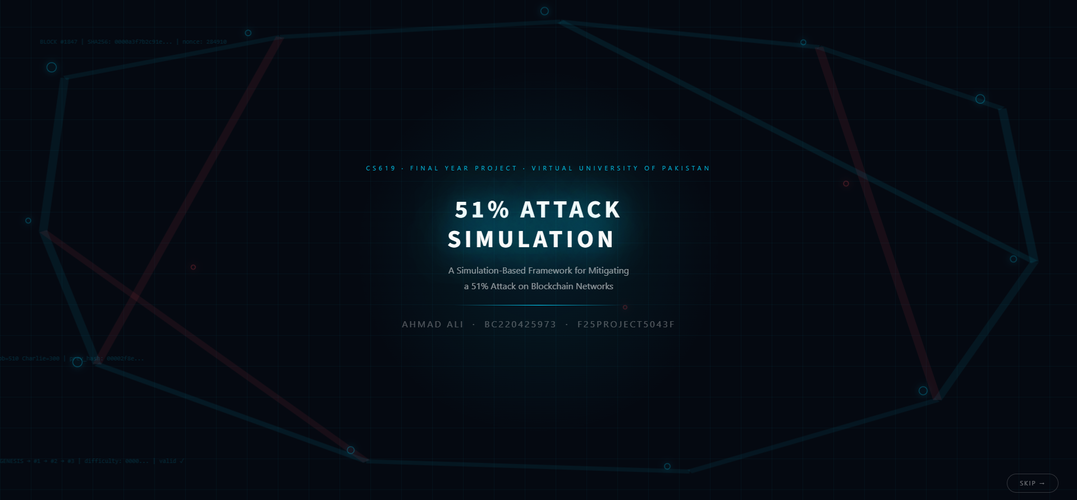
GUI: Intro Animation
Full-screen intro with animated network graph and project title — press SKIP to enter the app

Slide 15
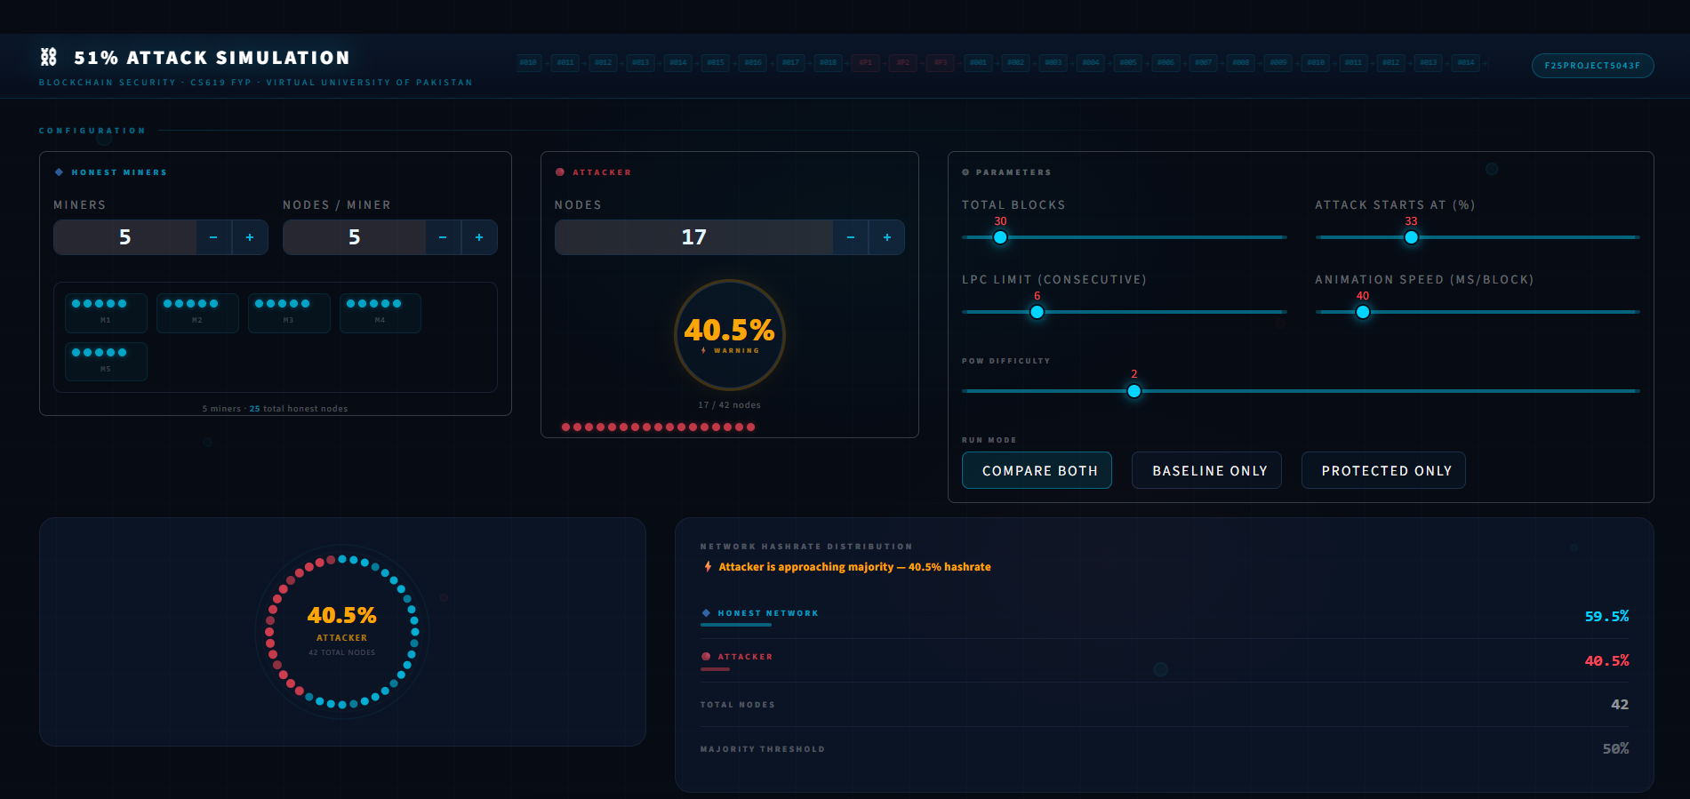
GUI: Configuration Panel
• Stepper controls (not sliders) for miners/nodes
• Visual node-dot grid per miner
• Live % ring gauge for attacker hashrate
• WARNING badge when attacker nears 50%
• Network ring topology diagram
• Run mode: Compare Both / Baseline Only / Protected Only
3-column bento grid: honest miners (with node-dot grid), attacker (live hashrate ring), parameters

Slide 16
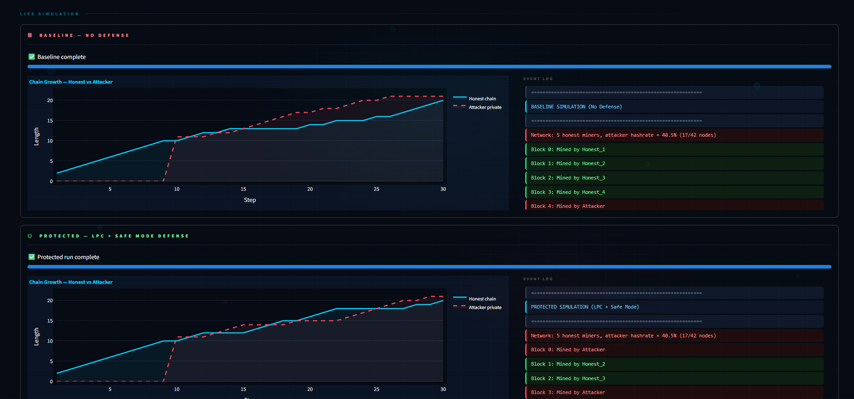
GUI: Live Simulation View
• Inline rendering — no tab switching
• Chain growth: honest (cyan) vs attacker (red dashed)
• Green = mined / Red = attack / Blue = defense
• Baseline runs first, Protected runs after
• Progress bar per section
Baseline (top) and Protected (bottom) sections run inline — chain growth chart + color-coded event log

Slide 17
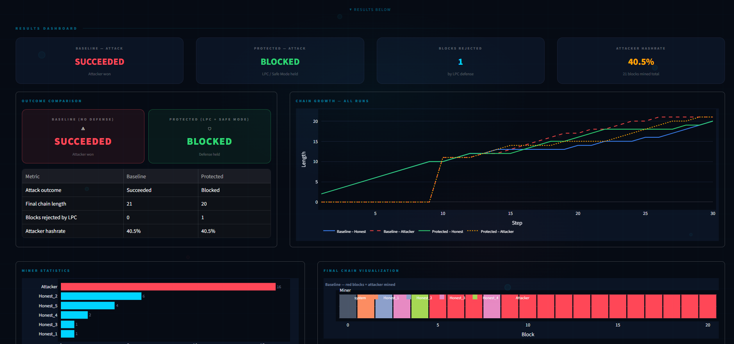
GUI: Results Dashboard
• SUCCEEDED (red) vs BLOCKED (green) status cards
• Comparison table for both scenarios
• 4-line chain growth chart
• Horizontal bar: blocks mined per miner
• Color-coded chain block strip
SUCCEEDED (red) vs BLOCKED (green) outcome cards | 4-line chain growth | miner bar chart | chain viz

Slide 18
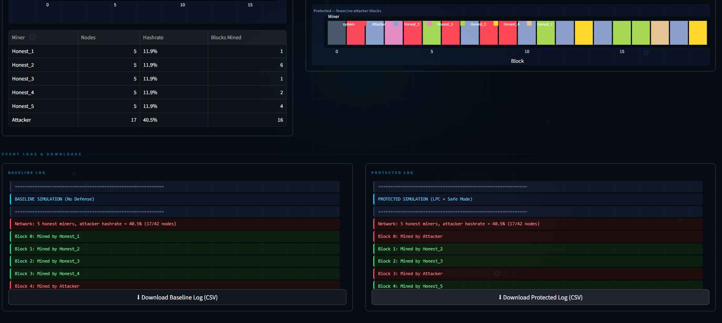
GUI: Miner Stats & Event Logs
• Miner table: nodes, hashrate, blocks mined
• Protected chain viz strip
• Full color-coded event logs
• CSV download for both runs
Miner table (nodes, hashrate, blocks mined) | Protected chain viz | color-coded event logs + CSV download

Slide 19
Live Demo
Run the GUI:
streamlit run app.py
Demonstrate:
1. Adjust attacker nodes — watch the hashrate readout cross 50%
2. Run Compare mode — both scenarios execute side by side
3. Baseline result: attacker SUCCEEDS (chain replaced)
4. Protected result: LPC + UTXO check BLOCKS the attack
5. Inspect the chain visualizer and event log details

Slide 20
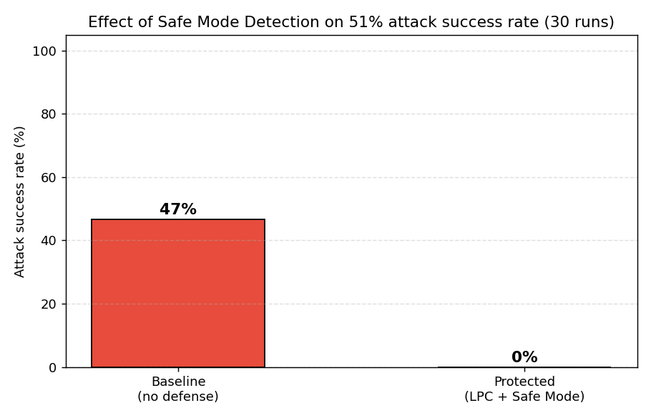
Result 1: Attack Success Rate
Baseline 47% success vs Protected 0% — Safe Mode catches every attack at 54.5% hashrate

Slide 21
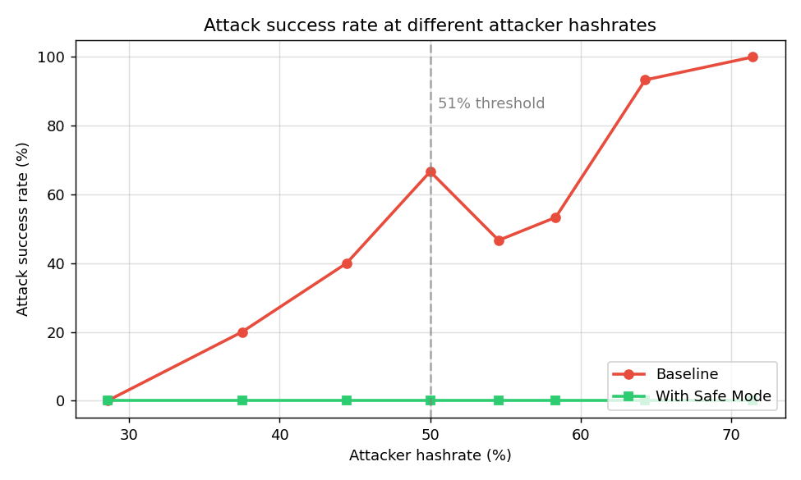
Result 2: Sweep Across Attacker Hashrates
Even at 70%+ attacker hashrate, the protected line stays at 0%

Slide 22
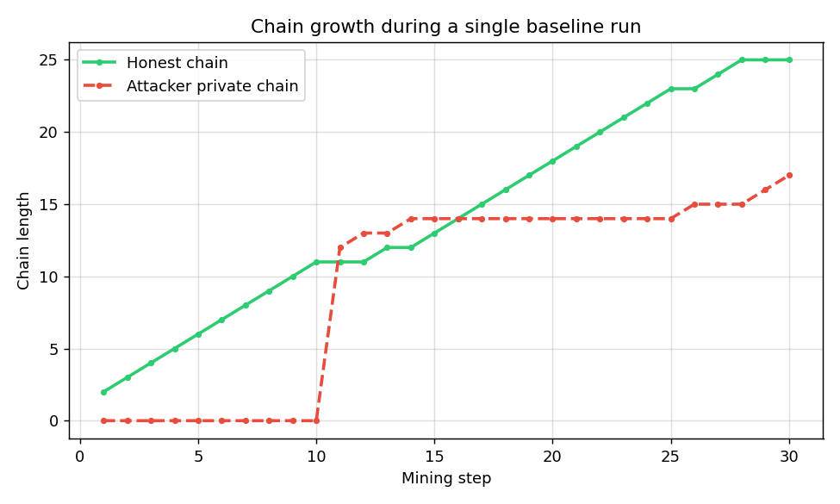
Result 3: Single-Run Chain Growth
Honest vs attacker private chain over time — until the fork point only the public chain grows

Slide 23
Limitations
• Mining is modeled probabilistically (weighted random selection), not real hash competition — standard for academic simulators
• No network latency or partition modeling
• Only the secret-fork-and-publish attack pattern is implemented
• Difficulty is fixed; real Bitcoin adjusts it every 2016 blocks
• These are deliberate scope limits, documented in the report

Slide 24
Future Work
• Add network latency and partition modeling for realism
• Implement and compare other defenses (checkpointing, finality gadgets)
• Add other attack patterns: selfish mining, eclipse attacks
• Scale up to many more miners and longer chains
• Wrap the engine into a reusable Python package others can extend

Slide 25
Conclusion
• Built a working Python simulation of a Proof-of-Work blockchain
• Implemented a malicious miner that carries out 51% attacks
• Implemented Safe Mode Detection: LPC + UTXO comparison
• Hashrate is derived dynamically from node counts, as the supervisor required
• Streamlit GUI lets anyone run experiments and watch the attack live
• Results: 47% baseline attack success dropped to 0% with the defense
The defense works under the conditions tested. Limitations and future work are documented in the report.

Slide 26
Thank You
Questions and feedback welcome
Ahmad Ali • BC220425973 • F25PROJECT5043F

