Slide 1


MUHAMMAD AHMAD
Who I am:

Slide 2
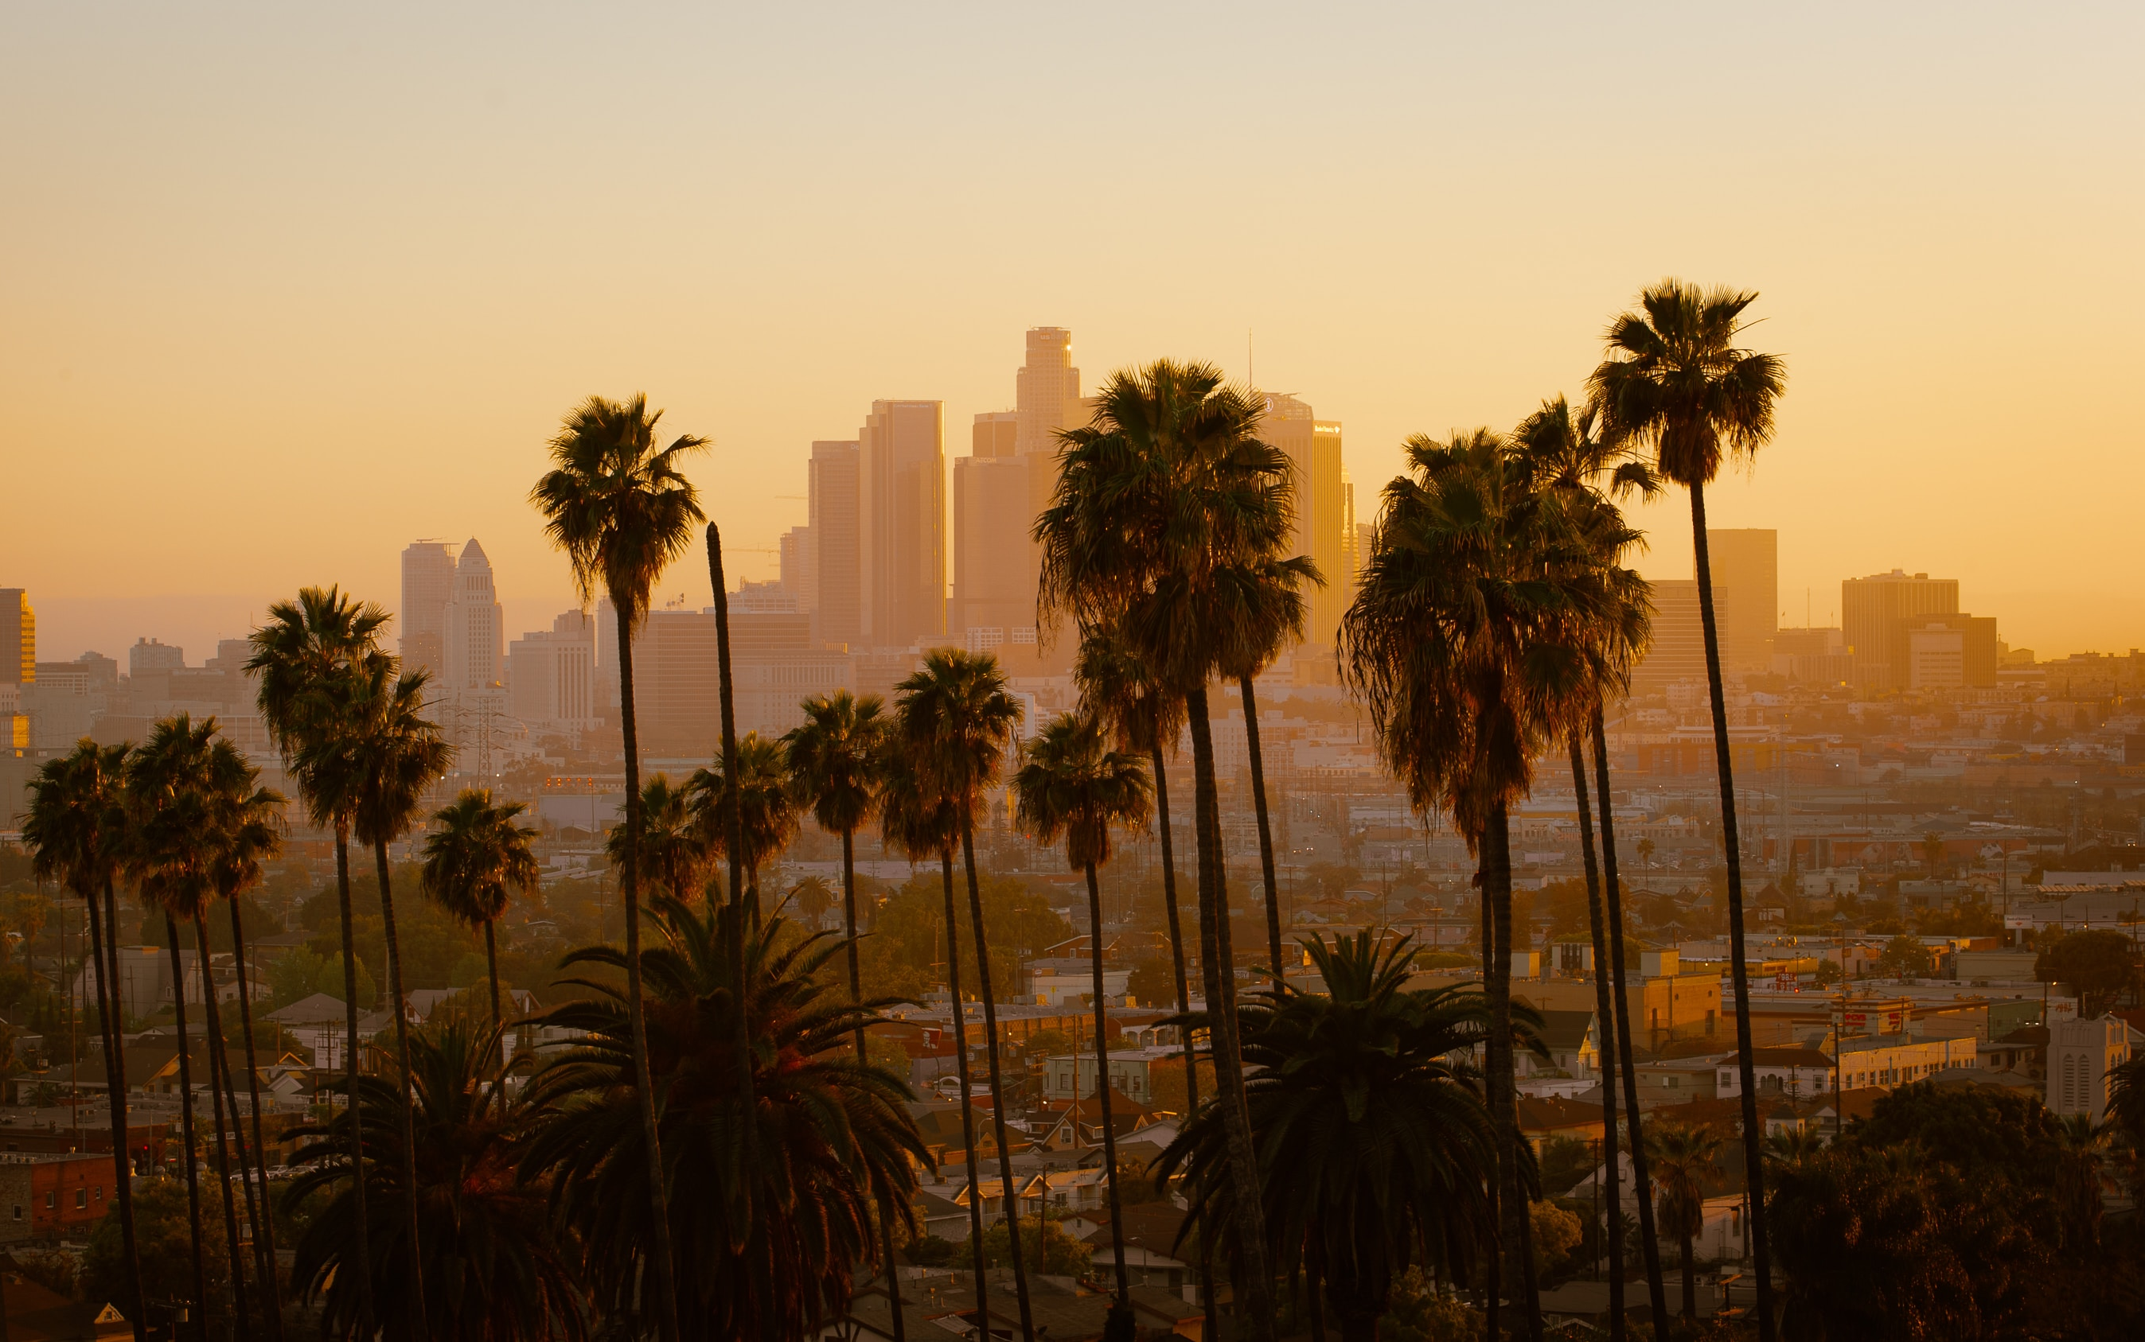


Scan to unlock:
Reporting
Data

Slide 3
Crime analysis
Los Angles

Slide 4


What?
Let’s explore the hidden gems.

Slide 5
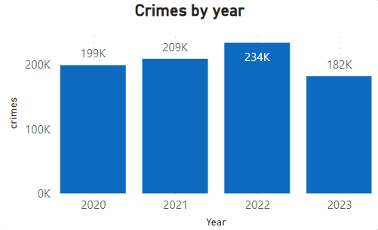
What is happening??
Most crimes year
2.47 k
2.77 k
2.35 k
2.15 k
More then 825k crimes in 4 years

Slide 6

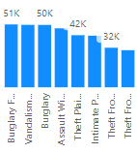
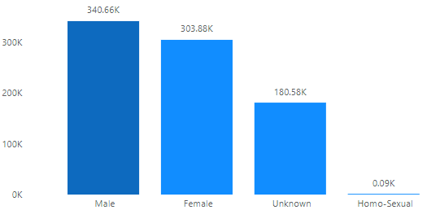
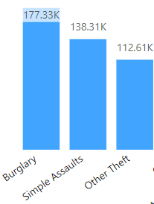
What is happening??
Men do more Burglary
Crime descent
Gender
Crime

Slide 7
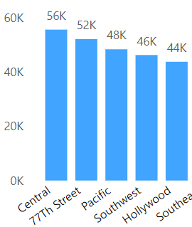
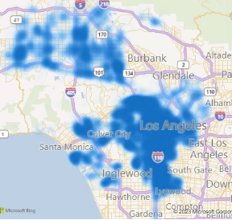
Where is happening??
Most affected area by crimes

Slide 8
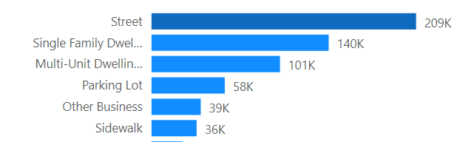
Where is happening??
The places which are mostly used for crime.

Slide 9

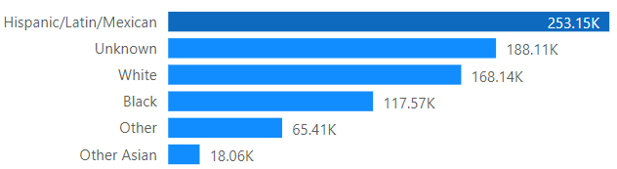
Who is doing?
Men of Hispanic/Latin/Mexican descent are often involved in crime.

Slide 10
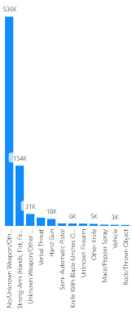
How?
Most crimes include hand, shots, vehicle or throwing object.

Slide 11
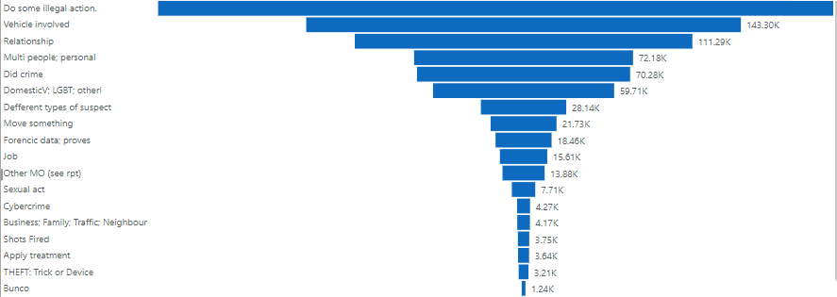
Victim Suspect

Slide 12
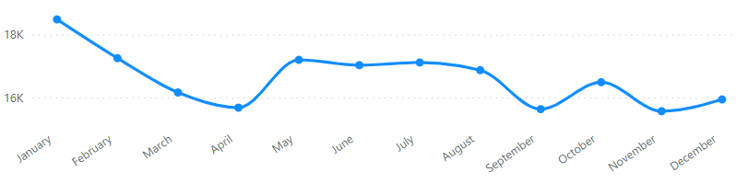
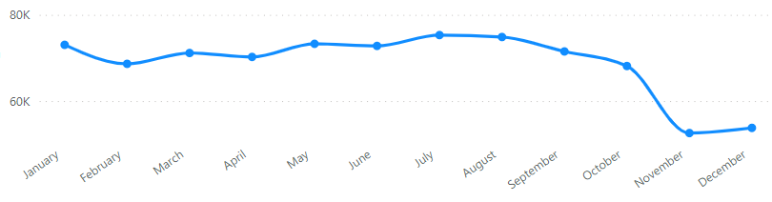
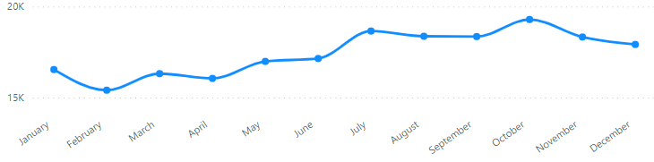
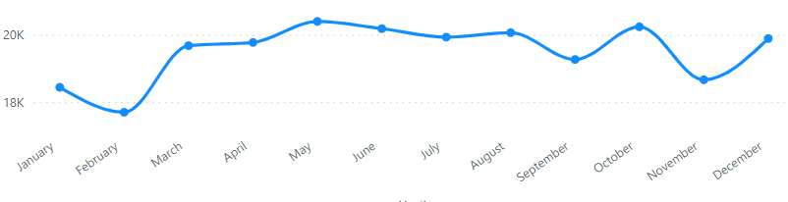
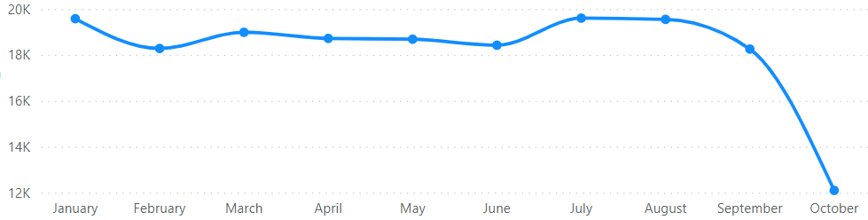
When happening?
Crimes trend of 4 years.

Slide 13
When happening?
2020
2021
2022
2023
Crimes trend of 4 years.

Slide 14
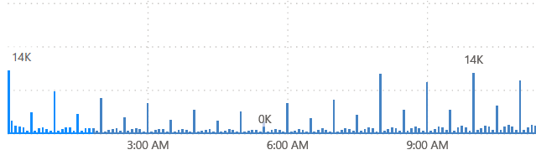
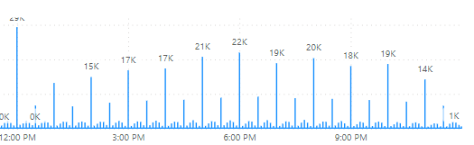
Time!!
AM
PM
The period within day when most crimes occur.

Slide 15

So What?
GTA
BURGLARY
Assaults
The reason behind Los angles crimes

Slide 16
So What?
In Los Angeles, the intersection of Hollywood glamour and socio-economic disparities creates a complex backdrop for crime. The allure of fame and cultural diversity, coupled with the city's vastness, contributes to a unique set of challenges requiring targeted interventions.
The reason behind Los angles crimes

Slide 17

Now What?
Taking actions on Los angles crimes

Slide 18
Now What?
To address rising crime in Los Angeles, focus on hotspot areas like Central, 777th street, Pacific, Southeast, Southwest, and Hollywood. Target interventions for young men, implement enhanced lighting in key locations, and engage the Hispanic/Mexican community with culturally sensitive programs. Strengthen gun regulations, increase police presence during peak hours, and provide tailored support for LGBTQ individuals and vehicle owners.

Slide 19

Any Question?

