Slide 1
Quantum Simulation: Adiabatic Hamiltonian

Slide 2
Contents
Introduction
Hamiltonian
Examples
Problem Classes
Adiabatic Computation
Worked Example
Qiskit implementation
Challenges
Complexity
Summary

Slide 3
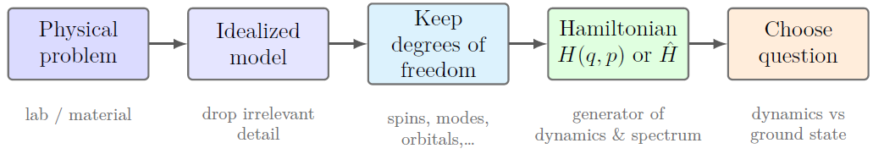
About Quantum Simulation and a physical model
Physical Model
Hamiltonian
The problem classes
Implementation method

Slide 4
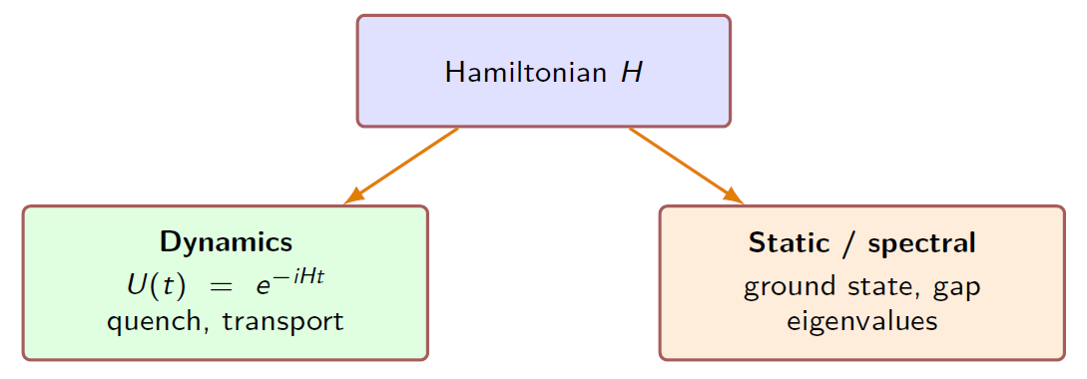
Choose Question
Dynamics or Statics?

Slide 5
Ground-state problem
Why it is important

Slide 6

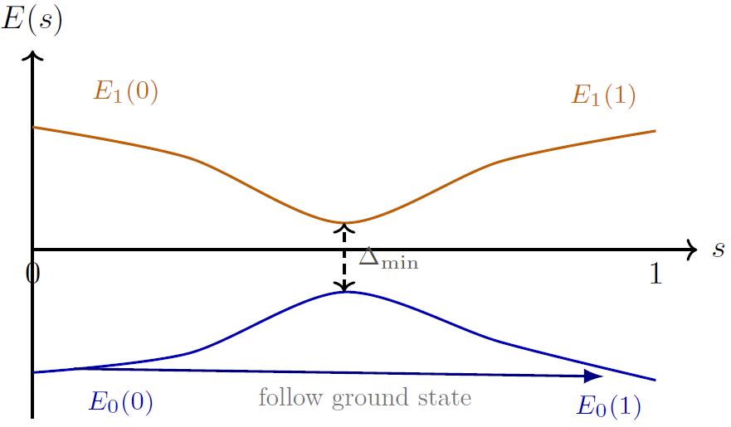

Method: Adiabatic approach
Problem Scope:
Gaps, runtime and complexity

Slide 7

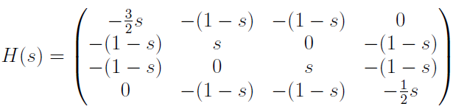
Example: Ising model
Drive Hamiltonian : H_b
Problem Hamiltonian: H_p

Slide 8
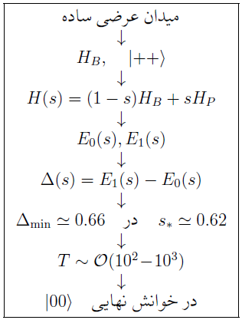
Adiabatic computation for Ising model

Slide 9
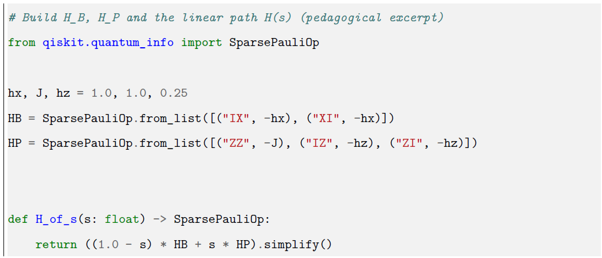
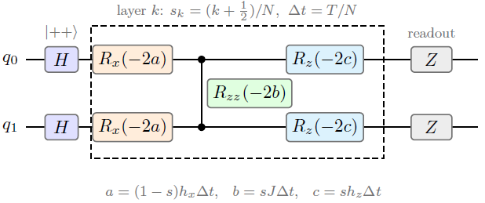
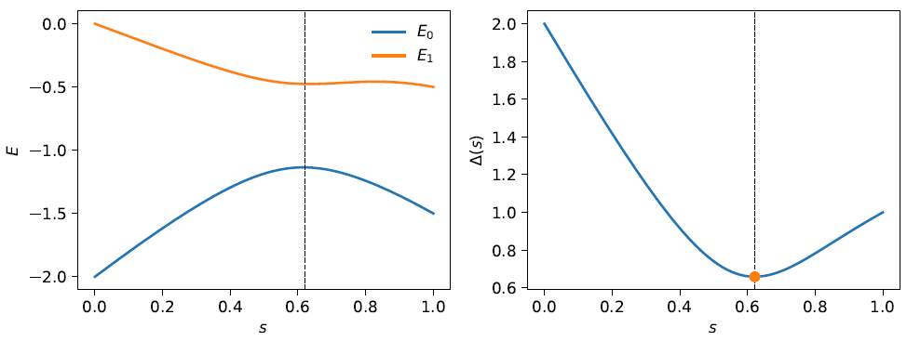
Qiskit implemention for Ising model

Slide 10
Gaps
instantaneous gap
minimum gap
avoided crossing
symmetry
three meanings of required time

Slide 11
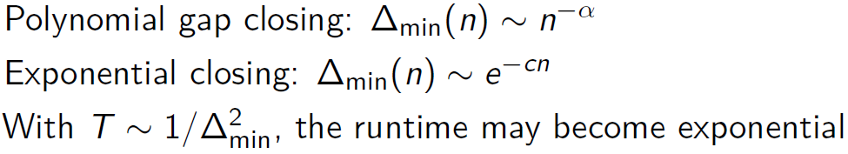
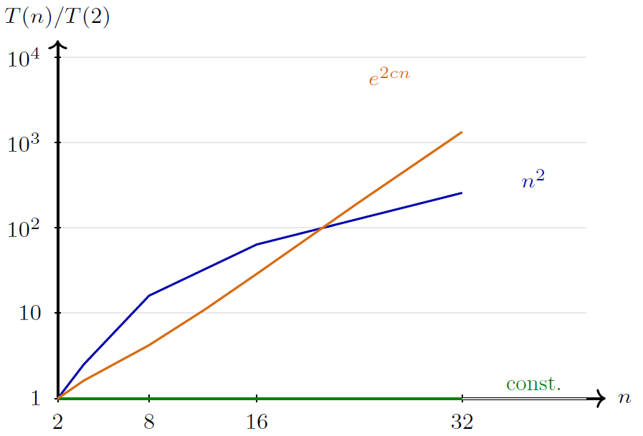
Scaling with System Size

Slide 12
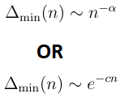
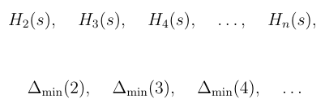
Scaling size and complexity pararameters

Slide 13

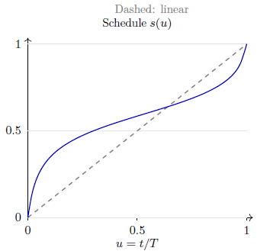
Scheduling time: s(t)
Linear or nonlinear

