Slide 1
Quantum Simulation: Adiabatic Hamiltonian
Ground states, Ising paths, and digital adiabatic methods

Slide 2
Contents
1. Introduction and roadmap
2. Algorithms and layers
3. From physics to Hamiltonians
4. Static vs dynamic; ground-state problems
5. Adiabatic computation
6. Worked example: 2-qubit Ising
7. Qiskit implementation
8. Gap, scheduling, and required time
9. Complexity and scaling
10. Challenges and summary

Slide 3
Motivation
Quantum simulation turns a physical model into a computational task
Shared language: algorithms, Hamiltonians, methods
Focus: adiabatic paths for ground-state problems
Worked Ising example + Qiskit for intuition

Slide 4
Roadmap
Algorithms -> Physics to H -> Static/dynamic
-> Adiabatic path -> Ising example -> Qiskit
-> Gap and T -> Complexity
Deep dive on adiabatic ground-state computation

Slide 5
Three Layers
Algorithm: research question
Simulation: model and Hamiltonian H
Tools: Trotter, adiabatic, VQE, ...
Path: question -> H -> method

Slide 6
From Physics to Hamiltonian
Physical problem -> idealized model
Keep degrees of freedom -> Hamiltonian H
Then choose the question: static vs dynamic
Fix H before choosing a method

Slide 7
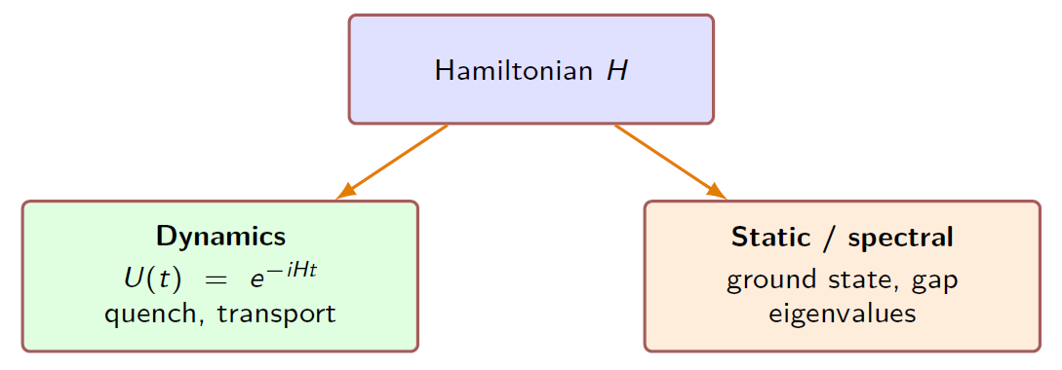
Dynamics or Statics?
Dynamics: U(t)=exp(-iHt); quench, transport
Static / spectral: ground state, gap, eigenvalues
This talk follows the static / ground-state branch

Slide 8
Ground-State Problems
Lowest-energy configuration of physical models
Many optimization tasks map to Ising / QUBO
Gap and low-lying spectrum control physics and runtime
Target: ground state of a problem Hamiltonian H_P

Slide 9
Adiabatic Idea
Start from easy initial Hamiltonian H_init (H_B)
Interpolate slowly to problem Hamiltonian H_P
Sufficient gap and time => ground state of H_P

Slide 10

The Path H(s)
H(s)=(1-s)H_init + s H_problem; example schedule s(t)=t/T

Slide 11
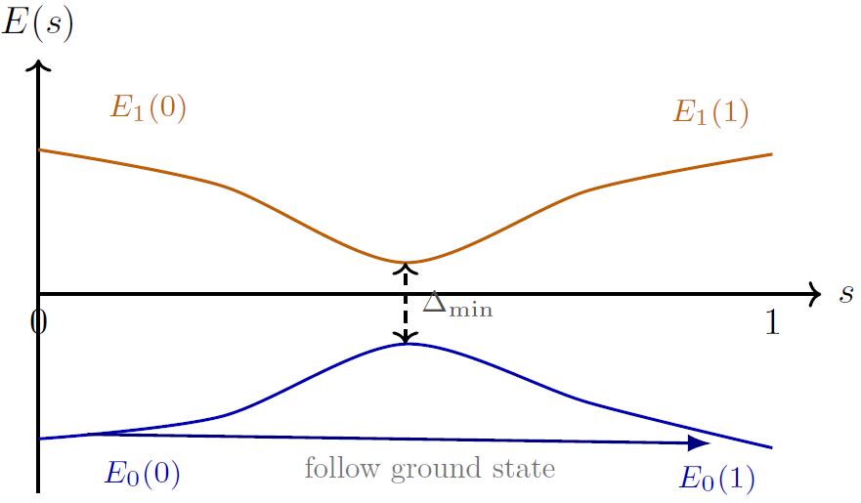

Minimum Gap Controls Runtime
Delta(s)=E1-E0; bottleneck Delta_min; heuristic T ~ 1/Delta_min^2

Slide 12

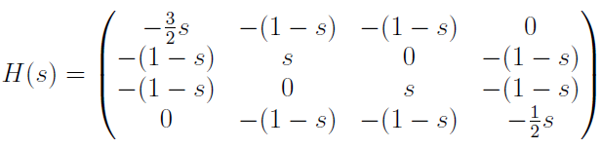
Example: Initial and Problem Hamiltonians
Initial H_B (driver/beginning); problem H_P for 2-qubit Ising

Slide 13
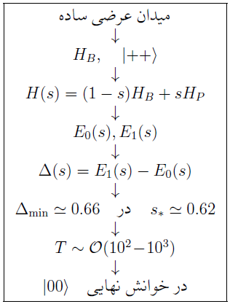
Adiabatic Pipeline for Ising
H_B, |++> -> H(s) -> Delta_min ~ 0.66 at s* ~ 0.62 -> readout |00>

Slide 14
Qiskit: Role
Shared stack for digital circuits
Turns the adiabatic path into a reproducible workflow
Environment: conda activate qcomputing

Slide 15
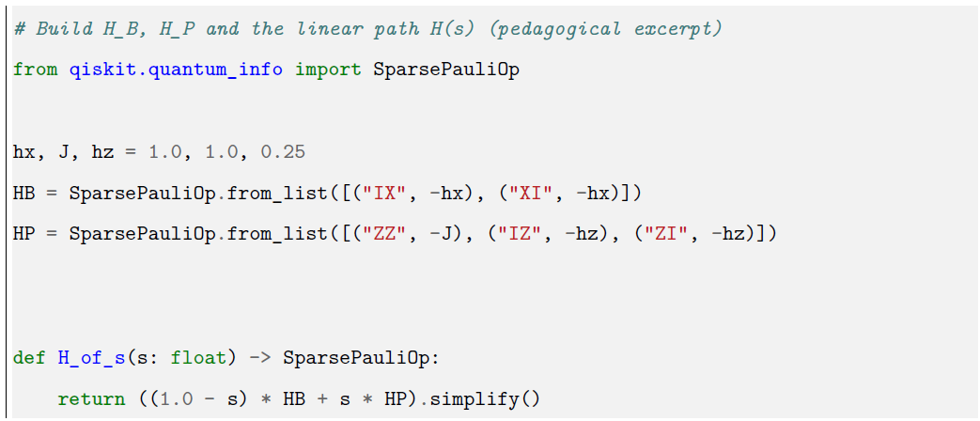
Qiskit: Build H(s)
SparsePauliOp: define H_B, H_P, and linear path H(s)

Slide 16
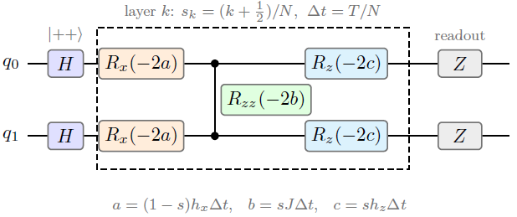
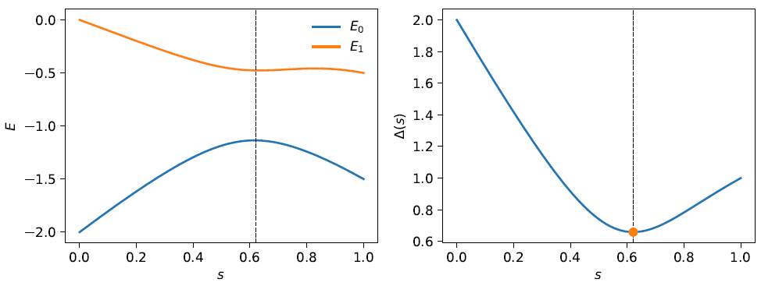
Qiskit: Trotter Layer and Gap Plot
Hadamard prep, Trotter layers R_x / R_zz / R_z, Z readout; scan Delta(s)

Slide 17
Gap Vocabulary
Instantaneous gap: Delta(s) = E1(s) - E0(s)
Minimum gap: Delta_min = min_s Delta(s) --- bottleneck
Avoided crossing: levels approach then separate
Full gap vs gap inside a reachable symmetry sector
Three meanings of required time: heuristic / bound / practical

Slide 18
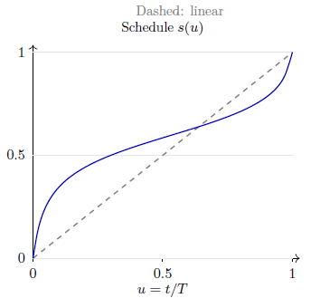

Scheduling: Linear or Nonlinear
Same path H(s); slow down near the bottleneck

Slide 19
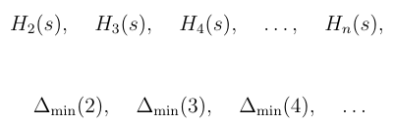
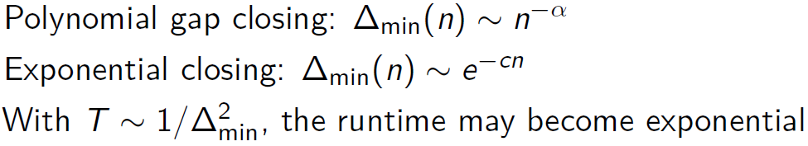
Scaling with System Size
n -> H_n(s) -> Delta_min(n) -> T(n); poly vs exponential closing

Slide 20
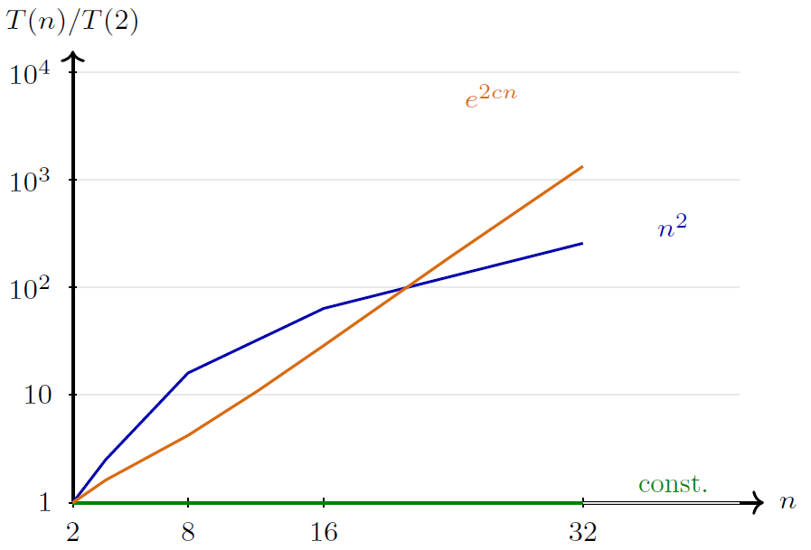
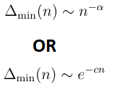
Polynomial vs Exponential Runtime
T ~ n^(2 alpha) vs T ~ exp(2 c n); qubit count alone is not difficulty

Slide 21
What Limits Adiabatic Simulation
Gap closing with system size (poly vs exponential)
Control / scheduling near the bottleneck
Noise and symmetry breaking
Trotter error and circuit depth in digital implementations
Related routes for same H_P: QAOA, VQE

Slide 22
Key Takeaways
Fix H and degrees of freedom first
Static and dynamic questions are distinct for the same H
Adiabatic computation is a path H(s); the gap sets the time
Complexity follows Delta_min(n), not n alone
Worked Ising + Qiskit make gap and runtime concrete

Slide 23
Outlook
Adaptive schedules near a small gap
Scaling beyond n=2 (TFIM families)
Compare with QAOA / VQE
Notes: QS&QA_Fundation/QS&QA_Fundation.tex

