Slide 1

Building the Mojifier
Using Azure Functions and Microsoft Cognitive Services

Slide 2

Emoji: An Unspoken Language
Over 10 billion emojis are sent daily.
They are used prevalently on social media—over 700 million emojis are used in Facebook posts daily. About 36% of Instagram posts contain 1 to 3 emojis each.
There are 3,019 official emojis
While we all have our favorite emojis, there is an official World Emoji contest. The 2018 Emoji of the Year was the Thinking Face emoji. It is awarded to the emoji that best describes the year
A Japanese artist invented emojis in 1999.
Source: http://gofisher.net/blogs/5-surprising-facts-about-emojis

Slide 3
What are we using?
Azure Functions
Microsoft Cognitive Services

Slide 4
What are we making today?
The Mojifier
Overlaying emojis based on the emotions in the image

Slide 5
What is Azure Functions?
Serverless computing service
Event driven experience
Enables development of scalable nanoservices
Notes:
Serverless computing is a cloud-computing execution model in which the cloud provider runs the server, and dynamically manages the allocation of machine resources. Pricing is based on the actual amount of resources consumed by an application, rather than on pre-purchased units of capacity

Slide 6
Why Azure Functions?
Highly Scalable
Variety of Languages Supported
JavaScript, C#, Python, and PHP, as well as scripting options such as Bash, Batch, and PowerShell
Trigger for almost every scenario available
Has all the features of an App Service
Pay only for the time it runs

Slide 7
How much does it cost?
Consumption Plan
Pay for the time your code runs
Scalability of the application code is handled automatically behind the scenes by the service
App Service Plan
Azure Functions can run within an App Service VM Instance
Azure Functions can run in an App Service Plan of another resource without incurring additional compute costs.

Slide 8
Common Scenarios
Timer-based processing
Azure service event processing
SaaS event processing
Serverless web application architectures
Serverless mobile backends
Real-time stream processing
Real-time bot messaging

Slide 9
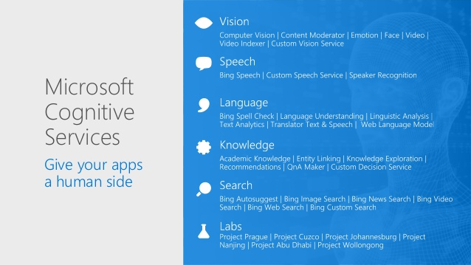
What is Cognitive Services?

Slide 10
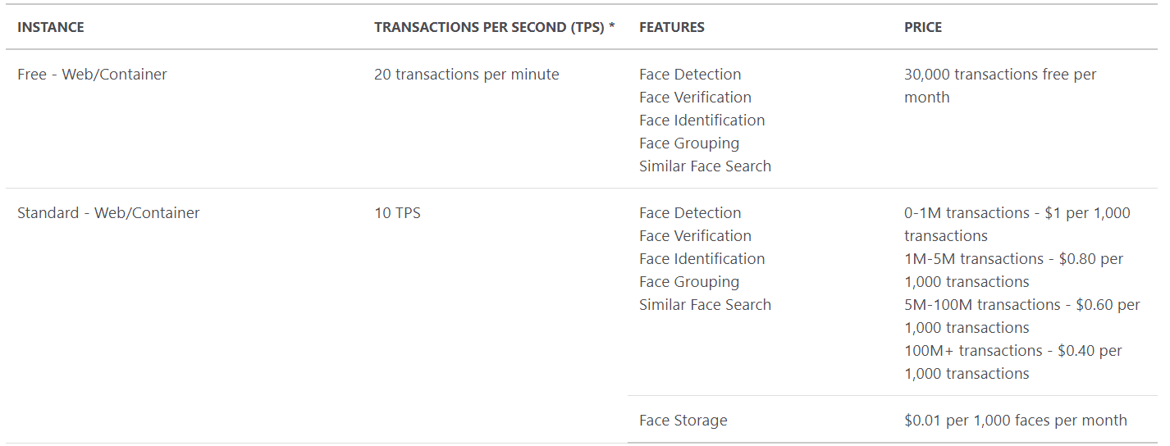
How much does it cost?

Slide 11
Let’s build the Mojifier!

Slide 12
Next Steps
Learn about serverless applications and azure functions: https://docs.microsoft.com/en-us/learn/browse/?products=azure-functions
Learn about Microsoft Cognitive Services: https://docs.microsoft.com/en-us/learn/browse/?products=azure-cognitive-services
Learn for free on Pluralsight about Microsoft Azure: https://www.pluralsight.com/partners/microsoft/azure
Become an Azure Champ with Certifications: https://docs.microsoft.com/en-us/learn/certifications/browse/?products=azure

