Slide 1
DATASET CONVERSION Final Year Project Zaid Ahmad 001811001042

Slide 2
Converting the Dataset
The raw dataset is the research paper text with abstract, method, conclusion
The required dataset is summarization dataset.
The approach to convert the dataset :
Extracted the abstract from the paper.
Made the abstract as summary.
The remaining part is the article.

Slide 3
RAW DATASET
The raw dataset consists of 500 papers with format :
MAIN-TITLE
.
HIGHLIGHTS
.
ABSTRACT
..
METHODS
.
DISCUSSION
.
CONCLUSION
.
REFERENCES

Slide 4
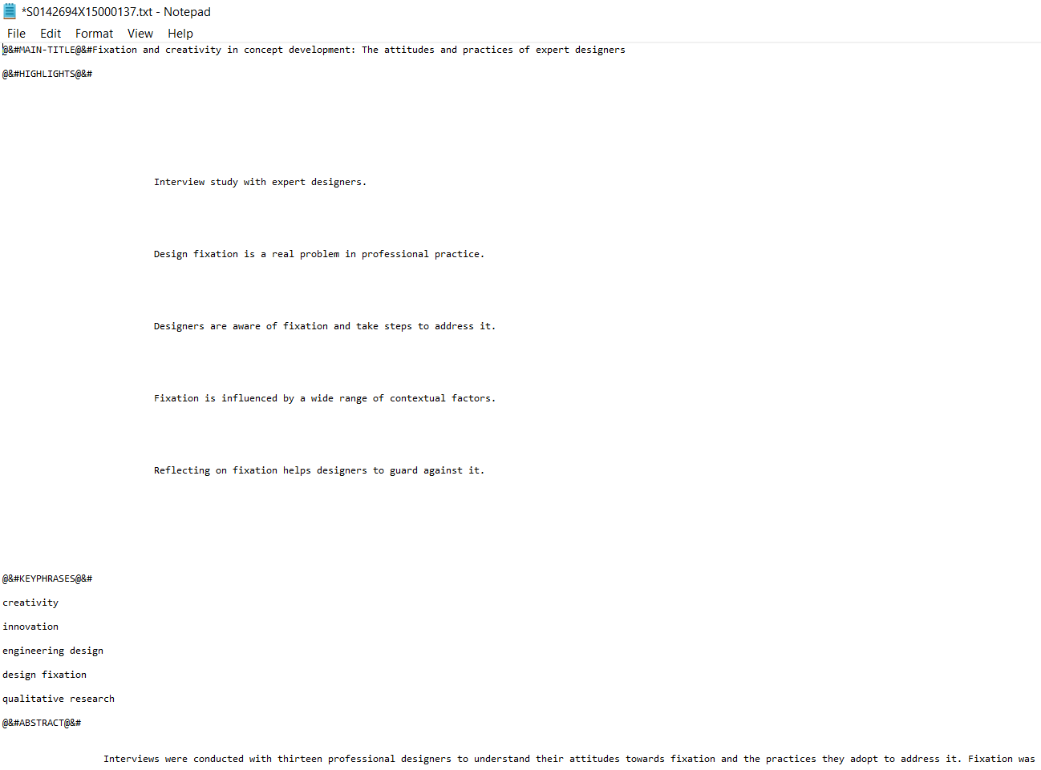
RAW DATASET

Slide 5
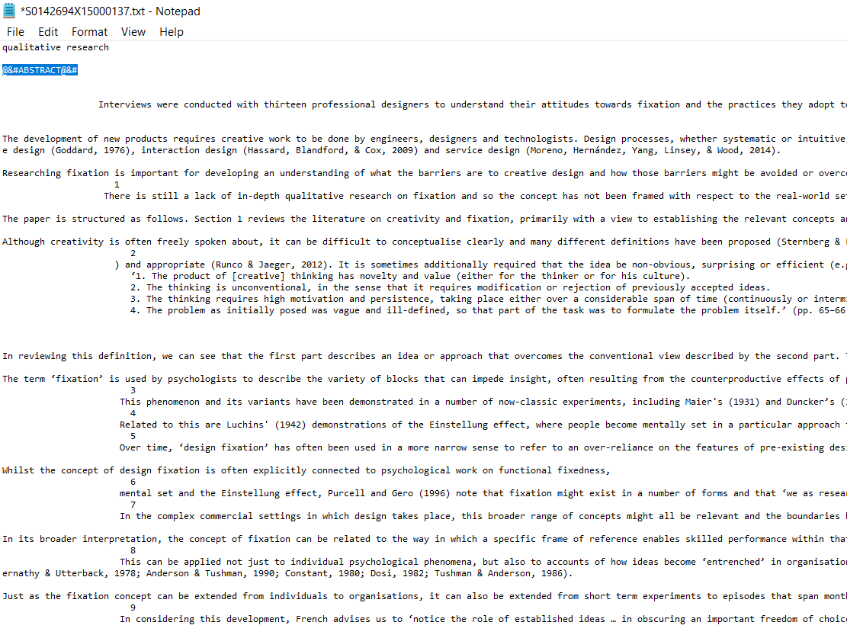
RAW DATASET

Slide 6
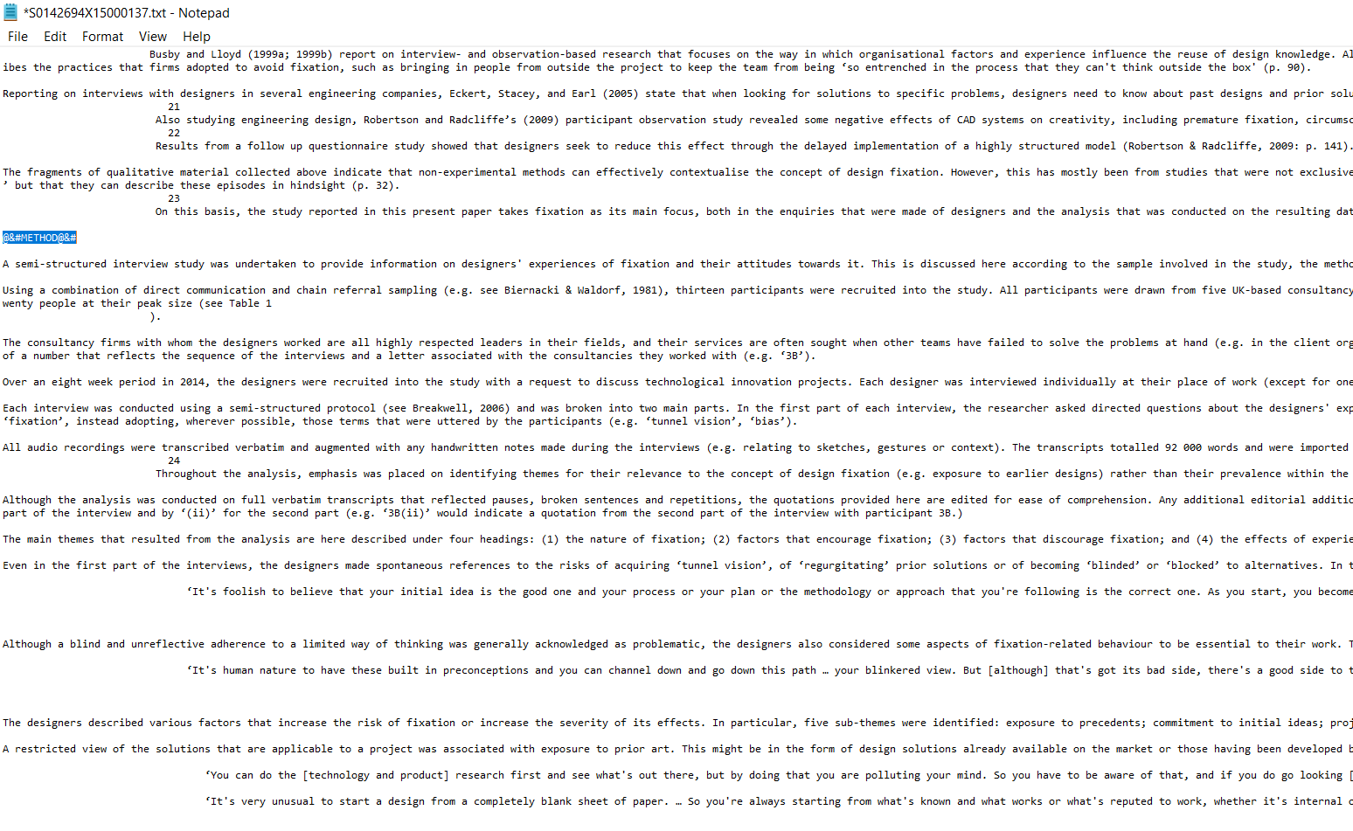
RAW DATASET

Slide 7
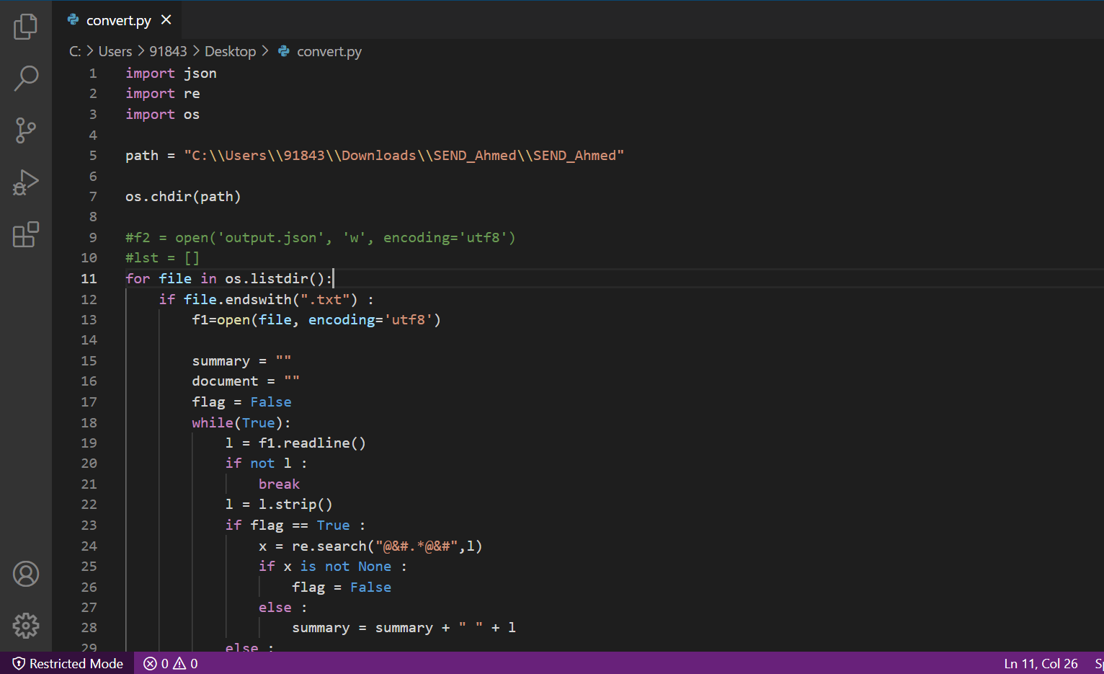
CODE

Slide 8
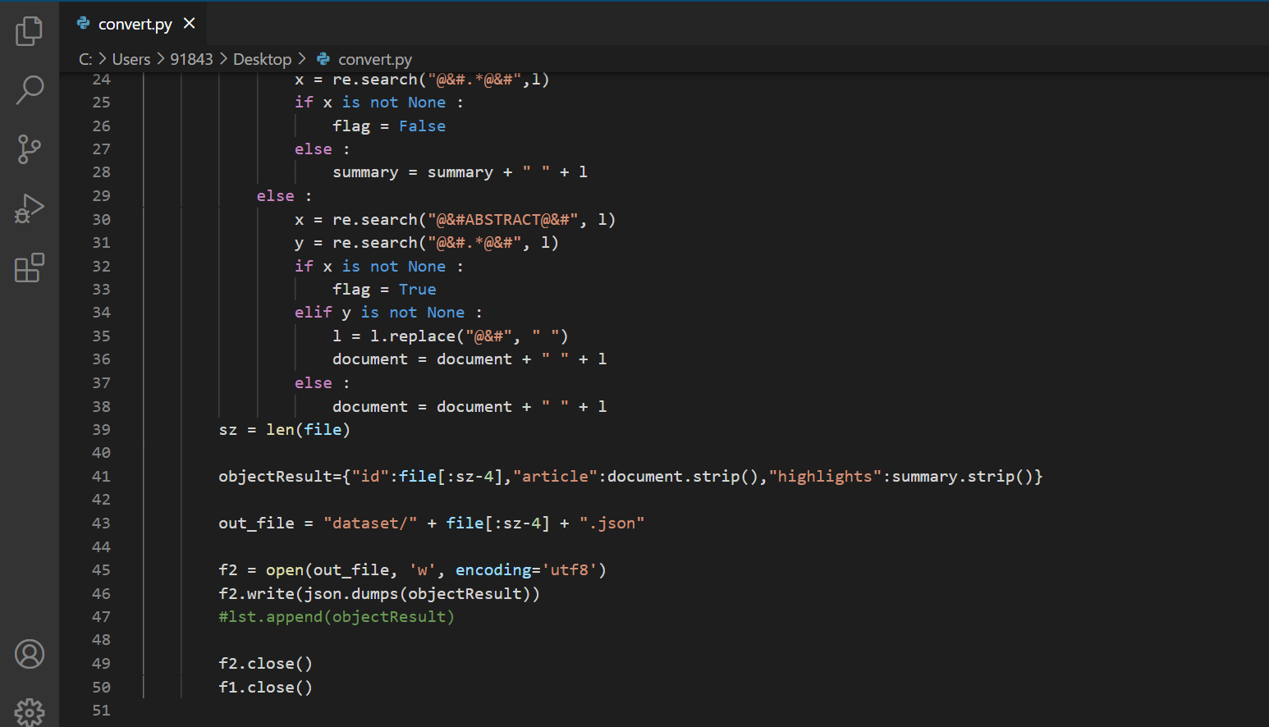
CODE

Slide 9
CONVERTED DATASET
Format:
The converted data is a json with format :
{
“id” : id of the document ,
“article” : document text,
“highlight” : summary of the document
}

Slide 10
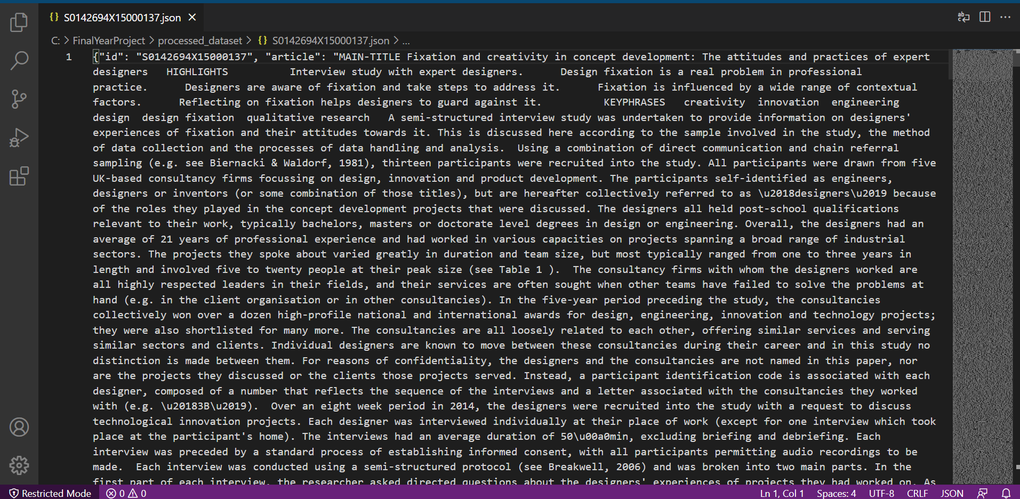
CONVERTED DATASET

Slide 11
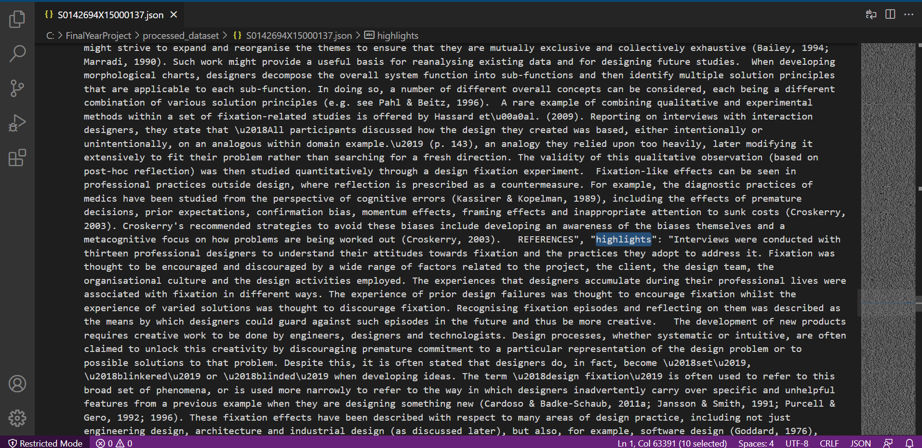
CONVERTED DATASET

Slide 12
THANK YOU

