Slide 1
PROJECT UPDATE
EXTRACTING EXPERIMENTAL CONFIGURATIONS
FROM RESEARCH PAPERS
ZAID AHMAD
TEJENDRA PRATAP
DATE : 21-01-22

Slide 2
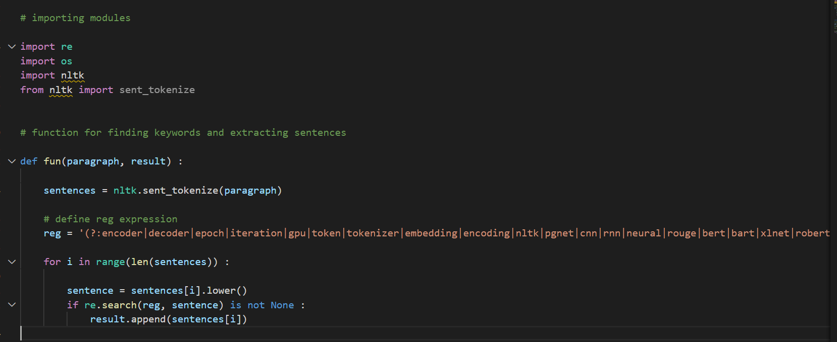
CODE

Slide 3
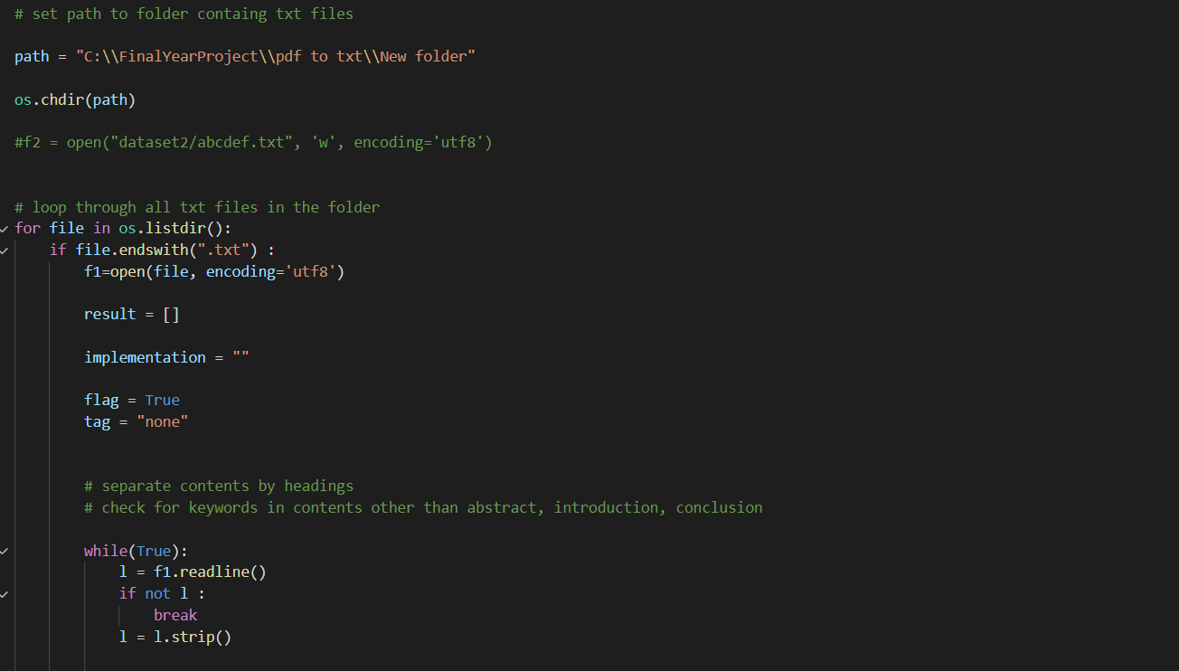
CODE

Slide 4
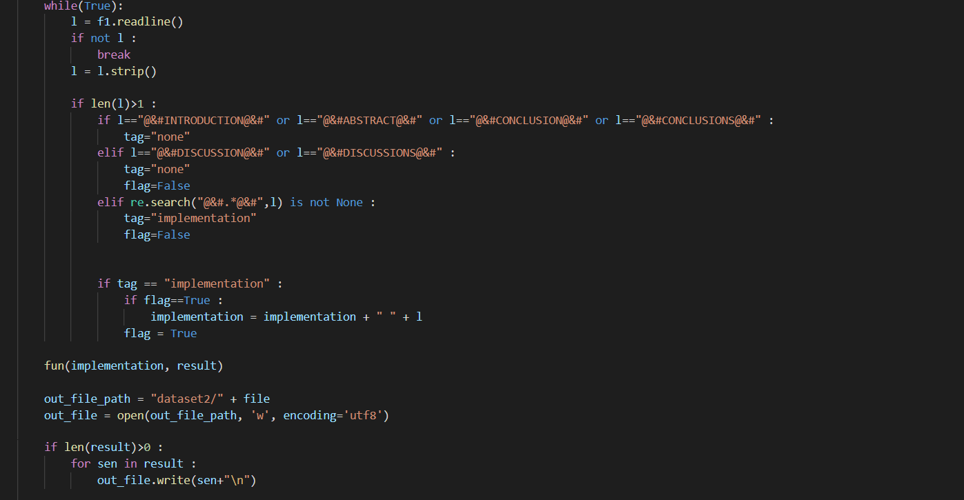
CODE

Slide 5
RESULT ON PREVIOUS DATASET

Slide 6
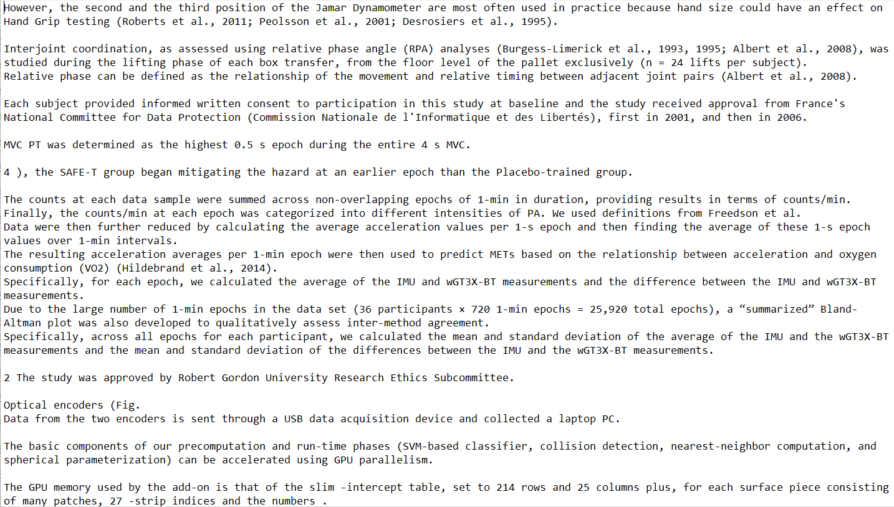

Slide 7
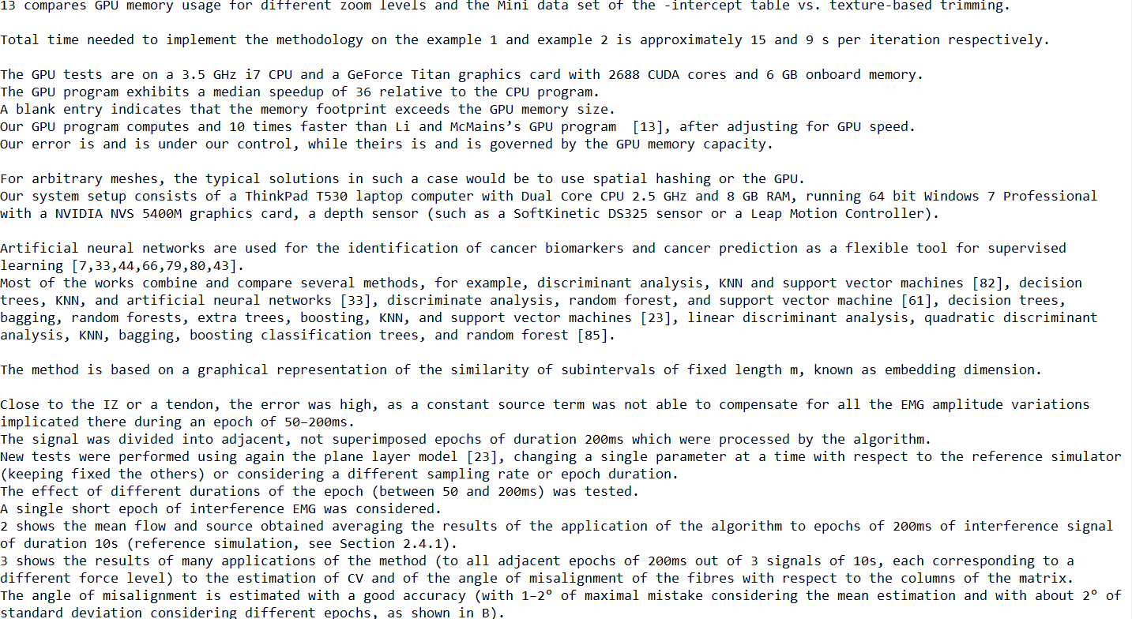

Slide 8
RESULT ON NEW DATASET

Slide 9
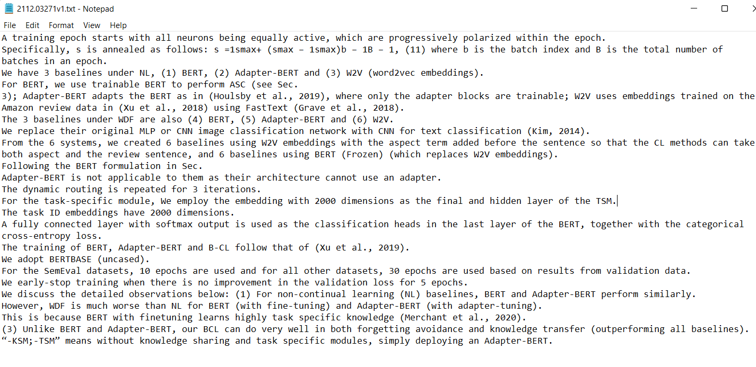

Slide 10
