Slide 1

Managing secrets with Vault
$ whoami
Zeeshan.ahmad

Slide 2

What is vault?
Vault is an open-source tool used for securely storing and managing secrets.

Slide 3

Vault use cases
Secret Management
- Centrally store, access, distribute secrets
Encrypting Application Data
- Keep application data secure with centralized key management
Identity-based Access
- Authenticate and access different clouds, systems using trusted identities

Slide 4
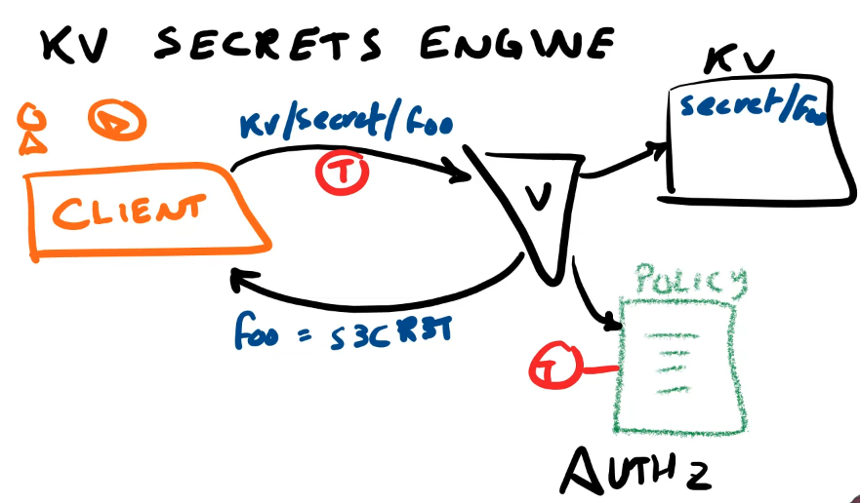

Slide 5
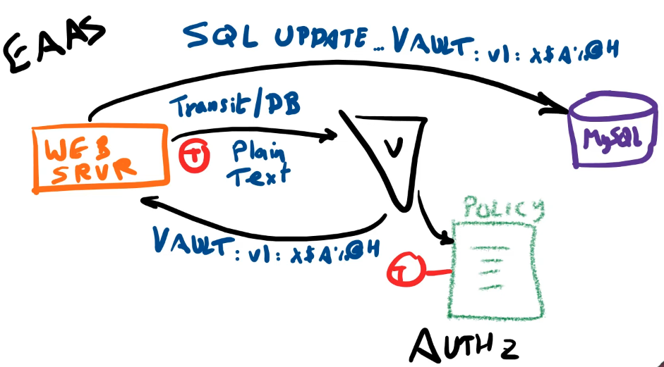

Slide 6
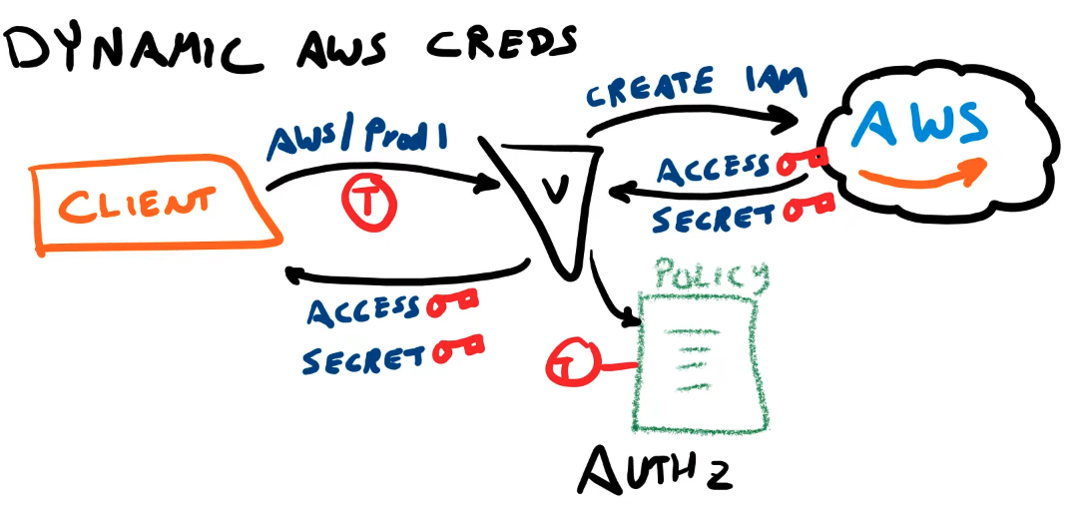

Slide 7
Vault hands on
Vault server modes
- Dev mode – intended for development, super insecure, runs everything in memory. - Prod mode – that can be used in production.
CLI
$ brew install hashicorp/tap/vault
$ vault --help
$ vault server –dev –dev-root-token-id=“root”

Slide 8
What has not been covered?
Vault architecture
Dynamic Secrets / roles
Leases and revocation
Setting up new policies
Deployment
Configuring TLS
High availability

