Slide 1

Housing Blazor web app
By: Ahmad
ahmad081177@gmail.com

Slide 2



Pre-Requisites
Software
Knowledge
Visual Studio 2022
ASP.NET and web development
.NET desktop development
.NET Multi-platform App UI development (for MAUI)
Data storage processing (optional)
.NET Core 7.x
Gmail account

Slide 3
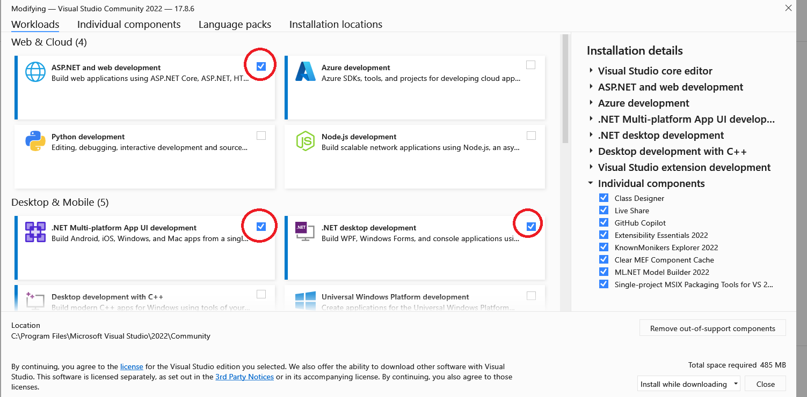

Slide 4
Tutorials / Links
HTML Tutorial
JavaScript Tutorial
CSS Tutorial
Get Started with ASP.NET Core
Async with .NET

Slide 5




Main Model Classes
Address (for both house and user)
App User & Admin
House

Slide 6








Functions/Features
Login
Register
Send an email upon registration
Create new House
Edit House
List/Map of all Houses

Slide 7
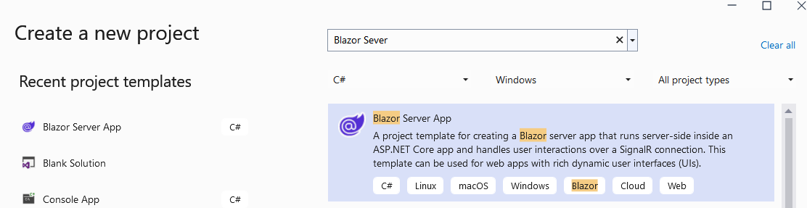
New Project
Visual Studio → New Project → Blazor Server

Slide 8
Entity Framework
https://slideplayer.com/slide/12447604/
https://www.slideshare.net/KiranShahi2/entity-framework-core-169821404

Slide 9
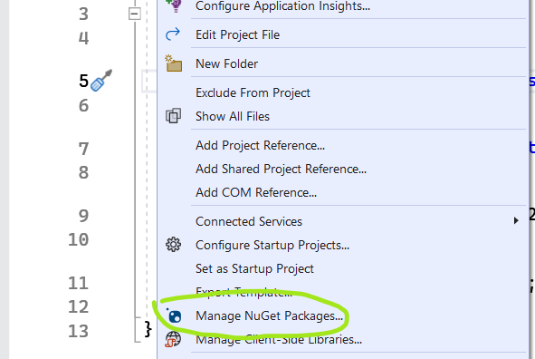
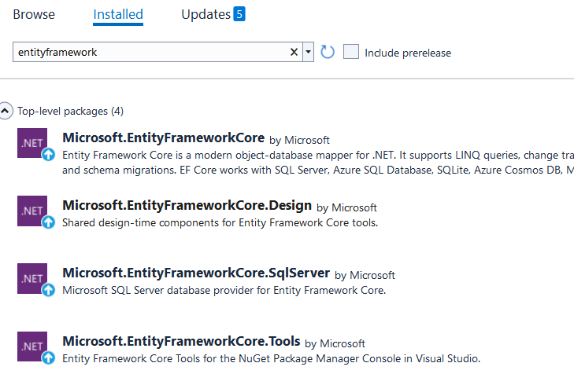
04-DB Creation Nuget Preparation

Slide 10
04-DB Creation Code for DB
appsettings.json
"ConnectionStrings": {
"DefaultConnection": "Server=(localdb)\\mssqllocaldb;AttachDBFilename=[DataDirectory]\\DB\\housing.mdf;Initial Catalog=housing;Trusted_Connection=True;MultipleActiveResultSets=true“
}
HousingDBContext.cs (new file)
Program.cs
string path = Directory.GetCurrentDirectory();
builder.Services.AddDbContext<HousingDBContext>(options =>
options.UseSqlServer(
builder.Configuration.GetConnectionString("DefaultConnection")
.Replace("[DataDirectory]", path)));
Package Manager Console
Add-migration init
Update-Database

Slide 11
05-Register with DB
Inject DB context
On Register:
Check if user exists, based on email
If so, error
Else, create new row in the DB using dbcontext
Check DB for info
On Login
Check if email & password exists in db context
If so, save email in session/cookies and navigate to home page
Else, error user does not exist

Slide 12
06 – Session Storage - Cookies
oi Icons
Different session storages:
@using Microsoft.AspNetCore.Components.Server.ProtectedBrowserStorage
ProtectedSessionStorage
ProtectedLocalStorage
Balzored
JS
Login -> save session
Index and MainLayout…check session
Logout -> Clear session

Slide 13
07- Send Email & Service
New Service (injection)
Send Email upon registration
Configure your gmail
Visit https://myaccount.google.com/security
How to:
https://youtu.be/Ms_FDe2VzFU

Slide 14
08 - New House & Image
New house model
House Details
Update DB
New House form
Image (base 64 code)

Slide 15
09 – Address & HTPP API
New Address class model
Update house model
Address Details
Update AppUser model
Address Details
Update DB
Update New House and Register forms
Update address to Longt & Lat
Calling external API thru HttpClient

Slide 16

10- Display Leaflet Map in Blazor
Inject Leaflet map in the webapp
Client-side library
Create map JS in Razor Page
Default center
Center based on logged in user address

Slide 17
11- Display House in Leaflet Maps
House as Marker
House details as Marker Pop-up
Click navigates to House details
C# ←→JS
Calling .NET from JS
Calling JS from .NET

Slide 18
12-Google Map
Getting started with Google Maps Platform
Google Maps Platform APIs by Platform
Maps JavaScript API
Lis of all Google Map icons

Slide 19
11- Initiate Map based on my Loc
Search?
Filters

Slide 20
09-Admin
Admin role
List all users
Edit user
Remove user?

