Slide 1

Housing Blazor web app
By: Ahmad
ahmad081177@gmail.com

Slide 2



Pre-Requisites
Software
Knowledge
Visual Studio 2022
ASP.NET and web development
.NET desktop development
.NET Multi-platform App UI development (for MAUI)
Data storage processing (optional)
.NET Core 7.x
Gmail account

Slide 3
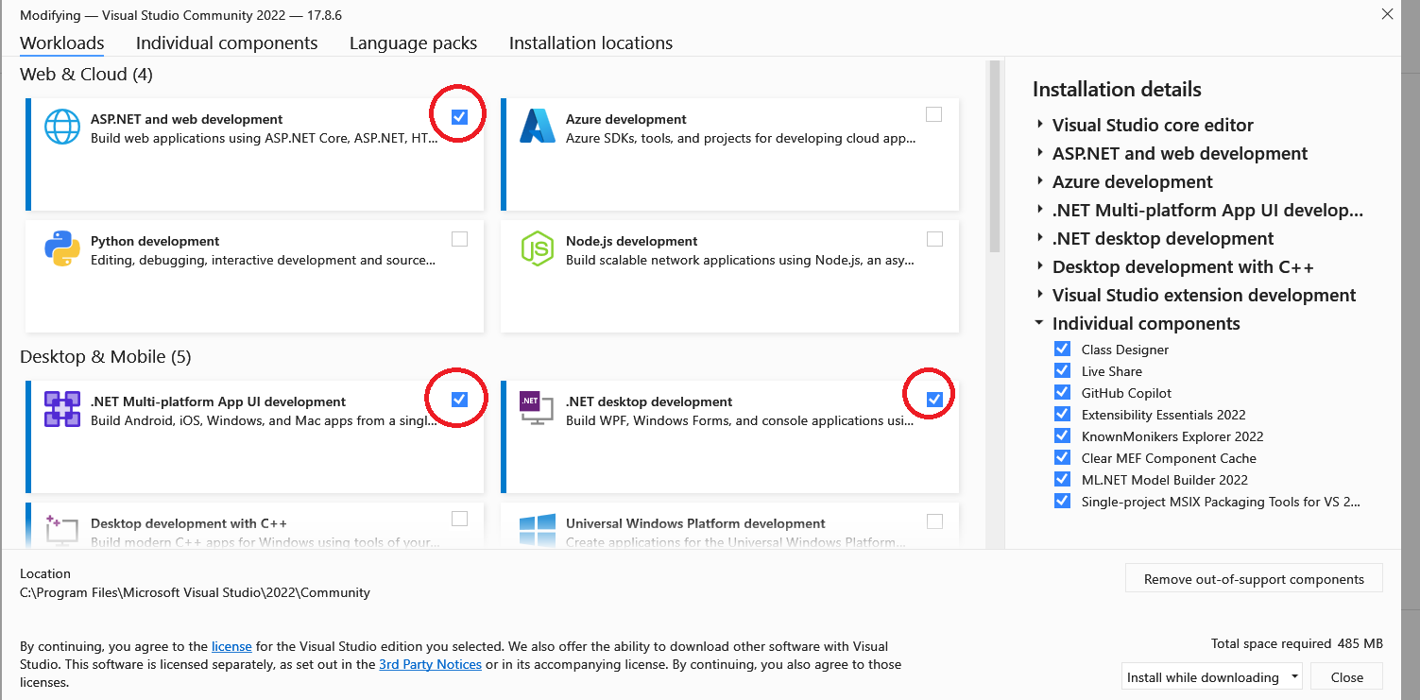

Slide 4
Tutorials / Links
HTML Tutorial
JavaScript Tutorial
CSS Tutorial
Get Started with ASP.NET Core
Async with .NET

Slide 5




Main Model Classes
Address (for both house and user)
App User & Admin
House

Slide 6








Functions/Features
Login
Register
Send an email upon registration
Create new House
Edit House
List/Map of all Houses

Slide 7
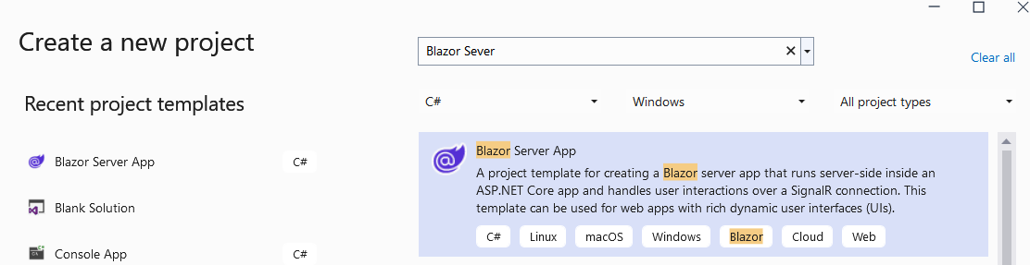
New Project
Visual Studio → New Project → Blazor Server

Slide 8
Entity Framework
https://slideplayer.com/slide/12447604/
https://www.slideshare.net/KiranShahi2/entity-framework-core-169821404

Slide 9
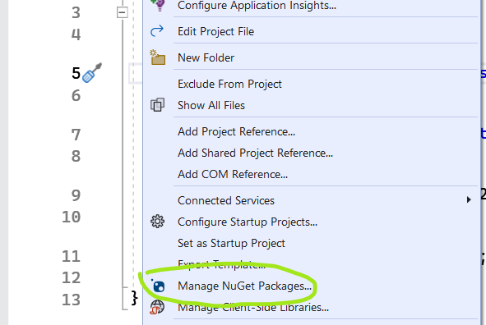
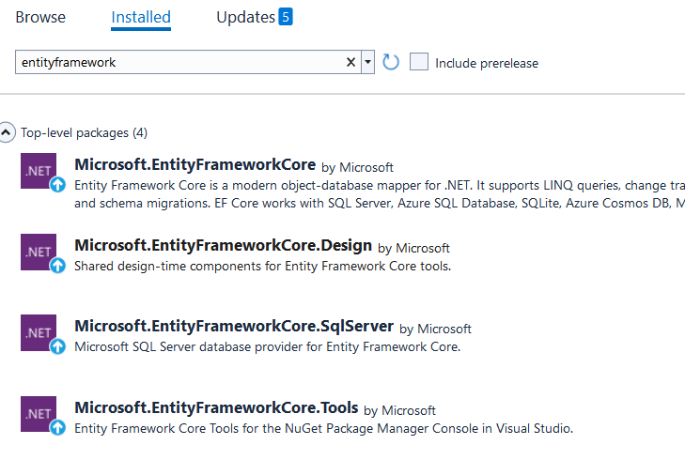
04-DB Creation Nuget Preparation

Slide 10
04-DB Creation Code for DB
appsettings.json
"ConnectionStrings": {
"DefaultConnection": "Server=(localdb)\\mssqllocaldb;AttachDBFilename=[DataDirectory]\\DB\\housing.mdf;Initial Catalog=housing;Trusted_Connection=True;MultipleActiveResultSets=true“
}
HousingDBContext.cs (new file)
Program.cs
string path = Directory.GetCurrentDirectory();
builder.Services.AddDbContext<HousingDBContext>(options =>
options.UseSqlServer(
builder.Configuration.GetConnectionString("DefaultConnection")
.Replace("[DataDirectory]", path)));
Package Manager Console
Add-migration init
Update-Database

Slide 11
05-Register with DB
Inject DB context
On Register:
Check if user exists, based on email
If so, error
Else, create new row in the DB using dbcontext
Check DB for info
On Login
Check if email & password exists in db context
If so, save email in session/cookies and navigate to home page
Else, error user does not exist

Slide 12
06 – Session Storage - Cookies
oi Icons
Different session storages:
@using Microsoft.AspNetCore.Components.Server.ProtectedBrowserStorage
ProtectedSessionStorage
ProtectedLocalStorage
Balzored
JS
Login -> save session
Index and MainLayout…check session
Logout -> Clear session

Slide 13
07- Send Email & Service
New Service (injection)
Send Email upon registration
Configure your gmail
Visit https://myaccount.google.com/security
How to:
https://youtu.be/Ms_FDe2VzFU

Slide 14
08 - New House & Image
New house model
House Details
Update DB
New House form
Image (base 64 code)

Slide 15
09 – Address & HTPP API
New Address class model
Update house model
Address Details
Update AppUser model
Address Details
Update DB
Update New House and Register forms
Update address to Longt & Lat
Calling external API thru HttpClient

Slide 16

10- Display Leaflet Map in Blazor
Inject Leaflet map in the webapp
Client-side library
Create map JS in Razor Page
Default center
Center based on logged in user address

Slide 17
11- Display House in Leaflet Maps
House as Marker
House details as Marker Pop-up
Click navigates to House details
C# ←→JS
Calling .NET from JS
Calling JS from .NET

Slide 18
12-Google Map
Getting started with Google Maps Platform
Google Maps Platform APIs by Platform
Maps JavaScript API
Lis of all Google Map icons

Slide 19
UI:
Add bootstrap, open-iconic
See websites Bootstrap , Iconic (or you can use FontAwsome)
Razor Pages
AuthComponent
Review
All Users + Block user
All Houses as list
Razor Component
ReviewsComponent
Image Slider
Popup using bootstrap
Stars for rating
Services
AppAuthService

Slide 20
Final Entity Framework
Model Classes:
Address
AppUser
House
HouseDetails
HouseImage
Review

Slide 21
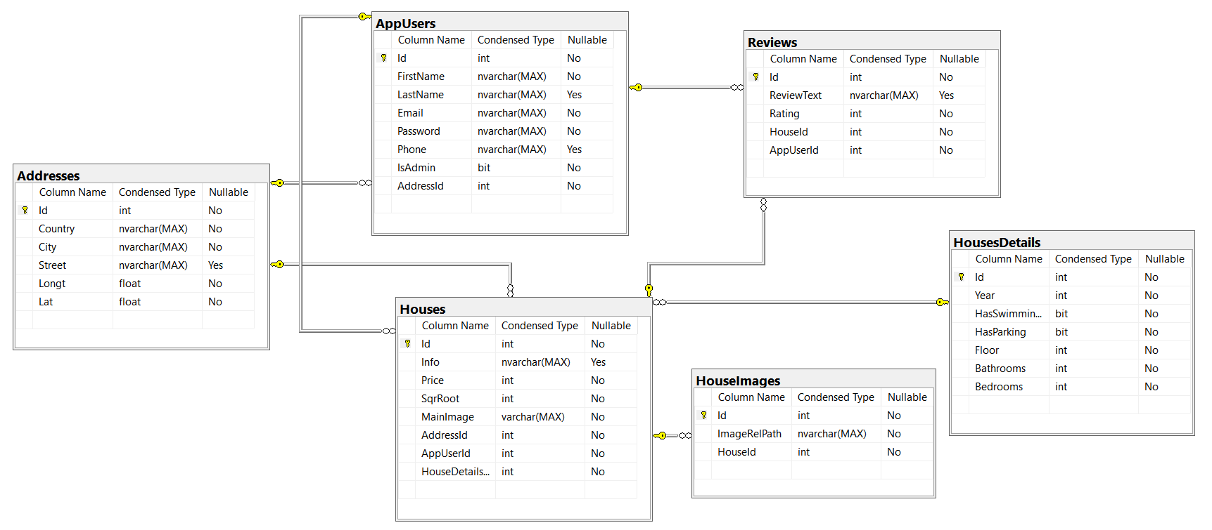
UML

Slide 22
Pages
Home Page
User:
Edit Profile (First name, Last name, phone)
Change Password (Old Password, New Password, New Password)
House:
New (Sell) House
Google Maps
Markers, popup
Search
Search / Filter
List
Editing!
Detail Page
Contact:
About Us
Contact House Owner (Chat)
Request Tour (Send email)
Reviews:
Add Review
List Reviews
Vote (Up/Down) (Need field in DB)
Admin
List All Users
Edit Users?
Delete User XXX
Block User (Modify DB)
List All House
Edit House
General Info (info, has swimming pool..)
Delete Image
ERROR HANDLING

Slide 23
SQL GPT

Slide 24
11- Initiate Map based on my Loc
Search?
Filters

Slide 25
09-Admin
Admin role
List all users
Edit user
Remove user?

