Slide 1

Housing Blazor web app
By: Ahmad
ahmad081177@gmail.com

Slide 2



Pre-Requisites
Software
Knowledge
Visual Studio 2022
ASP.NET and web development
.NET desktop development
.NET Multi-platform App UI development (for MAUI)
Data storage processing (optional)
.NET Core 7.x
Gmail account

Slide 3
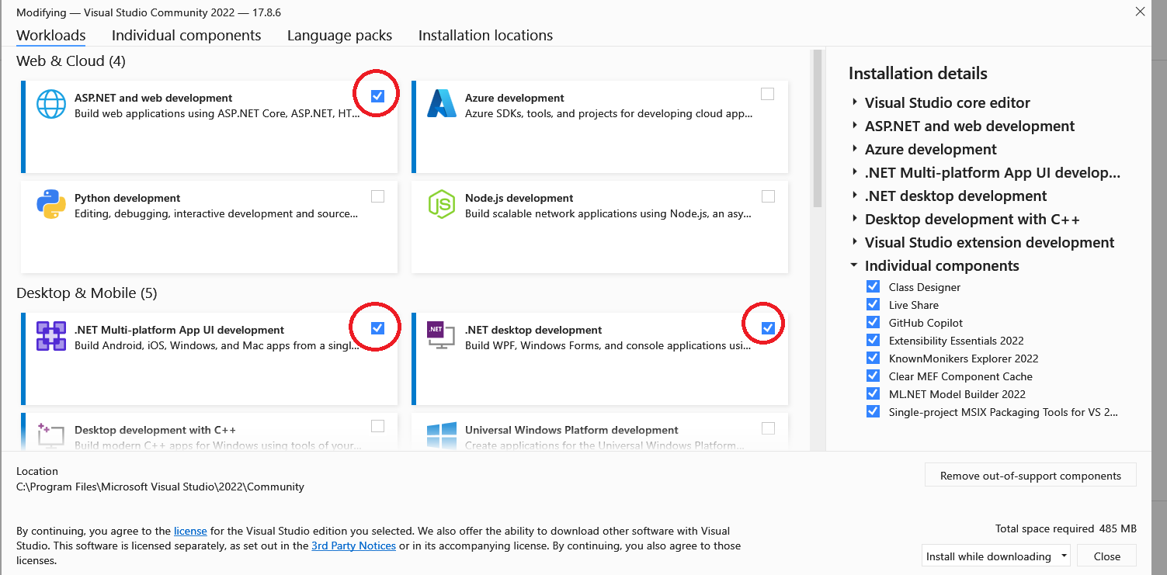

Slide 4
Tutorials / Links
HTML Tutorial
JavaScript Tutorial
CSS Tutorial
Get Started with ASP.NET Core
Async with .NET

Slide 5




Main Model Classes
Address (for both house and user)
App User & Admin
House

Slide 6








Functions/Features
Login
Register
Send an email upon registration
Create new House
Edit House
List/Map of all Houses

Slide 7
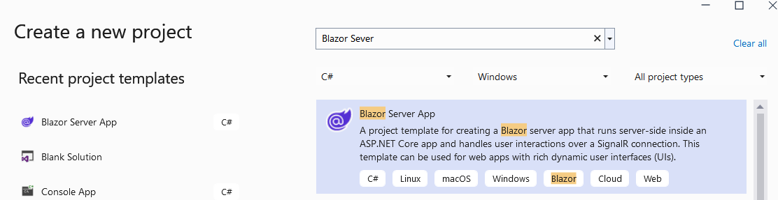
New Project
Visual Studio → New Project → Blazor Server

