Slide 1

Housing
Blazor
By: Ahmad

Slide 2



Pre-Requisites
Software
Knowledge
Visual Studio 2022
ASP.NET and web development
.NET desktop development
.NET Multi-platform App UI development (for MAUI)
Data storage processing (optional)
.NET Core 7.x
Gmail account

Slide 3
Tutorials / Links
HTML Tutorial
JavaScript Tutorial
CSS Tutorial
Get Started with ASP.NET Core
Async with .NET

Slide 4
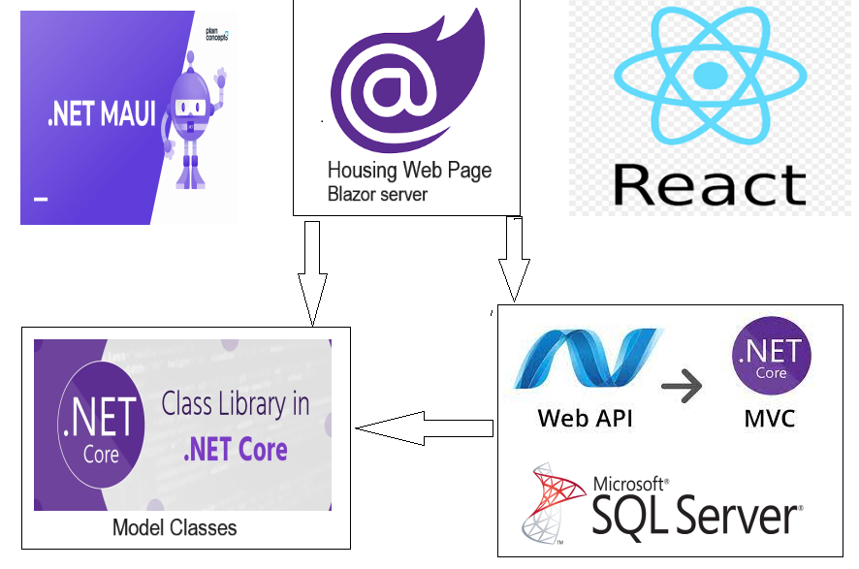
Housing App Arch

Slide 5




Main Model Classes
Address (for both house and user)
App User & Admin
House

Slide 6







Functions/Features
Login
Register
Send an email upon registration
Create new House
Edit House
List of all Houses

