Slide 1
Theo Jansen Mechanism
Ahmad Hamdan
Mechanics and Machines Project

Slide 2
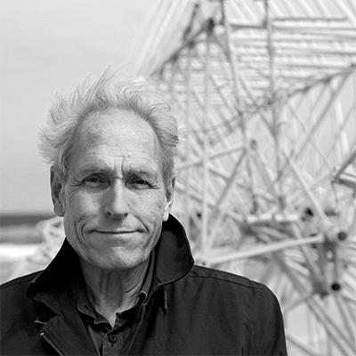
Theo Jansen
1948
Born in The Hague (Scheveningen), NL
1968
Begins studying applied physics at Delft University of Technology
1975
Became an artist

Slide 3
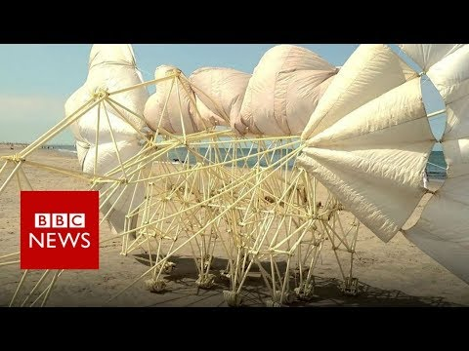
Strandbeest

Slide 4


1. Steps
Make a leg model
Study and simulate
Generalize the system
Add the motor
Make a prototype from aluminum.

Slide 5
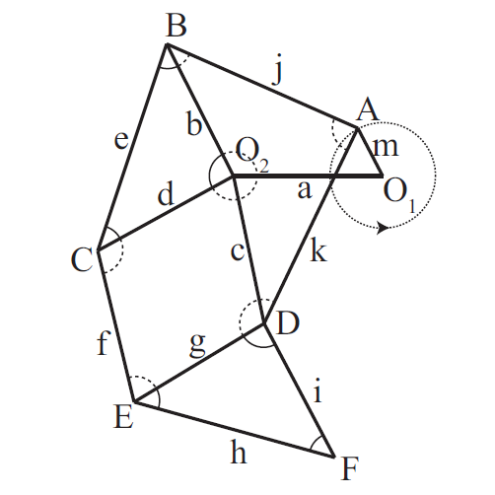
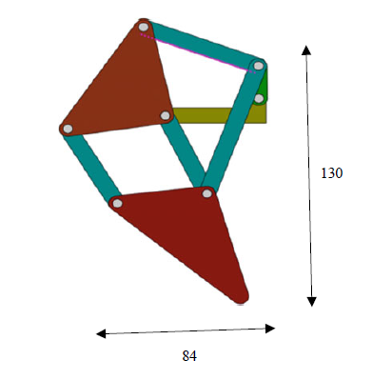
Make a leg model:

Slide 6
Study and Simulate:
Komoda, K. (2011). A study of availability and extensibility of Theo Jansen mechanism toward climbing over bumps. In The 21st Annual Conference of the Japanese Neural Networks Society Okinawa, Japan, Dec 2011 (pp. 192-193).
Nansai, S., Elara, M. R., & Iwase, M. (2013). Dynamic analysis and modeling of Jansen mechanism. Procedia Engineering, 64, 1562-1571.
Mohsenizadeh, M., & Zhou, J. (2015). Kinematic analysis and simulation of theo jansen mechanism (Doctoral dissertation, Lamar University).

Slide 7
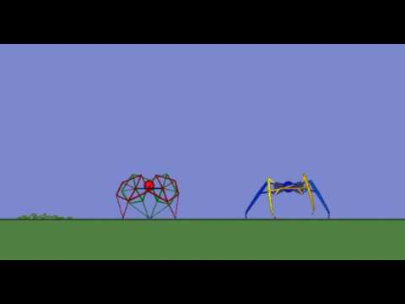
Simulation Example:

Slide 8
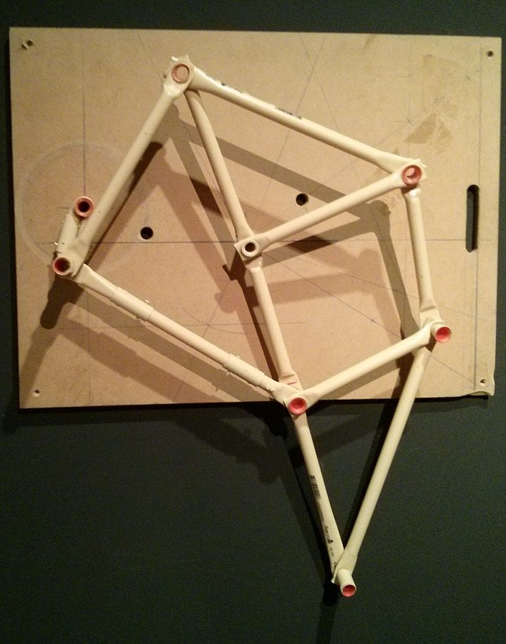
Implementation:
I will start with a 3D printed model for one leg.
Once I verify that it is working as needed I can move on.

Slide 9
Problems:
Manufacturing aluminum legs.
Motor torque may not be enough

Slide 10

Repeat and attach:
Create multiple legs and attach them to one body.
Check if the it is working just like the simulation and then attach a motor.
Story for illustration purposes only

Slide 11
Constraints:
1 motor (Pololu)
Maximum weight is 5kg
Maximum detail size 300x300
No payload

Slide 12
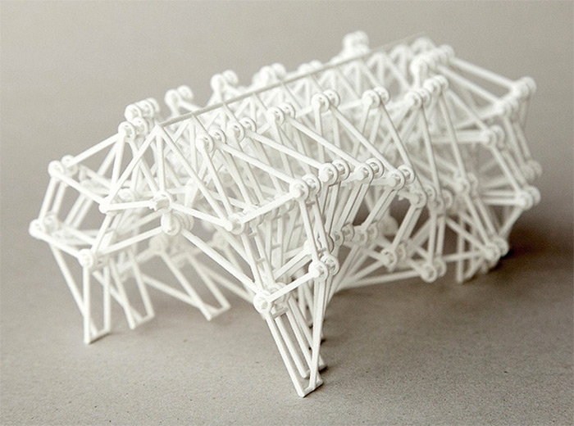
Keep
calm
and
build Strandbeests

