Slide 1

GitHub Tutorial
Koko Friansa 8-11-2024
(Sekolah Bisnis Manajemen ITB)

Slide 2

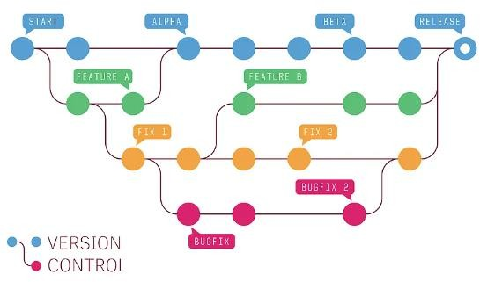
What is GitHub
Definition:
GitHub is a cloud-based platform for version control and
collaborative software development.

Slide 3
Key Feature
Documentation: Users can create or upload a files:
Word, Excel, pptx, PDF, Image (PNG, JPEG).
README files or LICENSE files (README.md), (LICENSE.md)
Application Programming Interface (API) – software interface
Script Files (R Script, Python, Java, Javascript, C++, SQL, etc)
Dataset (CSV file, JSON, XML, etc)
Repository Hosting: Allows users to create and store code repositories online.
Collaboration Tools: Supports team collaboration like pull requests, code reviews, and issue tracking.
Community Contributions: Facilitates open-source projects where developers can
contribute and collaborate globally.
Integrations: Connects with various third-party tools and services, testing, and deployment.

Slide 4






GitHub Benefit
STREAMLINES CODE MANAGEMENT (COMMIT, BRANCH, MERGE)
ENHANCES TEAM
COLLABORATION
PROMOTES TRANSPARENCY IN PROJECTS

Slide 5
Commit
Commit
Definition:
A commit is a saved
"snapshot" of changes in a
repository.
It records updates, deletions,
and additions to files over
time.
Purpose:
Tracks changes in a project.
Commit
Allows reverting to previous
versions.
Facilitates collaboration
between developers.
Commit

Slide 6
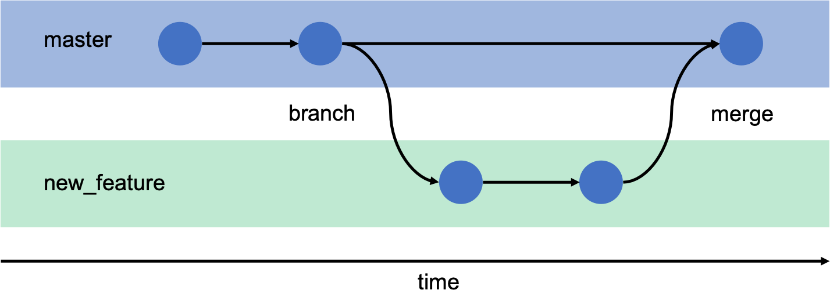
Branch and Merge
Branch
Merge
Parallel Development: Branches allow working on different features simultaneously.
Isolated Changes: Keeps changes separate
from the main/master code.
Combine Branches: Merge integrates changes from different branches.
Update Main/Master Code: Applies branch changes to the main project.

Slide 7

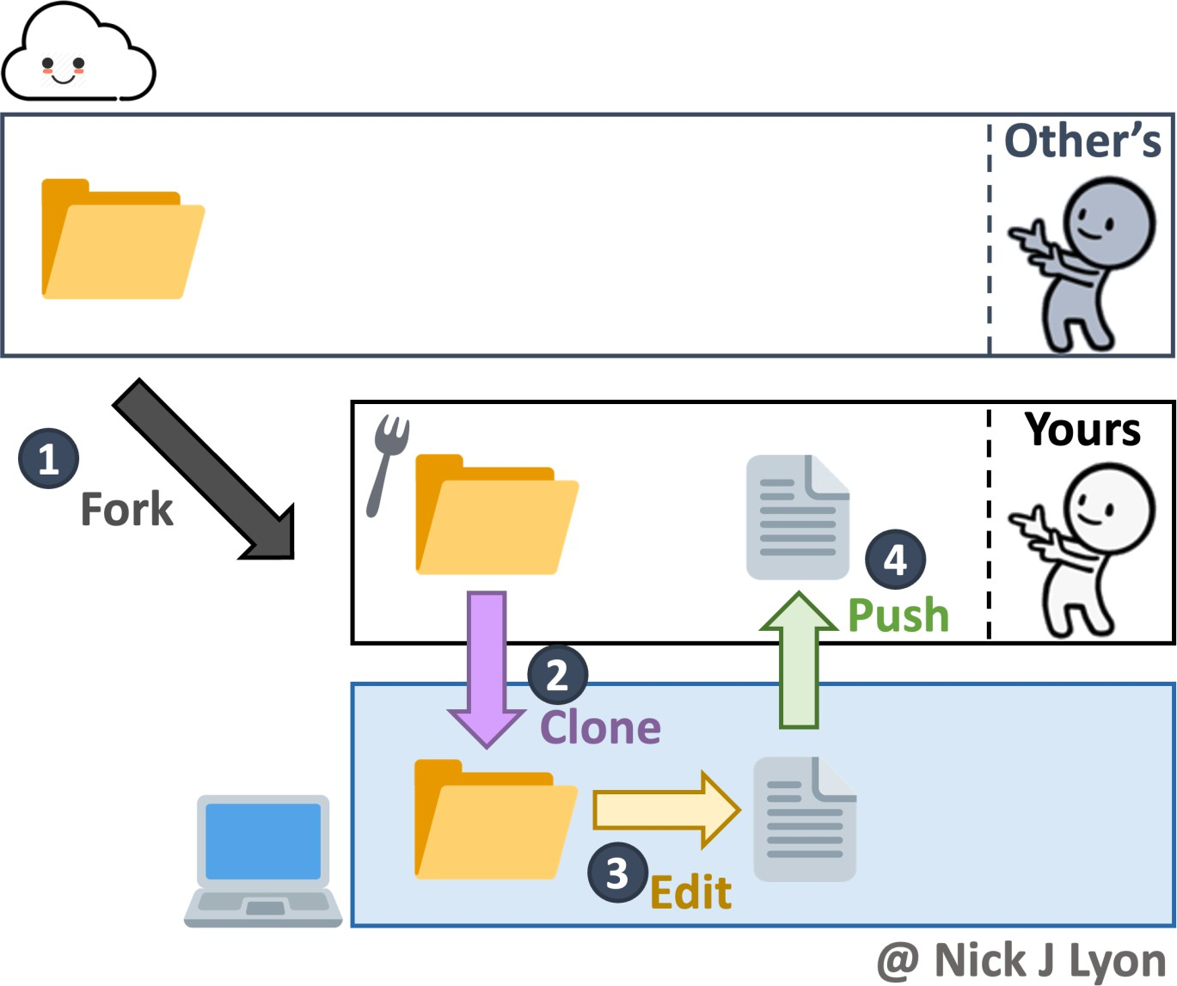
Forking Project
Someone else’s project
Create Personal Copy: Forking makes a personal copy of a project.
Experiment Freely: Allows independent changes without impacting the original

Slide 8
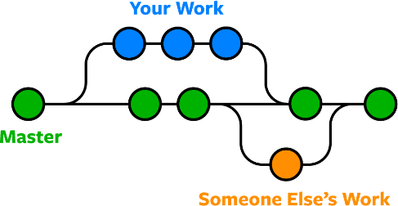
Branch and Fork
Branch
Fork
Fork
Someone else’s project: Creates an independent copy of a repository (often for external contributions).
No Immediate Connection: Changes made in your fork do not affect the original repository until a pull request is accepted and merged.
Branch
Internal development: Creates a parallel version of a project within the same repository (often for feature development or testing).
Feature development: bug fixes, or testing. Once the work is completed, the branch is typically merged back into the main branch.

Slide 9
How to Signup

Slide 10
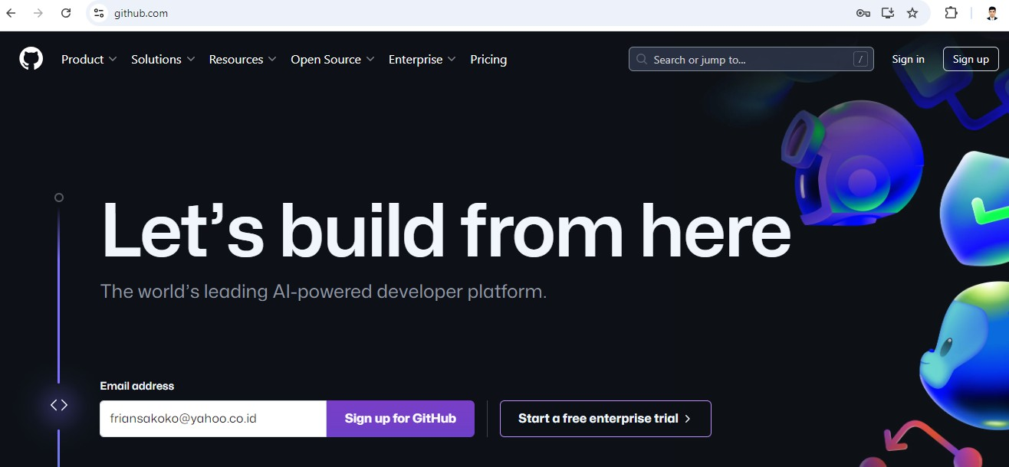
Get Started
https://github.com/

Slide 11
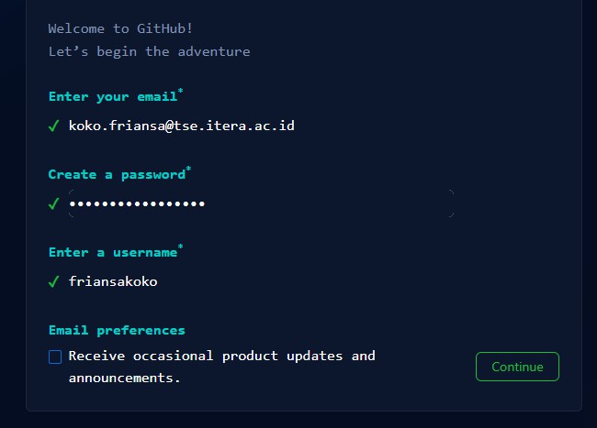
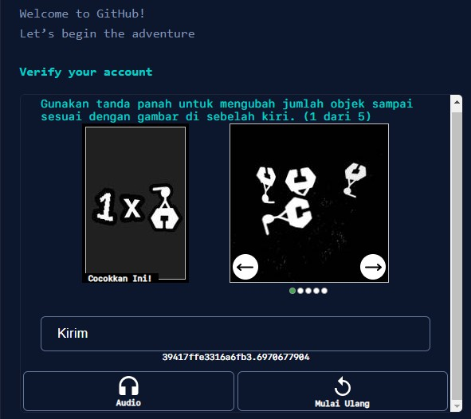
Signup Process
Create a username and password
CAPTCHA

Slide 12
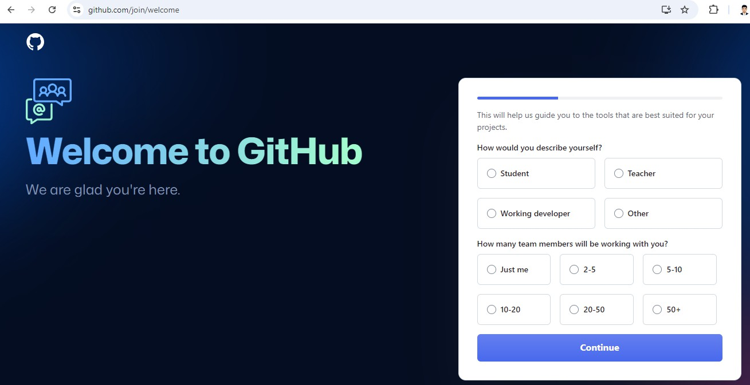
Describe yourself!

Slide 13
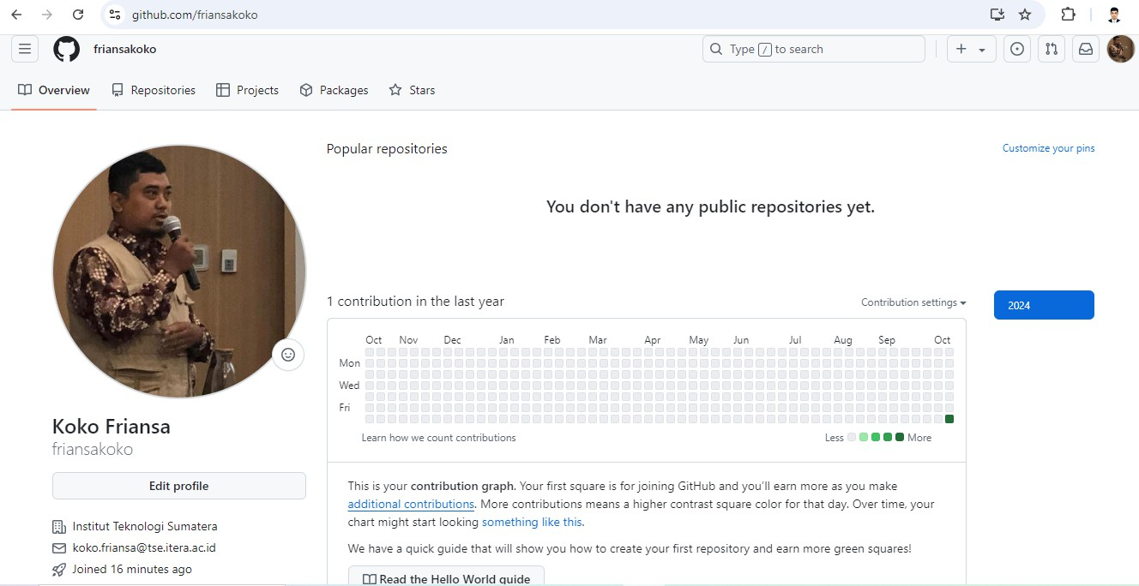
Edit your profile!

Slide 14
Submit your work

Slide 15

Submit your work
Create repositories
Upload file

Slide 16

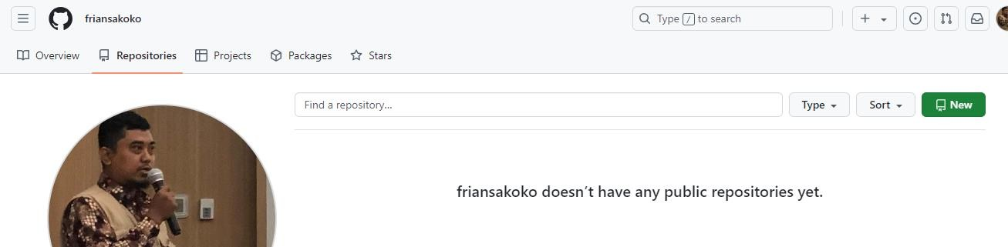
Create repositories
Create your repositories
Click Repositories Menu
Add New button

Slide 17

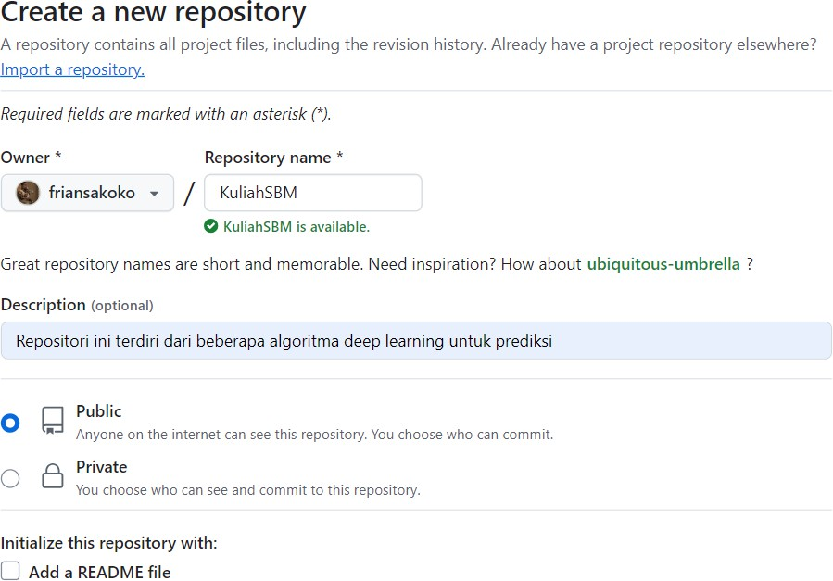
Create repositories
Write the repository name in the box
Description of the repository
A file that provides essential information about the project

Slide 18
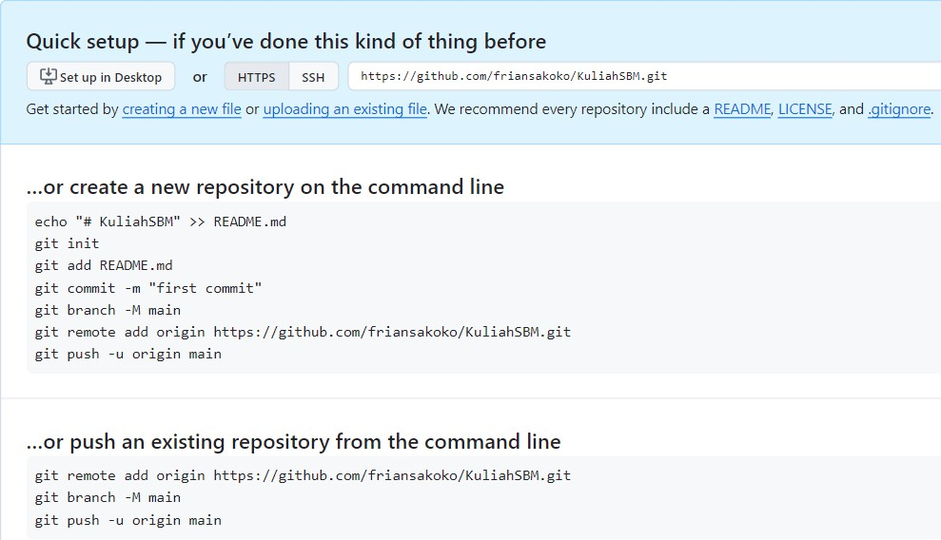
Create repositories
Interact with the repository
methods for securely communicating with a repository, specifically for operations like cloning, pushing, and pulling code.
Upload a file
Guide users on how to set up and push their code to the new repository.

Slide 19

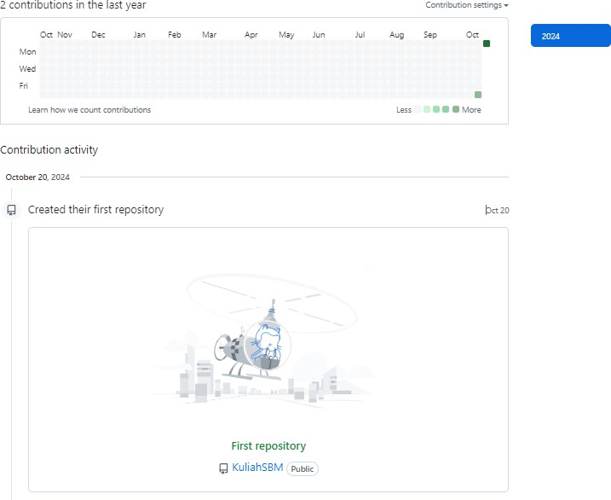
Congratulation!
Create repositories
A new activity has appeared.
A new activity (Create the first repository)

Slide 20

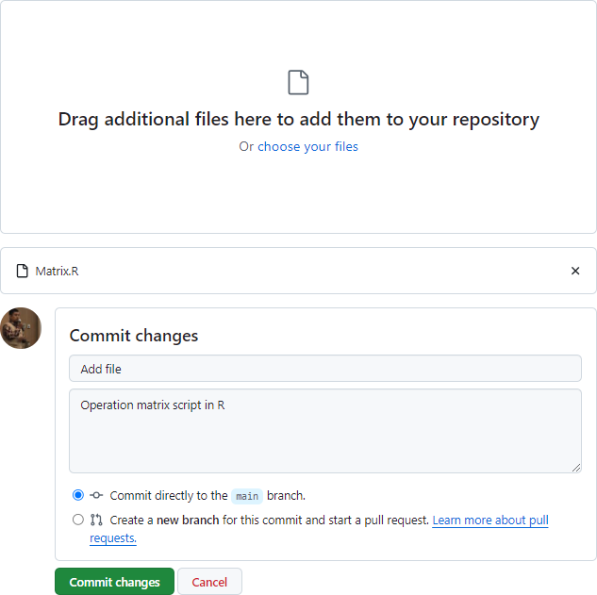
Upload File
Upload file
Drag and drop a new file
Candidate files to be uploaded
Commit box (write a description for tracking, history management)
Click Commit changes button for uploading file

Slide 21
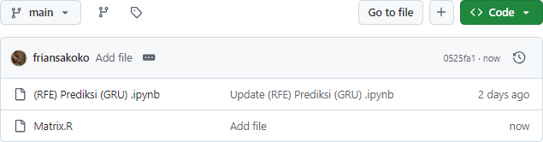
Upload file
Congratulation!
A new file has been uploaded

