Slide 1
Echoes of Lebanon
Logo Presentation Project

Slide 2
Concept
Echoes of Lebanon represents memory, identity, and cultural resonance.
The design blends nature and sound waves to reflect Lebanon’s voice and heritage.

Slide 3
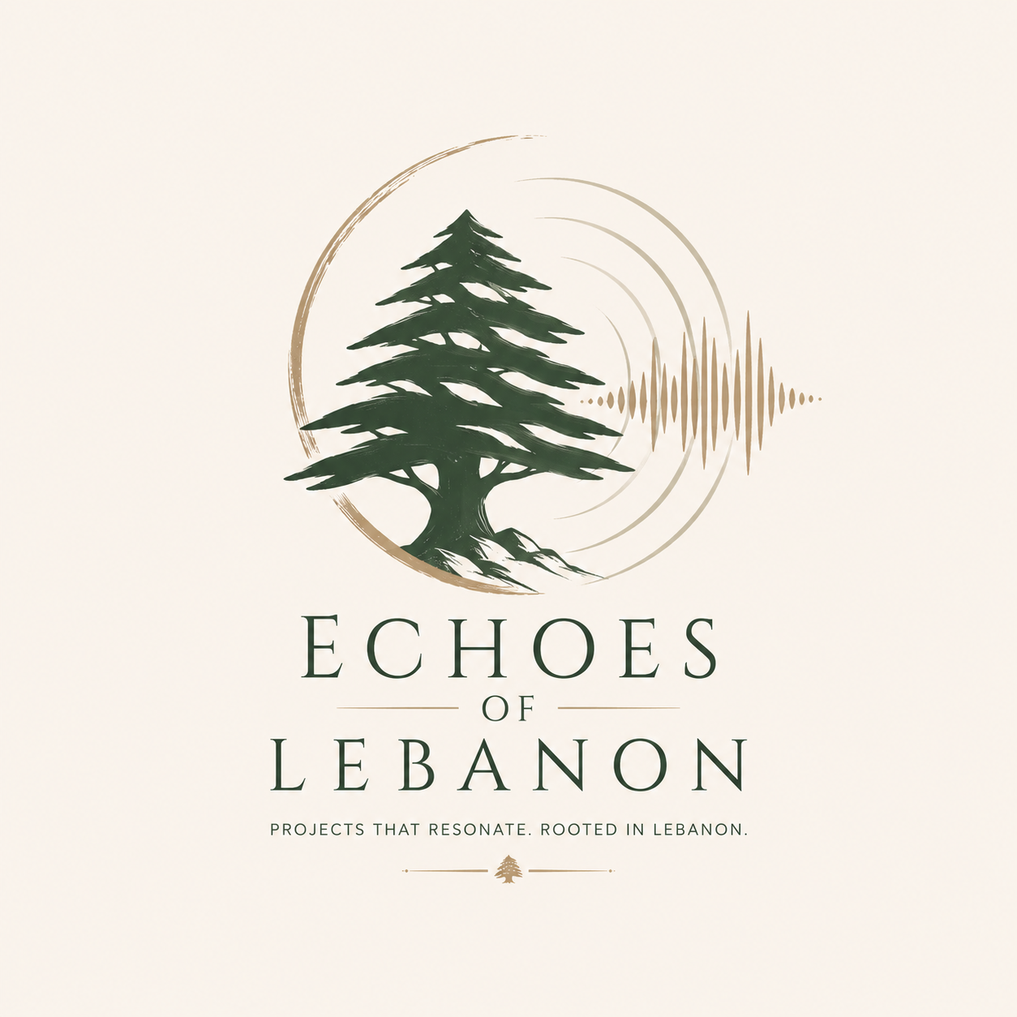

Slide 4
Meaning Behind the Logo
- Cedar tree: Lebanon’s strength & identity
- Sound waves: voices, memories, echoes of history
- Circular flow: continuity & unity

Slide 5
Color Palette
- Earth tones (green & beige)
- Represents nature, peace, and tradition
- Minimalist and elegant aesthetic

Slide 6
Usage
Ideal for:
- Cultural projects
- Music or film branding
- Documentaries
- Creative storytelling platforms

