Slide 1

SafeTone: Audio Deepfake Detection Using Convolutional Neural Networks
Graduation Project | Artificial Intelligence Department
Faculty of Information Technology, Zarqa University
Supervisor: Dr. Mosab Igtait | Academic Year: 2025/2026

Slide 2

BACKGROUND
The Rising Threat of Audio Deepfakes
Recent advances in artificial intelligence have enabled the generation of highly realistic synthetic speech that is virtually indistinguishable from authentic human voices. This technological capability introduces significant security vulnerabilities across multiple domains.
Audio deepfakes now pose critical risks to voice authentication systems, financial transactions, and digital identity verification. Traditional detection methods relying on human perception have proven insufficient against these sophisticated forgeries.
The urgent need for automated, AI-based detection systems has never been more apparent as synthetic speech technology continues to advance rapidly.

Slide 3

Problem Statement
Detection Challenge
Security Vulnerability
Modern synthetic speech exhibits acoustic properties that closely mimic genuine human voices, making manual identification nearly impossible.
Existing authentication and verification systems lack robust mechanisms to distinguish between real and artificially generated audio content.
Research Question
How can deep learning architectures accurately classify and differentiate authentic audio from synthetic deepfake recordings?

Slide 4
OBJECTIVES
Project Aim and Research Objectives
Primary Aim
Design, implement, and comprehensively evaluate a robust deep learning system capable of detecting audio deepfakes with high accuracy and reliability.
01
02
Feature Engineering
Model Development
Extract discriminative audio features that capture the subtle distinctions between authentic and synthetic speech patterns.
Train a convolutional neural network-based classifier optimized for binary audio classification tasks.
03
04
Performance Evaluation
System Architecture
Assess model effectiveness using industry-standard metrics including accuracy, precision, recall, and AUC.
Develop a modular, extensible system design that facilitates future enhancements and practical deployment scenarios.

Slide 5
Methodology and Implementation
Our approach meticulously defines each stage from data preparation to model deployment, ensuring a robust and reproducible deepfake detection system. This systematic methodology underpins the reliability and accuracy of the SafeTone solution.
Error rendering block: i.startsWith is not a function
Data Preprocessing
Training Configuration
Validation Strategy
Raw audio signals underwent rigorous standardization and MFCC computation, followed by normalization to ensure consistent input for the neural network. This step significantly reduces noise and emphasizes critical acoustic features.
The CNN was trained using the Adam optimizer with a learning rate schedule to facilitate convergence. Binary cross-entropy served as the loss function, optimizing for robust classification between real and synthetic audio samples over 10 epochs with a batch size of 1000.
A stratified 70/30 train-test split was applied to the FoR dataset, maintaining class balance. A dedicated validation set (15% of training data) monitored performance during training to prevent overfitting and guide hyperparameter tuning.

Slide 6
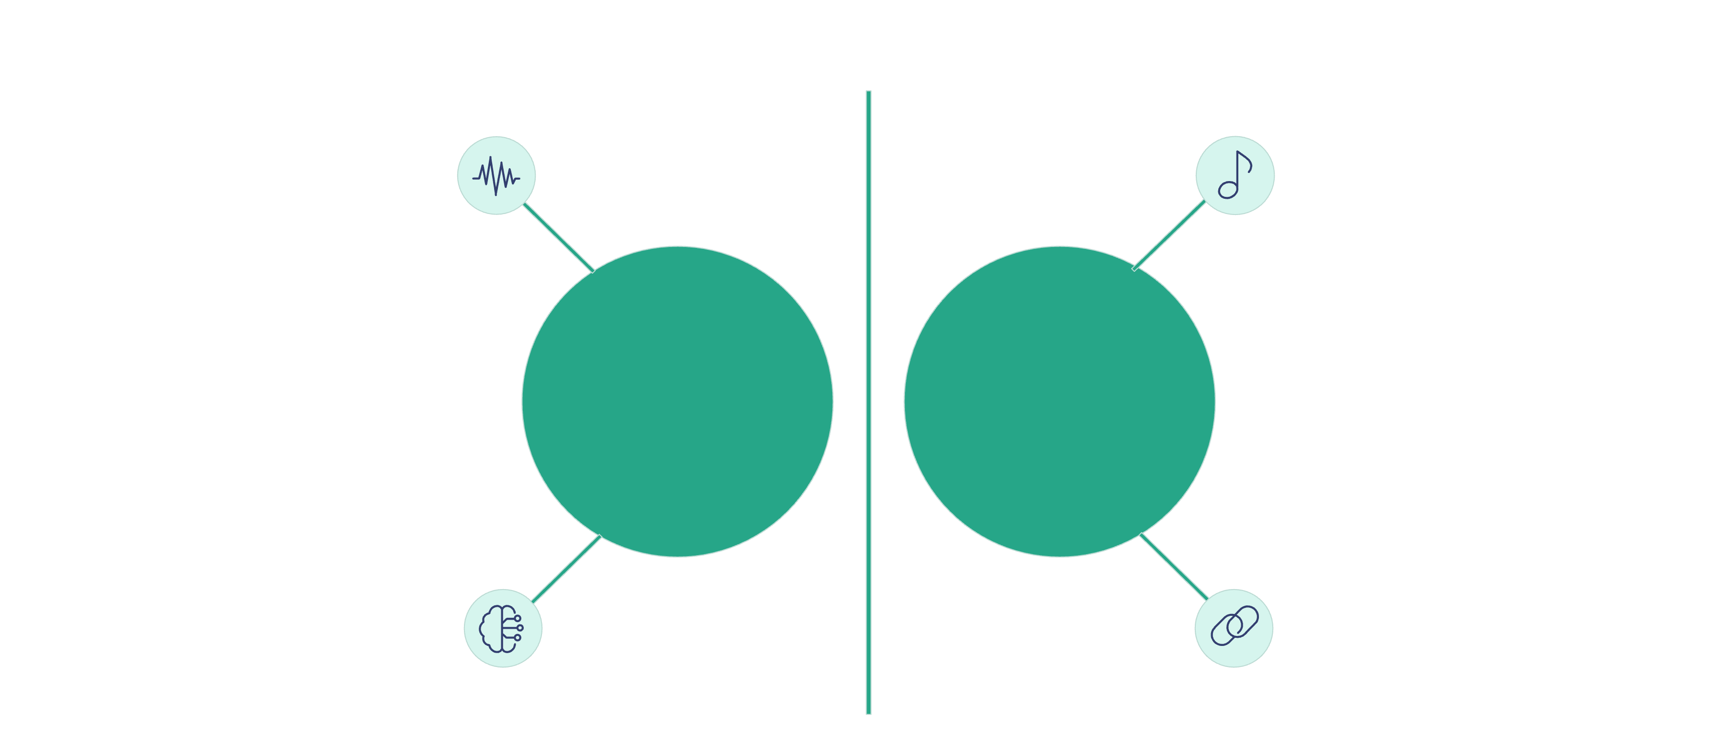




Comparative Analysis: Real vs Synthetic Audio
Distinguishing between authentic human speech and AI-generated deepfakes requires a keen understanding of their inherent acoustic properties. Our analysis highlights the subtle yet crucial differences that a robust detection model targets.
Natural pitch variation
Rich harmonic content
AI-Generated Deepfakes
Authentic Human Speech
Missing micro-fluctuations
Consistent spectral regularity
Acoustic Signatures
Subtle Artifacts
Detection Challenges
Real audio features complex, organic harmonic structures, whereas synthetic samples often display simpler, more uniform patterns in their MFCC representations.
Deepfakes can introduce detectable spectral anomalies, such as unnatural echoes, pitch discontinuities, or inconsistent background noise, absent in genuine recordings.
The continuous advancement in deepfake generation makes detection increasingly complex, demanding models that learn intricate, higher-order acoustic features.

Slide 7





System Architecture Overview
SafeTone implements an end-to-end deepfake detection pipeline with modular architecture designed for practical deployment. The system processes raw audio input through sophisticated feature extraction and classification stages to produce reliable authenticity assessments.
Audio Input
Raw waveform data sampled at 16 kHz
Feature Extraction
MFCC computation and normalization
CNN Classification
Deep learning inference and probability estimation
Decision Output
Binary classification with confidence score

Slide 8


DATASET
Fake-or-Real (FoR) Dataset
The model was trained and evaluated using the publicly available Fake-or-Real (FoR) dataset, a comprehensive collection specifically curated for audio deepfake detection research. This balanced dataset provides diverse examples of both authentic and synthetic speech samples.
21,235
10,718
Total Samples
Real Audio
Complete dataset size
Authentic human speech
10,517
Fake Audio
Synthetic generated samples
All audio samples are standardized at 16 kHz sampling rate, ensuring consistent input characteristics for model training, validation, and testing phases.

Slide 9

Feature Extraction: MFCC Analysis
Mel-Frequency Cepstral Coefficients
Model Input Specifications
MFCCs serve as the primary feature representation, capturing perceptually relevant speech characteristics that align with human auditory perception. This transformation converts raw audio waveforms into compact time-frequency representations that effectively encode acoustic properties.
216 time frames – Temporal resolution
40 MFCC coefficients – Frequency bands
1 channel – Mono audio input
Final shape: 216 × 40 × 1
The feature extraction process generates representations that preserve critical information while reducing dimensionality, enabling efficient neural network processing.

Slide 10





ARCHITECTURE
Convolutional Neural Network Design
Sequential Architecture
Three Conv Blocks
Streamlined layer-by-layer processing optimized for 2D feature map analysis and hierarchical pattern learning.
Progressive feature extraction with increasing filter complexity captures low to high-level acoustic patterns.
Dense Classification Head
Fully connected layers aggregate learned features for final binary classification decision with probability output.
The architecture is specifically designed for MFCC spectrograms, employing convolutional operations to detect local patterns and spatial hierarchies that distinguish authentic from synthetic audio.

Slide 11
CNN Architecture: Detailed Layer Configuration
Convolutional Block 1
1
32 filters | Conv2D (3×3 kernel) + ReLU → Batch Normalization → MaxPooling (2×2) → Dropout (0.25)
2
Convolutional Block 2
64 filters | Conv2D (3×3 kernel) + ReLU → Batch Normalization → MaxPooling (2×2) → Dropout (0.25)
Convolutional Block 3
3
128 filters | Conv2D (3×3 kernel) + ReLU → Batch Normalization → MaxPooling (2×2) → Dropout (0.25)
4
Classification Layers
Flatten → Dense (256 neurons, ReLU) → Dropout (0.5) → Output (1 neuron, Sigmoid)
Regularization Strategy
Filter Progression
Batch normalization stabilizes training dynamics while dropout layers (0.25 and 0.5) provide strong regularization to prevent overfitting on training data.
The increasing filter count (32→64→128) enables hierarchical feature learning, capturing progressively more complex acoustic patterns.

Slide 12




RESULTS
Performance Metrics and Experimental Outcomes
95.26%
0.21
99%
Test Accuracy
Test Loss
AUC Score
Overall classification performance
Binary cross-entropy
Area under ROC curve
Key Findings
Strong class separation achieved between real and fake audio samples
Model exhibits stable generalization to previously unseen test data
High recall demonstrates effective detection of synthetic speech instances
Misclassifications primarily occur with high-quality deepfakes exhibiting strong acoustic
similarity to authentic speech
Conclusion and Future Directions
SafeTone successfully validates the CNN-based detection approach, demonstrating that convolutional architectures combined with MFCC features provide effective, computationally efficient, and reproducible deepfake detection. Future work will explore larger diverse datasets, cross-dataset generalization, real-time detection capabilities, and integration with fully trained speaker verification modules.

Slide 13




IMPACT
Real-World Applications and Impact
SafeTone's deepfake detection capabilities have far-reaching implications across critical sectors, bolstering security and trust in an increasingly voice-driven digital world.
Banking & Finance
Law Enforcement
Safeguarding financial assets by detecting fraudulent voice commands and preventing unauthorized access to accounts, enhancing transaction security.
Crucial for forensic analysis, authenticating audio evidence in investigations, and identifying fabricated recordings used in disinformation campaigns.
Media Authentication
Voice Biometrics
Verifying the authenticity of audio content in news and social media, combating deepfake-driven misinformation and protecting journalistic integrity.
Strengthening biometric security in voice authentication systems, preventing sophisticated spoofing attacks and ensuring reliable user verification for access control.
By providing a robust defense against audio deepfakes, SafeTone helps preserve trust in digital communication and protects individuals and institutions from emerging threats.

Slide 14
OUTLOOK
Limitations and Future Research Directions
While SafeTone demonstrates robust deepfake detection, inherent complexities and the rapid evolution of synthetic audio technology present ongoing challenges and exciting avenues for future exploration.
Cross-Dataset Generalization
Computational Demands
Evolving Threat Landscape
The model's performance can diminish when encountering audio characteristics significantly different from the training data, highlighting a need for broader domain adaptation.
Processing high volumes of audio data, especially for real-time applications, requires optimized inference speeds and efficient resource utilization.
The continuous improvement in deepfake generation techniques necessitates ongoing model updates and research into more adaptive detection mechanisms.
Strategic Research Priorities
Expand Datasets
Multi-Language Support
Incorporate larger, more diverse audio corpora to enhance robustness and reduce bias across various acoustic environments and speaker demographics.
Develop detection capabilities that are effective across numerous languages, addressing the global nature of audio deepfake threats.
Real-time Processing
Ensemble & Integration
Optimize the model for near-instantaneous detection, crucial for live communication platforms and dynamic threat environments.
Explore combining SafeTone with other detection methods or integrating with speaker verification systems for enhanced accuracy and reliability.

