Slide 1
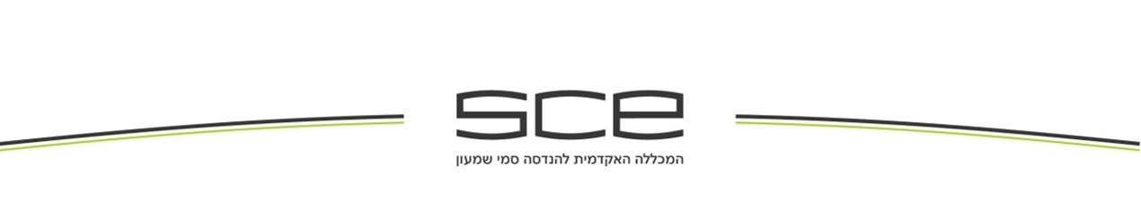
PYTHON How python is different from other programming languages?
Presenter: safaa azbarqa
I.D: 211342530
Class: English Advanced B

Slide 2
Content
What is python?
Advantages of python.
How the code in python more simple.
Popularity of python.

Slide 3
What is python?
Python is an advanced interpreted programming language

Slide 4
Advantages of Using Python Over Other Languages
Clean and easy syntax[1]
Simple to understand
high-level programming language
supports multi programming paradigms[2]
Notes:
paradigms such as imperative, functional, and object-oriented //Python gradually becomes a new option of the first language for learning.

Slide 5

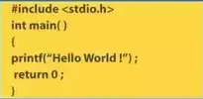

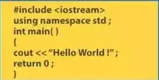
Same code in different programming languages
Java
C
Python
C++

Slide 6
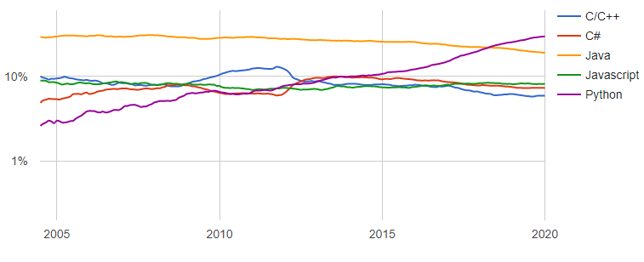
PYTHON Popularity of Programming Language
the bar graph shows the differences between the programming languages over time, the x- axes shows the years and the y-axes shows the ratings of the language.
Python in 2005 was the lowest language from rating but it increased quickly over the time and became the most popular language after 15 year.

Slide 7
Bibliography
[1] Chieh-An Lo and Yu-Tzu Lin and Cheng-Chih,“Which programming language should students learn first?”, International Conference on Learning and Teaching in Computing and Engineering, April 2015, pp.225-226
[2] M.Ami,” On parallel software engineering education using python”, Education and Information Technologies, 2018, Vol.23(1), pp.357-372
[3] B.kmekci and C.Mcanany and C.Mura, “An Introduction to Programming for Bio scientists: A Python-Based Primer“ ,PLoS Computational Biology, 01 June 2016, Vol.12(6), p.e1004867
[4] P.Aaron and A.Craig and N.James, “What Programming Languages Do Developers Use?”, 2018 IEEE Symposium on Visual Languages and Human-Centric Computing (VL/HCC), October 2018, pp.239-24
[5] K. Jarrod and A.Michael,” Python for Scientists and Engineers “, Computing in Science & Engineering, March 2011, Vol.13(2), pp.9-12

