Slide 1

a smart and innovative system for making appointments for small businesses from their personal website.

Slide 2
problem
During the Corona period, governments required business owners to maintain guidelines to prevent the spread of the disease. Businesses around the world have realized that a solution needs to be found for a crowd of customers somewhere. There is currently no quality and effective solution to the problem of scheduling appointments. The main problem: High costs for developing private systems for any business and lack of support for all customers who use. Small businesses cannot afford a high investment in development.

Slide 3





Target Audience The product is mainly aimed at small business owners, including:
Hair Stylists
Driving School
Spa and Massage
Private Medicine
Nail Builder

Slide 4
product
advanced business schedule
Automatic scheduling
Advanced management panel
Advanced CRM customer system.
Business photo gallery management.

Slide 5
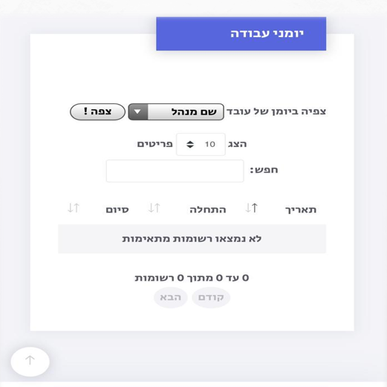
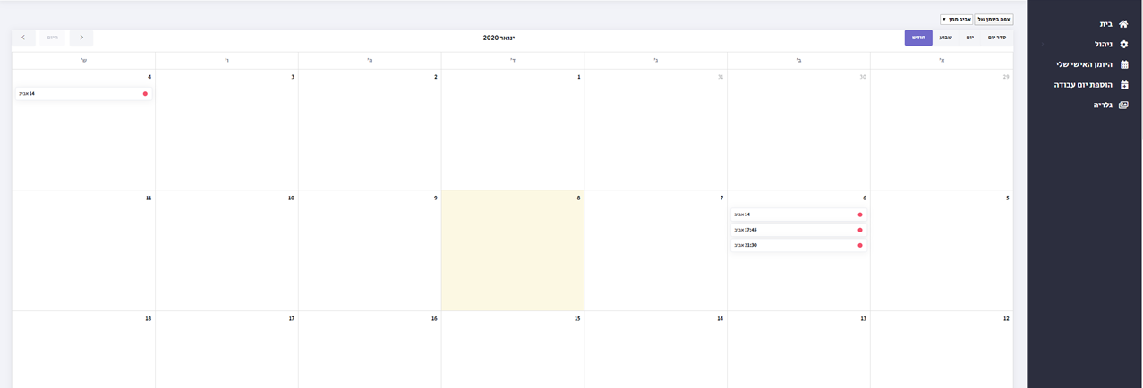
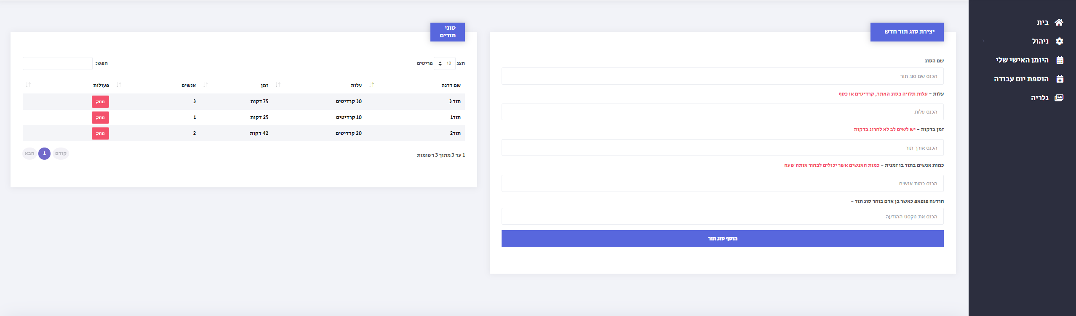
Business diary of the business owner
product
Managing the types of queues of the business

Slide 6
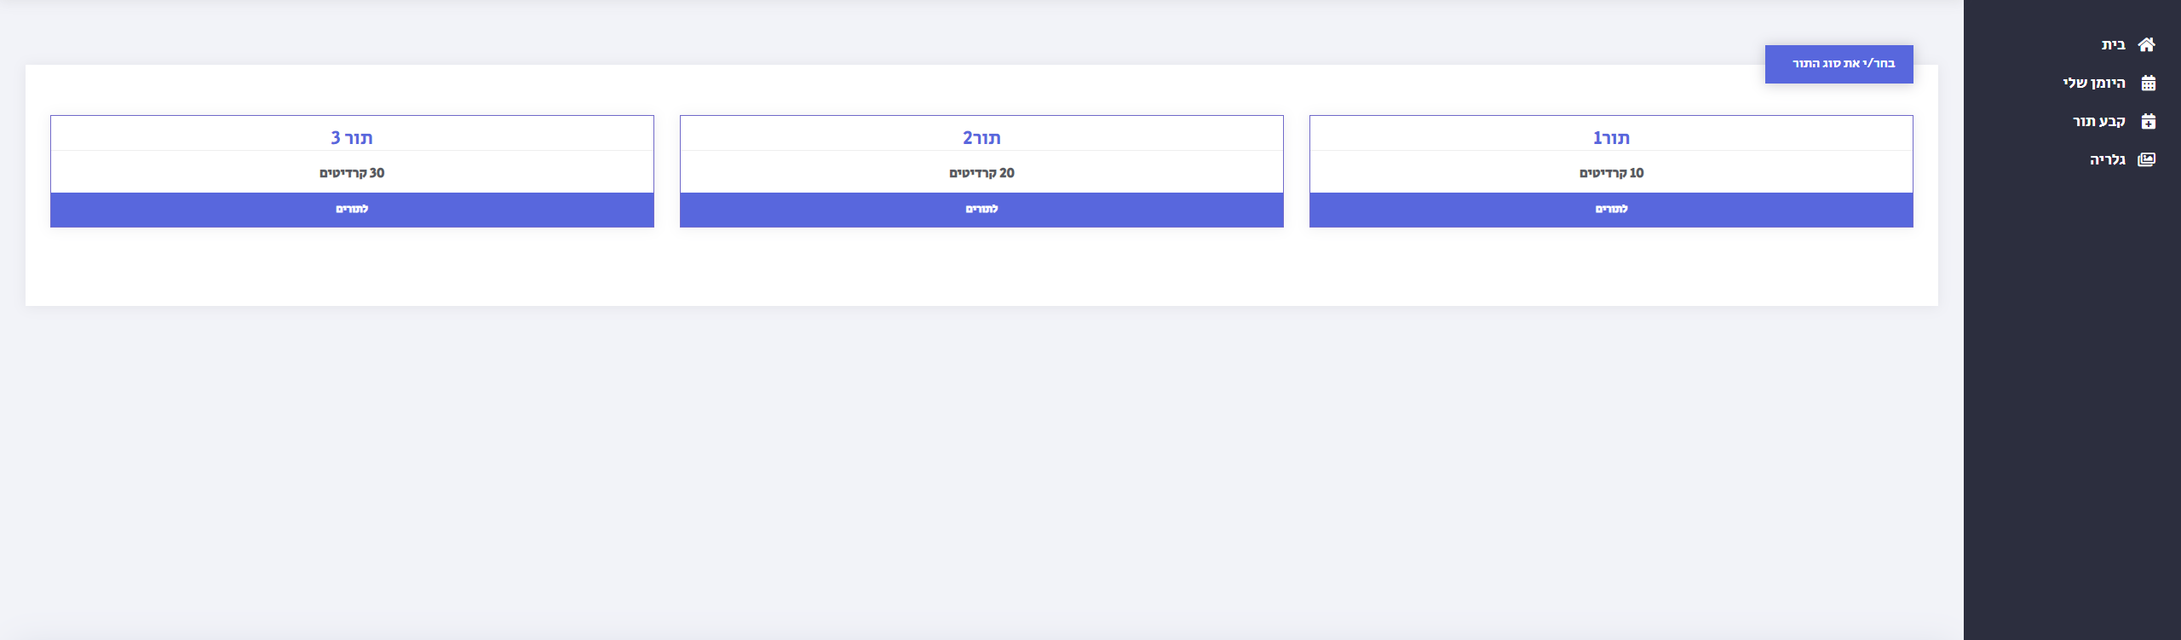
Customer queue selection

Slide 7
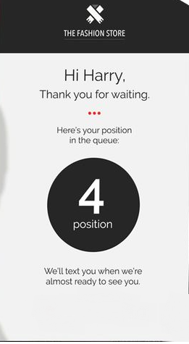
Business design

Slide 8
developing cost
Current cost
Branding and graphics 4000
Development 5000
Establishing an image site 2000
Servers 400
Technical center and service 3000
Advertising agency 1500

Slide 9
pricing
50%
6 months
0.01$
Less price than the other competitors
(15$ instead of 30$)
Using the system for free to the customers.
For every sms the customer receives from the system

Slide 10
Marketing &
distribution channels
Low distribution cost, as it is a digital distribution with no limit on the number of copies.
Using digital distribution of the application is efficient and appropriate to the nature of the product.
The use of digital distribution on the network constitutes control over the distribution: stopping the distribution, prices, version updates, etc.

Slide 11
Competitors
Q-FLOW
American company. Applicable diary and customer management system. Their disadvantage compared to us is QFLOW does not offer extensive experience which will allow to measure the importance of the system in front of the customers of the business.
GALI
an application for smartphones and tablets. CALI is a strong competitor in this market but its main problem - it is application based only which does not allow those with old devices to support your business as well.

Slide 12
team
Yarin
Avraham
Wadeea
Abu Koosh
Safaa
azbarqa
Software engineering student with experience in website development and applications. Responsible for product design and marketing.
Software engineering student. Responsible for software code and development.
- Software engineering student . Assistant for software code and development, and responsible for communicating with the customers.

Slide 13
THANK YOU

