Slide 1
Problem solvine in AI

Slide 2
Constraint Satisfaction Problems (CSP) in Artificial Intelligence
Finding a solution that meets a set of constraints is the goal of constraint satisfaction problems (CSPs), a type of AI issue.
Finding values for a group of variables that fulfill a set of restrictions or rules is the aim of constraint satisfaction problems.
For tasks including resource allocation, planning, scheduling, and decision-making, CSPs are frequently employed in AI.

Slide 3
Components in the constraint satisfaction problem
Variables: The things that need to be determined are variables.
Variables in a CSP are the objects that must have values assigned to them in order to satisfy a particular set of constraints.
Boolean, integer, and categorical variables are just a few examples of the various types of variables
Variables, for instance, could stand in for the many puzzle cells that need to be filled with numbers in a sudoku puzzle.

Slide 4
Domains
The range of potential values that a variable can have is represented by domains.
Depending on the issue, a domain may be finite or limitless.
For instance, in Sudoku, the set of numbers from 1 to 9 can serve as the domain of a variable representing a problem cell.

Slide 5
Constraints
The guidelines that control how variables relate to one another are known as constraints.
Constraints in a CSP define the ranges of possible values for variables.
Unary constraints, binary constraints, and higher-order constraints are only a few examples of the various sorts of constraints.
For instance, in a sudoku problem, the restrictions might be that each row, column, and 3×3 box can only have one instance of each number from 1 to 9.

Slide 6
Constraint Satisfaction Problems (CSP) representation
The finite set of variables V1, V2, V3 ……………..Vn.
Non-empty domain for every single variable D1, D2, D3 …………..Dn.
The finite set of constraints C1, C2 …….…, Cm.
where each constraint Ci restricts the possible values for variables,e.g., V1 ≠ V2
Each constraint Ci is a pair <scope, relation>
Example: <(V1, V2), V1 not equal to V2>
Scope = set of variables that participate in constraint.
Relation = list of valid variable value combinations.
There might be a clear list of permitted combinations.

Slide 7
Real-world Constraint Satisfaction Problems (CSP)
Scheduling: A fundamental CSP problem is how to efficiently and effectively schedule resources like personnel, equipment, and facilities. The constraints in this domain specify the availability and capacity of each resource, whereas the variables indicate the time slots or resources.
Sudoku: The well-known puzzle game Sudoku can be modeled as a CSP problem, where the variables stand in for the grid’s cells and the constraints specify the game’s rules, such as prohibiting the repetition of the same number in a row, column, or area

Slide 8
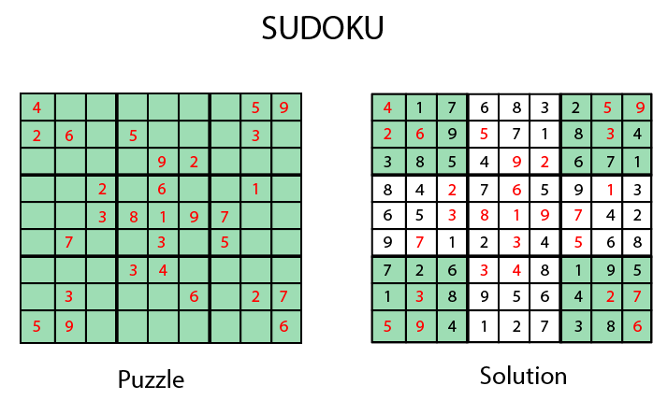

Slide 9
Adversarial Search
Adversarial search is a search, where we examine the problem which arises when we try to plan ahead of the world and other agents are planning against us.
In previous topics, we have studied the search strategies which are only associated with a single agent that aims to find the solution which often expressed in the form of a sequence of actions.
But, there might be some situations where more than one agent is searching for the solution in the same search space, and this situation usually occurs in game playing.
The environment with more than one agent is termed as multi-agent environment, in which each agent is an opponent of other agent and playing against each other.
Each agent needs to consider the action of other agent and effect of that action on their performance.
Searches in which two or more players with conflicting goals are trying to explore the same search space for the solution, are called adversarial searches, also known Games.
Games are modeled as a Search problem and heuristic evaluation function, and these are the two main factors which help to model and solve games in AI.

Slide 10
Types of Games in AI
Perfect information: A game with the perfect information is that in which agents can look into the complete board. Agents have all the information about the game, and they can see each other moves also. Examples are Chess, Checkers, Go, etc.
Imperfect information: If in a game agents do not have all information about the game and not aware with what's going on, such type of games are called the game with imperfect information, such as tic-tac-toe, Battleship, blind, Bridge, etc.
Deterministic games: Deterministic games are those games which follow a strict pattern and set of rules for the games, and there is no randomness associated with them. Examples are chess, Checkers, Go, tic-tac-toe, etc.
Non-deterministic games: Non-deterministic are those games which have various unpredictable events and has a factor of chance or luck. This factor of chance or luck is introduced by either dice or cards. These are random, and each action response is not fixed. Such games are also called as stochastic games.

Slide 11
Formalization of the problem
Game tree
A game tree is a tree where nodes of the tree are the game states and Edges of the tree are the moves by players. Game tree involves initial state, actions function, and result Function.
Example: Tic-Tac-Toe game tree:
The following figure is showing part of the game-tree for tic-tac-toe game. Following are some key points of the game:
There are two players MAX and MIN.
Players have an alternate turn and start with MAX.
MAX maximizes the result of the game tree
MIN minimizes the result.

Slide 12
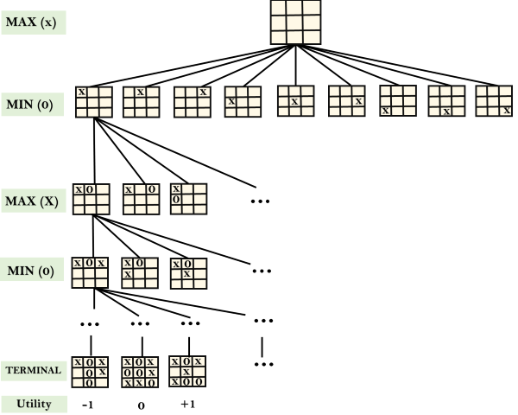

Slide 13
Probabilistic reasoning in Artificial intelligence

Slide 14
Uncertainty
We have learned knowledge representation using first-order logic and propositional logic with certainty, which means we were sure about the predicates.
With this knowledge representation, we might write A→B, which means if A is true then B is true, but consider a situation where we are not sure about whether A is true or not then we cannot express this statement, this situation is called uncertainty.
So to represent uncertain knowledge, where we are not sure about the predicates, we need uncertain reasoning or probabilistic reasoning.
Causes of uncertainty:
Following are some leading causes of uncertainty to occur in the real world.
Information occurred from unreliable sources.
Experimental Errors
Equipment fault
Temperature variation
Climate change.

Slide 15
Probabilistic reasoning
Probabilistic reasoning is a way of knowledge representation where we apply the concept of probability to indicate the uncertainty in knowledge.
In probabilistic reasoning, we combine probability theory with logic to handle the uncertainty.
We use probability in probabilistic reasoning because it provides a way to handle the uncertainty that is the result of someone's laziness and ignorance.
In the real world, there are lots of scenarios, where the certainty of something is not confirmed, such as "It will rain today," "behavior of someone for some situations," "A match between two teams or two players." These are probable sentences for which we can assume that it will happen but not sure about it, so here we use probabilistic reasoning.

Slide 16
Need of probabilistic reasoning in AI
When there are unpredictable outcomes.
When specifications or possibilities of predicates becomes too large to handle.
When an unknown error occurs during an experiment.
In probabilistic reasoning, there are two ways to solve problems with uncertain knowledge:
Bayes' rule
Bayesian Statistics
As probabilistic reasoning uses probability and related terms, so before understanding probabilistic reasoning, let's understand some common terms:

Slide 17

Probability: Probability can be defined as a chance that an uncertain event will occur. It is the numerical measure of the likelihood that an event will occur. The value of probability always remains between 0 and 1 that represent ideal uncertainties.
0 ≤ P(A) ≤ 1, where P(A) is the probability of an event A.
P(A) = 0, indicates total uncertainty in an event A.
P(A) =1, indicates total certainty in an event A.
We can find the probability of an uncertain event by using the below formula.
P(¬A) = probability of a not happening event.
P(¬A) + P(A) = 1.

Slide 18
Event: Each possible outcome of a variable is called an event.
Sample space: The collection of all possible events is called sample space.
Random variables: Random variables are used to represent the events and objects in the real world.
Prior probability: The prior probability of an event is probability computed before observing new information.
Posterior Probability: The probability that is calculated after all evidence or information has taken into account. It is a combination of prior probability and new information.

Slide 19


Conditional probability
Conditional probability is a probability of occurring an event when another event has already happened.
Let's suppose, we want to calculate the event A when event B has already occurred,
"the probability of A under the conditions of B", it can be written as:
Where P(A⋀B)= Joint probability of a and B
P(B)= Marginal probability of B.
If the probability of A is given and we need to find the probability of B, then it will be given as:
It can be explained by using the below Venn diagram, where B is occurred event,
so sample space will be reduced to set B, and now we can only calculate event A when event B is
already occurred by dividing the probability of P(A⋀B) by P( B ).

Slide 20
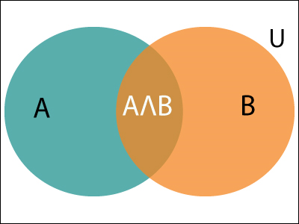

Slide 21

Example:
In a class, there are 70% of the students who like English and 40% of the students who likes English and mathematics,
and then what is the percent of students those who like English also like mathematics?
Solution:
Let, A is an event that a student likes Mathematics
B is an event that a student likes English.
Hence, 57% are the students who like English also like Mathematics.

