Slide 1
Problem solvine in AI

Slide 2
Constraint Satisfaction Problems (CSP) in Artificial Intelligence
Finding a solution that meets a set of constraints is the goal of constraint satisfaction problems (CSPs), a type of AI issue.
Finding values for a group of variables that fulfill a set of restrictions or rules is the aim of constraint satisfaction problems.
For tasks including resource allocation, planning, scheduling, and decision-making, CSPs are frequently employed in AI.

Slide 3
Components in the constraint satisfaction problem
Variables: The things that need to be determined are variables.
Variables in a CSP are the objects that must have values assigned to them in order to satisfy a particular set of constraints.
Boolean, integer, and categorical variables are just a few examples of the various types of variables
Variables, for instance, could stand in for the many puzzle cells that need to be filled with numbers in a sudoku puzzle.

Slide 4
Domains
The range of potential values that a variable can have is represented by domains.
Depending on the issue, a domain may be finite or limitless.
For instance, in Sudoku, the set of numbers from 1 to 9 can serve as the domain of a variable representing a problem cell.

Slide 5
Constraints
The guidelines that control how variables relate to one another are known as constraints.
Constraints in a CSP define the ranges of possible values for variables.
Unary constraints, binary constraints, and higher-order constraints are only a few examples of the various sorts of constraints.
For instance, in a sudoku problem, the restrictions might be that each row, column, and 3×3 box can only have one instance of each number from 1 to 9.

Slide 6
Constraint Satisfaction Problems (CSP) representation
The finite set of variables V1, V2, V3 ……………..Vn.
Non-empty domain for every single variable D1, D2, D3 …………..Dn.
The finite set of constraints C1, C2 …….…, Cm.
where each constraint Ci restricts the possible values for variables,e.g., V1 ≠ V2
Each constraint Ci is a pair <scope, relation>
Example: <(V1, V2), V1 not equal to V2>
Scope = set of variables that participate in constraint.
Relation = list of valid variable value combinations.
There might be a clear list of permitted combinations.

Slide 7
Real-world Constraint Satisfaction Problems (CSP)
Scheduling: A fundamental CSP problem is how to efficiently and effectively schedule resources like personnel, equipment, and facilities. The constraints in this domain specify the availability and capacity of each resource, whereas the variables indicate the time slots or resources.
Sudoku: The well-known puzzle game Sudoku can be modeled as a CSP problem, where the variables stand in for the grid’s cells and the constraints specify the game’s rules, such as prohibiting the repetition of the same number in a row, column, or area

Slide 8
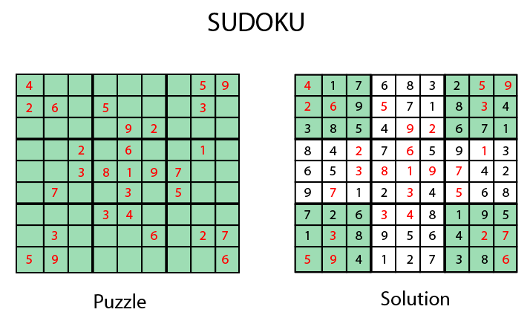

Slide 9
Adversarial Search
Adversarial search is a search, where we examine the problem which arises when we try to plan ahead of the world and other agents are planning against us.
In previous topics, we have studied the search strategies which are only associated with a single agent that aims to find the solution which often expressed in the form of a sequence of actions.
But, there might be some situations where more than one agent is searching for the solution in the same search space, and this situation usually occurs in game playing.
The environment with more than one agent is termed as multi-agent environment, in which each agent is an opponent of other agent and playing against each other.
Each agent needs to consider the action of other agent and effect of that action on their performance.
Searches in which two or more players with conflicting goals are trying to explore the same search space for the solution, are called adversarial searches, also known Games.
Games are modeled as a Search problem and heuristic evaluation function, and these are the two main factors which help to model and solve games in AI.

Slide 10
Types of Games in AI
Perfect information: A game with the perfect information is that in which agents can look into the complete board. Agents have all the information about the game, and they can see each other moves also. Examples are Chess, Checkers, Go, etc.
Imperfect information: If in a game agents do not have all information about the game and not aware with what's going on, such type of games are called the game with imperfect information, such as tic-tac-toe, Battleship, blind, Bridge, etc.
Deterministic games: Deterministic games are those games which follow a strict pattern and set of rules for the games, and there is no randomness associated with them. Examples are chess, Checkers, Go, tic-tac-toe, etc.
Non-deterministic games: Non-deterministic are those games which have various unpredictable events and has a factor of chance or luck. This factor of chance or luck is introduced by either dice or cards. These are random, and each action response is not fixed. Such games are also called as stochastic games.

Slide 11
Formalization of the problem
Game tree
A game tree is a tree where nodes of the tree are the game states and Edges of the tree are the moves by players. Game tree involves initial state, actions function, and result Function.
Example: Tic-Tac-Toe game tree:
The following figure is showing part of the game-tree for tic-tac-toe game. Following are some key points of the game:
There are two players MAX and MIN.
Players have an alternate turn and start with MAX.
MAX maximizes the result of the game tree
MIN minimizes the result.

Slide 12
