Slide 1
Computer Vision
(CV) download the actual slides from the link provided in the docx file

Slide 2
Current state of the art
The next slides show some examples of what current vision systems can do

Slide 3
Computer Vision
The goal of computer vision is to make useful decisions about real physical objects and scenes based on sensed images.
Images and movies are everywhere
Fast-growing collection of useful applications
  building representations of the 3D world from pictures
  automated surveillance (who’s doing what)
  movie post-processing
  face finding
Various deep and attractive scientific mysteries
  how does object recognition work?
Greater understanding of human vision

Slide 4
Need & Importance
Autonomous Robots
Industry
Character Recognition
Finding images in large collections
  searching for pictures
  browsing collections of pictures
  Find me the picture of Jinnah
Surveillance
  Warn me if there is some movement in the area
HCI
  Do what I show you
Military
  Shoot this, not that

Slide 5
Why study computer vision?
Vision is useful
Vision is interesting
Vision is difficult
  Half of primate cerebral cortex is devoted to visual processing
  Achieving human-level visual perception is probably “AI-complete”

Slide 6
Connections to other disciplines
Artificial Intelligence
Robotics
Machine Learning
Computer Vision
Computer Graphics
Psychology
Neuroscience
Image Processing

Slide 7
Steps of computer vision
Computer mimics human sight in four steps
  Image acquisition
  Image Processing
  Image Analysis
  Image understanding / Comprehension

Slide 8
Image Acquisition
It translate visual information into a format that can be further manipulated by the brain
Computer vision system needs an eye

Slide 9
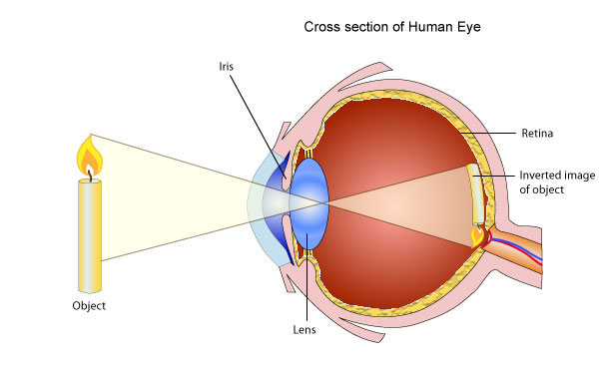
Human Vision System

Slide 10
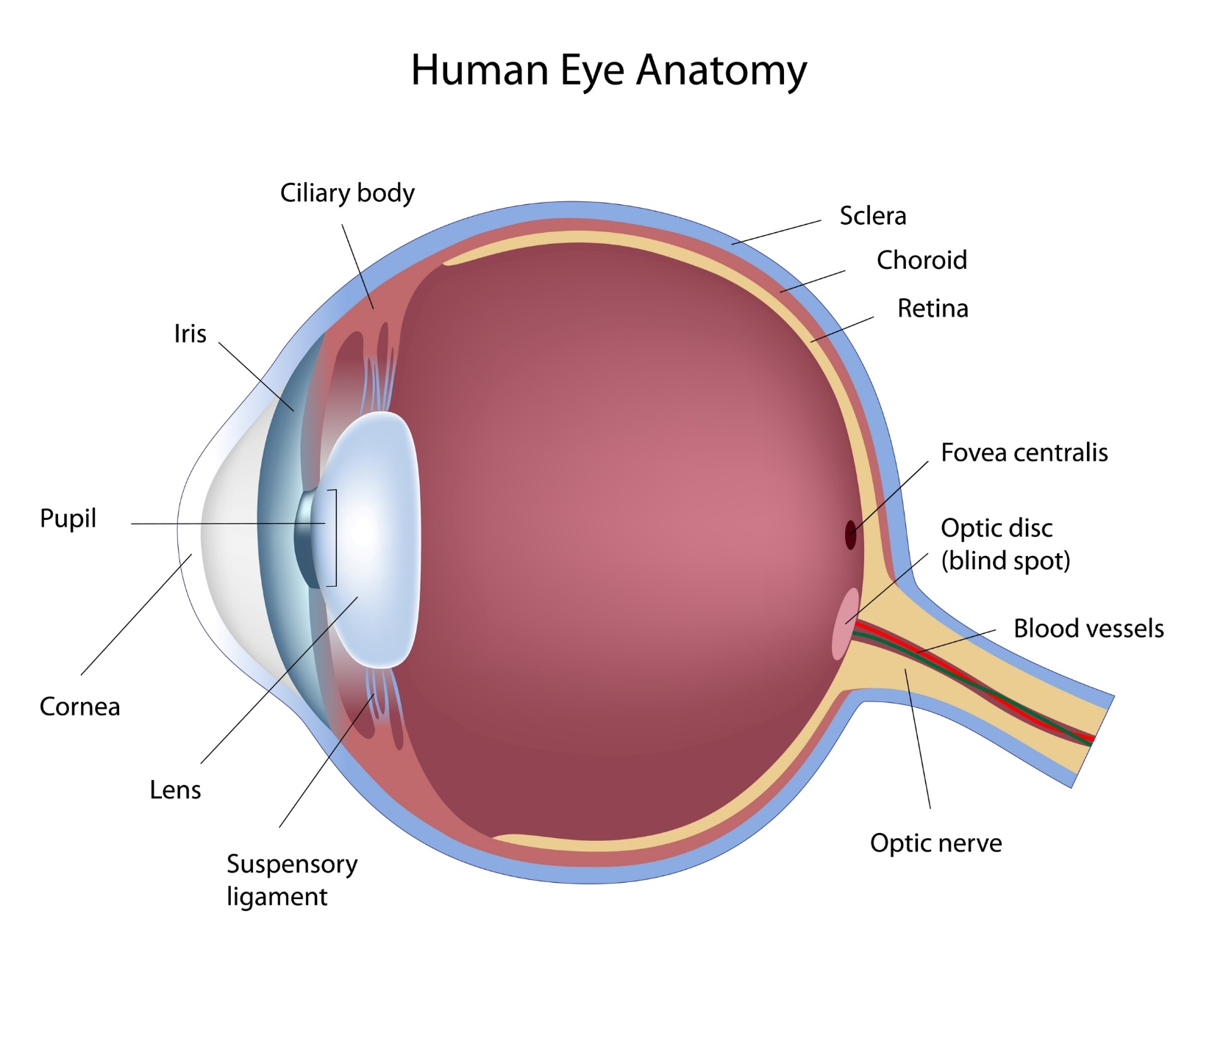

Slide 11
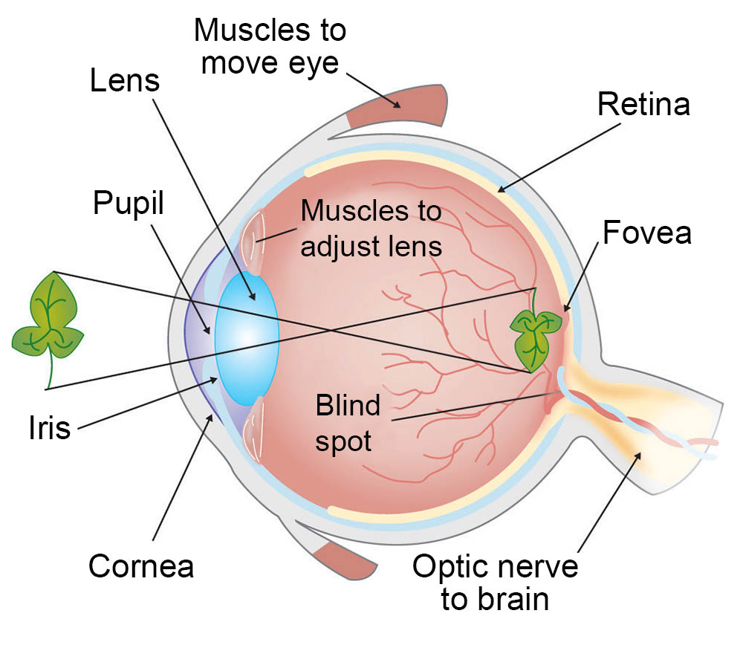

Slide 12
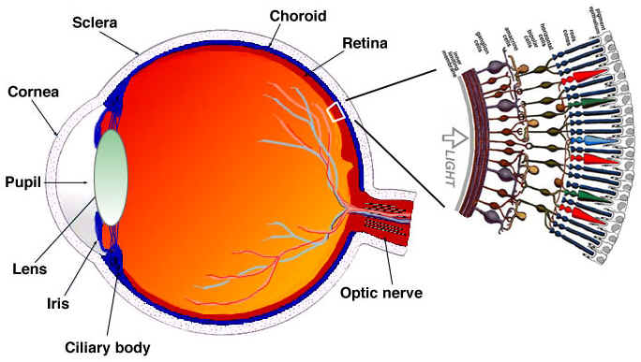
Rods and Cones

Slide 13
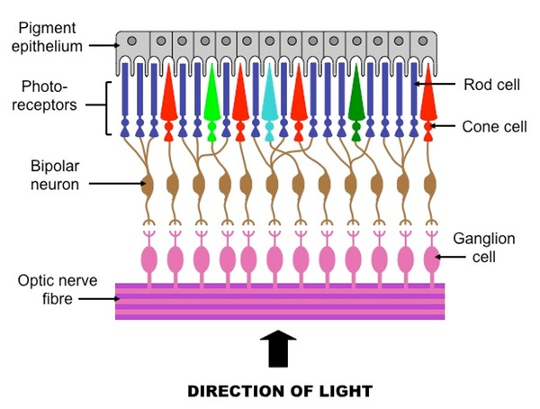
Rods and Cones

Slide 14
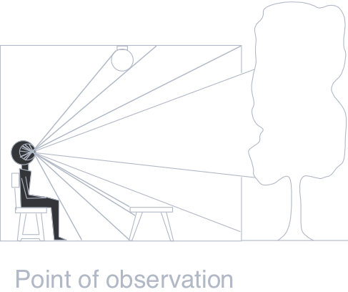
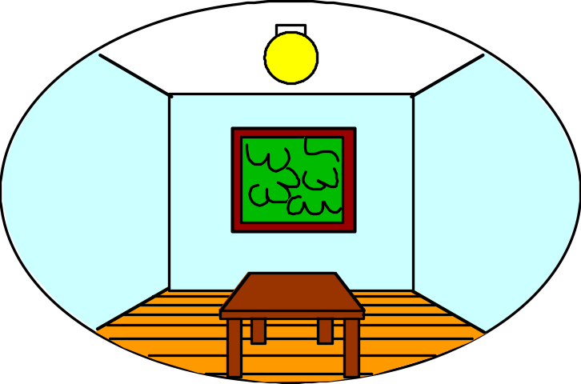
Dimensionality Reduction Machine (3D to 2D)
3D world
2D image
What have we lost?
  Angles
  Distances (lengths)
Slide by A. Efros
Figures © Stephen E. Palmer, 2002

Slide 15
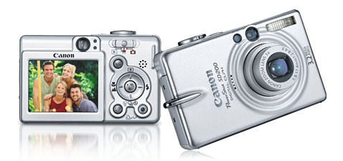

Digital camera
    Used for image acquisition

Slide 16
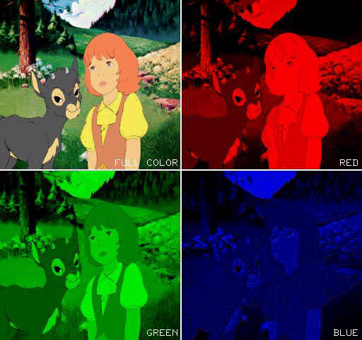
Red, Green, and Blue are used to Create a Color Image

Slide 17
Steps of computer vision
Computer mimics human sight in four steps
  Image acquisition
  Image Processing
  Image Analysis
  Image understanding / Comprehension
With binary version of the scene stored in memory, image processing can now begin
It is also known as image enhancement
It’s the process of improving the quality of the image
Anything that can be done to make the image clearer will simplify analysis and lead to improved understanding

Slide 18
Image processing
Initial manipulation of the binary data take place
  Helps to improve the quality of the image for analysis and comprehending
  Improve the signal-to-noise ratio
  Contrast in scenes can be improved
  Unwanted reflections can be removed

Slide 19
Image processing
Optical filtering is used in which filters are used with the lenses to control the amount of light, its color and the contrast of the various objects in the scene
Controlling illumination level
Positioning of objects to light for increasing the visibility
Steps involved are:
  Noise reduction
  Gray scale modification-lighten or darken the scene
  Histogram flattening

Slide 20
1. Noise reduction
To reduce the noise and image distortion image averaging method is used
Image averaging
  Multiple images of the same object are taken from different views and averaged

Slide 21
2. Gray scale modification (1)
The processing of lightening and darkening a scene is gray scale modification
Suppose the level of brightness is measured by an 8-bit binary number
  00000000 ----> represent dark
  11111111 -------> represent white
  In between 0 and 1 ----> represent some intermediate shade of grey

Slide 22
Gray scale modification (2)
Dark scene
  Pixel values of a dark scene + fixed value to each pixel -----> to lighten the scene
Bright scene
  Pixel values of a dark scene - fixed value from each pixel -----> to darken the scene
Contrast improvement
  The range between the darkest and lightest pixel in an image is called contrast
  increasing the level of contrast in an image is called contrast improvement

Slide 23
Gray scale modification (3)
Factors
  Color of the objects, position and intensity of light and distortion of image can uncertain edges and boundaries because there is insufficient contrast
Solution to the above problem
  Upper and lower threshold values are set and any pixel falling in this range is modified
  Modifications can be done according to the need either by:
    Addition
    Subtraction
    Multiplication
    Division pixel value by a constant

Slide 24
3. Histogram flattening
Histogram
  A vertical bar chart of the statistical information of an image
Histogram construction
  Counting the number of times a distinct gray level occurs in an image and plotting using a bar chart
  The analysis shows the unusually very dark or very bright levels.
  If certain intensity value occurs through out the scene, histogram flattening can reduce them

Slide 25
Histogram flattening …
Conclusions
  Sharpens images by highlighting rare intensity values that occur at boundaries or edges
  The more common intensity values which occur over large regions of equal intensity are de-emphsized

Slide 26
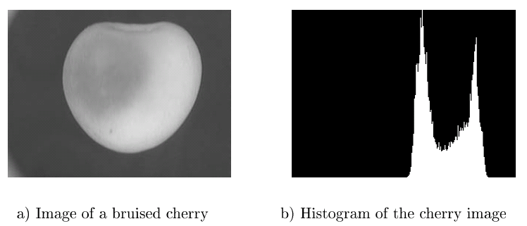
Use of Histograms

Slide 27

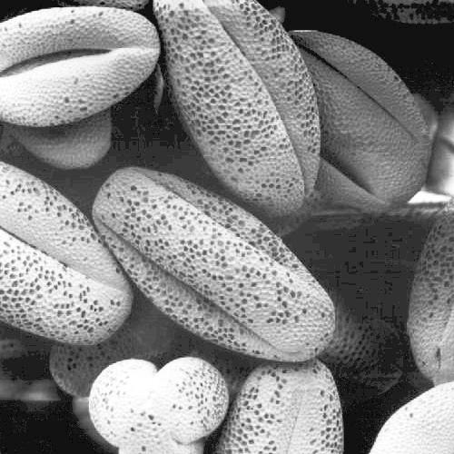
Histogram Equalization

Slide 28
Steps of computer vision
Computer mimics human sight in four steps
  Image acquisition
  Image Processing
  Image Analysis
  Image understanding / Comprehension

Slide 29
Image Analysis (1 of 3)
Up to this point, the scene is not clearly described
It can be an outdoor landscape, an aerial photograph, a human face or a toy
Image analysis begins the process of locating and defining the various objects in the scene.
Image analysis is accomplished by identifying regions and boundaries or edges.
Edges represent boundaries where two surfaces come together

Slide 30
Image Analysis (2 of 3)
It can also identify the interface between two different surfaces or between an object and a background
An edge is also formed between two objects when one is in front or back of another
The first step in image analysis is to locate all of these edges and boundaries
The line between an object and its shadow, and the outline of the shadow itself form edges

Slide 31
Image Analysis (3 of 3)
Edges and regions or surfaces completely define the scene
Regions are large, flat areas of an object or scene that have the same intensity value and occur between various edges and boundary lines

Slide 32
Image Analysis Steps Involved (1)
Surface smoothing
  Surfaces are easy to identify because they are relatively uniform in light intensity
  Adjacent pixels within the surface will have equal values or values very close to one another
  Surfaces are often smoothed out to remove irregularities or shading before edge detection
  It is usually done by replacing each pixel value with a new value
  The new value is the average of the value of the original pixel
  This averaging process causes the shading of the surface to become more uniform

Slide 33
Image Analysis Steps Involved (2)
Edge Detection
  After surface smoothing, the computer begins looking for edges or edge detection
  Binary numbers representing pixels are scanned to be checked whether they fall on the boundary b/w two surfaces
  Intensity of the adjacent pixels are compared
  Intensity(n)-intensity(n-1) = d , where nth is the pixel, d is difference calculated.
  If d is small then pixels are part of the same surface
  If d is large then pixels are on edge or boundary
  A predefined value of d is set to be considered as edge recognition

Slide 34
Image Analysis Steps Involved (3)
Edge Detection
  Edge detection usually is checked in group of horizontally and vertically
  In other words, it looks through a window at a small square of pixels
  It provides better fix on the size and location of an edge
  Several pixels can help make better determination
  When the boundaries of all the objects are identified, a line drawing scene can be created referred to as primal sketch
  That completes the analysis part.

Slide 35
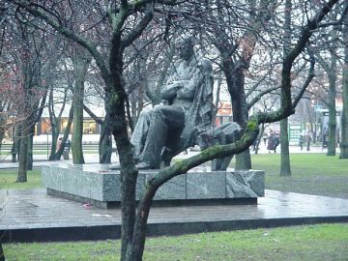
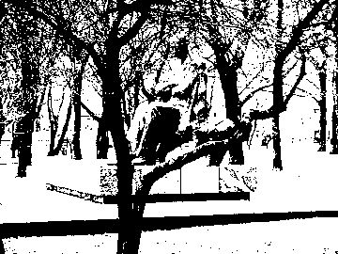
First step is create a binary image based on some cut off value for pixel intensity.

Slide 36
Steps of computer vision
Computer mimics human sight in four steps
  Image acquisition
  Image Processing
  Image Analysis
  Image understanding / Comprehension

Slide 37
Image Comprehension (1)
Till now, image has been captured, enhanced and analyzed
The computer still do not know what the scene means
Template matching
  Compares a model of a known object stored as a binary image in the computer to the binary image of the scene being viewed
  The basis of comparison is primal sketch(group similar pixal to each other)
  Both the scene and the template are stored in primal sketches

Slide 38
Image Comprehension (2)
Template matching
  Comparison is based on pixel to pixel basis
  If scene(pixel-n) - template(pixel-n) = 0 then they matched
  If scene(pixel-n) - template(pixel-n) = d (small), likely to be similar
  If scene(pixel-n) - template(pixel-n) = d (large), large disparity-not same
  Different statistical models can also be used for comparison

Slide 39
Image Comprehension (3)
Template matching-Challenges
  The stored template is fixed in size and orientation
  It poses great difficulty in comparison
  Template must be manipulated using processing techniques to increase or decrease size and rotate or tilt to better approximate the orientation
  After each reorientation and/or scaling, a new comparison is made
  if a match is found then the system “understand”
  If a match is not found then the system cannot understand the scene
  If there is no template for the required scene, then a match can never be found-main limitation of CV

Slide 40
Summary
CV tries to provide a computer an ability to see and understand.
Videos and images can be treated same as videos are also images with certain frame rate.
Firstly, an image must be acquired and digitalized-Image Acquisition
Secondly, an image must be processed to remove any irregularities and noise.
Then, an image must be analyzed to detect edge and boundaries-Image Analysis
Lastly, an image is understood by template matching-Image Comprehension

