Slide 1
ATPMAT: An Open Source Toolbox for Systematic Creation of EMTP Cases in ATP Using Matlab
Ahmad Abdullah
ahmad@tamu.edu

Slide 2
Highlights
User has to obtain ATP related executable from www.emtp.org
Code is freely available online at https://bitbucket.org/ahmadmabdullah/atpmat
IEEE 118 bus case and a tutorial is available online in the same repository
Automatic creation of fault, lightning strikes and line switching cases
We first show the overall logic for an individual case, then the logic for creating batch of cases.

Slide 3
Logic
Line is duplicated
The two lines are then connected to each other at a common point
A block is then inserted at the common point according to the type of study
Nodes of the two sections of the line are then renamed to avoid name collision
Line lengths are then adjusted
Current and voltage probes are then added
ATP is called from within Matlab
Pl4 file are then converted to mat files.

Slide 4
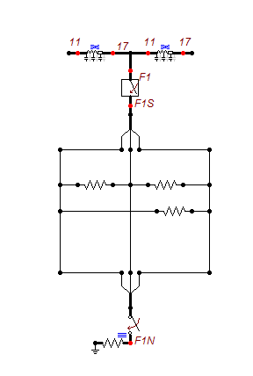
Fault Creation ( Line 11-17 )
CreateFault function is used
Line is first duplicated, and a fault block is inserted

Slide 5
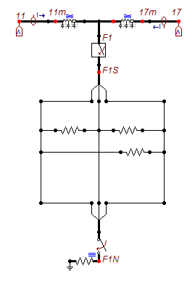
Fault Creation ( continued..)
Lengths adjusted, probes added and node renamed

Slide 6
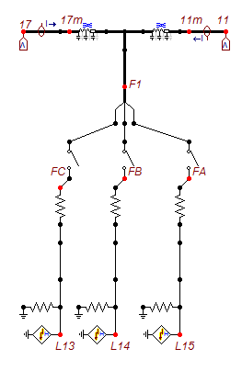
Lightning Strike (LightStrike function)

Slide 7

Line Switching (SwitchLine function)

Slide 8
Batches of Faults?
ATP provided a statistical study, what if the details are needed ?
BatchProcessATP is a function that creates a group of faults or lightening strikes or switching studies
Parameters of the study have to supplied by user using CreateScenarios function
The outcome is a series of mat files at a directory supplied by the user to the CreateScenarios function

Slide 9
Flexibility
Specialized ATP file search functions
By default, toolbox output only voltages and currents at the line terminals. However, user can insert probes anywhere in the system
User can insert an impulse source other then the Heidler type used.
Debugging mode is available. Diagnostic messages are printed in the Matlab workspace and ATP error messages can be retrieved

Slide 10
More info
Tutorial is available in the repository online
Users can “branch out” the toolbox and create their own ”flavors”
Features can be added to original repo if original developer thinks they are deserve publishing
Questions or bugs? Please contact Ahmad at ahmad@tamu.edu

Slide 11


