Slide 1
Visual Question Answering on Chart Images
Multi-Scale CNN + Transformer + Cross-Attention Fusion
Ahmad Agah | Winter 2026

Slide 2
1. What is Visual Question Answering?
Given a chart image and a natural language question, predict Yes or No.
The model must jointly understand visual content and language to reason about data encoded in charts.
Chart Image
"Is dark blue greater than red?"
VQA Model
Yes / No
The core challenge: Fine-grained color discrimination — is "Dark Seafoam" greater than "Medium Seafoam"?

Slide 3
2. FigureQA Dataset
Chart Images
100,000
15 Templated Question Types
QA Pairs
1,327,368
Identification: "Is X the minimum/maximum?"
Comparison: "Is X greater/less than Y?"
Median: "Is X the median?"
Smoothness: "Is X the smoothest/roughest?"
Intersection: "Does X intersect Y?"
Area under curve: "Does X have the largest area?"
Chart Types
5 (bar, line, pie, dot-line, area)
Class Balance
50/50 Yes/No
Image Splits
80K / 10K / 10K
Vocabulary
128 unique words
Why split by image?
Each chart generates ~13 QA pairs. Random splitting would leak visual features across train/val/test sets. I split by image to ensure the model never sees the same chart during evaluation.

Slide 4
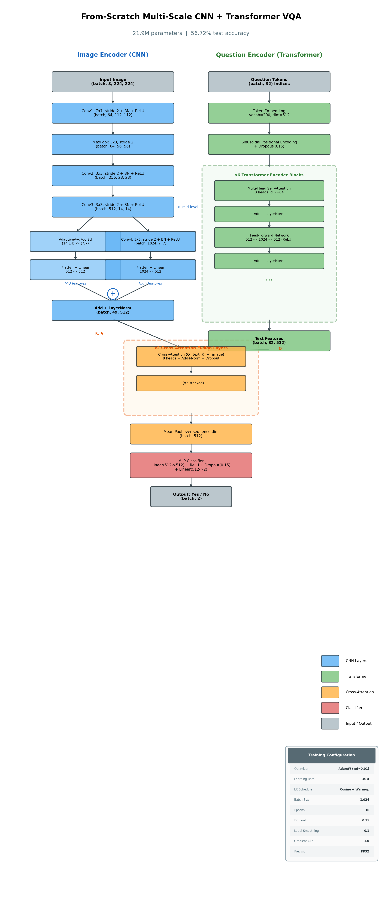
3. Architecture Overview
Two-stream architecture: images and text processed in parallel, fused via cross-attention.
21.9M parameters (from-scratch CNN) / 26.2M parameters (with ResNet-18)

Slide 5
4. Image Encoder: Multi-Scale CNN
Layer
Channels
Kernel
Spatial
What it learns
Conv1
3 → 64
7×7, stride 2
224 → 112
Edges, basic textures
Conv2
64 → 256
3×3
56 → 56
Color patterns
Conv3
256 → 512
3×3, stride 2
56 → 14
Colors & edges (mid-level)
Conv4
512 → 1024
3×3, stride 2
14 → 7
Semantic structure (high-level)
Multi-scale fusion:
Mid-level features (Conv3, 14×14) capture color information crucial for chart questions.
High-level features (Conv4, 7×7) encode spatial relationships between chart elements.
Both pooled to 7×7, projected to 512 dims, combined via element-wise addition + LayerNorm.

Slide 6
5. Text Encoder: 6-Layer Transformer
Built entirely from scratch — every attention head, projection, and layer norm hand-implemented.
128-word vocabulary
Templated questions → small vocab, no subword tokenization needed
Sinusoidal positional encoding
Deterministic, no extra trainable parameters
Padding mask
Variable-length questions handled with attention masking
6 layers, 8 heads, 512 dims
Standard Transformer configuration from 'Attention Is All You Need'

Slide 7
6. Where Vision Meets Language
Cross-attention allows text tokens to query image features — each word learns which spatial regions of the chart are relevant to it.
Layer 1
Locates relevant colors in the 7×7 spatial grid
Layer 2
Compares values between located regions
Worked example: "Is navy blue greater than crimson?"
Layer 1 finds both colors → Layer 2 compares their values → Mean-pool → MLP(512→512→2) → Yes/No

Slide 8
7. Training Setup
From-Scratch CNN
ResNet-18
Image Encoder
Custom 4-layer CNN
Pretrained ResNet-18
Parameters
21.9M
26.2M
Optimizer
AdamW (wd=0.01)
AdamW (wd=0.01)
Learning Rate
3e-4
5e-4
LR Schedule
Cosine + 1-epoch warmup
Cosine + 1-epoch warmup
Batch Size
1024 (FP32)
4096 (FP16)
GPU
A100 40GB
A100 80GB
Precision
FP32
FP16 Mixed
Training Time
~4–5 hours
~1 hour
Epochs
10
10

Slide 9
8. Regularization
Four complementary strategies to prevent overfitting on 1.06M training examples:
Label Smoothing (0.1)
Softens hard targets [1,0] → [0.9, 0.1], preventing overconfident predictions
Dropout (0.15)
Applied in self-attention, feed-forward network, and MLP classifier
Weight Decay (0.01)
AdamW decoupled L2 regularization — penalizes large weights
Transfer Learning (ResNet only)
ImageNet pretraining constrains the image encoder to a good weight region

Slide 10
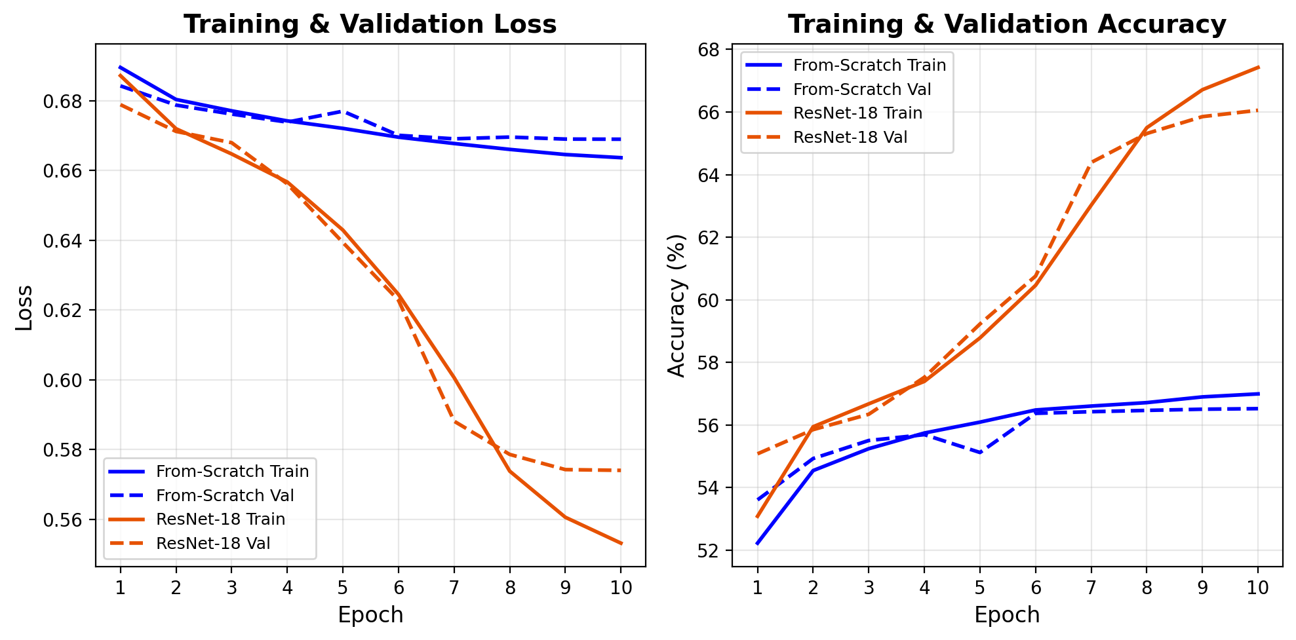
9. From-Scratch CNN Results
Test Results
Overall Accuracy: 56.72%
Yes Accuracy: 53.67%
No Accuracy: 59.76%
Balanced predictions, no class bias.
Plateaued at epochs 7–8.
Bottleneck: 4 conv layers trained on 80K images cannot learn fine-grained color discrimination.

Slide 11
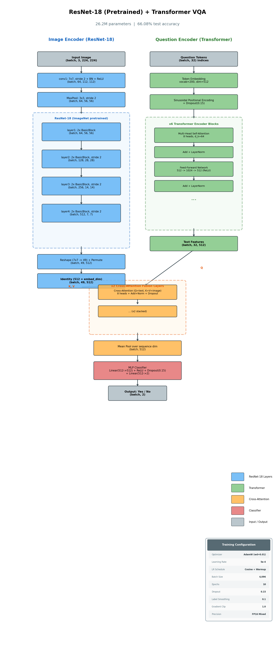
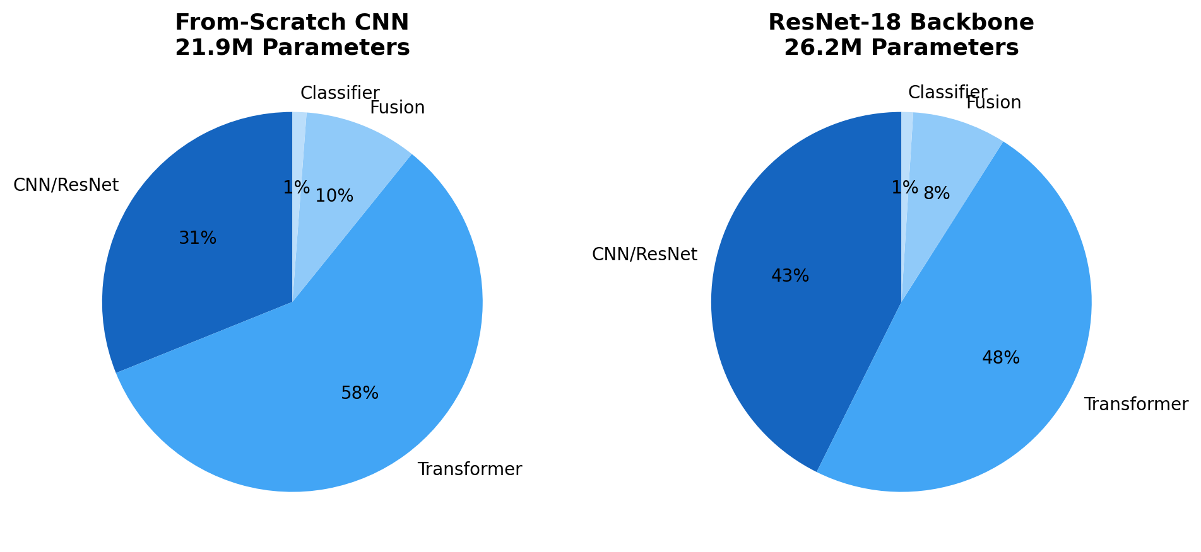
10. Transfer Learning: ImageNet → Chart Understanding
Rich visual priors
ImageNet's 1.2M images teach colors, textures, and edges — exactly what chart VQA demands
Data efficiency
80K chart images aren't enough from scratch. Pretrained weights provide a massive head start
Low-level transfer
Early CNN layers detect edges and color boundaries — transfers directly from photos to charts

Slide 12
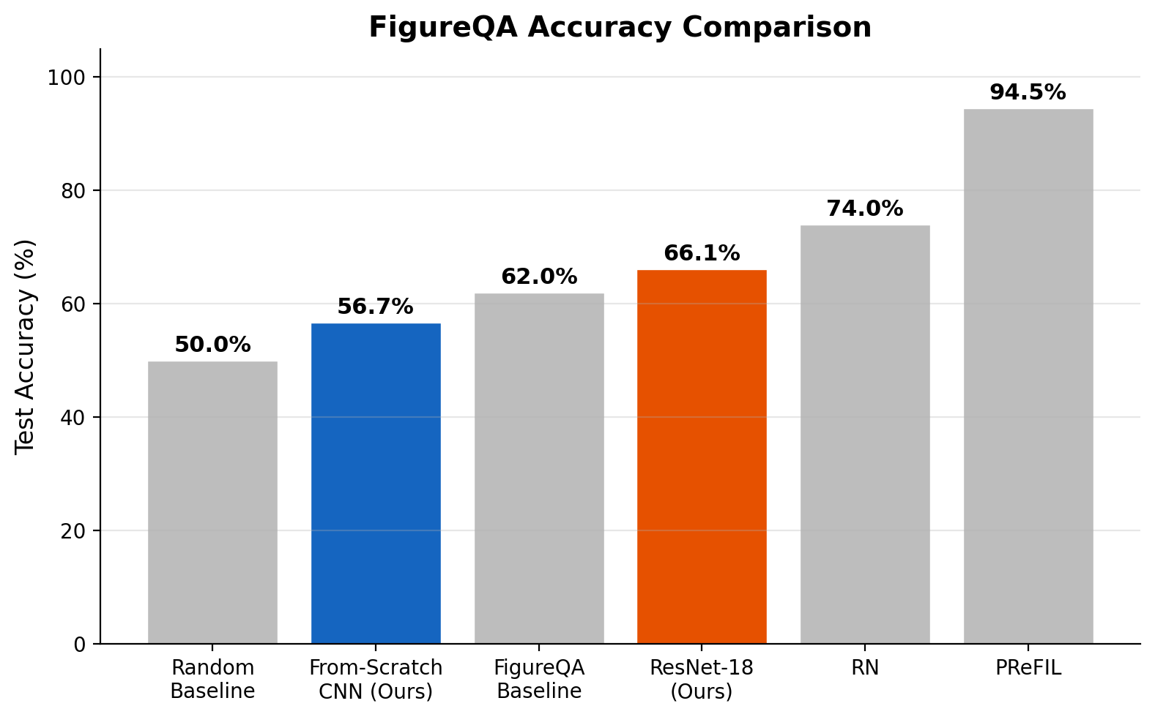
11. ResNet-18 Results
66.08% test accuracy
+9.4 percentage points over from-scratch CNN
Still improving at epoch 10 — no plateau
Model
Accuracy
Random baseline
50.0%
Ours (from-scratch CNN)
56.7%
FigureQA paper baseline
~62%
Ours (ResNet-18)
66.1%
Published SOTA (RN)
72–76%
Published SOTA (PReFIL)
93–96%

Slide 13
12. Training Dynamics
Warmup phase (epoch 1)
LR ramps linearly from 0 to peak. Model reaches ~55% accuracy — necessary for stability with large batches and Transformer's sensitivity to initial LR.
CNN plateau (epochs 7–8)
From-scratch CNN hits 56.5% ceiling. Fundamental limitation: 4 conv layers on 80K images cannot learn fine-grained color representations.
ResNet keeps learning
66.1% after 10 epochs with no plateau. Pretrained backbone enables continued improvement — more epochs could push toward 70%+.
+15.4pp on Yes questions
Yes: 53.7% → 69.1%, No: 59.8% → 63.1%. Transfer learning disproportionately helps affirmative reasoning — recognizing a color is present requires finer discrimination.

Slide 14
13. Design Decisions
Why 512 embedding dim?
Matches ResNet-18 feature map width. Divides into 8 heads × 64 dims — standard from 'Attention Is All You Need.'
Why 2 cross-attention layers?
Layer 1 finds colors, layer 2 compares values. One layer locates; two layers reason.
Why multi-scale CNN?
Mid-level (Conv3) = colors & edges. High-level (Conv4) = spatial layout. Both needed for chart VQA.
Why split by image?
Each chart → ~13 QA pairs. Random split leaks features, inflating accuracy by up to 10%.
Why mean-pool?
Simple aggregation. Fewer params than attention pooling, competitive for binary classification.
Why sinusoidal encoding?
Deterministic, no trainable params. 128 vocab + 32 seq length doesn't benefit from learned encodings.

Slide 15
14. Conclusion & Future Work
Transfer learning works
+9.4pp from ImageNet pretraining. Pretrained color and texture features transfer directly to chart understanding, beating the FigureQA baseline.
Cross-attention fuses modalities
Two-layer cross-attention bridges vision and language. Text tokens attend to spatially relevant image regions for multi-step reasoning.
Color is the bottleneck
Fine-grained color discrimination remains the core challenge. The gap between 66% and SOTA 93%+ is primarily about distinguishing similar chart colors.
Future Work
• More epochs — ResNet still improving at epoch 10, could push toward 70%+
• Larger backbones — ResNet-50 or Vision Transformer (ViT)
• Open-ended QA — extend beyond binary Yes/No to free-form answers
• Attention visualization — overlay cross-attention weights on charts

Slide 16
Thank You
Ahmad Agah
github.com/ahmadagah

