Slide 1

Joplin
Quick Start Guide for Students

Slide 2

Get Started Using Joplin Note Taking App
Get Your Notes Organised
Take Handwritten Notes
Manage Task Lists, To-Dos, and Reminders
Collaborate on Group Projects
Add Multimedia to Your Notes

Slide 3
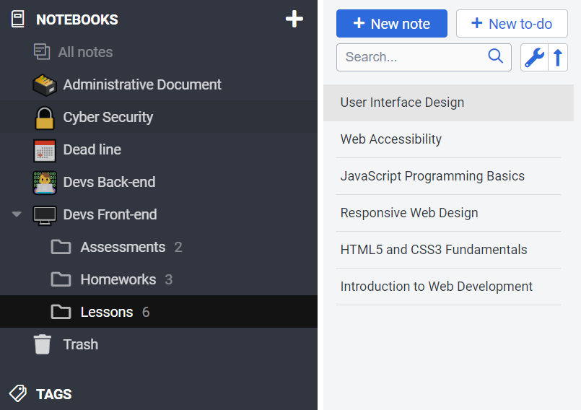
Joplin for Students | Quick Start Guide
1
Get Your Notes Organized in Notebooks
Keep all your coursework and class notes in one place with Joplin. Create a notebook for each class, then add sub-notebooks for topics or projects. Use tags to group related notes and find them quickly.
Sync your notes across devices. Take notes on your tablet in class, then review or edit them later on your laptop or phone.

Slide 4
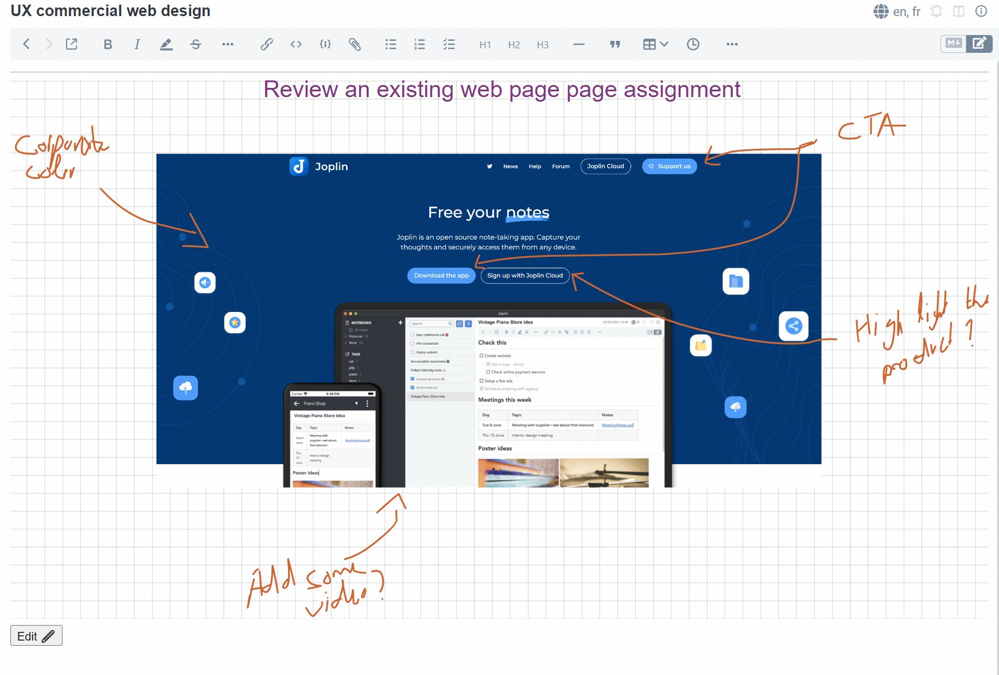
2
Take Handwritten Notes Prefer writing by hand? Joplin lets you capture your handwritten notes easily using a stylus on a tablet or touchscreen device. This is perfect for saving diagrams, equations, and sketches that are hard to type. Simply write naturally, and your notes will be stored and synced with your other class materials.

Slide 5
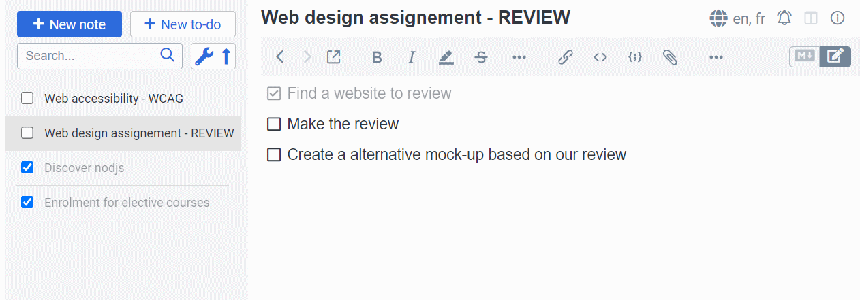
Manage Task Lists, To-Dos, and Reminders
Stay organized and keep track of your academic work with Joplin. Create to-do lists with checkboxes, set reminders for deadlines, and prioritize tasks so you never miss an assignment. With everything in one place, Joplin becomes your personal study planner throughout the school year.
3

Slide 6
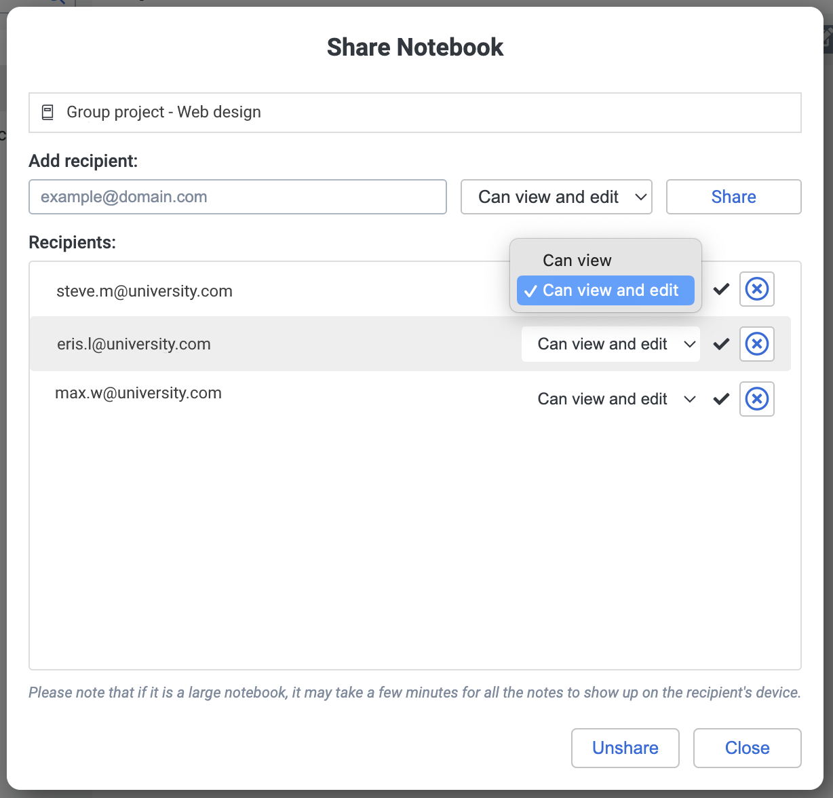
4
Collaborate on Group Projects
Working on a team project? Joplin helps you share notebooks and notes with classmates so everyone can contribute. This makes it easier to divide tasks, share research, and build your final report together — all in one organized workspace.

Slide 7
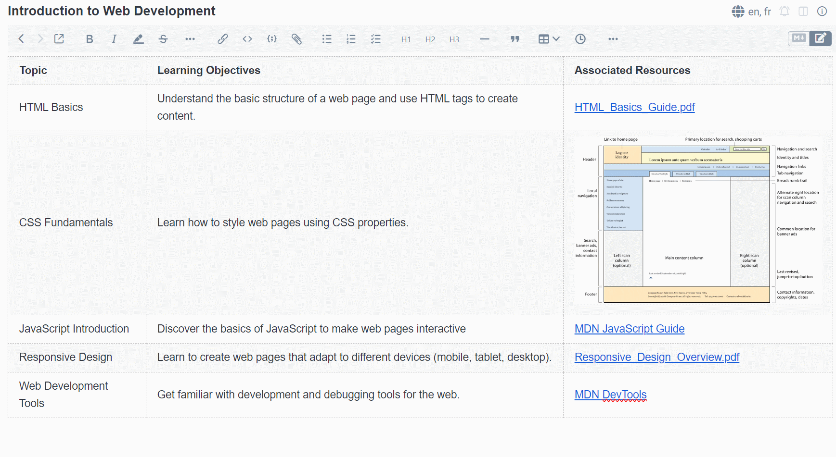
Add Multimedia to Your Notes
Make your notes more powerful by adding images, attachments, and photos. Capture lecture slides, lab results, or important documents directly into Joplin. Whether you use your phone’s camera, a stylus on your tablet, or your desktop computer, your notes stay synced and ready — even when you’re offline.
5

Slide 8
Resources & Next Steps
Official Help
Joplin Documentation
Joplin FAQ
Community
Joplin Forum
Try This Next
Create your first notebook
Add tags to organize notes
Install Joplin on your phone and sync

