Slide 1
Introduction to cyber security

Slide 2
Essential Terminology
Vulnerability
Threat
Risk
Exploit
Zero day attack
Security Policy
Incident Handling

Slide 3
Element of Information Security
Confidentiality
Availability
Authenticity
Integrity
None Repudiation

Slide 4
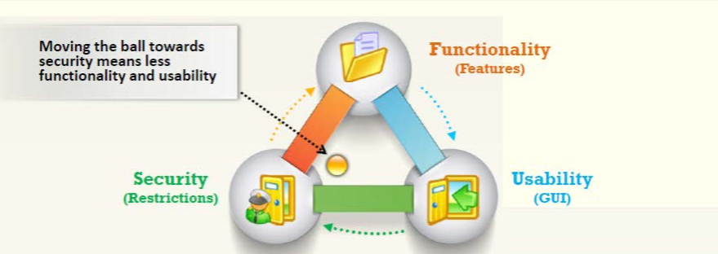
Functionality, Usability and Security Triangle

Slide 5
Attack
Attack = Motive (Goal) + Method + Vulnerability

Slide 6
Information Security Attack Category
Network Threats
Host Threats
Application Threats
Information gathering
Sniffing and eavesdropping
Spoofing
Session hijacking and Man-in-the-Middle attack
DNS and ARP Poisoning
Password-based attacks
Denial-of-Service attack
Compromised-key attack
Firewall and IDS attacks
Malware attacks
Footprinting
Password attacks
Denial-of-Service attacks
Arbitrary code execution
Unauthorized access
Privilege escalation
Backdoor attacks
Physical security threats
Improper data/Input validation
Authentication attacks
Security misconfiguration
Information disclosure
Broken session management
Buffer overflow attacks
Cryptography attacks
SQL injection
Improper error handling and exception management

Slide 7
Types Of Attacks
Attackers search for vulnerabilities in an operating system's design, installation or configuration and exploit them to gain access to a system.
OS Vulnerabilities: Buffer overflow, bugs in operating system, unpatched operating
Operating System Attacks
Attacks Misconfiguration vulnerabilities affect web servers, application platforms, databases, networks, or frameworks that may result in illegal access or possible owning of the system.
Misconfiguration
Application-Level Attacks
Attackers exploit the vulnerabilities in applications running on organizations' information system to gain unauthorized access and steal or manipulate data.
Application Level Attacks: Buffer overflow, cross-site scripting, SQL injection, man-in-the-middle, session hijacking, denial-of-service, etc.
Shrink-Wrap Code Attacks
Attacks Misconfiguration vulnerabilities affect web servers, application platforms, databases, networks, or frameworks that may result in illegal access or possible owning of the system.

Slide 8
What is Hacking
Hacking refers to exploiting system vulnerabilities and compromising security controls to gain unauthorized or inappropriate access to the system resources.
It involves modifying system or application features to achieve a goal outside of the creator's original purpose.
Hacking can be used to steal, pilfer, and redistribute intellectual property leading to business loss.

Slide 9
Hacker Classes
Black Hats: Individuals with extraordinary computing skills, resorting to malicious or destructive activities and are also known as crackers.
White Hats: Individuals professing hacker skills and using them for defensive purposes and are also known as security analysts.
Gray Hats: Individuals who work both offensively and defensively at various times.
Suicide Hackers: Individuals who aim to bring down critical infrastructure for a "cause" and are not worried about facing jail terms or any other kind of punishment.
Script Kiddies: An unskilled hacker who compromises system by running scripts, tools, and software developed by real hackers.
Cyber Terrorists: Individuals with wide range of skills, motivated by religious or political beliefs to create fear by large-scale disruption of computer networks.
State Sponsored Hackers: Individuals employed by the government to penetrate and gain top-secret information and to damage information systems of other governments.
Hacktivist: Individuals who promote a political agenda by hacking, especially by defacing or disabling websites.

Slide 10
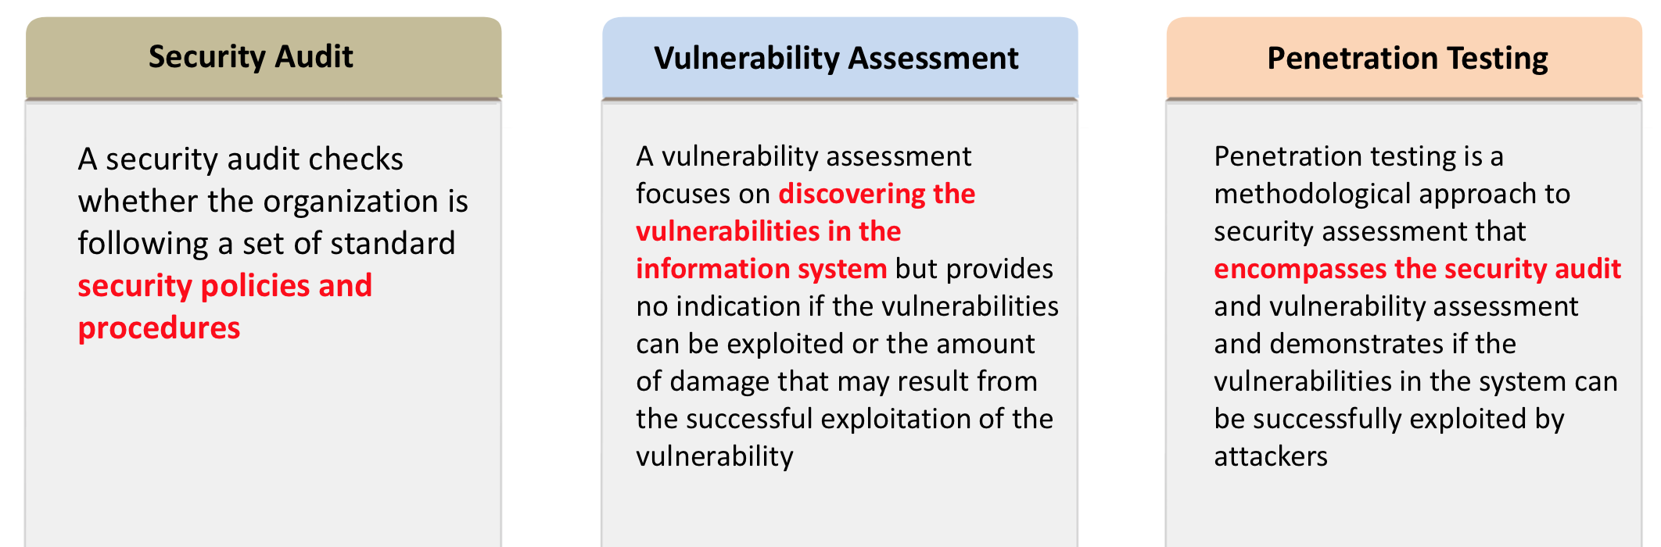
Comparing Audit, Vulnerability and Pen testing

Slide 11
Threat modelling
Threat modelling works to identify, communicate, and understand threats and mitigations within the context of protecting something of value.
Threat modelling can be applied to a wide range of things, including software, applications, systems, networks, distributed systems, things in the internet of things, business processes, etc.

Slide 12
Blue Team and Red Team
Blue Teaming:
An approach where a set of security responders performs analysis of an information system to assess the adequacy and efficiency of its security controls.
Blue team has access to all the organizational resources and information.
Primary role is to detect and mitigate red team (attackers) activities, and to anticipate how surprise attacks might occur.
Red Teaming :
An approach where a team of ethical hackers performs penetration test on an information system with no or a very limited access to the organization's internal resources.
It may be conducted with or without warning.
It is proposed to detect network and system vulnerabilities and check security from an attacker's perspective approach to network, system, or information access.

Slide 13
Information Security Standards
PCI-DSS Payment Card Industry Data Security Standard
ISO 27001
HIPAA Health Insurance Portability and Accountability Act
DMCA The Digital Millennium Copyright Act

